Slide 1
Final Project
Which emails do I need to respond to?
Chad Iman

Slide 2

Problem: Using work emails from December 2016, determine whether or not a future email requires a response. I want a user to be able to return from vacation with a full inbox, and have their emails auto-prioritized by whether or not an email requires a response.
Which emails do I need to respond to?

Slide 3

Data: Email text taken from work email and metadata from those emails. I will process the text of the email, looking for indicators such as whether the recipient’s name was found in the email. I will also use recipient fields for features (how many people were CC’d on the email, etc.)
What emails do I need to respond to?

Slide 4
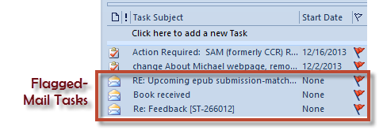
Hypothesis: Past email data will allow us to predict which unread emails require a response
hypothesis

Slide 5
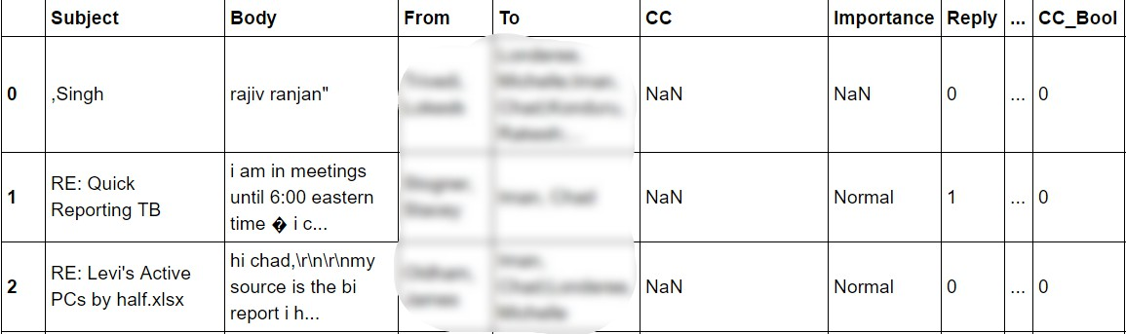
DATA EXAMPLE

Slide 6
APPROACH
I used a logistic regression model, looking to classify an email as requiring a response or not requiring a response
I created binary features from the data I had available, including:
Whether I was sole recipient
Whether others were CC’d on email
Whether my name was found in the body of the email
Whether the phrase “EOD” or “end of day” was found in the email

Slide 7
What’s New?
Fixed issue with NA and CC field
Fixed issue with Proper case vs. all in lower case
Added in "To_Counts" and created dummy variables
Checked for "EOD" and "end of day"
Scrapped the "Body Length" feature
Dropped where NA's in "To" field - these were meeting invite replies

Slide 8
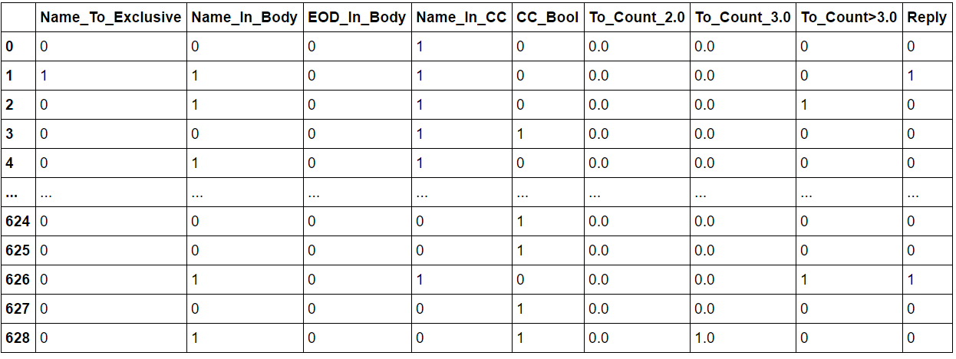
BINARY FEATURES

Slide 9
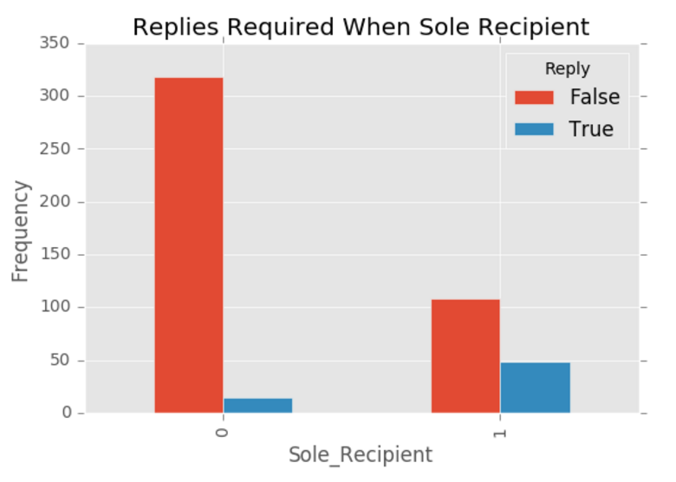
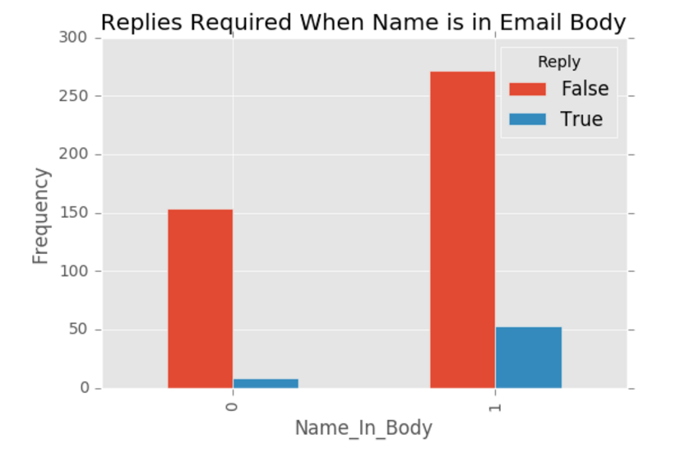
STRONGEST COEFFICIENTS

Slide 10
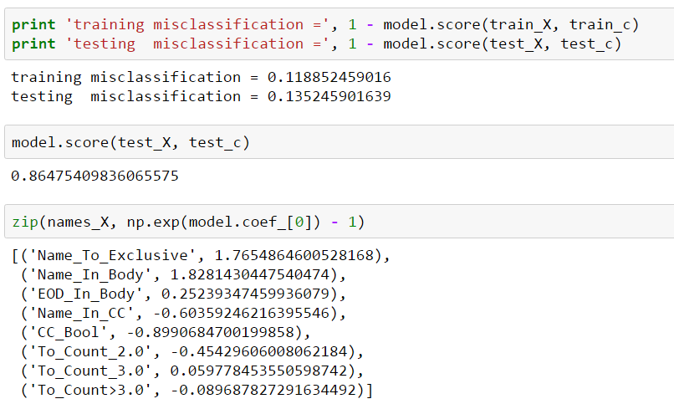
MODEL COEFFICIENTS
An email is 176% more likely to require a response if it is addressed to me specifically
An email is 183% more likely to require a response if my name is found in the body of the email

Slide 11
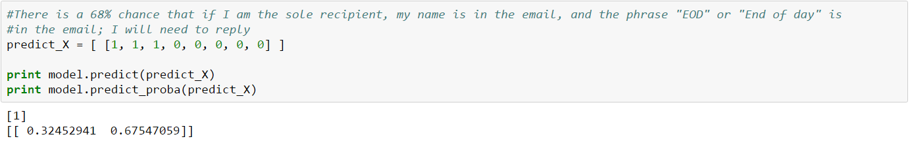
PREDICTIONS

Slide 12
CHALLENGES
Outlook security settings prevented me from extracting all of the originally intended data, such as time of email
I tossed out “length of body” as a feature, as it was challenging to get an accurate length due to email signatures
At the time of starting, I did not yet have experience with NLP, which may have been a better approach in constructing a model

Slide 13
CONCLUSIONS
While the model allowed predictions better than chance, I believe having the additional metadata as well as taking different modeling approaches would yield higher results
This model is also constructed for me specifically, it would require a lot more work and logic in order to be a model that is applicable for any user
If this model could be perfected, it could make for a much more productive work environment, and allow users to tackle higher priority work first

