Slide 1

Attrition Analysis
Presented by Chad Kwong
This Photo by Unknown Author is licensed under CC BY-SA
Notes:
The following video recording is based on a SMU graduate level data science case study, where I have been asked to perform an exploratory data analysis on a data set provided by Frito Lay.
Slide 1: Hello and welcome CEO and CFO of Frito Lay. My name is Chad Kwong and I am here today to present to you the insights discovered through an exploratory data analysis of the employee information data set you have provided to me. By the end of this presentation, you will hopefully have a solid understanding of the variables that can be used to predict Attrition and Monthly income.

Slide 2


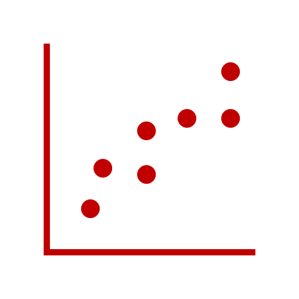

Agenda
Investigation Into Leading Variables
Attrition Prediction Model
Monthly Income Prediction
Final Insights and Suggestions
Notes:
Our agenda for today includes:
A walkthrough of the steps taken to select the three leading variables that contribute to Attrition, An in depth analysis of the model chosen to predict attrition based off of the top three classification factors, A breakdown of Attrition related factors that contribute to the prediction of Monthly Income, and Key insights that will help to lower the attrition rate at Frito Lay

Slide 3
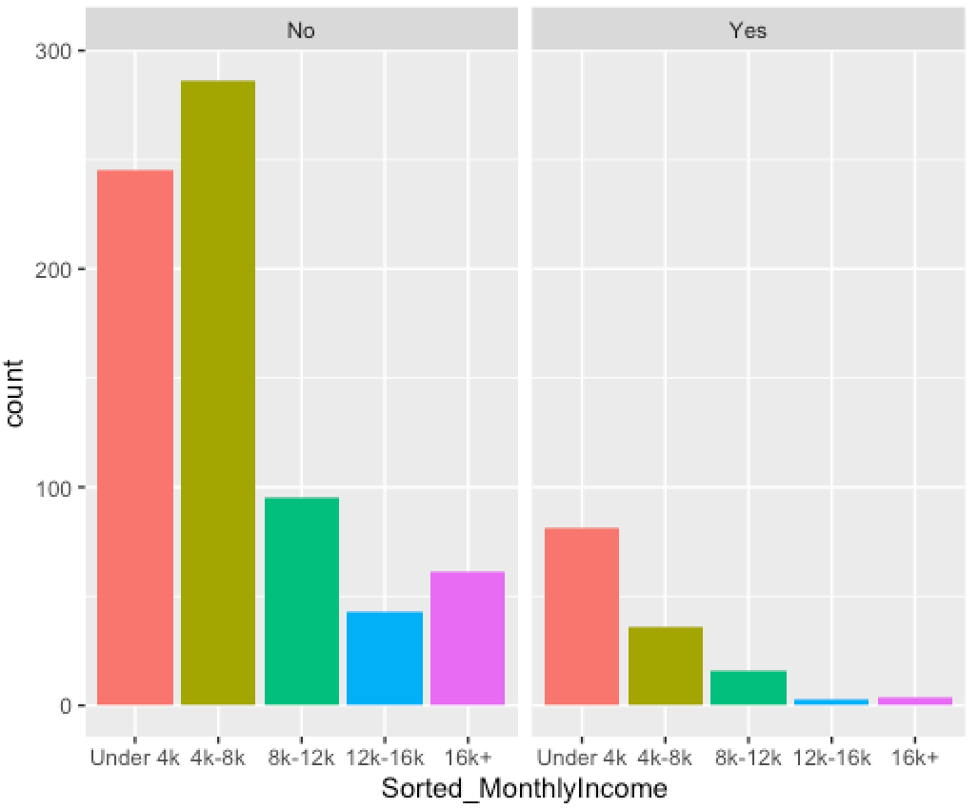
Initial Variable Investigation
Analyzed distribution of several variables
Initial choosing based off direct observation and intuition.
Monthly Income, Stock Option Level, Years At Company
Notes:
My investigation into the data set began with plotting the distribution of various variables using histograms. For each histogram, I performed a facet wrap that divided the histograms by the Attrition variable. From my analysis, I chose to initially pursue the Monthly Income, Stock Option Level, and Years At Company variables. As you can see, the Monthly Income variable follows a Right Skewness in its relation to attrition.

Slide 4
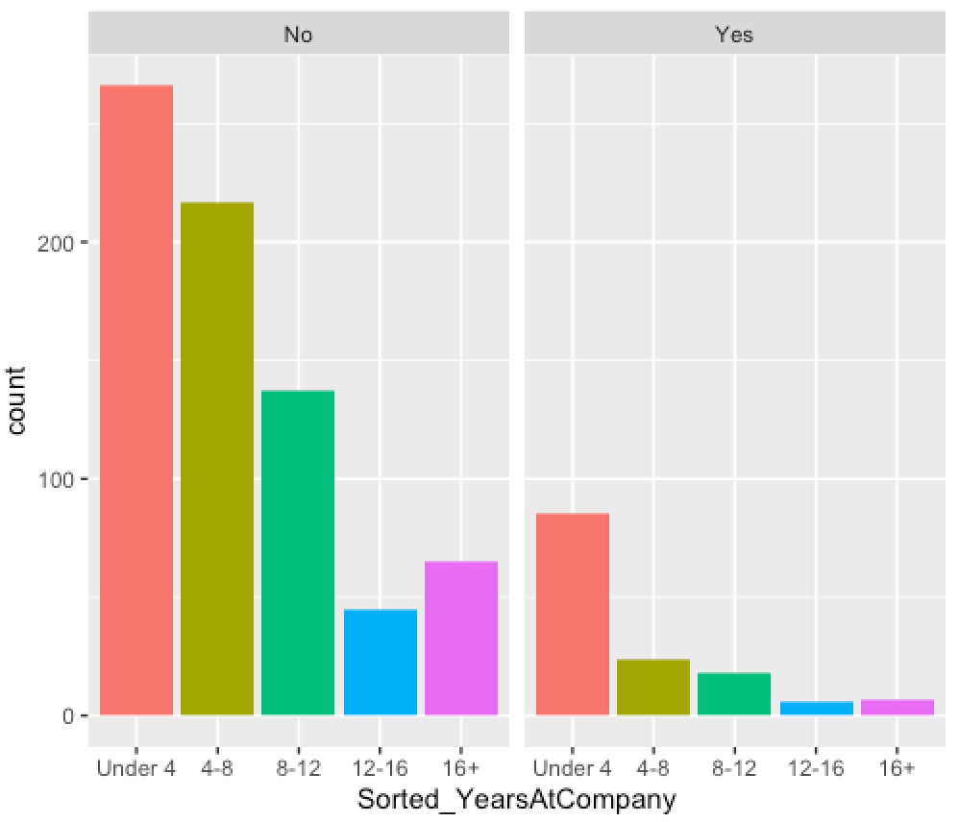
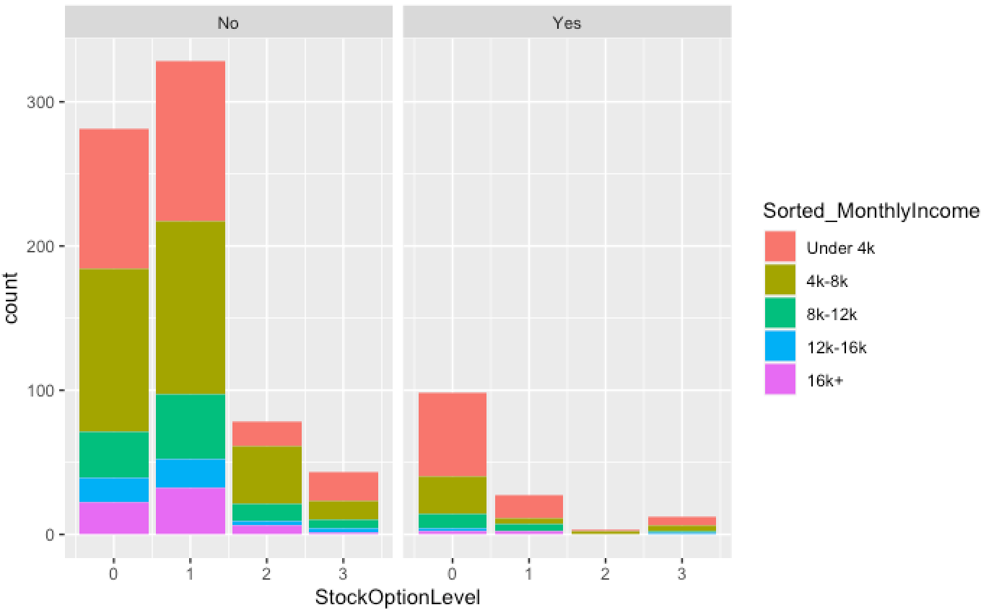
Initial Variable Investigation (Continued)
Notes:
You can also observe right skewness in the Years At Company and Stock Option Level variables, although one could also argue that there is a mild multimodal distribution to the Stock Option Level. These distributions help suggest that there is a relationship between the variables and Attrition, however these variables most likely are more significant at lower levels. Knowing that more evidence is required in the choosing of the variables, I performed a second investigation that is less intuition based.

Slide 5
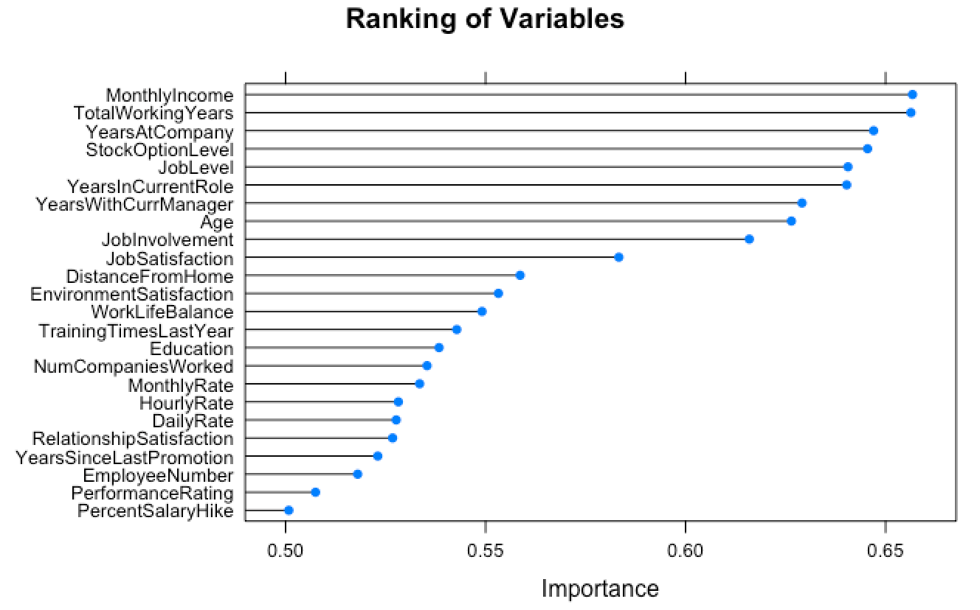
Investigation Verification
Learning Vector Quantization (LVQ) and Cross Validation used for Variable Importance Measurement
The top three contributing variables are Monthly Income, Total Working Years, and Years at Company
Other noticeable variables include Stock Option Level, Job Level, and Years In Current Role
Notes:
For the second part of the investigation, I chose to use a Learning Vector Quantization, or LVQ, classification method combined with a normal cross validation to predict the importance of each variable within the data set. The graph on the right displays the rank of importance of each variable within the data set. This graph was obtained by using the Variable Importance function combined with the LVQ model mentioned prior. As we can see, the top three factors contributing to attrition as predicted by this LVQ model are Monthly Income, Total Working Years, and Years at Company in that respective order. Other noteworthy variables include Stock Option Level, Job Level, and Years in Current Role, respectively. An interesting point here is that employee satisfaction, whether that is satisfaction with the job, environment, or general relationship with the manager, does not play a significant role in attrition.

Slide 6
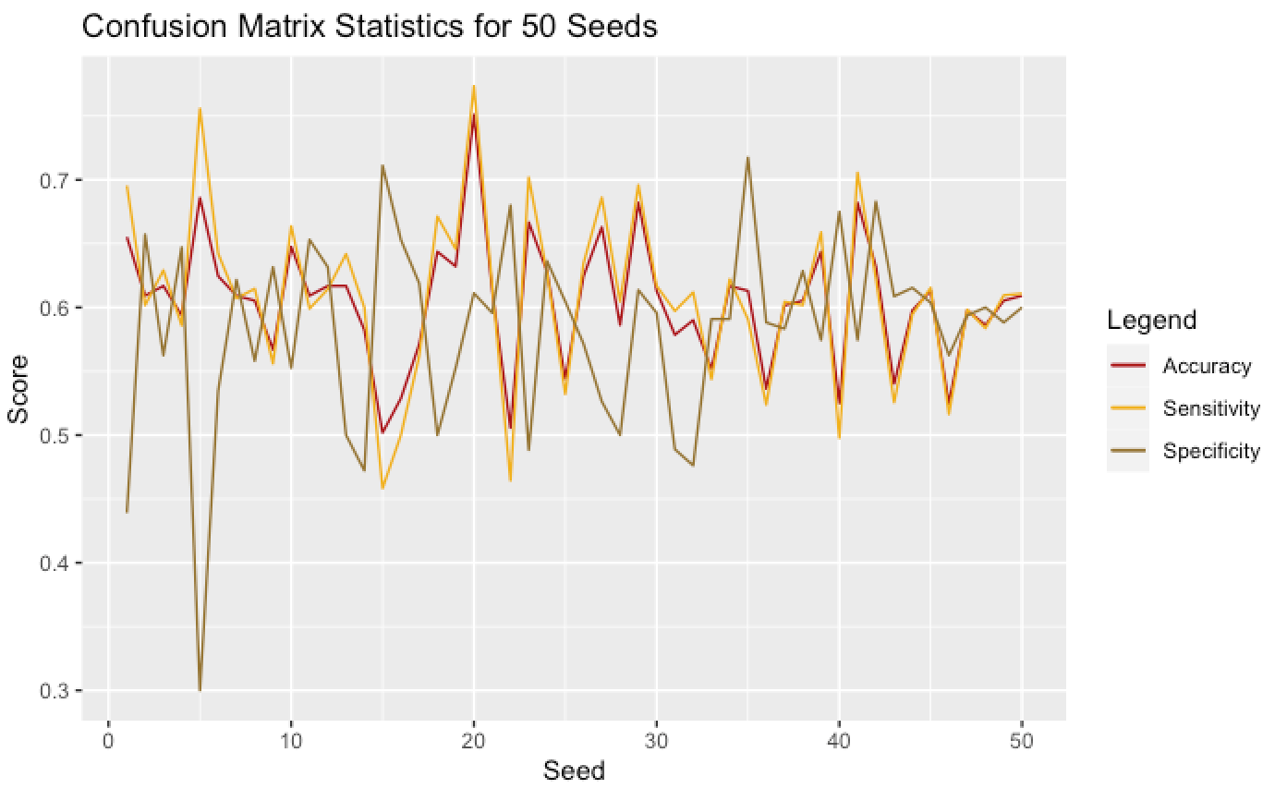
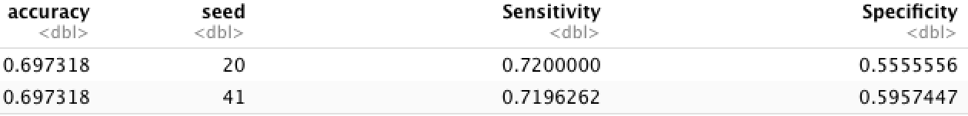
Creating a Model
Naïve Bayes Model
Two sets of variables used for comparison
LVQ Suggested Variables
Intuition Based Variables
Comparison of Models
Focus on Accuracy, Sensitivity, and Specificity
50 seeds tested for each model
LVQ Suggested Variables Superior
LVQ Based Model
Intuition Based
Notes:
A Naive Bayes model was chosen as the model to be used when predicting Attrition, and a 70/30 split was performed when separating the data set into a training and test set. Because the positive Attrition rate was so low in this data set, an upsampling was performed on the training data set to simulate more yes responses to Attrition. When creating the model, the accuracy, specificity, and sensitivity seemed to vary greatly with each seed, so the these scores were taken across 50 different seeds to determine the best seed to use with the model. I also chose to compare two different variable sets: the variables predicted by the LVQ model, and the variables chosen by my own intuition. As expected, the model that performed better was the one that use the variables predicted by the LVQ model.

Slide 7
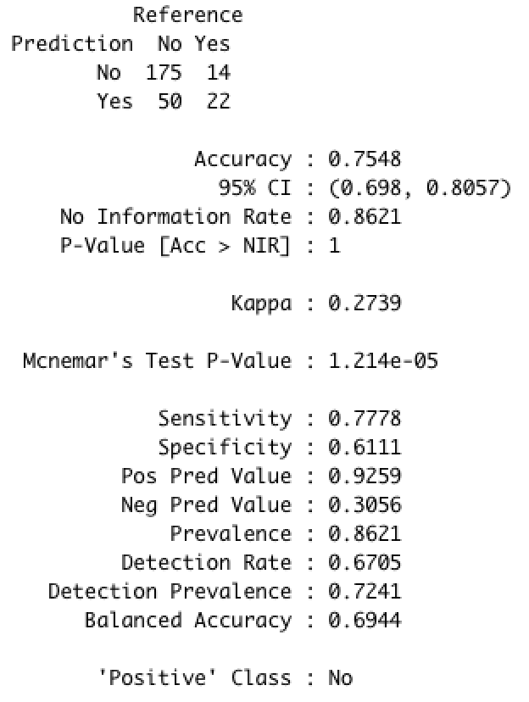
Application of Model
Variables used: Monthly Income, Total Working Years, Years at Company
Attrition Predictions Exported to CSV File
P-value: 1.213e-5
Seed Value: 20
Accuracy Score: 0.7548
Sensitivity Score: 0.7778
Specificity Score: 0.6111
Notes:
With all this information in mind, the Naive Bayes model chosen to predict Attrition uses the Monthly Income, Total Years Working, and Years At company variables and a seed value of 20. The predictions made by the model can be observed in the CSV file contained within my GitHub repository. Within that file, you will be able to compare the predicted attrition response to the recorded response. I have also provided the variables used in the model inside the file. On the right you will see the confusion matrix constructed by comparing the predicted attrition responses to the recorded responses. From this matrix we can see an accuracy score of about 75%, a Sensitivity score of about 78%, a Specificity score of about 61%, and a small p-value of 1.2e-5. The low P-value infers that the model performs adequately, but I suspect that higher accuracy scores cannot be obtained from the current data set without the involvement of more variables.

Slide 8
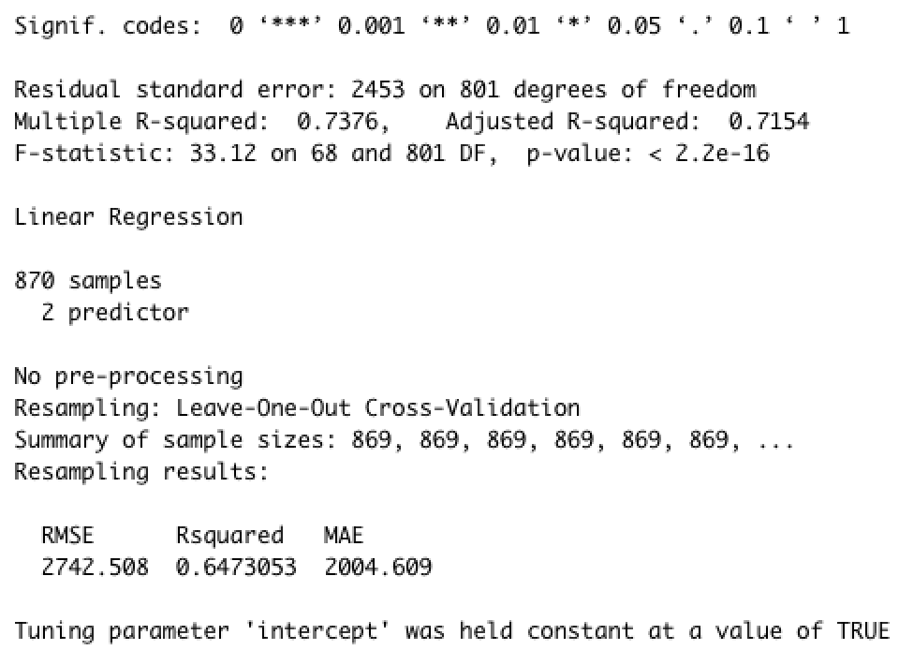
Predicting Monthly Income
Linear Regression Model using the Years at Company and Total Years Working variables
Leave One Out Cross Validation
P-value of 2.2e-16
RMSE of 2742.508
Notes:
The next step in my exploratory data analysis involved investigating the relationship that the selected variables share with Monthly Income. Given that Monthly Income IS one of the selected variables, I chose to limit the relationship down to the remaining variables, Years At Company, and Total Years Working. A simple linear regression method was used to construct the relationship and then a Leave One Out Cross Validation was performed to verify the model. The model constructed, at it’s simplest form, provided an RMSE of about 2742. I suspect that this model is valid considering it’s P-value is low at 2.2e-16.

Slide 9
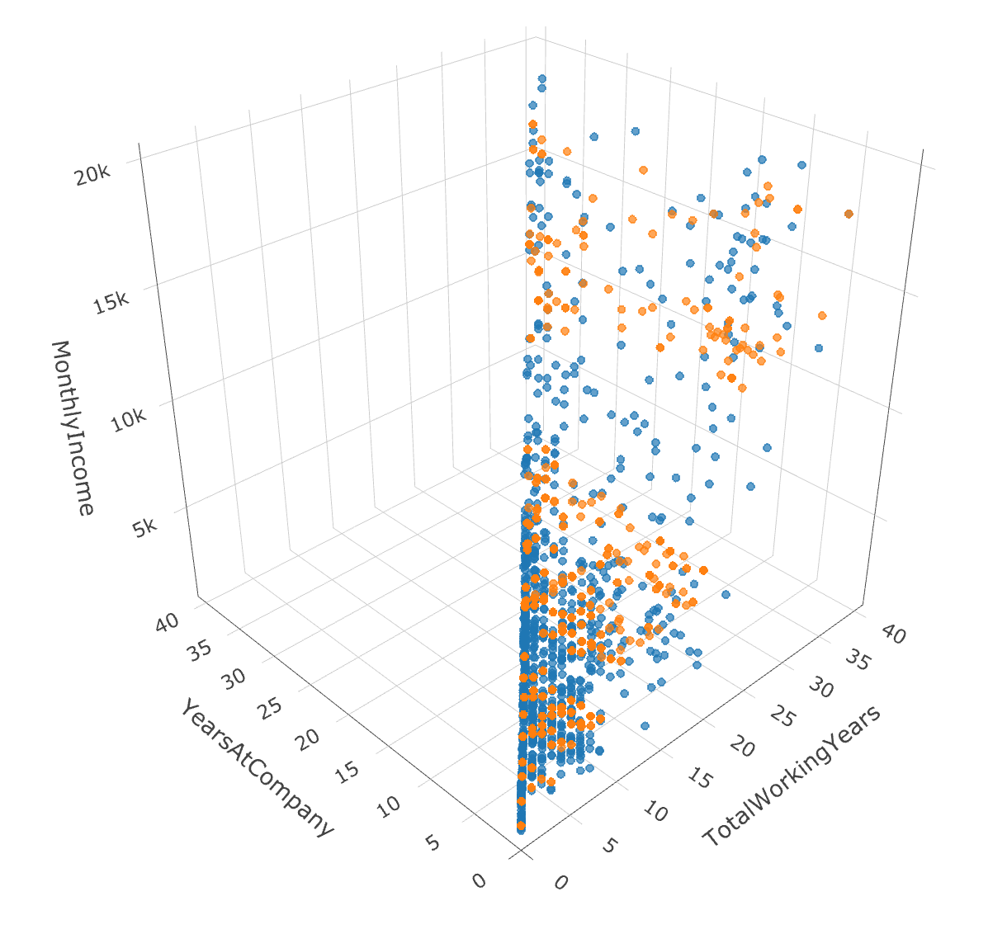
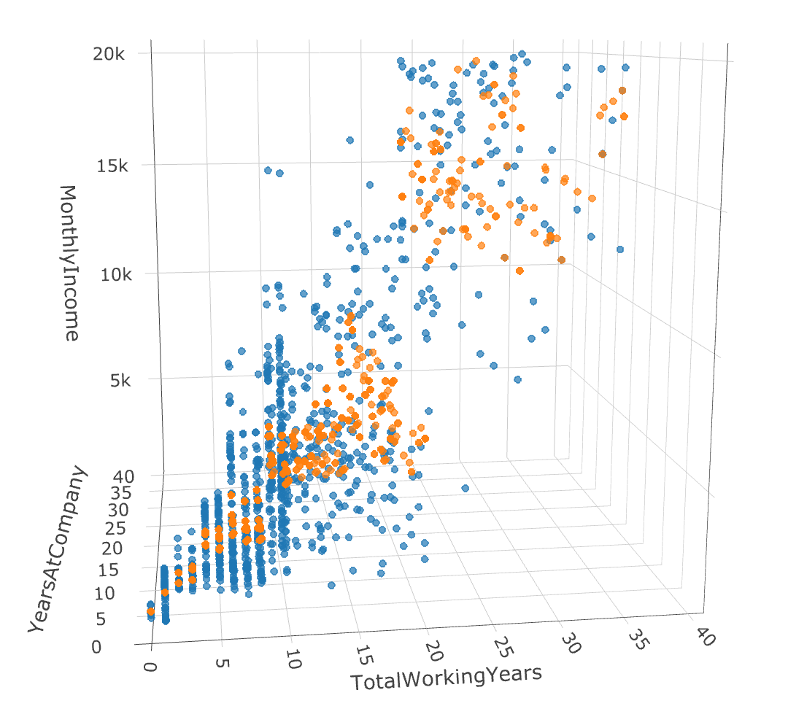
Predicting Monthly Income (Continued)
Notes:
In an attempt to visually convey the comparison of my model to the recorded values, constructed a 3d plot of the relationship between the Monthly Income, Years At Company, and Total Working Years. There are two sets of points on the plot: the monthly income as predicted by the linear regression model, and the recorded values of Monthly Income. As you can see on the plots, the predicted values seem to fall under a similar distribution as the recorded values. However, as with the model predicting attrition, I suspect that a more defined relationship can be found with the involvement of more predicting variables.

Slide 10
Final Insights and Suggestions
The three leading factors that contribute to attrition are Monthly Income, Total Years Working, and Years at Company
Monthly Income is dependent on at least the Years at Company and Total Years Working variables
Notes:
In conclusion to my presentation, I would like you to take the following insights and suggestions to heart:
Insight #1: the top three factors that contribute to attrition are Monthly Income, Total Working Years, and Years at Company, however I would highly suggest a more in-depth investigation involving more variables for the most accurate model to predict attrition.
Insight #2: Monthly Income is dependent on at least the Total Working Years and Years at Company variables
Insight #3: most of the distributions for the variables seemed to be skewed to the right which indicates that for each variable, a larger percentage population contributing to higher attrition rates are on the lower end of each variable. For example attrition responses seemed to be higher for employees that had few to no stock options.
Thank you for your undivided attention and I would now like to open the room to any questions.

