Slide 1
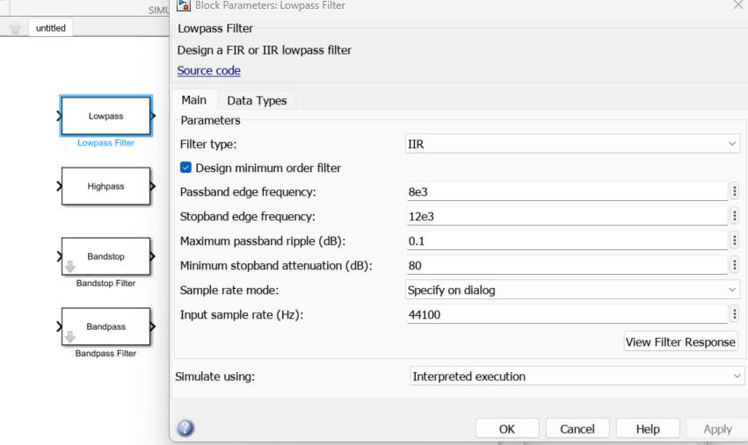
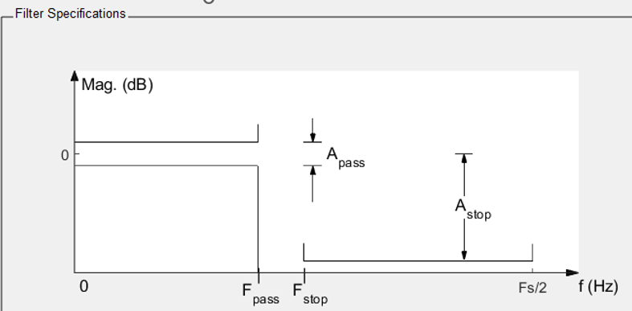
The Lowpass filter. There is a ripple setting here and both the IIR and FIR can be selected.
Simulink Blocks
Filter Designer Specifications

Slide 2
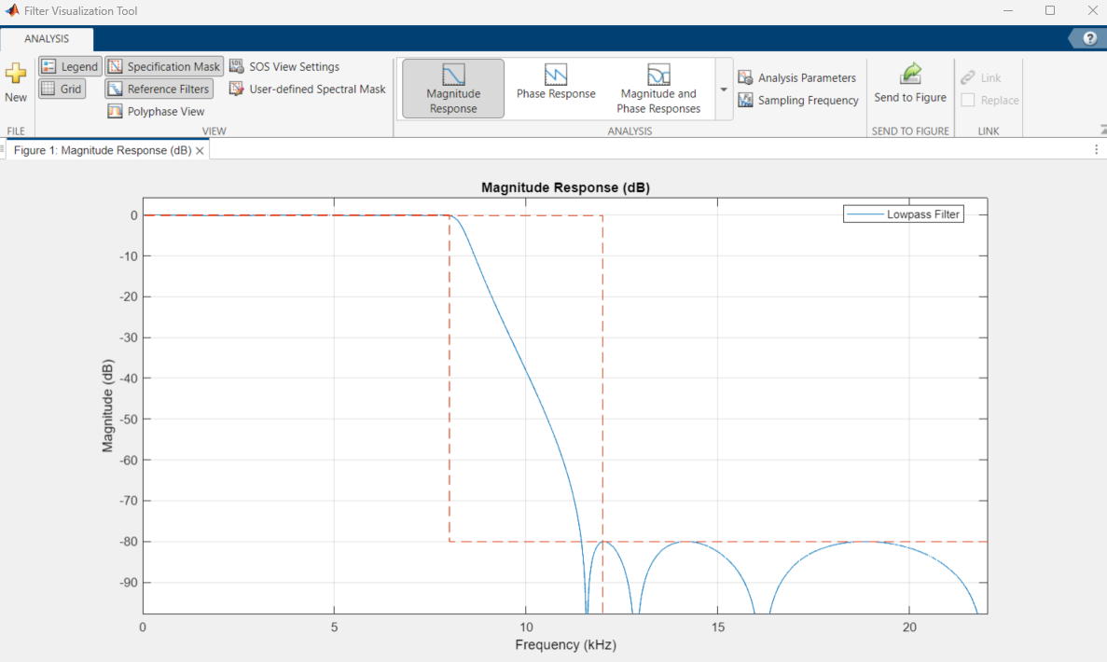
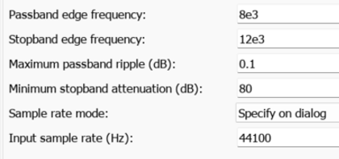
The Lowpass filter: The Filter Response.

Slide 3
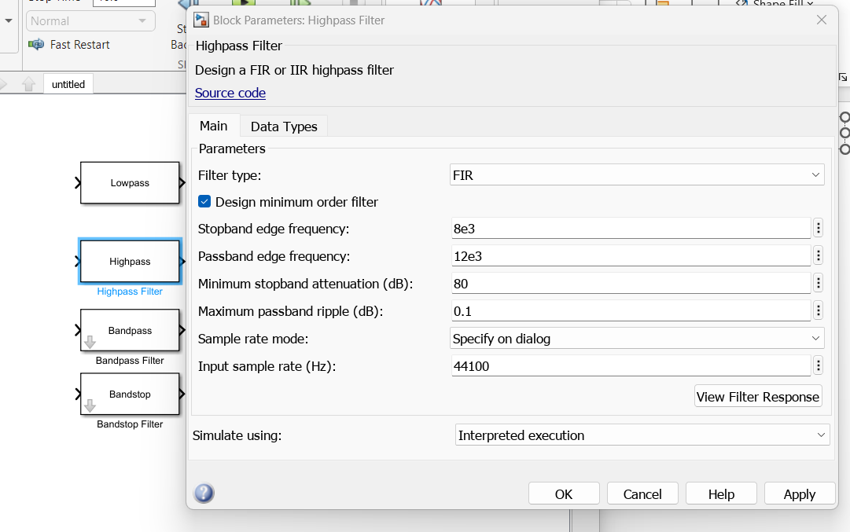
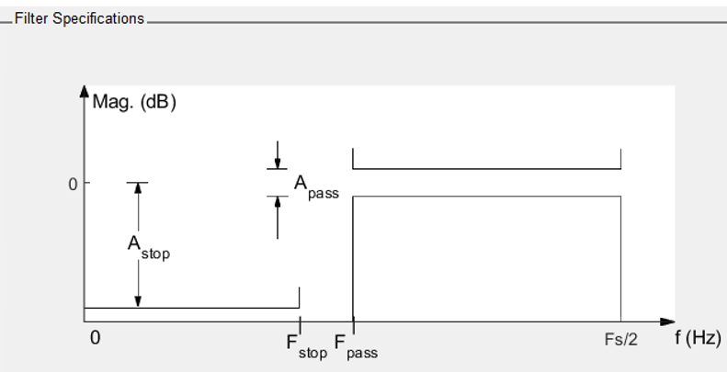
The Highpass filter. There is a ripple setting here and both the IIR and FIR can be selected.
Simulink Blocks
Filter Designer Specifications

Slide 4
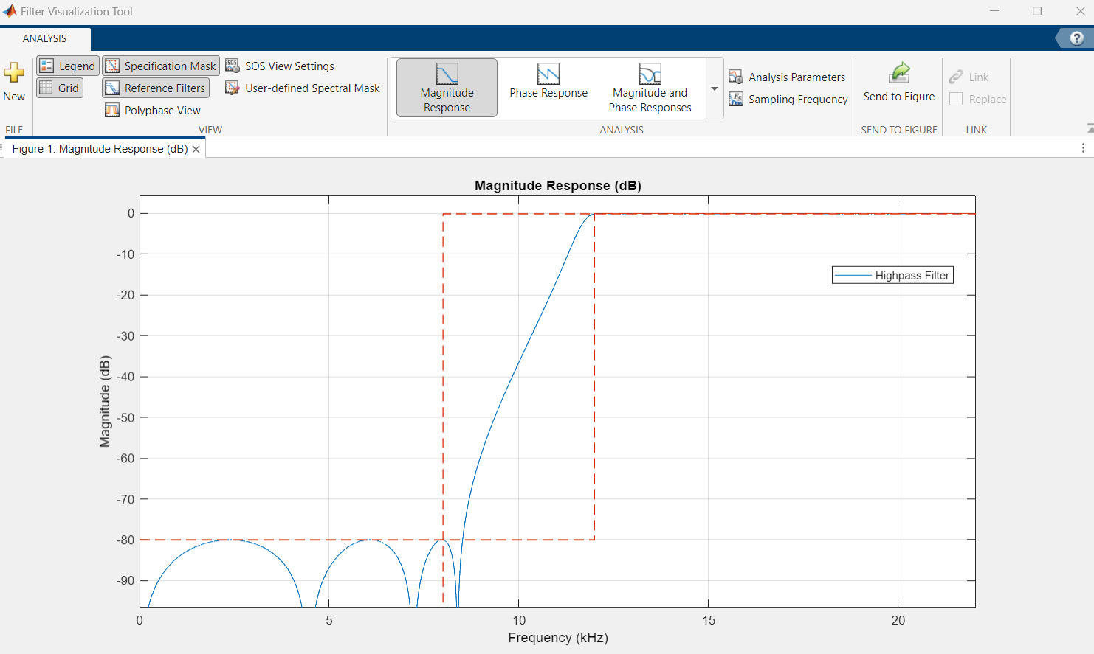
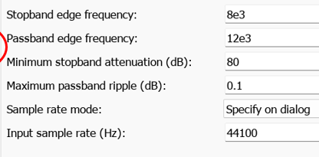
The Highpass filter: The Filter Response.

Slide 5
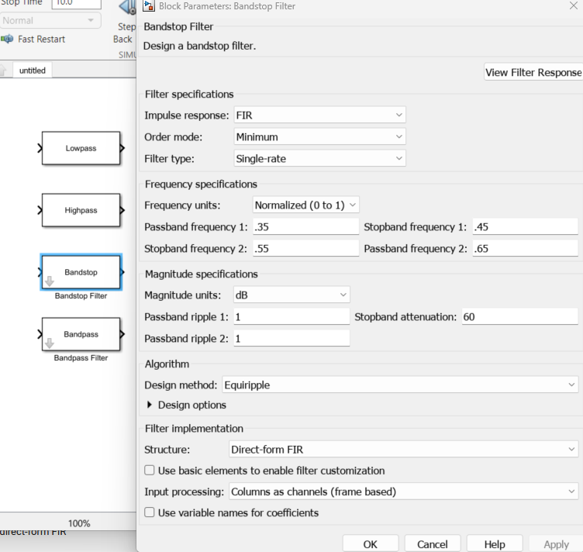
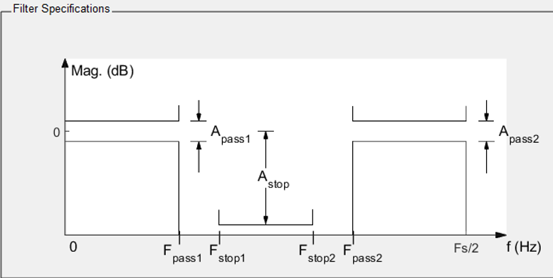
The Bandstop filter. (Instead of notch filter. Simulink has other types of notch blocks that wouldn’t be applicable.) There is a ripple setting here and both the IIR and FIR can be selected.
Simulink Blocks
Filter Designer Specifications

Slide 6
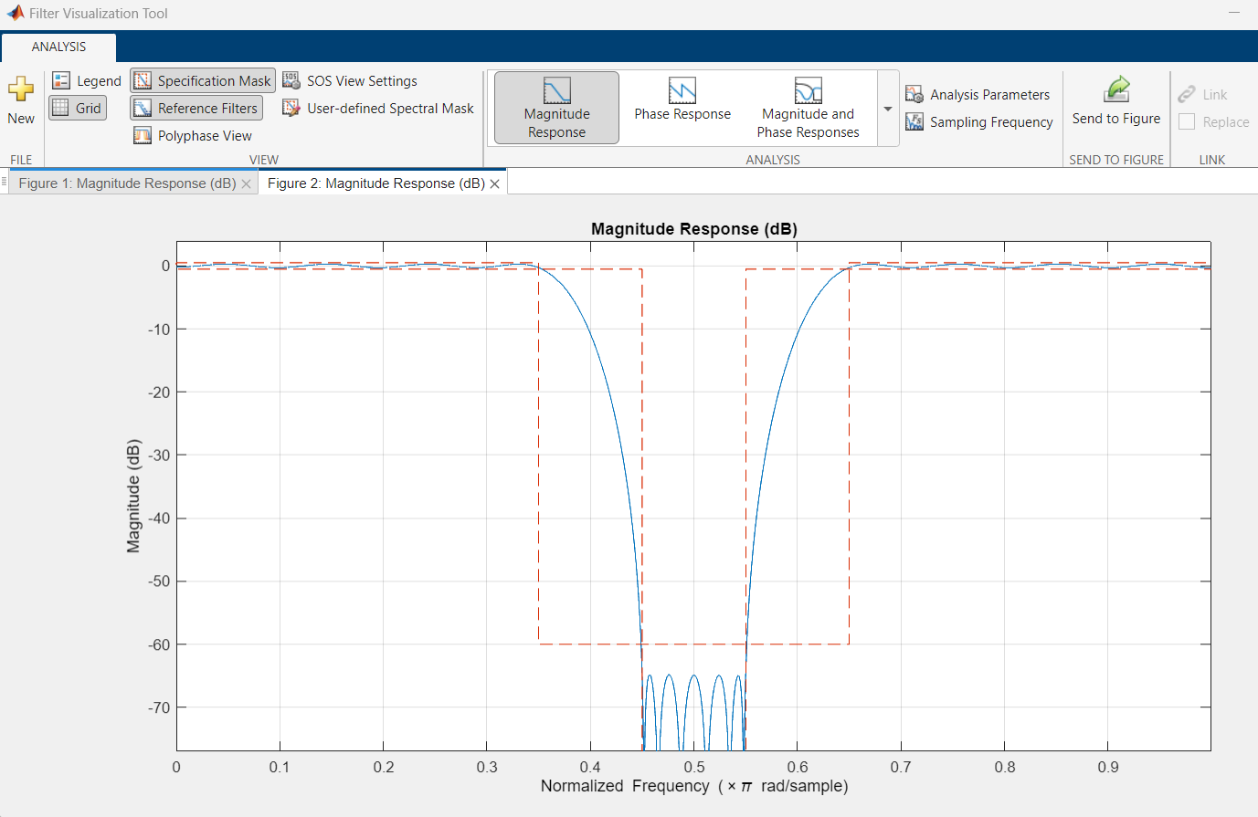
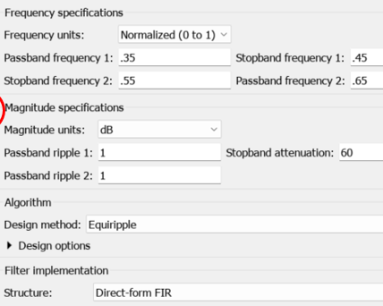
The Bandstop filter: The Filter Response.

Slide 7
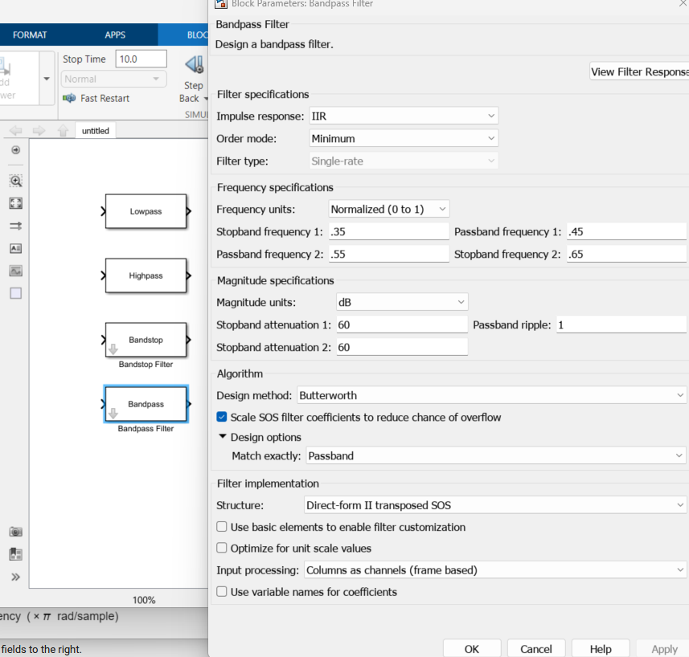
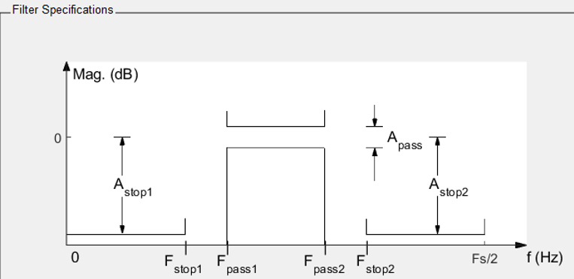
The Bandpass filter. There is a ripple setting here and both the IIR and FIR can be selected.
Simulink Blocks
Filter Designer Specifications

Slide 8
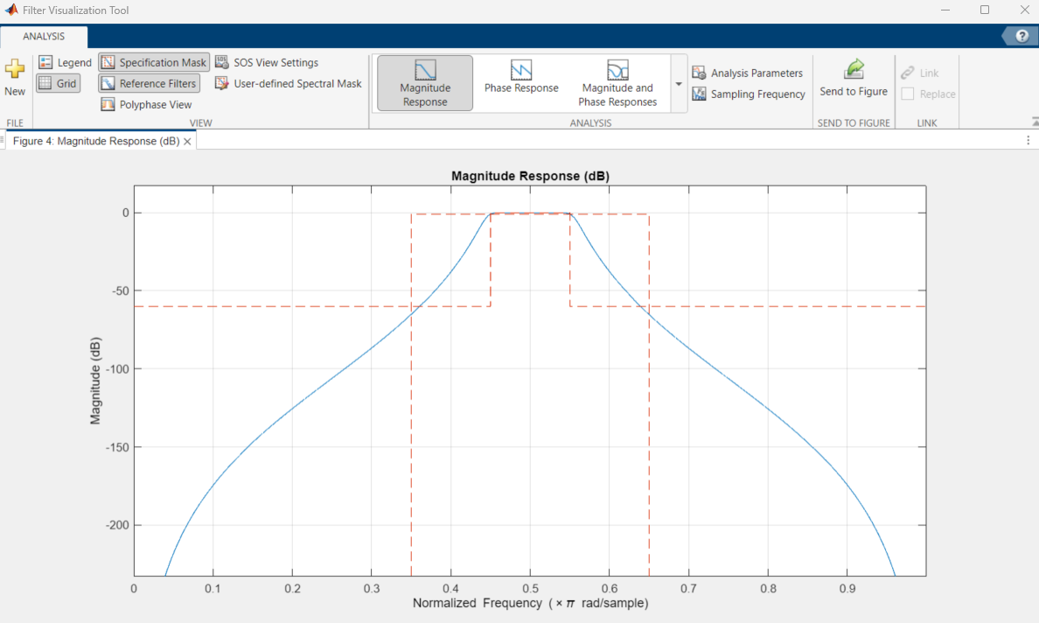
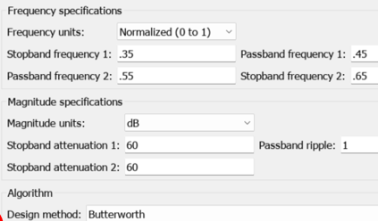
The Bandpass filter: The Filter Response.

