Slide 1
High Pass and Band Pass Filter Design and analysis
Chad NORTHEY
Gab Bettley

Slide 3
Layout
Filter Design
For both high pass and band pass
Filter Analysis
Sine Wave Analysis
Diraq Analysis (Do we need both)

Slide 4
PIS’ center frequency =(1/2)(f_{PISmin} + f_{PISmax})

Slide 5
Filter Design

Slide 6
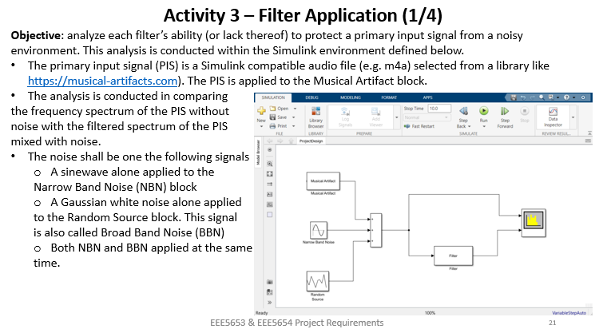
Filter Analysis

