Slide 1
High Pass and Band Pass Filter Design and analysis
Chad NORTHEY
Gab Bettley

Slide 3
Layout
Filter Design
For both high pass and band pass
Filter Analysis
Sine Wave Analysis
Diraq Analysis (Do we need both)

Slide 4
Filter Design

Slide 5
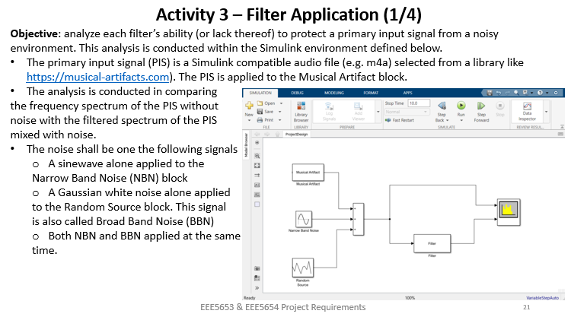
Filter Analysis

