Slide 1
High Pass and Band Pass Filter Design and analysis
Chad NORTHEY
GabE Bettley

Slide 2
Layout
Filter Design
For both high pass and band pass
Filter Analysis
Sine Wave Analysis
Diraq Analysis (Do we need both)

Slide 3
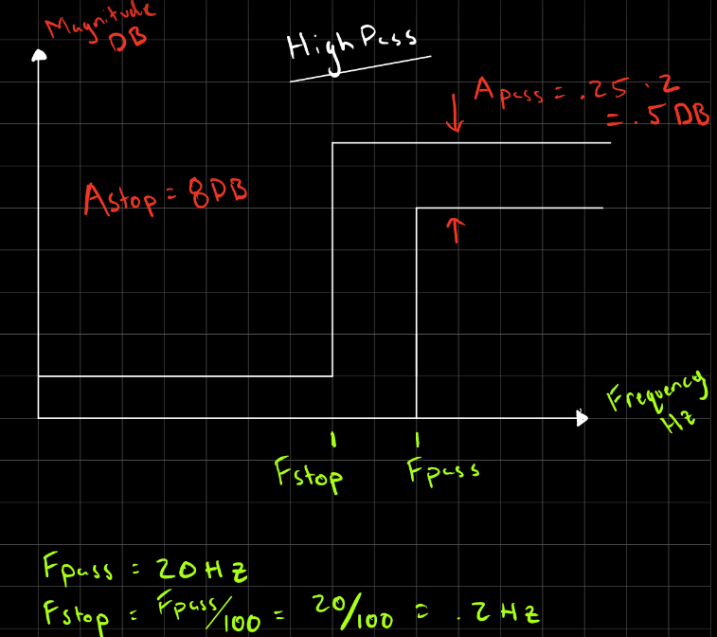
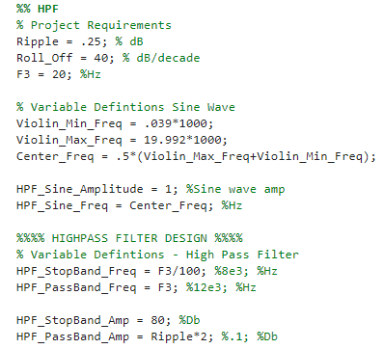
High Pass Filter Requirements and Layout
Corner Frequency | Roll Off | Ripple
20 Hz | +40 dB | 0.25 dB

Slide 4
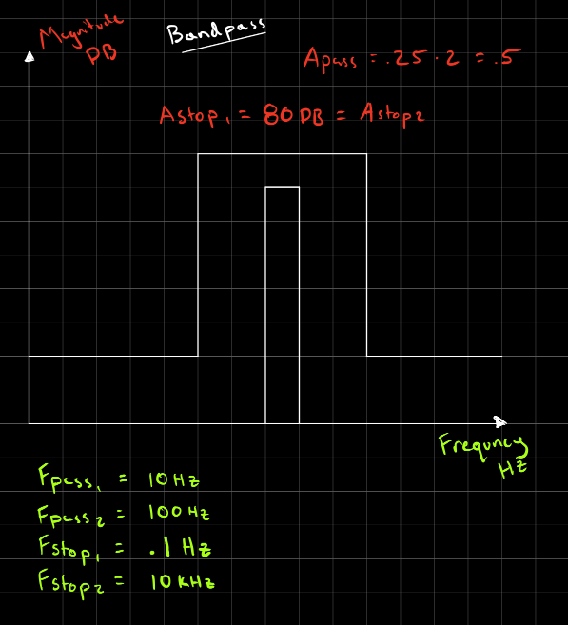
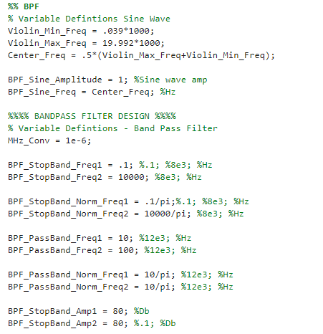
Band Pass Filter Requirements and Layout
Corner Frequency | Roll Off | Ripple
20 Hz | +40 dB | 0.25 dB

Slide 5

Activity 2
Filter Performance
Plot the magnitude $\left|H(f)\right|$ of the filter’s transfer function by:
Calculating the ratio of output amplitude to input amplitude in dB

Slide 6
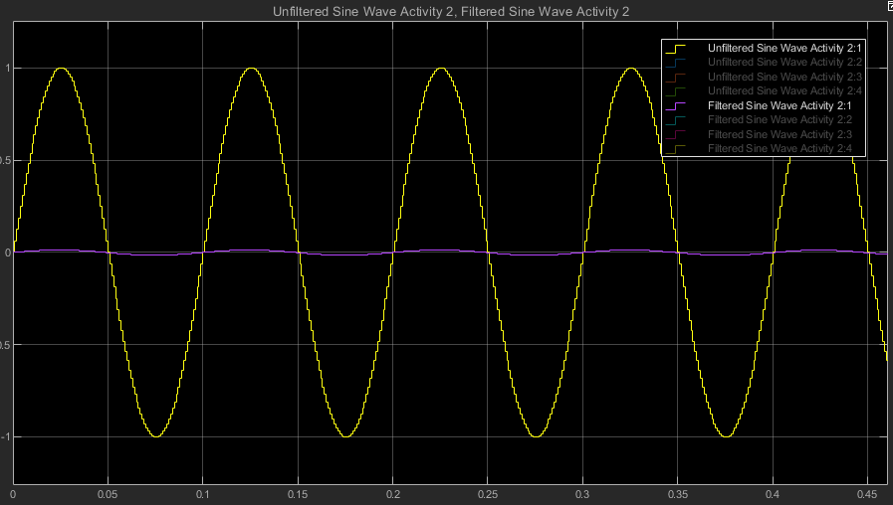
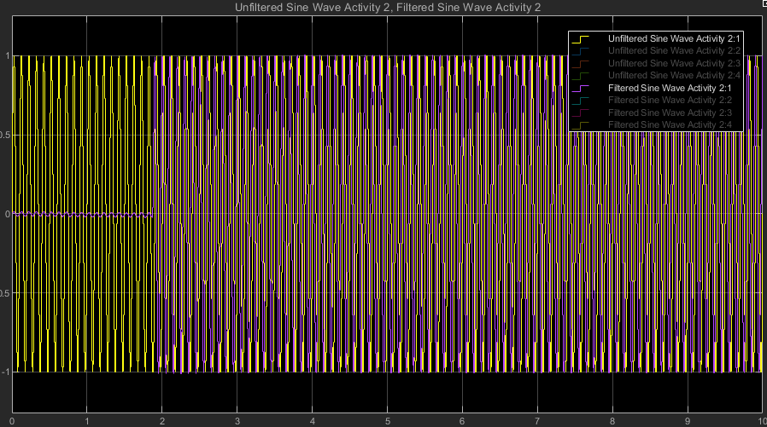
10 Hz

Slide 7
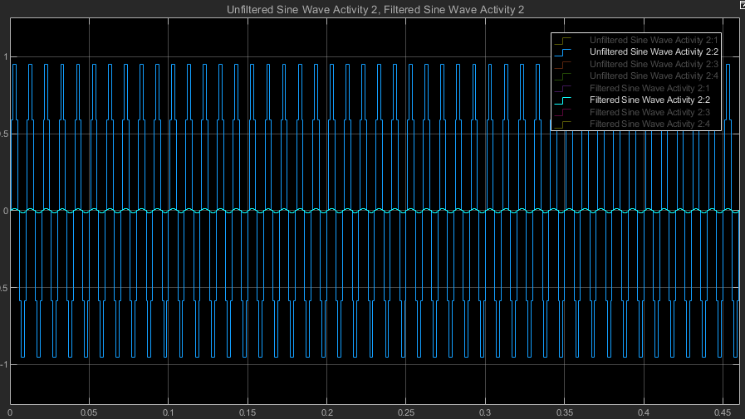
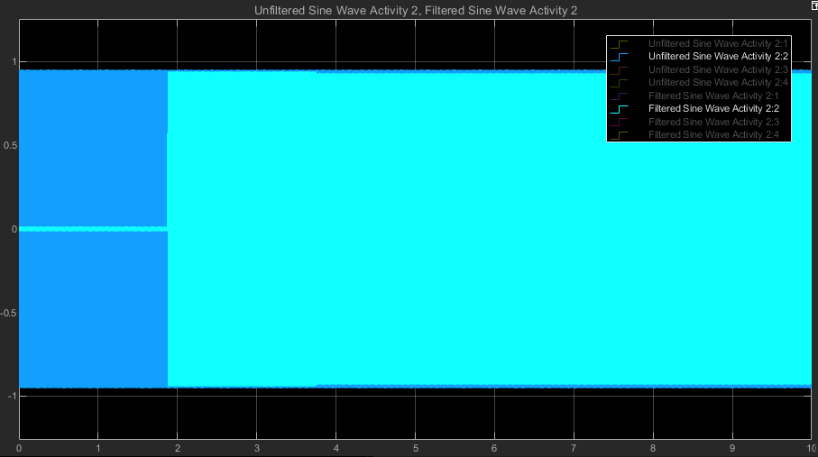
100 Hz

Slide 8
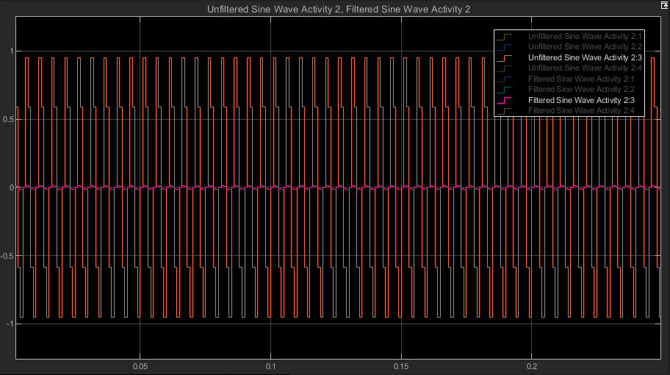
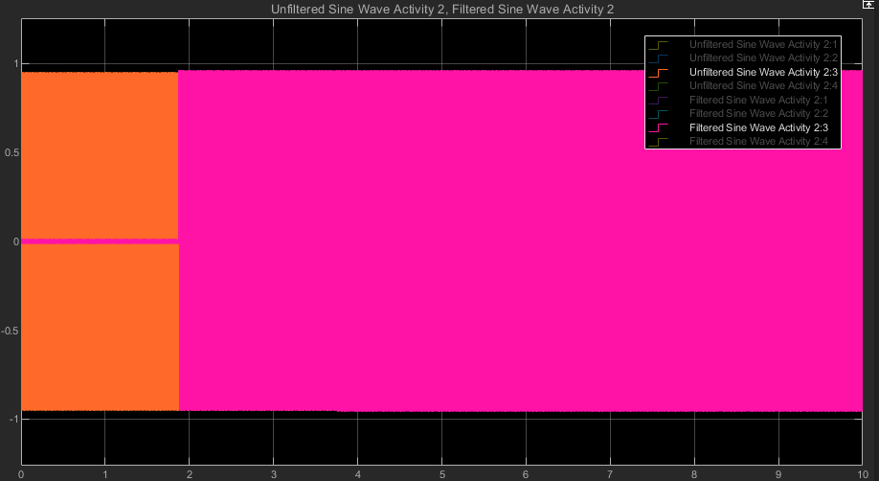
200 Hz

Slide 9
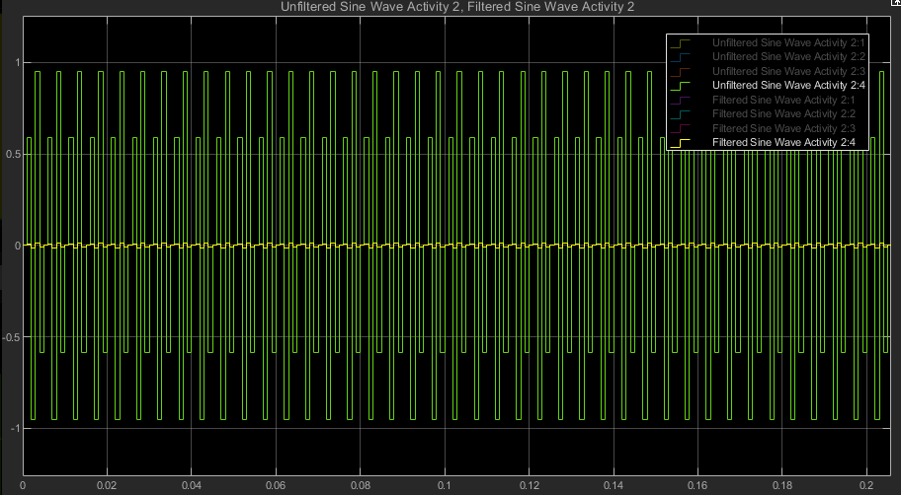
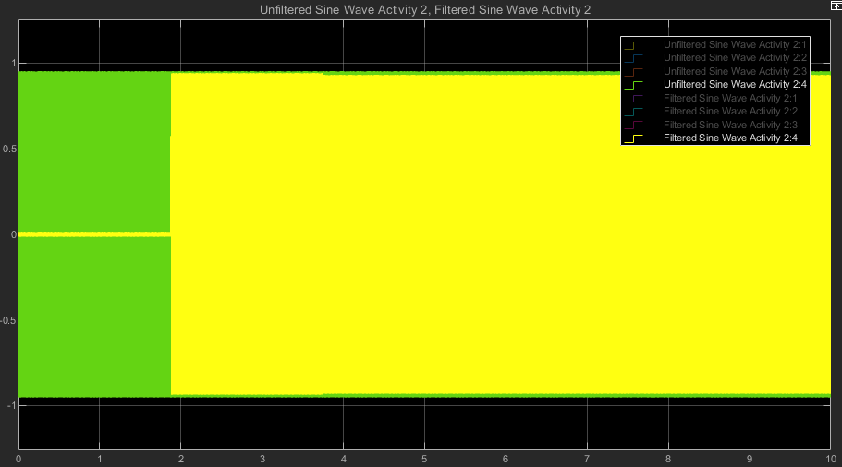
400 Hz

Slide 10
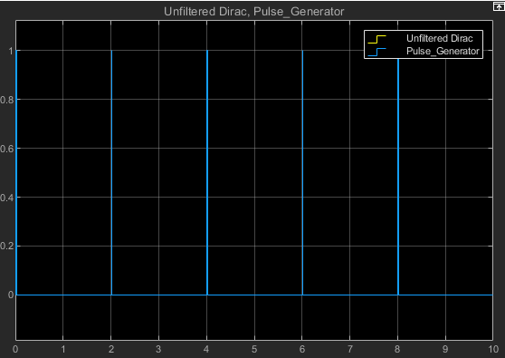
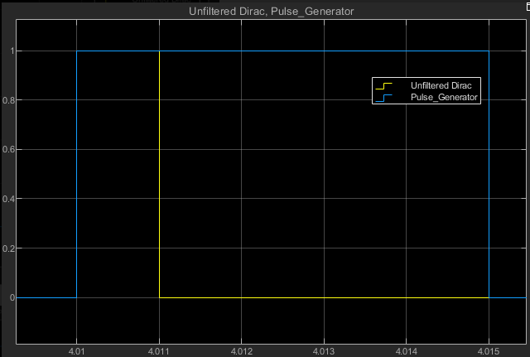
Dirac Function

Slide 11
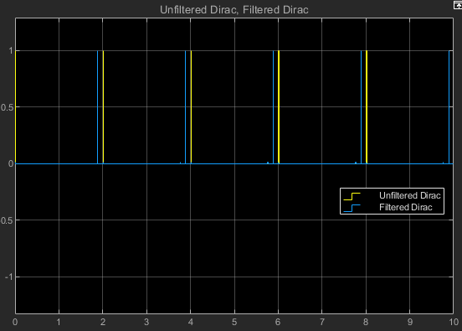
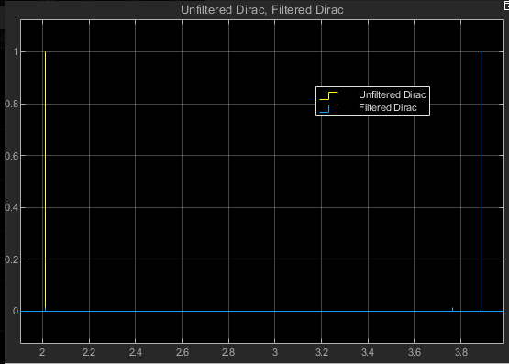
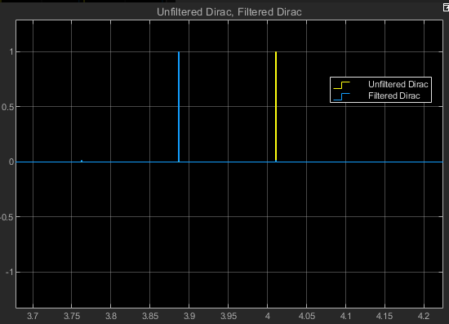
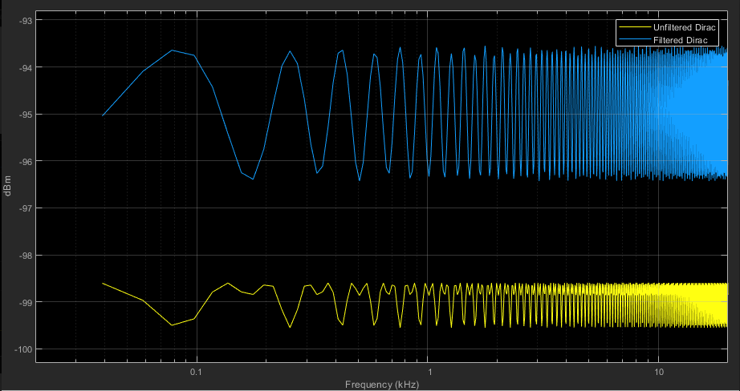

Slide 12
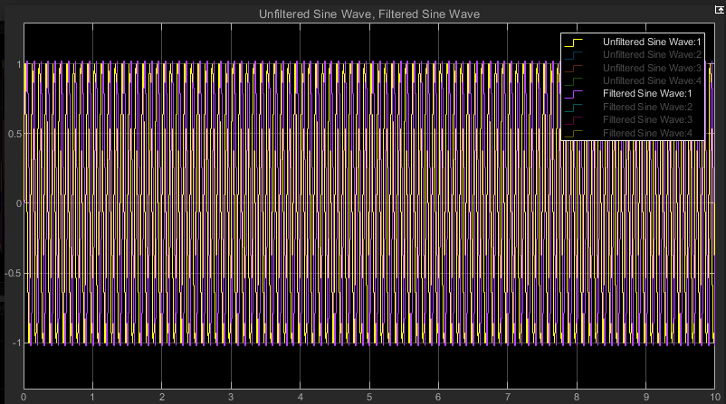
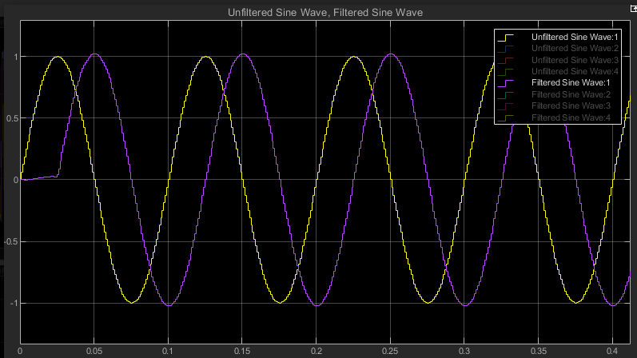

Slide 13
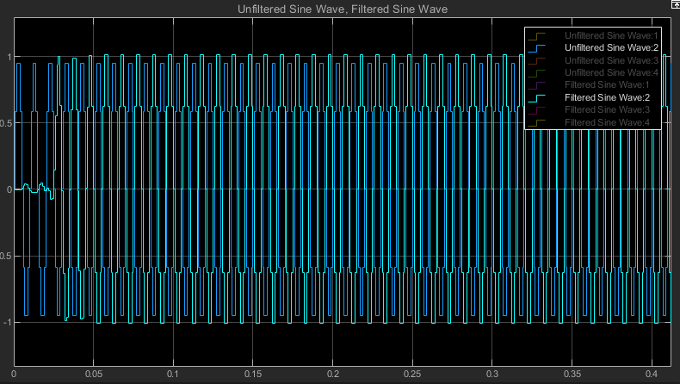
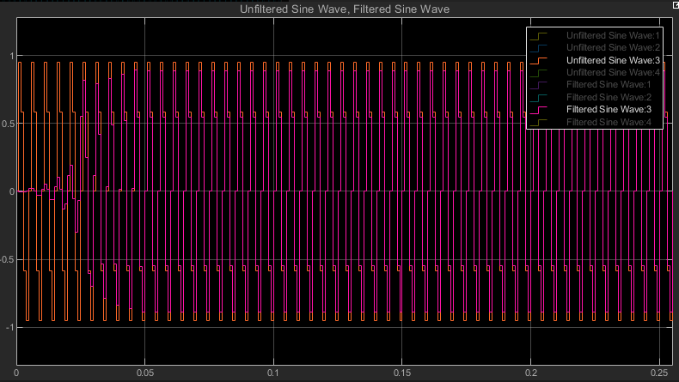
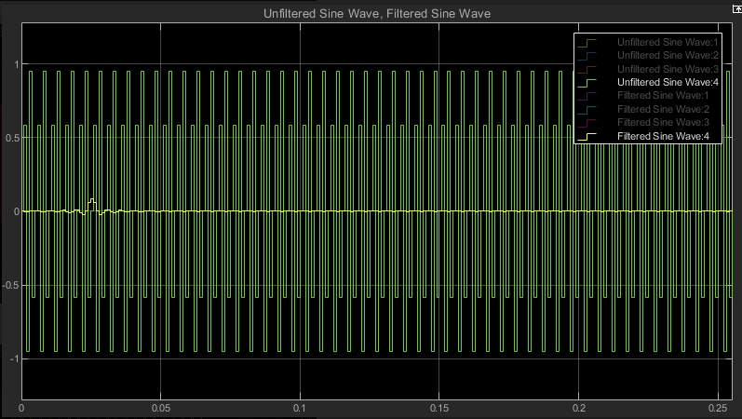

Slide 14
Activity 3
Filter ability to clean up input signal (noise)
Must compare PIS before and after
Noise must be one of the following
A sinewave alone applied to the Narrow Band Noise (NBN) block (See slide 8)
A Gaussian white noise alone applied to the Random Source block. This signal is also called Broad Band Noise (BBN) (See slide 9)
Both NBN and BBN applied at the same time.

Slide 15
NBN
Characterize the PIS spectrum in dB value in identifying its half-power bandwidth [f_{PISmin}, f_{PISmax}] Mix the PIS with a Narrowband Noise (NBN) defined as follows:
Signal type: sinewave
Frequency = PIS’ center frequency =(1/2)(f_{PISmin} + f_{PISmax})
RMS amplitude = PIS’ average amplitude over the half-power bandwidth [fmin, fmax]
Display the spectrum of the non-filtered compound signal PIS mixed with NBN denoted as PIS&NBN
Characterize the Signal to Noise ratio of PIS&NBN
Display the spectrum of the filtered PIS&NBN denoted as F_ PIS&NBN
Characterize the Signal to Noise ratio of F_ PIS&NBN
Use the Spectrum Analyzer capability or use a subtractor block to compare PIS with PIS&NBN
Summarize your findings and conclude as to the efficiency of the filtering. If you have determined that the filter is not efficient, provide an explanation as to why. Which of the 2 assigned is most capable to protect the PIS against a Broad Band noise? This can be a few bullet points here, then discussed more in depth in report

Slide 16
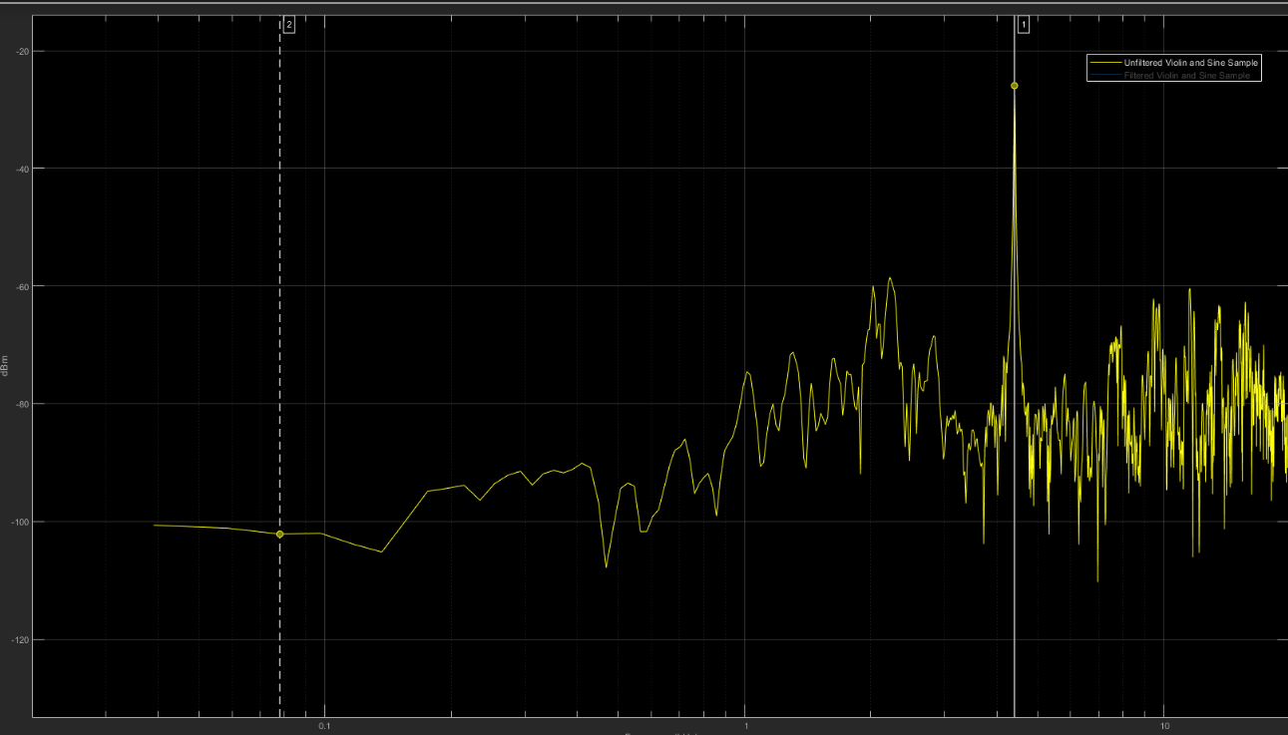
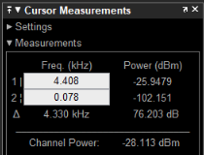
NBN
Peak Amplitude
Figure xx. Unfiltered Violin and Sine Wave

Slide 17
NBN Continued
Characteristic | Value | Source
Peak Amplitude | -25.49 dB | Peak point on Figure 1
Half-Power Bandwidth | [4.375 khz, 4.444 khz] | (1)
PIS’ Center Frequency | 4.4095 khz | (1/2)*(f_{PISmin} + f_{PISmax})
RMS Amplitude | -35.055 dB | PIS’ average amplitude over the half-power bandwidth

Slide 18
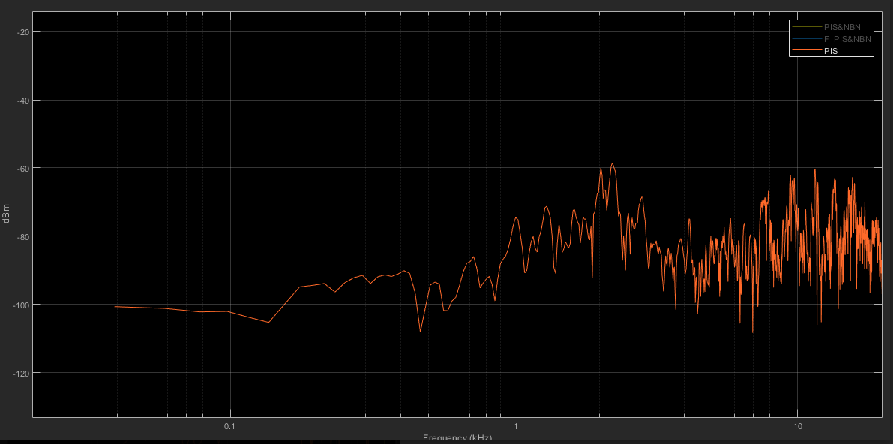
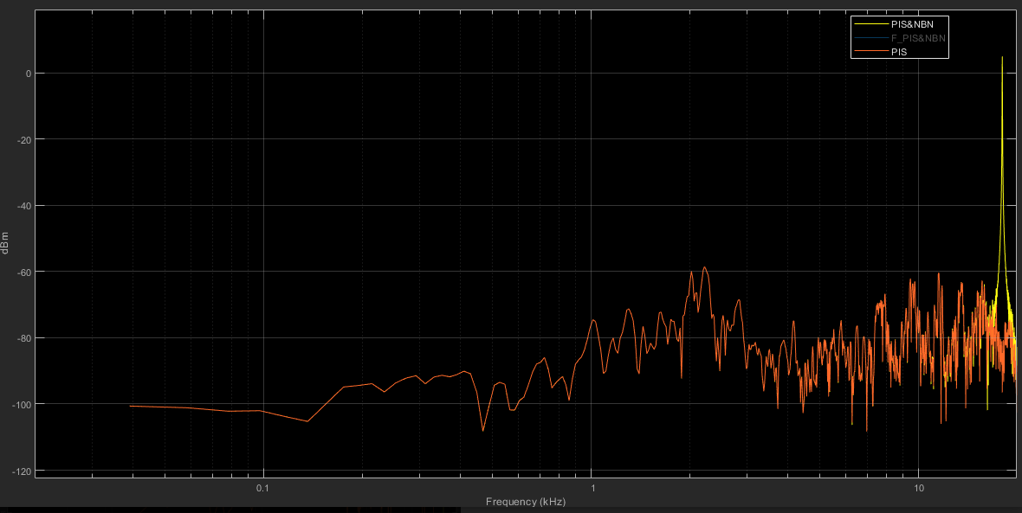
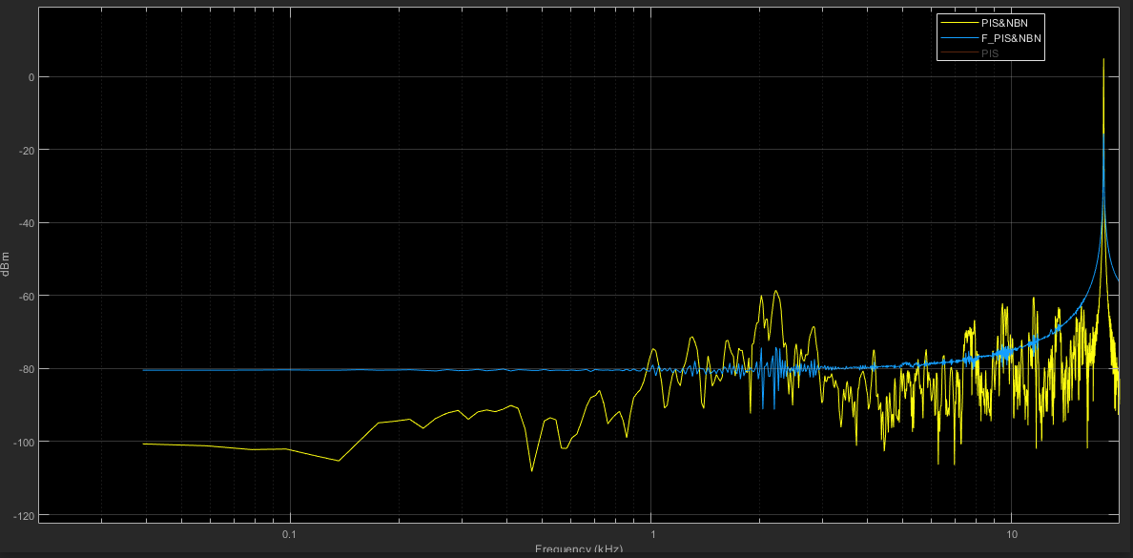

Slide 19
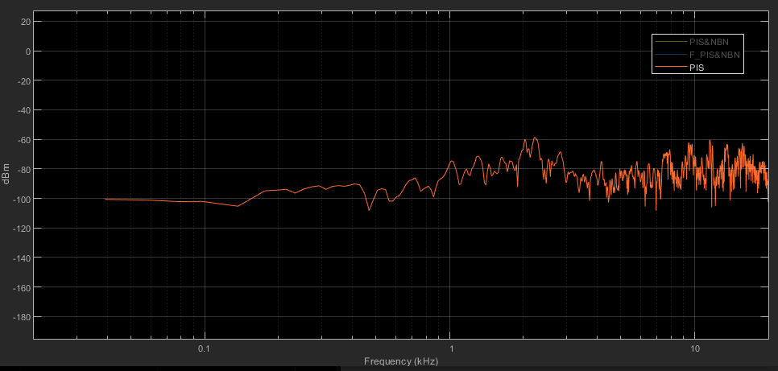
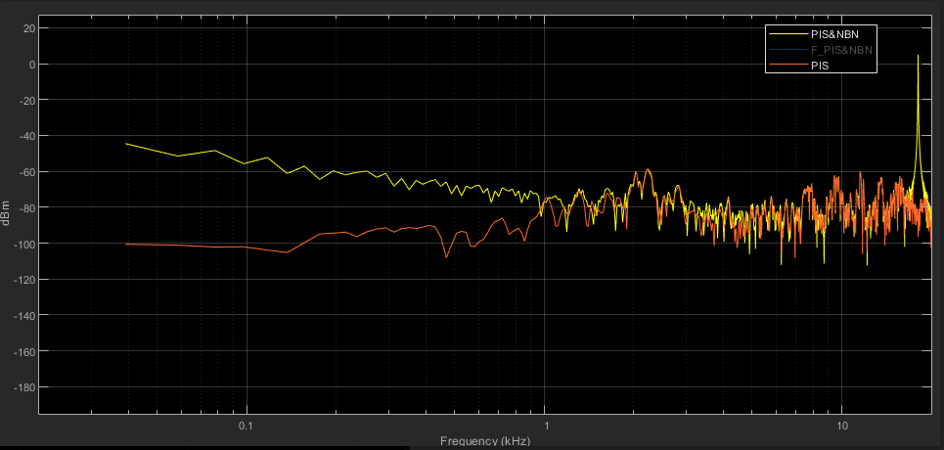
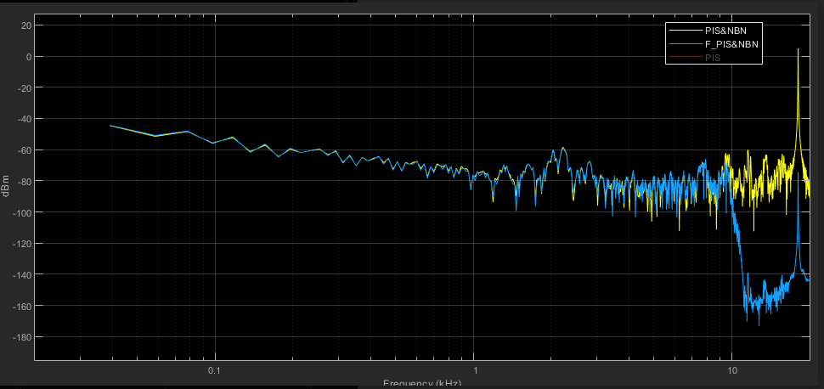

Slide 20
BBN
Characterize the PIS spectrum in dB value in identifying its half-power bandwidth [f_{PISmin}, f_{PISmax}]
Mix the PIS with a Broad Band Noise (BBN) defined as follows:
Signal type: White Noise Gaussian
Mean amplitude = PIS’ average amplitude over the half-power bandwidth [f_{PISmin}, f_{PISmax}]
Standard deviation = RMS value of the PIS spectrum over its half-power bandwidth [f_{PISmin}, f_{PISmax}]
Display the spectrum of the non-filtered compound signal PIS mixed with BBN denoted as PIS&BBN
Characterize the Signal to Noise ratio of PIS&BBN
Display the spectrum of the filtered PIS&BBN denoted as F_ PIS&BBN
Characterize the Signal to Noise ratio of F_ PIS&BBN
Use the Spectrum Analyzer capability or use a subtractor block to compare PIS with PIS&BBN
Summarize your findings and conclude as to the efficiency of the filtering. If you have determined that the filter is not efficient, provide an explanation as to why. Which of the 2 assigned is most capable to protect the PIS against a Broad Band noise? This can be a few bullet points here, then discussed more in depth in report

Slide 21
Activity 3 Cont.
Comparison of Narrow Band (NB) Broad Band (BB) Noise Filtering
Which type of noise signal is the easiest to filter?
What filter is most efficient in protecting against:
NBN
BBN
Need to propose a redesign of the filter that will improve the Signal to Noise ratio by at least 6 dB for NBN given the noise characteristics

Slide 22
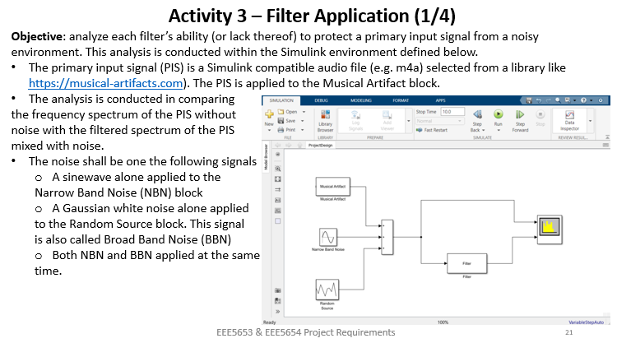
Filter Analysis

