Slide 1
MAS456 Final Project
20200639 Woojin Chae

Slide 2
Introduction
Question 1
Question 2
Question 3
Question 4
Question 5
Conclusion
Objectives
disc_hire
To identify…
Response to the question,
“Have you ever experienced discrimination in getting hired?”
1. Which factors are strongly associated with experience of discrimination in hiring?
2. Whether the experience of discrimination stands out in a particular group

Slide 3
Introduction
Question 1
Question 2
Question 3
Question 4
Question 5
Conclusion
provided by KLIPS

Slide 4
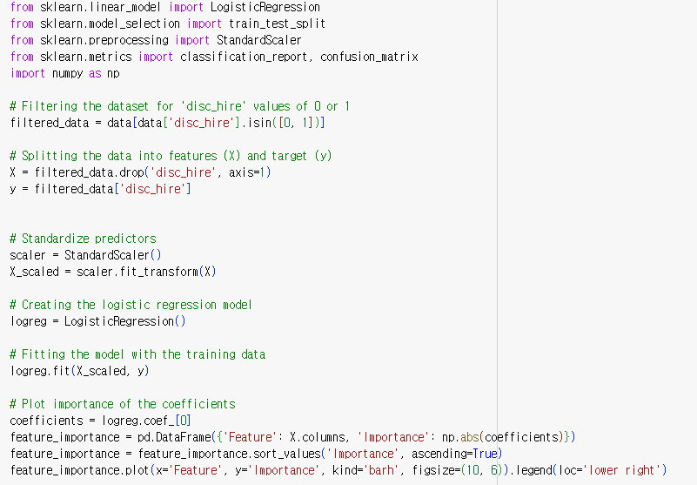
Introduction
Question 1
Question 2
Question 3
Question 4
Question 5
Conclusion
1. Identifying and Analyzing Key Variables in Hiring Discrimination Experiences
Unify scale of features
:to make comparison of coefficients available

Slide 5
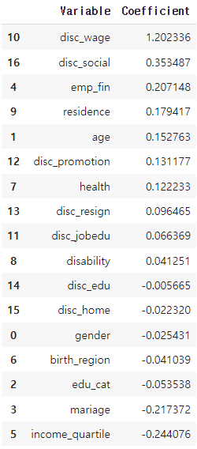
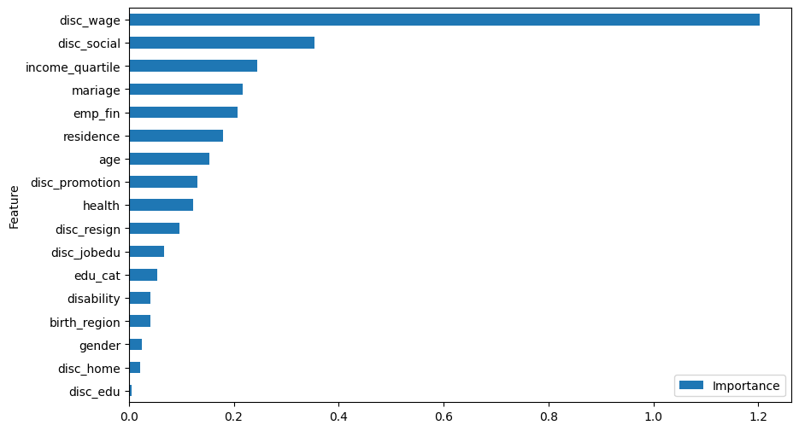
Introduction
Question 1
Question 2
Question 3
Question 4
Question 5
Conclusion
(a) Coefficients
(b) Importance Rank

Slide 6

Introduction
Question 1
Question 2
Question 3
Question 4
Question 5
Conclusion
Caveat from bias can be ignored…

Slide 7
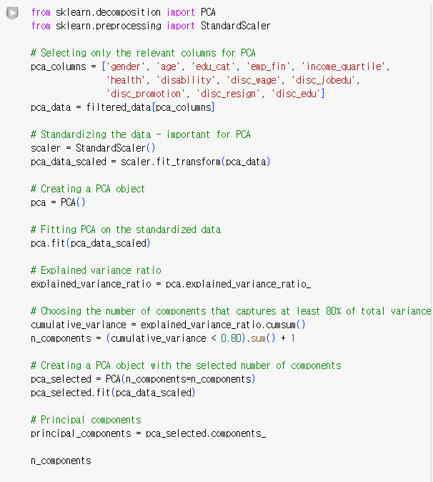
Introduction
Question 1
Question 2
Question 3
Question 4
Question 5
Conclusion
2. PCA of 12 Explanatory Variables Influencing Discrimination Experiences
Increase the number of principal components
until 80% variance of the total data is captured

Slide 8
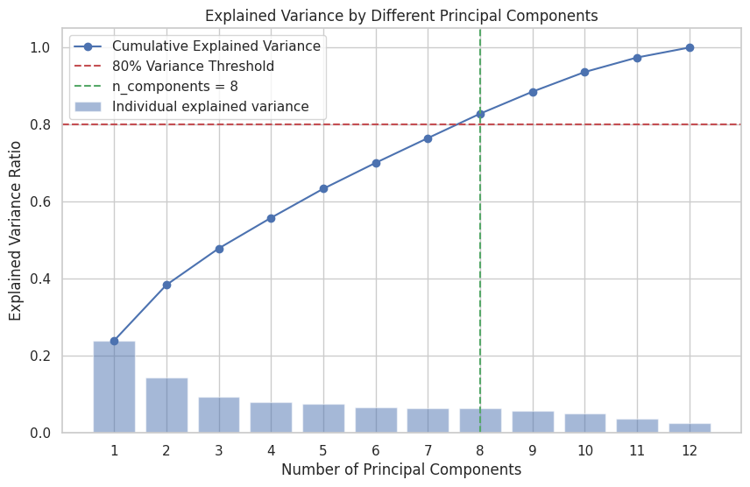
Introduction
Question 1
Question 2
Question 3
Question 4
Question 5
Conclusion

Slide 9
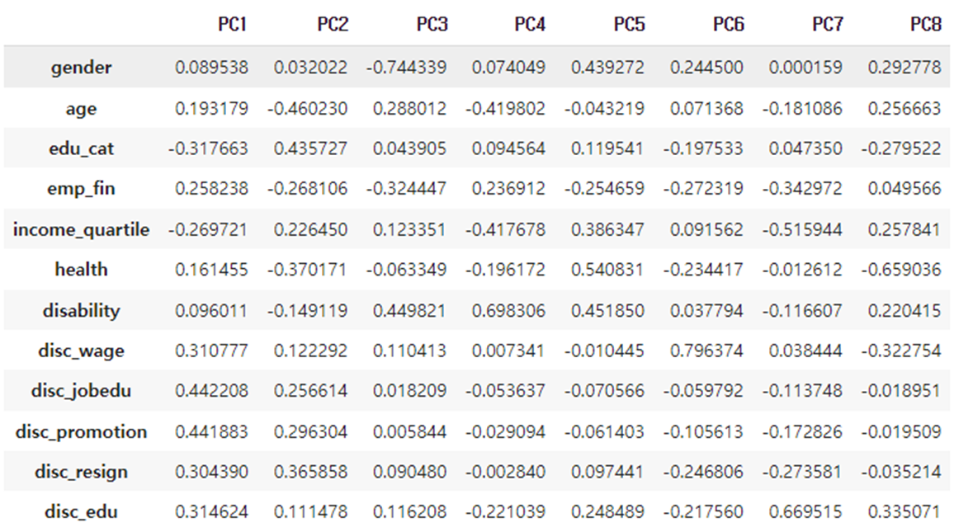
Introduction
Question 1
Question 2
Question 3
Question 4
Question 5
Conclusion
PC2: Changing Educational
trends over generation
PC1: Exposure to high discrimination

Slide 10
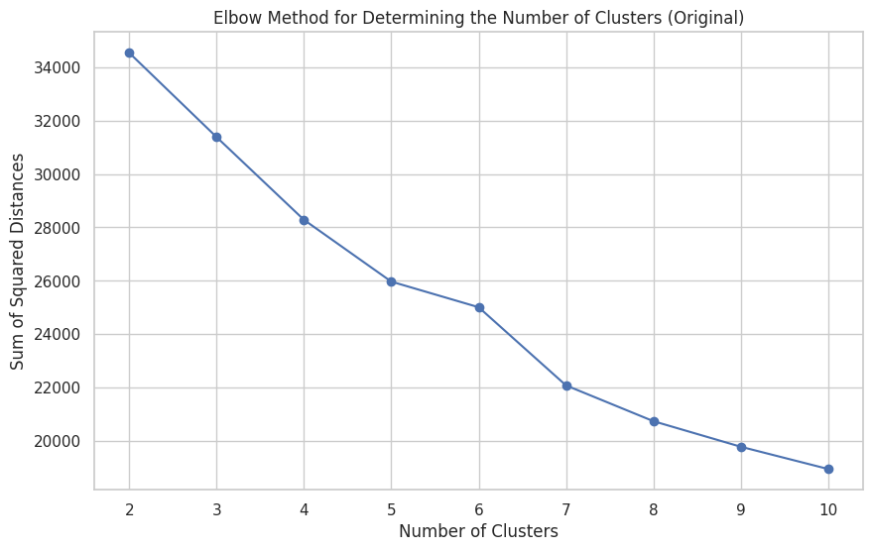
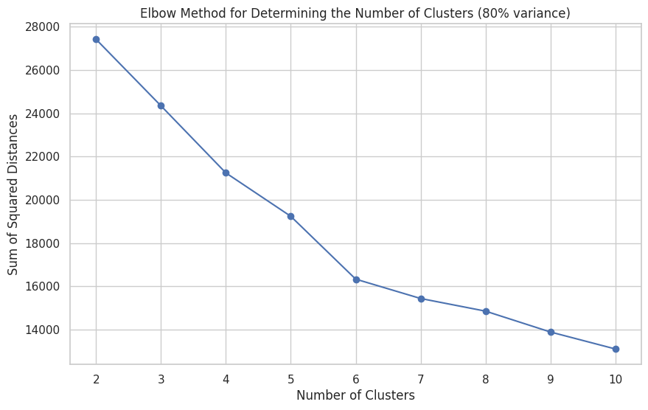
Introduction
Question 1
Question 2
Question 3
Question 4
Question 5
Conclusion
3. Comparative Analysis of Subgroup Clustering Based on
Original Variables and Principal Components
(a) sum of squared distance (original)
(b) sum of squared distance (PCs)
Hard to determine only considering this..!

Slide 11
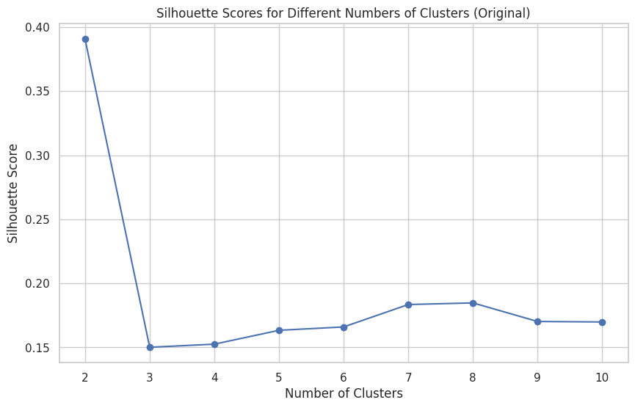
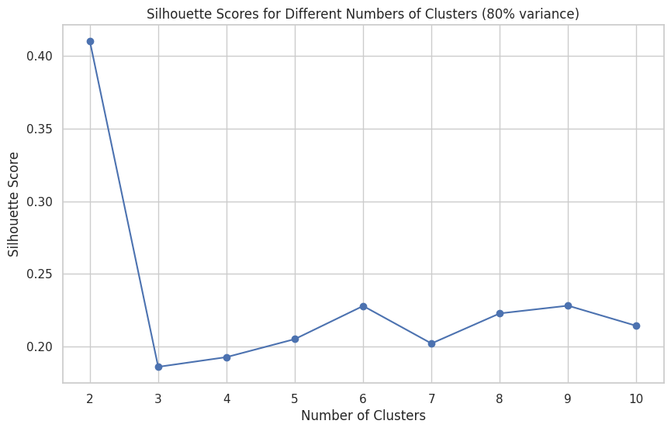
Introduction
Question 1
Question 2
Question 3
Question 4
Question 5
Conclusion
(a) silhoutte score (original)
(b) silhoutte score (PCs)
Both case yields optimal number of cluster as 2!

Slide 12
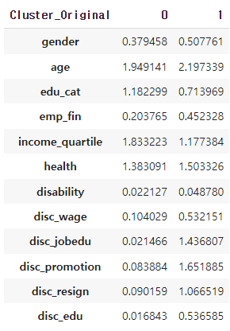
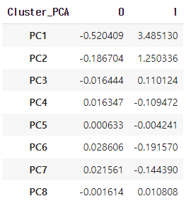
Introduction
Question 1
Question 2
Question 3
Question 4
Question 5
Conclusion
(a) cluster (Original)
(b) cluster (PCs)

Slide 13
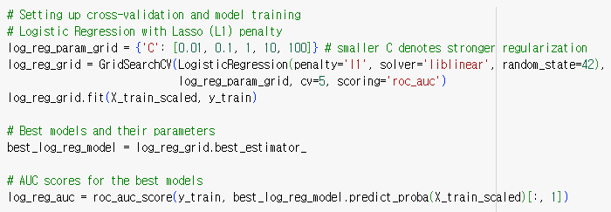
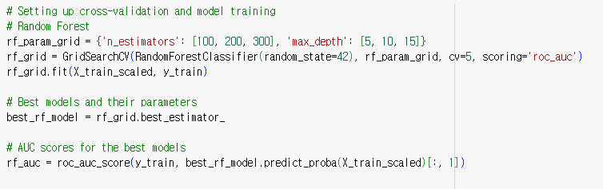
Introduction
Question 1
Question 2
Question 3
Question 4
Question 5
Conclusion
4. Under-Reporting of Hiring Discrimination in terms of Gender
Hyper-parameter tuning to obtain best logistic regression model in terms of AUC
Hyper-parameter tuning to obtain best random forest model in terms of AUC

Slide 14
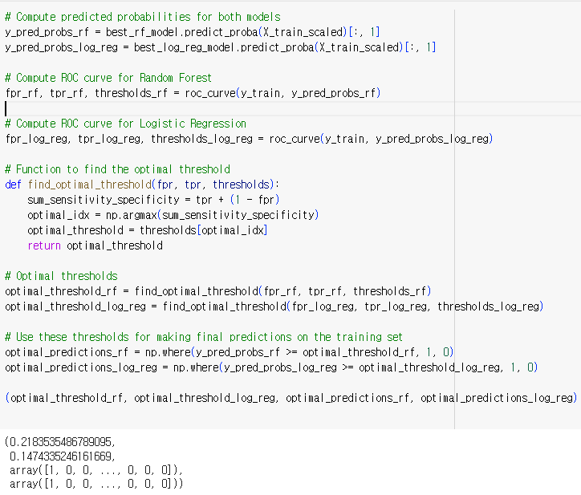
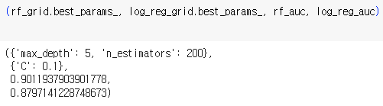
Introduction
Question 1
Question 2
Question 3
Question 4
Question 5
Conclusion

Slide 15
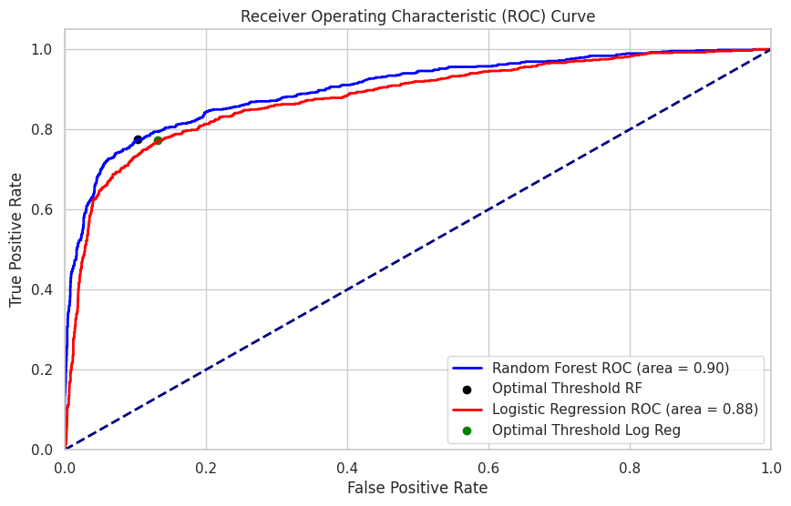
Introduction
Question 1
Question 2
Question 3
Question 4
Question 5
Conclusion

Slide 16
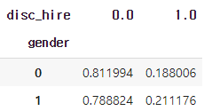
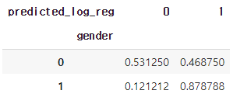
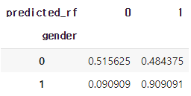
Introduction
Question 1
Question 2
Question 3
Question 4
Question 5
Conclusion
(a) Original Data
(b) Logistic Regression
(c) Random Forest

Slide 17
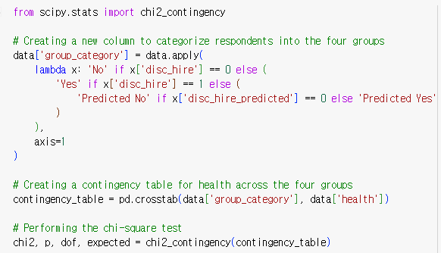
Introduction
Question 1
Question 2
Question 3
Question 4
Question 5
Conclusion
5. Link Between Hiring Discrimination Experiences and Self-Rated Health Score
Categorize data into four groups
according to the results obtained from random forest prediction model
(1) Answered No
(2) Answered Yes
(3) Answered NAN, but Predicted No
(4) Answered NAN, but Predicted Yes

Slide 18
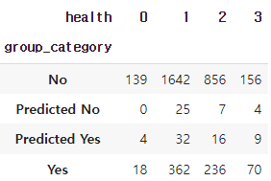
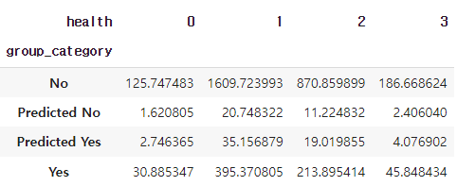
Introduction
Question 1
Question 2
Question 3
Question 4
Question 5
Conclusion
5. Link Between Hiring Discrimination Experiences and Self-Rated Health Score
(a) Observed Frequency
(b) Expected Frequency
If there are no association between the experience of hiring discrimination and health,…

Slide 19
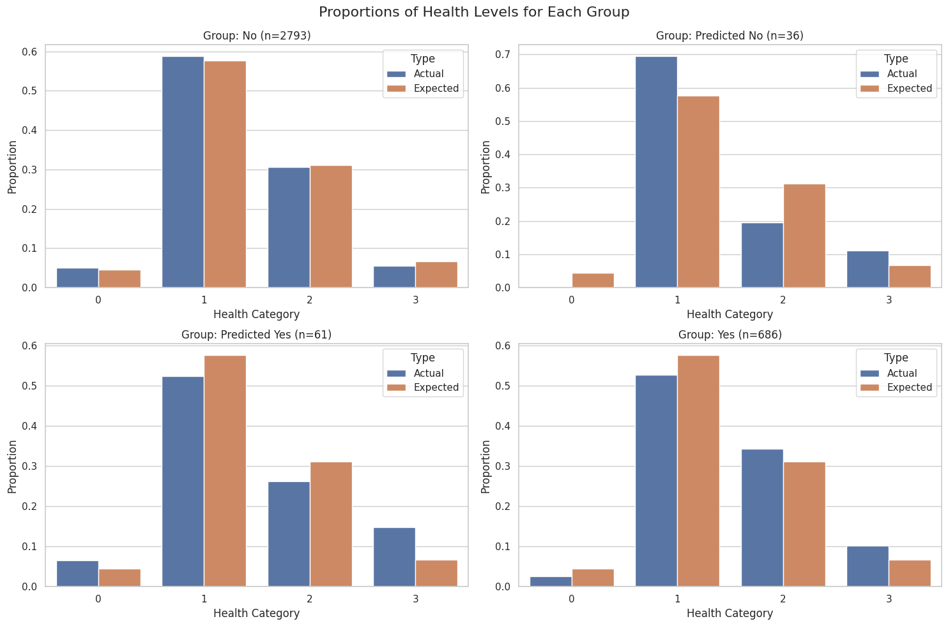
Introduction
Question 1
Question 2
Question 3
Question 4
Question 5
Conclusion

Slide 20



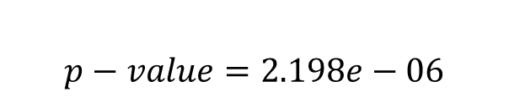
Introduction
Question 1
Question 2
Question 3
Question 4
Question 5
Conclusion
Conduct chi-square test (Distribution test)
Observed Frequency
Expected Frequency
$$χ^{2}=\sum_{k}{\frac{{\left(O_{k}−E_{k}\right)}^{2}}{E_{k}}}$$
Under null hypothesis, it follows chi-square distribution with df=(r-1)X(c-1)=9
$$TS=42.953$$
$∴$ Reject Null Hypothesis
$$p−value=2.198e−06$$

Slide 21
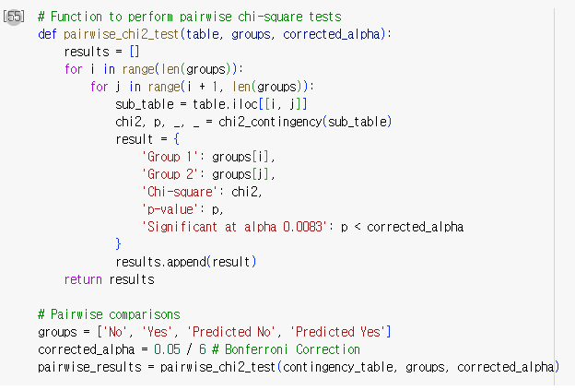
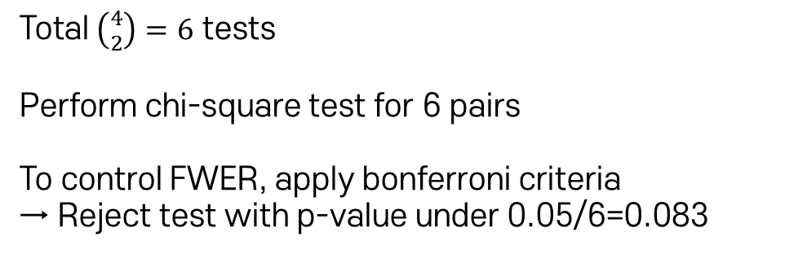
Introduction
Question 1
Question 2
Question 3
Question 4
Question 5
Conclusion
Conduct Pairwise Comparison
Total $\left({4 \atop 2}\right)=6$ tests
Perform chi-square test for 6 pairs
To control FWER, apply bonferroni criteria
→ Reject test with p-value under 0.05/6=0.083

Slide 22
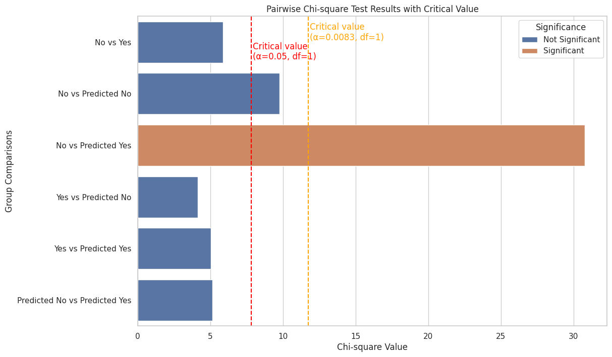
Introduction
Question 1
Question 2
Question 3
Question 4
Question 5
Conclusion
The only test that null hypothesis is rejected

Slide 23
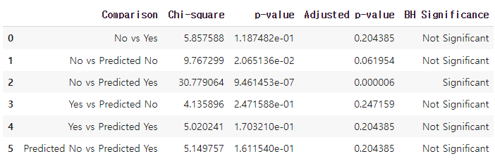
Introduction
Question 1
Question 2
Question 3
Question 4
Question 5
Conclusion
How about Benjamini-Hochberg Procedure?
Same as before…

Slide 24
Introduction
Question 1
Question 2
Question 3
Question 4
Question 5
Conclusion
Conclusion
Identifying and Analyzing Key Variables in Hiring Discrimination Experiences
: disc_wage, disc_social, income_quartile
PCA of 12 Explanatory Variables Influencing Discrimination Experiences : PC1 capture overall experience in discrimination, …
Comparative Analysis of Subgroup Clustering Based on Original Variables and Principal Components : similarity in characteristics between clusters from original variables and PCs has confirmed
Under-Reporting of Hiring Discrimination in terms of Gender : Maybe …, but should consider whether it might have been cherry-picked
Link Between Hiring Discrimination Experiences and Self-Rated Health Score : Maybe …, but should consider whether it might have been cherry-picked

Slide 25
Introduction
Question 1
Question 2
Question 3
Question 4
Question 5
Conclusion
Thank you!

