Slide 1
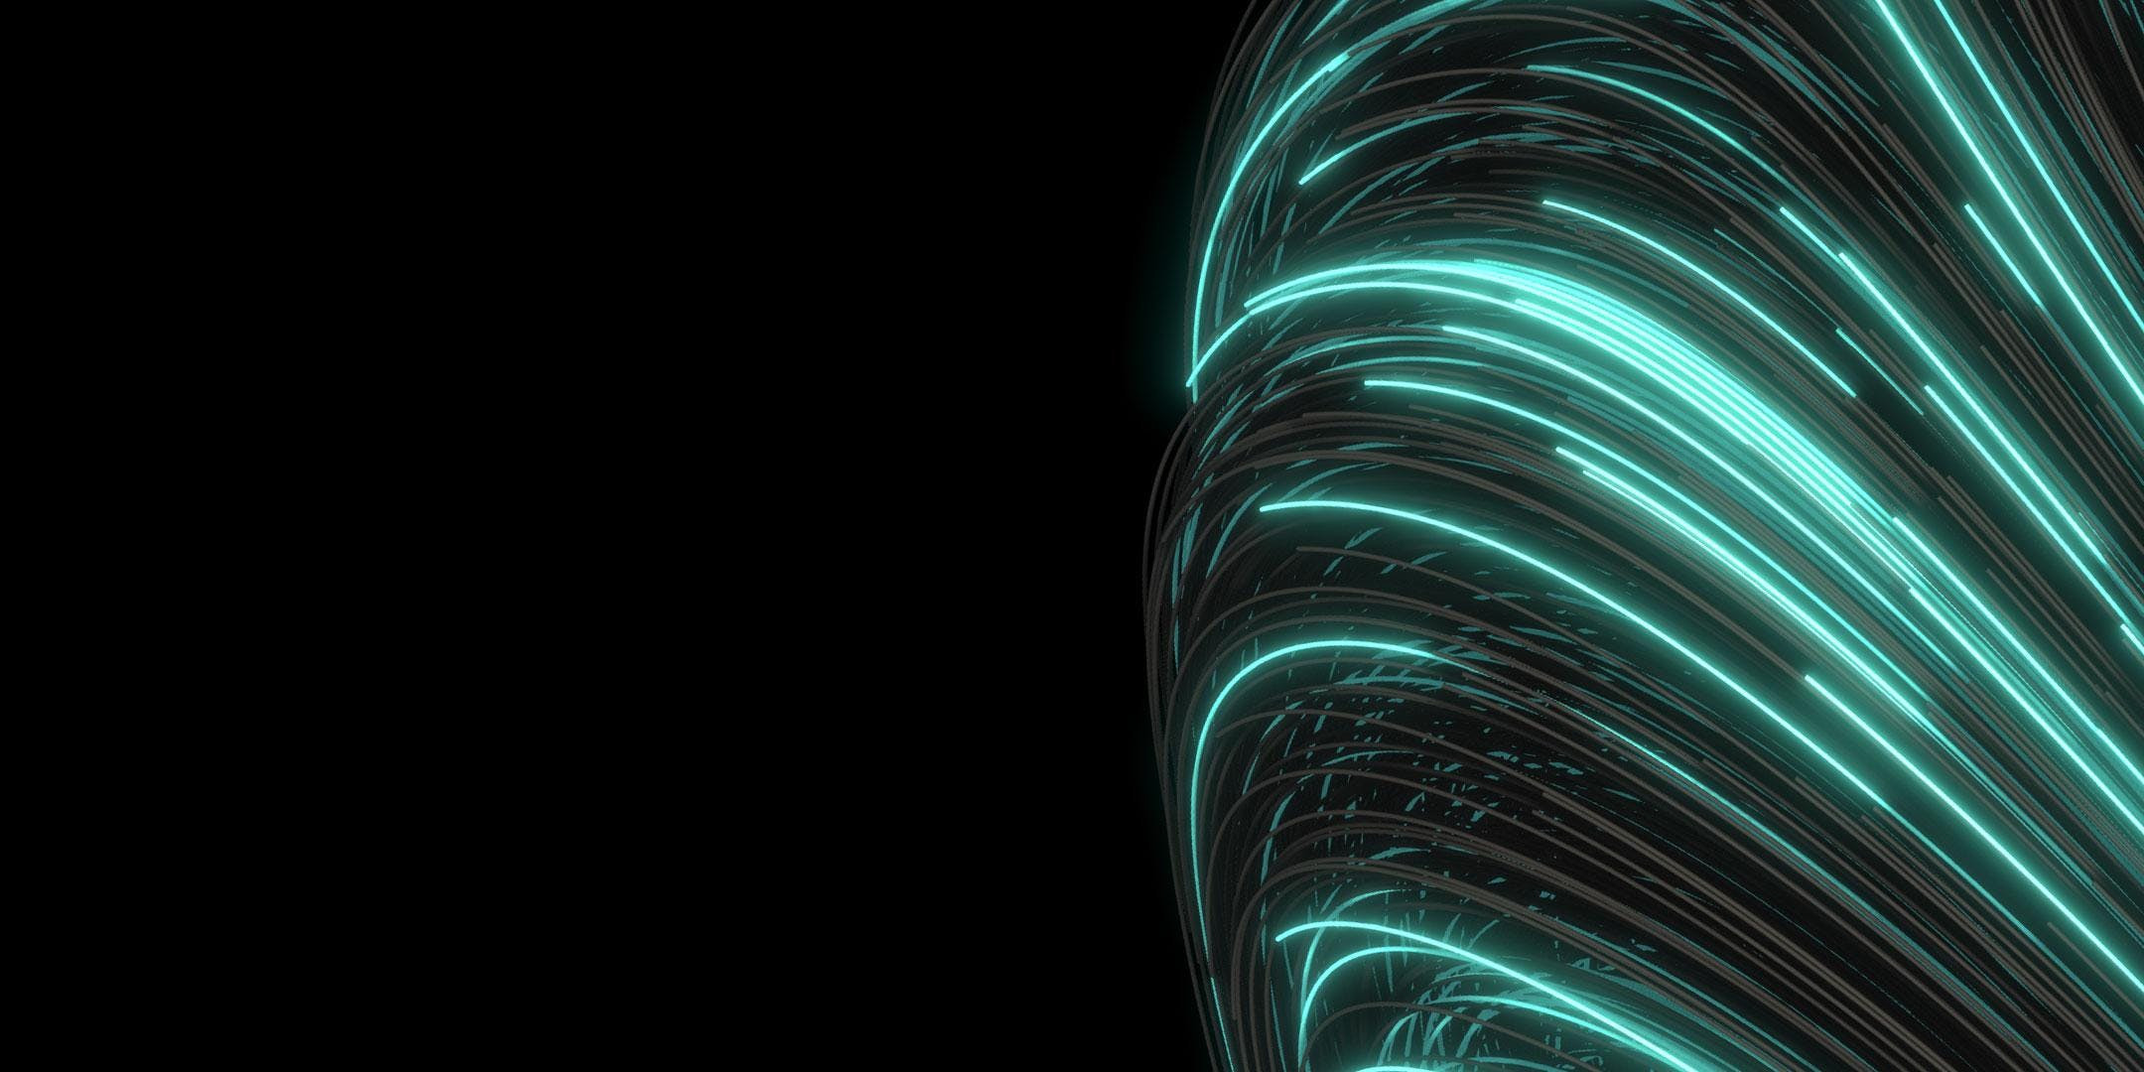
Ray Tracing in
Unity
CSS 552 Winter 2019 Final Project

Slide 2
Objectives
Real time rendering and advanced rendering
Fogs, Depth-of-field
1
Performance
Multi-threaded rendering
2
3
Integrate with the editors
Scene view and Game view; WYSIWYG
4
Ray tracing render on Unity Engine
Phong Shading, Secondary Rays, Texture Mapping

Slide 3
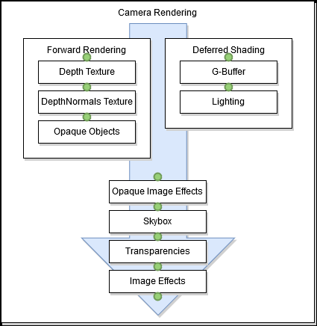
Engineering challenges
Unity built-in render pipeline use Forward Rendering
Local illumination
Culling
Limited API expose to developer to adjust the behavior of its built-in render pipeline

Slide 4
Scriptable Render Pipeline
Experimental feature in Unity 2018
Allow developers to instruct Unity what to do whenever it needs to render the scene
However, built-in instructions are designed for forward rendering

Slide 5
Compute Shader
Program GPU through shader
Slice the image plane in 8px * 8px blocks
Dispatch blocks to GPU in multi-threading mode
The shader will return the result in texture
Blitting the result to target

Slide 6
Render Pipeline Overview
SRP
Dispatch
Ray tracing
Blitting
Program entry point
Disable all forward rendering
Gather the scene geometries and perform data conversion
The image plane is sectored into 8px * 8px block
Each block is dispatched to GPU’s individual rendering pipeline
Passing the geometry data
Passing the material data
Phong shading
Secondary rays
Texture mapping
The resulting texture will copied to the target render texture

Slide 7
Alternative approach: Ray tracing on CPU
Image plane setup
Dispatch
Ray Tracing
Render Texture
- Config the size and orientation of the render texture
Dispatch sectors of the image plane to threads
Ray tracing
- Combine all the rendering result into a render texture
- Use another camera to view the render texture
Disadvantage: 1. Unnecessary forward rendering (the scene and the render texture) 2. Not real-time; Not WYSIWYG 3. Write our own multi-threading programming

Slide 8
Major Components
Parser (to create Game Objects from XML file) [Andrew]
Phong shading + Lights (Primary Ray tracing) [Joe]
Shadows (Shadow Ray or Shadow Depth Map) [Kai]
Reflection + Refraction (Translucent) [Chaeng]
Texture mapping [Andrew, Chaeng-sphere only]
Performance Benchmark (compare with Unity Built-in; LWRP; HDRP)
Extra Credits
Fog
Depth of field

Slide 9
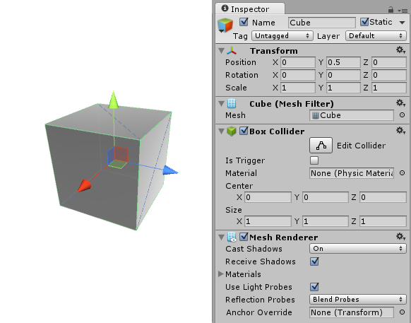
Parser (to create Game Objects from XML file)
RTViewer | Unity
Camera | Camera
Sphere, Rectangle | PrimitiveType
Triangle | Mesh
Mesh, Material, Texture | Mesh, Material, Texture
ImageSpec, Rtspec | Scene
Light | Light
Use XML files provided by Prof. Sung
User can select a file to open
Right: Example of parsed Rectangle
Source: https://docs.unity3d.com/Manual/class-GameObject.html

Slide 10
Primary Ray Tracing
Passing the geometry information
Ray intersection
Phong Shading
Output
- Read the converted geometry information to shader as an array of structure of float
- Read the material information to the shader
- Read the light information to the shader
- Intersect the ray with all objects based on their geometry type
- Phong shading per lights
Save the resulting color to the render texture for output

Slide 11
Primary Ray Tracing
Fundamental | Intermediate | Advanced
Scriptable render pipeline setup Phong Shading Ray intersection for spheres | Ray intersection for planes Ray intersection for triangles (meshes) Spotlight penumbra | Depth of field

Slide 12
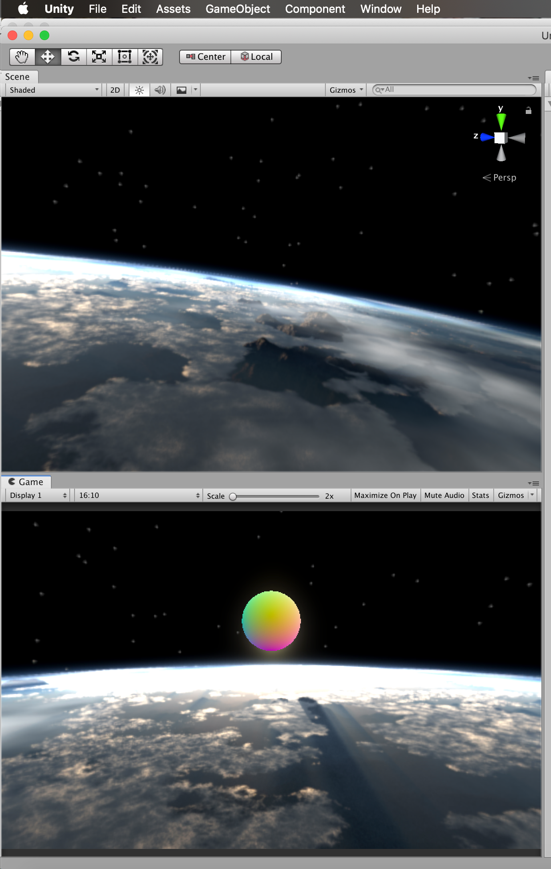

Slide 13
Hard Shadows
Passing the geometry information
Ray intersection
Apply visibility
Output
- Read the converted geometry information to shader as an array of structure of float
- Read the light information to the shader
- cast ray between visible point and each lights, cast shadow if hit any object.(except itself)
- ignored or skip current light phong shading computation if the shadow is casted.
If the shadow is casted, return empty color

Slide 14
Soft Shadows + Depth Map for Spot light
Passing the geometry information
Read Depth Map
Compute visibility
Output
- Read the converted geometry information to shader as an array of structure of float
- Read the light information to the shader
- Create depth map for Spot light
- Cast ray between visible point and each lights, retrieve the Depth data from depth map to determine if there is a shadow.
- Compute visibility based on shadow filter. And apply it on the result color.
If the shadow is casted, return color based on its visibility,

Slide 15
Reflection
Passing the geometry information
Ray intersection
Diffuse & Specular
Output
- Read the converted geometry information to shader as an array of structure of float
- Read the material information to the shader
- Read the light information to the shader
- Intersect the ray with all objects based on their geometry type
- Compute diffuse and specular shading per light
Save the resulting color to the render for output

Slide 16
Refraction
Passing the geometry information
Ray intersection
Refraction Shading
Output
- Read the converted geometry information to shader as an array of structure of float
- Read the material information to the shader
- Read the light information to the shader
- Intersect the ray with all objects based on their geometry type
- Dompute refraction per light per object
Save the resulting color to the render for output

Slide 17
Texture Mapping - Sphere
Passing the geometry information
Ray intersection
Mapping
Output
- Read the converted geometry information to shader as an array of structure of float
- Intersect the ray with objects sphere type
- Mapping to s-t map
Save the resulting color to the render for output

Slide 18
Texture Mapping - Triangles & Rectangle
Passing the geometry information
Ray intersection
Mapping
Output
- Read the converted geometry information to shader as an array of structure of float
- Intersect the ray with objects 3D triangle and rectangle type
- Rectangle uses s-t coordinate mapping
- Triangle uses barycentric coordinate mapping
Save the resulting color to the render for output

Slide 19
Potential Extra Credits

Slide 20
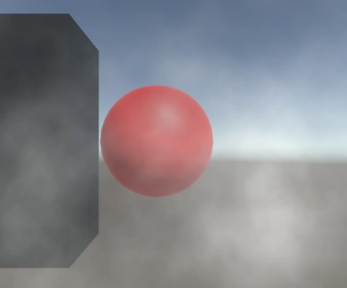

Fog & Depth of Field
Passing the geometry information
Ray intersection
Fog Shading
Output
- Read the converted geometry information to shader as an array of structure of float
- Intersect the ray with objects sphere type
- Compute fog effect - Compute depth of field effect
Save the resulting color to the render for output

Slide 21
Credit: https://www.google.com/search?biw=1218&bih=561&tbm=isch&sa=1&ei=gv5sXL2DGqrb0gLfhYi4Cw&q=render+fog+unity&oq=render+fog+unity&gs_l=img.3...199154.201111..201379...2.0..0.65.444.9......1....1..gws-wiz-img.......0i8i30j0i30j0i24j35i39.LfBst7UA4LA#imgrc=ZZ-fM-aDjmqTRM:
https://www.google.com/search?biw=1218&bih=561&tbm=isch&sa=1&ei=TP9sXKS9GsmW0gLnl424BA&q=render+depth+of+field+unity&oq=render+depth+of+field+unity&gs_l=img.3...60369.66577..66882...8.0..0.68.779.15......1....1..gws-wiz-img.......0i8i7i30.qOQ9zpgPOzo#imgdii=LNdze2zertCcoM:&imgrc=F9Cs7aLLWxhD7M:

