Slide 1
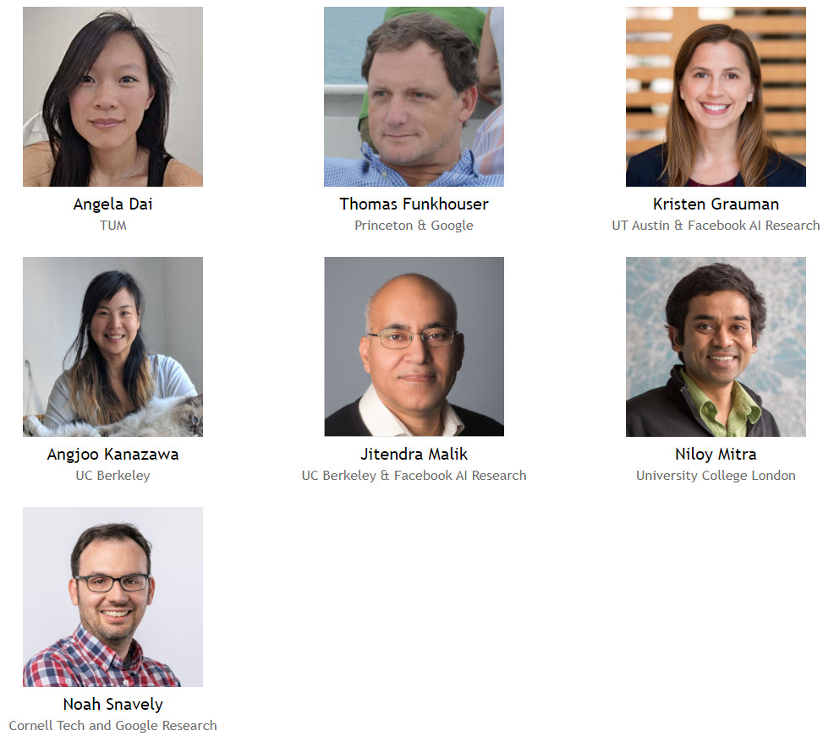
The first ECCV 2020 Workshop on
Learning 3D Representations for Shape and Appearance
Virtual Event, August 27-28 @ ECCV 2020

