Slide 1
MATCVFEM v2.0 Update
Harry Wells 24th May 2024

Slide 2
Goals of update
Improve the readability of the code
Remove excess/surplus parts of the code
Expand the capabilities for more complex problems
Easily translated code to other languages (e.g. C++/Python)
Allow for users to easily add their own extensions/modifications

Slide 3
New features
Object oriented style of program, far more "modularity" to simplify presentation and future extensions
User written code needed for set-up but far simpler and more flexible
Optional MATLAB generated visuals

Slide 4
Structure of code
CVFEM
Mesh structures
Delaunay triangles
Voronoi cells
Pressure FEM
Velocity FVM
PDE features
Darcy laws
Extras
User specific code
Visualise
Solution components

Slide 5
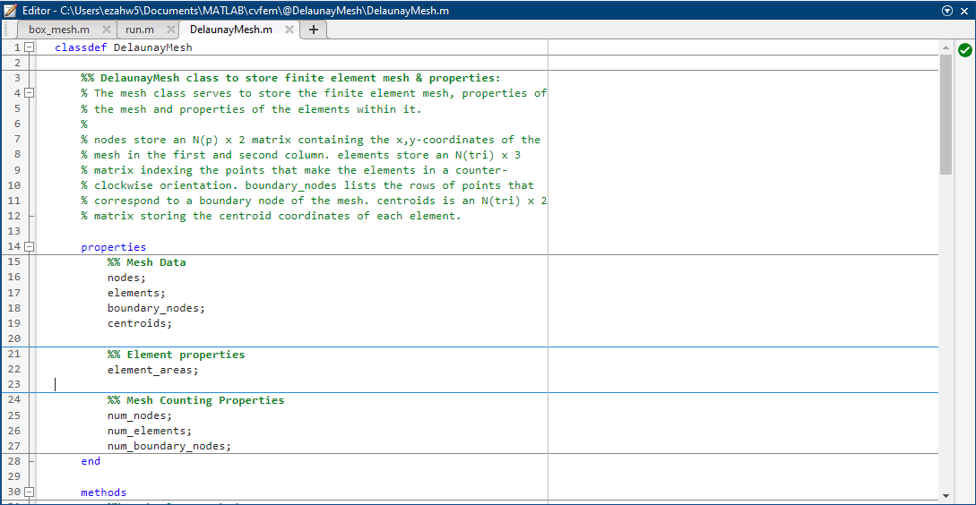
Mesh Classes
Delaunay mesh built with points, edges and triangles "p e t" exported from the pdetool GUI
Voronoi mesh built using only the Delauney mesh class
Classes contain only key geometric properties of the 2 meshes used in the CVFEM

Slide 6
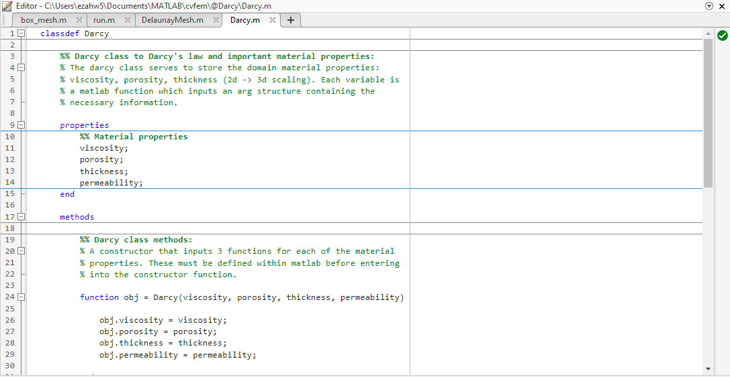
PDE Class
A class to contain any PDE specific data, functions or methods
At the moment only stores permeability, porosity, viscosity

Slide 7
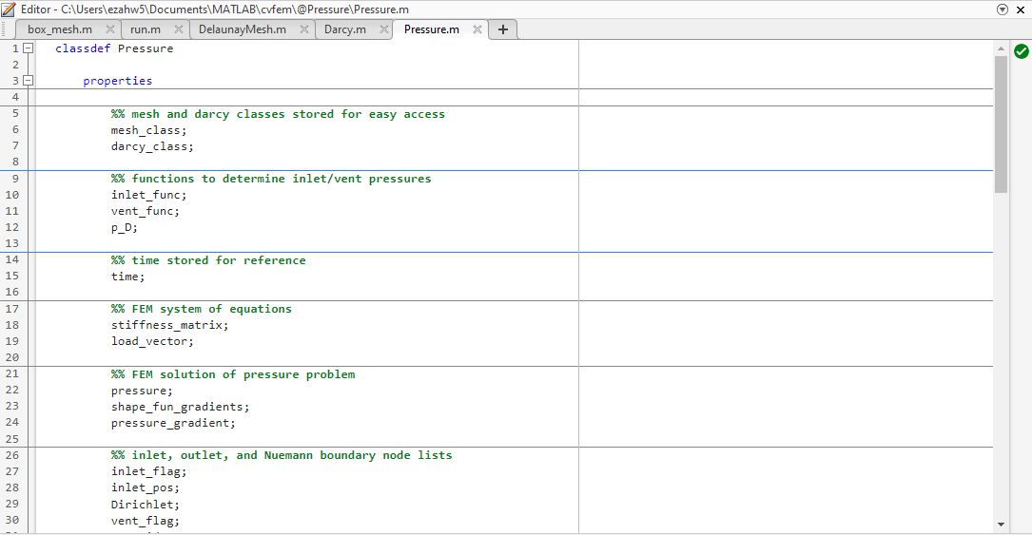
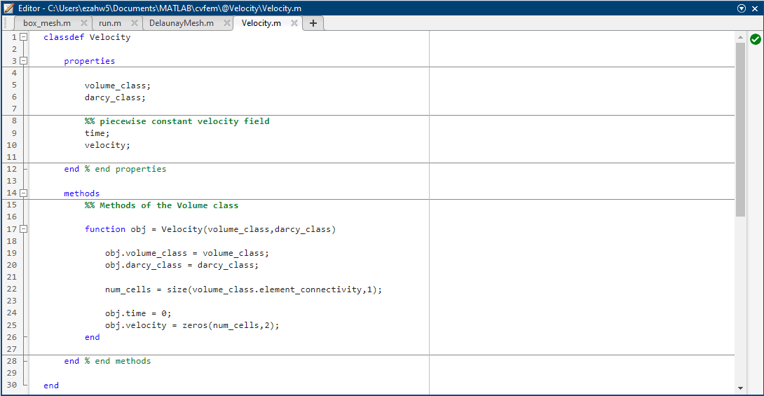
Solution Classes
Pressure class stores the pressure FEM, system of equations, boundary conditions, pressure gradient
Velocity class stores the velocity field and method given by Darcy's Law
Both classes have access to their respective meshes

Slide 8
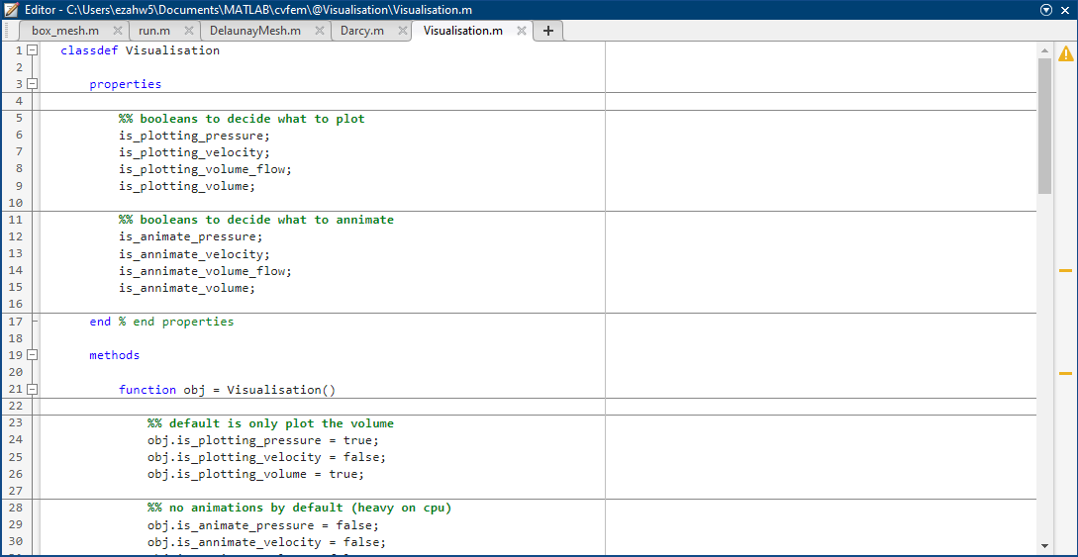
Visualisation Class
Have options of plotting pressure, velocity, flow rate and volume within MATLAB
Animation code to export videos to GiFs to be added shortly

Slide 9
Demonstrations

Slide 10
To-do list
Completely boundary-lying elements still not permitted
Exporting features to VTK/VTU files and other programs
Remove leftover flags and data from version 1.0
Set up boundary conditions in the pdetoolbox GUI to lessen work for user
Reintegrate ideal pressure laws and think about what variable inlet/vent pressures would need for this
Bring back user specified time-stepping

Slide 11
Ideas for future
Moving mesh/free boundary applications
Easy importing of GMesh files instead of pdetoolbox
Write up a counterpart in Python
Put it into practice somewhere in the project

