Slide 1
Comparative Study of Generative AI Models
Assignment 02 – Comparative Study and Practical Analysis of Generative AI Models
Generative AI
Generative AI Models
Models that learn the underlying distribution of data in order to reconstruct existing images or create entirely new ones.
Assignment Objective
Image Reconstruction
(CO3)
Image Generation
(CO4)
Understand and analyze image reconstruction and image generation using four different generative models.
Autoencoder (AE)
Deep Convolutional GAN (DCGAN)
CO3 · Image Reconstruction
CO4 · Image Generation
Group Members
Variational Autoencoder (VAE)
Stable Diffusion
Gandhar Chafle | PRN: 202401110018
Sujal Chaudhari | PRN: 202401110026
Arjun Mankuskar | PRN: 202401110038
Notes:
(~40 sec) Introduce Generative AI, the objective of Assignment 02, and the two categories: reconstruction (AE, VAE; CO3) and generation (DCGAN, Stable Diffusion; CO4). Introduce group members.

Slide 2
Image Reconstruction: Autoencoder vs VAE (CO3)
Autoencoder (AE)
Input Image
Encoder
Latent Space
Decoder
Reconstructed Image
Loss: reconstruction loss
Variational Autoencoder (VAE)
Input Image
Encoder
Mean & Variance (μ, σ²)
Sampling
z = μ + σ·ε
Decoder
Reconstructed Image
Loss: reconstruction + KL divergence
Aspect | Autoencoder (AE) | Variational Autoencoder (VAE)
Working principle | Compresses image to a latent code, then reconstructs it (deterministic) | Learns a latent probability distribution; reconstructs from sampled points
Architecture | Encoder → latent vector → Decoder | Encoder → μ and σ² → sampling (reparameterization) → Decoder
Advantages | Simple; effective for compression and denoising | Smooth, structured latent space; can sample new images
Limitations | Latent space not suited for generation; may lose fine detail | Outputs tend to be blurry; KL term must be balanced
Applications | Denoising, compression, anomaly detection | Generation, latent interpolation, representation learning
Notes:
(~60 sec) Walk through the two diagrams. AE: deterministic latent code, minimizes reconstruction loss. VAE: encoder outputs mean and variance, reparameterization trick for sampling, loss = reconstruction + KL divergence. Then point to the table.

Slide 3
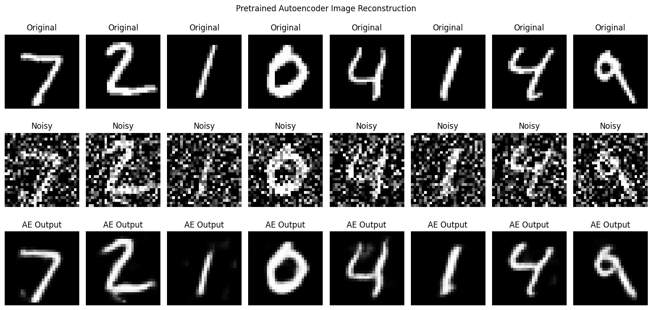
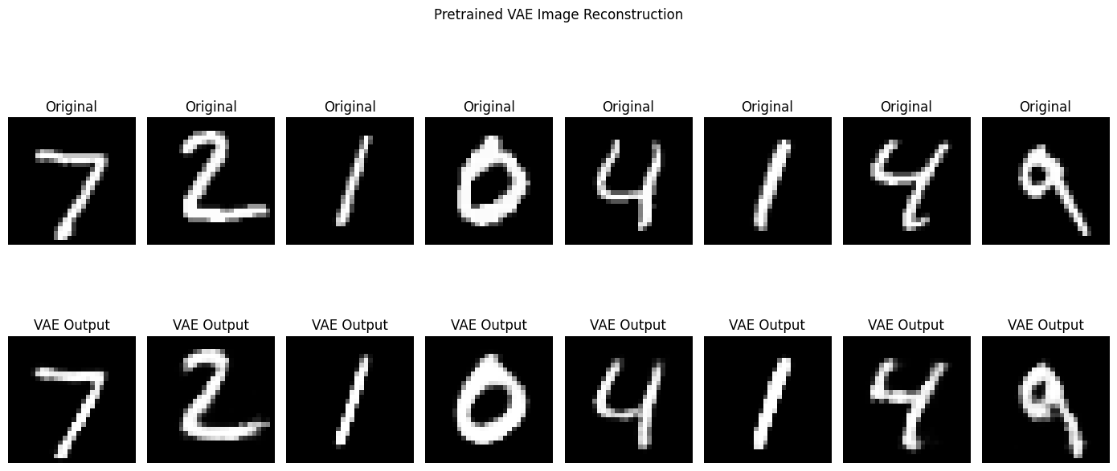
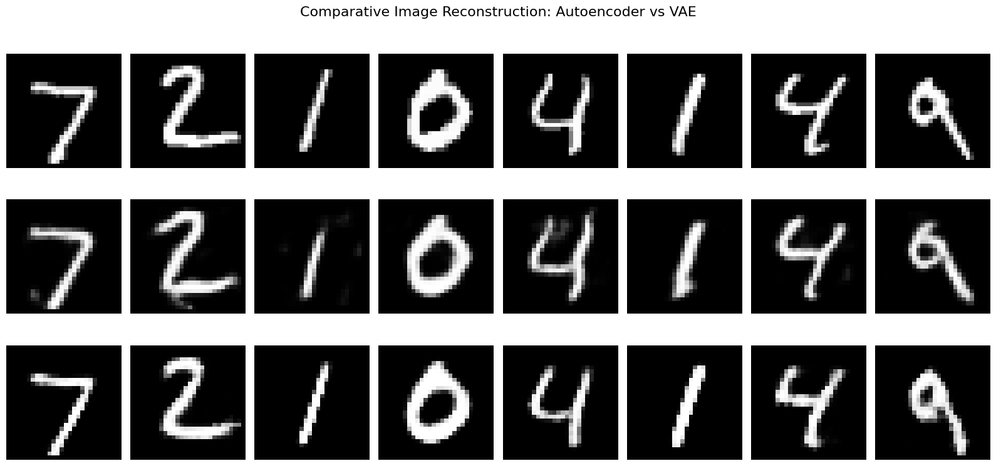
Practical Activity A: Image Reconstruction
Implementation
Original & Noisy Inputs
MNIST digits
[ Insert your screenshot here ]
Autoencoder Output
Denoised reconstruction
[ Insert your screenshot here ]
Platform: Google Colab
Pretrained Autoencoder: MNIST denoising
Pretrained VAE: MNIST reconstruction
Original images passed through both models
Output Analysis
VAE Output
Reconstructed digits
[ Insert your screenshot here ]
Final Comparison
Side by side: input · AE · VAE
[ Insert your screenshot here ]
Autoencoder
Reduced noise and reconstructed recognizable digits; some fine details were lost.
VAE
Smooth, recognizable digit reconstructions; some loss of sharpness.
Both models successfully reconstructed input images, but their reconstruction characteristics differed because of their architectures and training objectives.
Notes:
(~60 sec) Describe the Colab setup, then show the four screenshots in order: noisy input, AE output, VAE output, final comparison. State the observation. Replace the dashed frames with your actual screenshots and describe only what they show.

Slide 4
Image Generation: DCGAN vs Stable Diffusion (CO4)
DCGAN
Random Noise (z)
Generator
Generated Image
Adversarial training; images reflect training-dataset patterns
Real Images (dataset)
Discriminator
Real or Fake?
Stable Diffusion
Text Prompt
Text Encoder
Denoising Process
(from latent noise)
Latent Decoder
Generated Image
Latent diffusion, guided by a text prompt
Aspect | DCGAN | Stable Diffusion
Working principle | Generator and discriminator compete in adversarial training | Gradually denoises random latent noise, guided by a text prompt
Architecture | Convolutional generator + convolutional discriminator | Text encoder + denoising network + latent decoder
Advantages | Fast sampling; one forward pass per image | High-quality, diverse, prompt-controlled images
Limitations | Unstable training; mode collapse; no text control | Multi-step sampling is slower; heavy compute and memory
Applications | Face / image synthesis, data augmentation | Text-to-image, art and design, image editing
Notes:
(~60 sec) DCGAN: generator makes images from noise, discriminator separates real from generated, both improve adversarially. Stable Diffusion: starts from latent noise, denoising network removes noise step by step, guided by the text-encoded prompt, then the decoder produces the image.

Slide 5
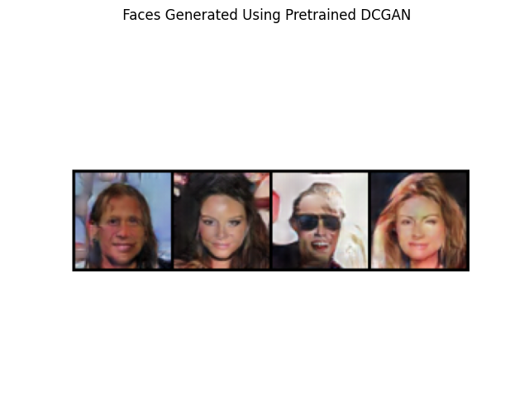
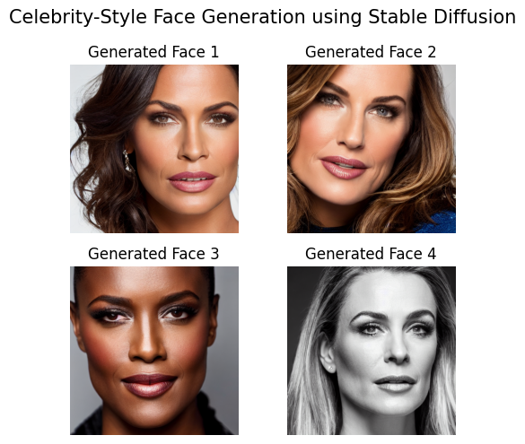
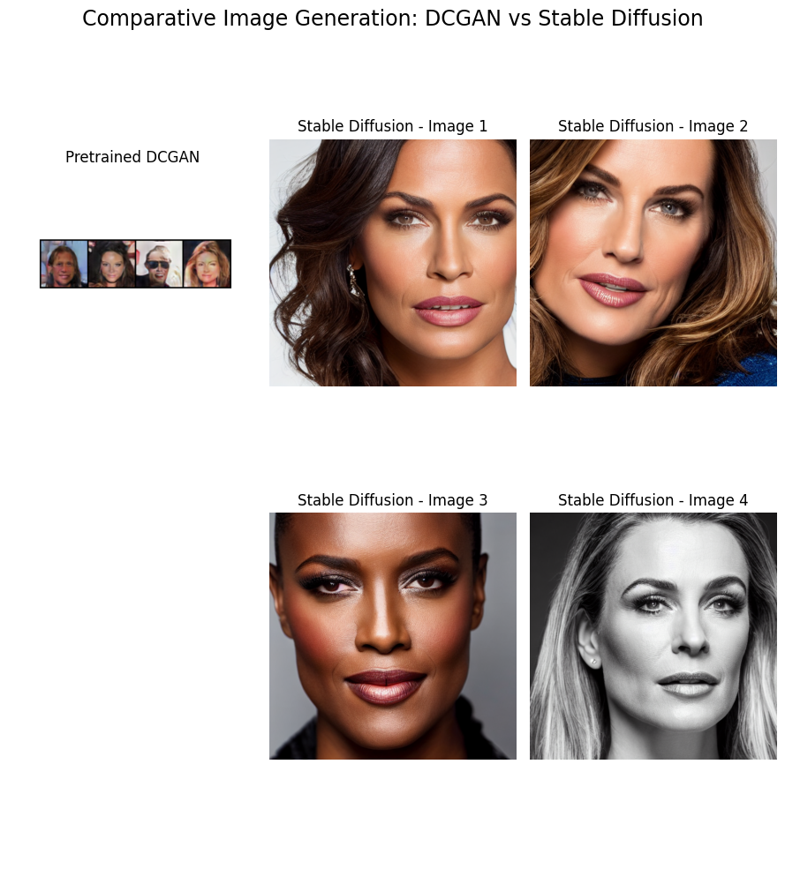
Practical Results, Overall Comparison and Conclusion
DCGAN: 4 Generated Faces
Pretrained CelebA generator · random noise input · patterns learned from CelebA
[ Insert your screenshot here ]
Stable Diffusion: 4 Portraits
Pretrained Stable Diffusion 1.5 · fictional celebrity-style portraits from a text prompt
[ Insert your screenshot here ]
Side-by-Side Comparison
DCGAN vs Stable Diffusion outputs
[ Insert your screenshot here ]
Model | Main Purpose | Input | Output
Autoencoder | Reconstruction | Image | Reconstructed image
VAE | Reconstruction and probabilistic generation | Image / latent sampling | Reconstructed or sampled image
DCGAN | Image generation | Random noise | Synthetic image
Stable Diffusion | Text-conditioned image generation | Text prompt and noise | Generated image
Key Learning Outcomes
Deterministic vs probabilistic reconstruction
Adversarial image generation (DCGAN)
Text-conditioned diffusion-based generation
Compared actual outputs from all four models
Conclusion
Thank You – Questions & Answers
Autoencoders and VAEs focus on learning meaningful representations and reconstructing images, whereas DCGANs and Diffusion Models focus on generating new images. Each model has different strengths, limitations, and practical applications.
Notes:
(~80 sec) Show DCGAN faces and Stable Diffusion portraits, then the side-by-side image. Point out DCGAN is shaped by CelebA patterns and SD by the text prompt. Run through the overall table and learning outcomes, read the conclusion, and open for questions.

