Slide 1
Football Match Prediction and Betting using Data Science and Machine Learning
Sahil Bharodiya Chaganti Venkat Rami Reddy
12011008 12011041
Notes:
© Copyright Showeet.com – Creative & Free PowerPoint Templates

Slide 2
People love to wager on the outcome of matches, so the betting industry is booming. Cricket, football, horseback riding, and wrestling are just a few available sports. Football, which is a major sport in Europe and North America, brings in a lot of money for the betting sector. People wager on the outcome of the game as well as on the outcome of the play event. Each football league produces a large amount of data. Several strategies and methodologies are used to forecast the outcome of a football match. Many of these strategies are based on past performance and goal totals.
Notes:
© Copyright Showeet.com – Creative & Free PowerPoint Templates

Slide 3
English Premier League is arguably the most competitive, so it is the most natural sport to study. There has never been an analytic definition of football because the sport is in a constant state of change, with certain characteristics becoming less significant over time. Here, machine learning could prove to be invaluable.

Slide 4
Welcome!
Let’s Start, The purpose of this project is to explore the application of data science, statistical and machine learning methods in an effort to make predictions regarding the outcomes of matches such as win, lose, draw, goal differentials, and total goals by using historical data pertaining to the teams that participated in the match. The majority of the project consists of constructing a framework that, when given raw match data, generates appropriate features by drawing on historical statistics regarding match outcomes. Following that, we will measure the accuracy of the model utilizing a variety of different techniques, all of which are based on machine learning.
Notes:
© Copyright Showeet.com – Creative & Free PowerPoint Templates

Slide 5
Begin with an outline or agenda to give a big picture view
Football and Data Science
01
04
Objective
02
Motivation
05
Background
03
Aim
06
Ethical Aspects
Notes:
© Copyright Showeet.com – Creative & Free PowerPoint Templates

Slide 6
Used Tools
Python
Numpy
Pandas
Matplotlib & Seaborn
BeautifulSoup
Scikit-Learn
Notes:
© Copyright Showeet.com – Creative & Free PowerPoint Templates

Slide 7
Data
Data is extracted from https://www.besoccer.com/competition using BeautifulSoup module of python.
Home_Team = Name of Home Team
Away_Team = Name of Away Team
Result = Outcome of Match
Link = URL of the match
Season = Year
Round = Week of the Season
League = Name of the league
Home_ELO = ELO rating of Home Team
Away_ELO = ELO rating of Away Team
Date = Date of Match played
Home_Yellow = No. of Yellow card given to the Home Team
Home_Red = No. of Red card given to the Home Team
Away_Yellow = No. of Yellow card given to the Away Team
Away_Red = No. of Red card given to the Away Team
Notes:
© Copyright Showeet.com – Creative & Free PowerPoint Templates

Slide 8
Data Insights
We have a total of 12164 match records from season * 1990 to 2021.
There were 52 teams played in this duration.
Total of 32110 Goals have been scored by Teams in this duration.
Total of 18245 Goals were scored by Home Team while 13865 Goals were scored by Visiting Team
Average 2.63 Goals registered per Match.
3182 Matches have been drawn.
*currently we have data from 2012 to 2021

Slide 9
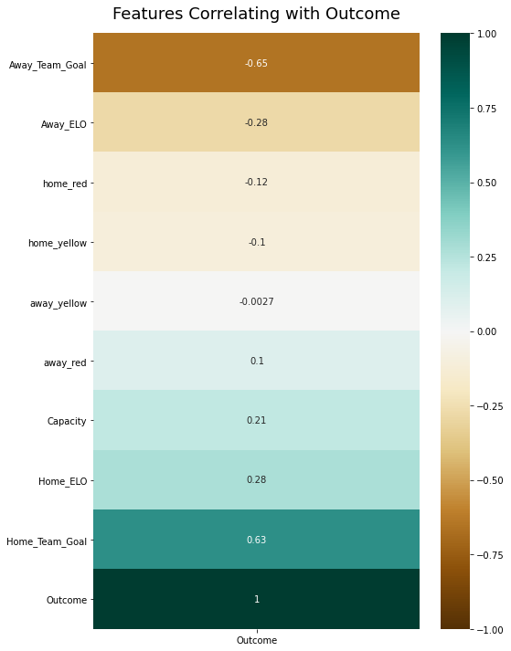
Feature Co-relation

Slide 10
New Features Creation
Since the high co-relation features are in very less amounts, we have to create new features.
The new features that we will create will have a high co-relation value.
New features will be derived from the existing features.

Slide 11
New Features
Last_5_Home_Team_avgGoal : Average Goal of Home Team from last 5 match
Last_5_Away_Team_avgGoal : Average Goal of Away Team from last 5 match
Last_5_Home_Team_Home_avgGoal : Average Goal of the Home Team when they played at Home in the Last 5 match
Last_5_Away_Team_Away_avgGoal : Average Goal of Away Team when they played Away in the Last 5 match
Last_5_Home_Team_All_Streak : Home Team’s Last 5 Result(sum).
Last_5_Away_Team_All_Streak : Away Team’s Last 5 Result(sum).
Last_5_Home_Team_Home_Streak : Home Team’s Last 5 match results when played at home
Last_5_Away_Team_Away_Streak : Away Team’s Last 5 match results when played at away

Slide 12
Training and Testing

Slide 13
Used Model
K Nearest Neighbors
Decision Tree
Naive Bayes
Support Vector Machine
Random Forest Regressor
AdaBoost
Logistic Regression
Notes:
© Copyright Showeet.com – Creative & Free PowerPoint Templates

Slide 14
Optimization
Since we have multiple models with multiple accuracies, to pickup the best from that will use GridSearchCV algorithms.
In the GridSearchCV algorithm, we provide a parameter grid of arguments in model like max_depth, alpha, n_estimators, learning_rate, etc.
GridSearchCV will try all the possible combinations and give us the best model.

Slide 15
Accuracy Comparison
Model | Accuracy | F1 Score
GaussianNB | 0.746744 | 0.748221
KNeighbours | 0.535456 | 0.515414
SVC | 0.604920 | 0.512565

Slide 16
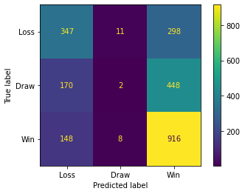
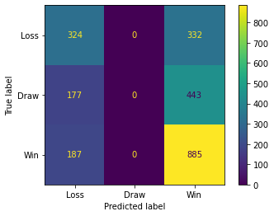
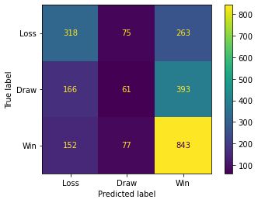
Confusion Matrix
GaussianNB
K Neighbors
SVM

Slide 17
Kelly Betting
The Kelly criterion is a mathematical formula developed by John L. Kelly Jr. while working at AT&T's Bell Laboratories. The formula is related to the growth of capital over a long period of time. It is used to determine how much money should be invested in a particular asset to achieve the greatest possible increase in one's wealth over time. It decides how much money should be wagered on each round. In order to achieve an optimal level of expected value, it makes use of the fundamental concepts underlying probability theory.

Slide 18
In Kelly Betting we have the formula for Odds.
We also calculate the Betting amount in each section using Kelly Betting.
Using Odds we will calculate profit in each section.
Notes:
© Copyright Showeet.com – Creative & Free PowerPoint Templates

Slide 19
Deployment
We have created three models,
1. Goal Difference Prediction
2. Outcome Prediction
3. Total Goal Prediction
Will create a Flask server in localhost with HTML and CSS, then deploy it on the Google Cloud Platform.
Notes:
© Copyright Showeet.com – Creative & Free PowerPoint Templates

Slide 20
Let’s Look at What we have built
Photo credit: fancycrave1 via Pixabay (Creative Commons Zero license)
Notes:
© Copyright Showeet.com – Creative & Free PowerPoint Templates

