Slide 1
Energy Efficient Election- LEACH
Presented by- Chahat Bansal
2018ANZ8060

Slide 2
WSN- Wireless Sensor Network
WSN consists of spatially distributed autonomous sensors to monitor physical or environmental conditions and to cooperatively pass their data through the network to a main location.

Slide 3
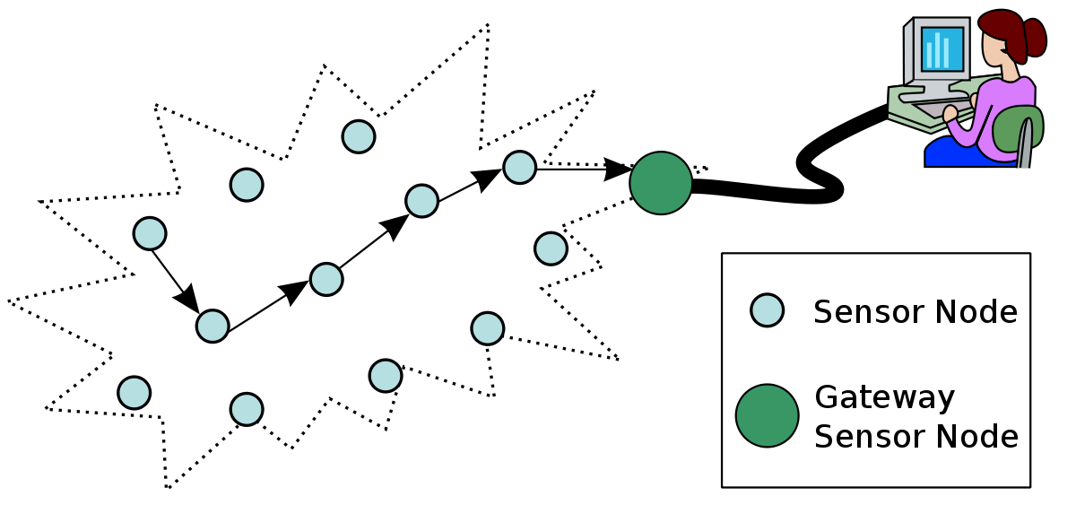
A WSN generally consists of a base station (gateway) that can communicate with a number of wireless sensors via radio link.
Data is collected at the wireless sensor node, compressed and transmitted to the gateway directly or indirectly (using other sensor nodes to forward data to the gateway).
The transmitted data is then presented to the system by the gateway connection.

Slide 4
Size and constraints on sensor nodes result in corresponding constraints on resources such as-
Energy
Memory
Computational speed
Communication Bandwidth

Slide 5
The in-network processing in WSN like data aggregation, information fusion, computation and transmission activities require the sensors to use their energy efficiently in order to extend their effective network life time.
Sensor nodes are prone to energy drainage and failure!

Slide 6
Energy Constraints In WSN
As low power, low cost and longevity of transceivers are major requirements in WSN, optimizing their design under energy constraints is of paramount importance.
Energy conservation in WSN is critical and has been addressed by substantial researchers.

Slide 7
Levels of Energy Conservation
Efficient scheduling of sensor nodes between sleep and active nodes.
Energy efficient routing, clustering and data aggregation.
Efficient control of transmission power to ensure an optimal trade-off between energy consumption and connectivity.
Data compression to reduce the amount of transmitted data.
Efficient channel access and packet re-transmission protocols on Data Link Layer.

Slide 8
LEACH
Low Energy Adaptive Clustering Hierarchy Protocol.
Hierarchical protocols are defined to reduce energy consumption by aggregating data and reducing transmission to the base station.
LEACH is a Self-organizing, adaptive clustering protocol that uses randomization to distribute energy load evenly.

Slide 9
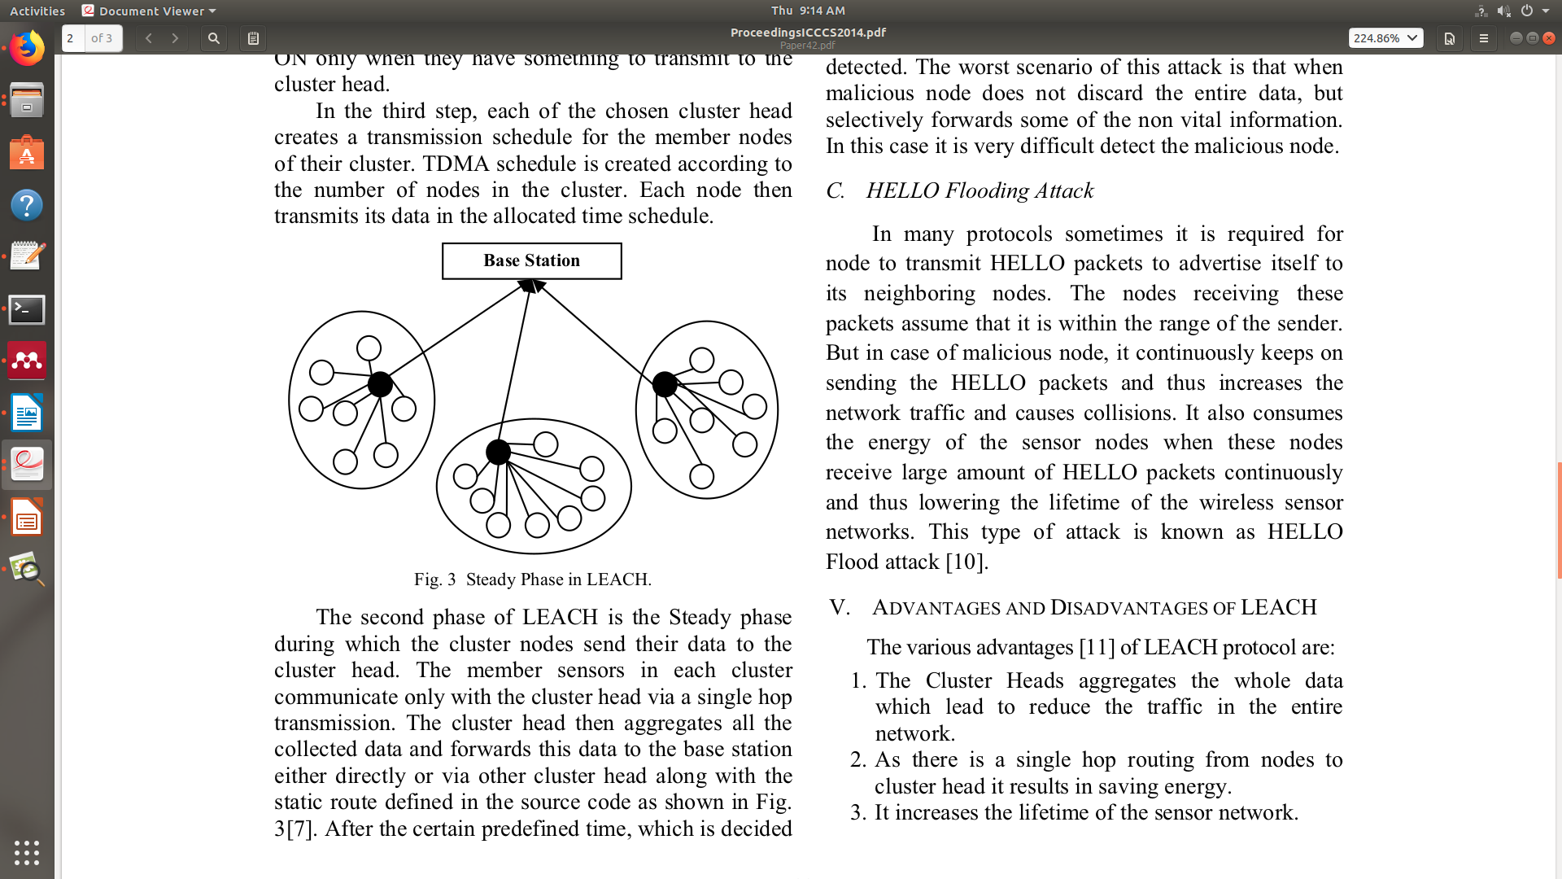
LEACH is a TDMA based MAC protocol.
A network is divided into several clusters.
Within each cluster, 1 sensor node is elected as Cluster Head (CH).
All other nodes are Cluster Members (CM).
CH collects the data locally from all its CMs and transmits the aggregated data either directly or via multi-hop transmission to the base station.

Slide 10
LEACH Protocol
LEACH protocol provides a concept of rounds.
Each round contains two phases
1) Cluster Set-up phase
2) Steady phase
Set-up phase is used to make cluster and select cluster head for each cluster by choosing the sensor node with maximum energy.
Steady phase deals with the aggregation of data at the cluster heads and transmission of aggregated data to the Base Station.

Slide 11
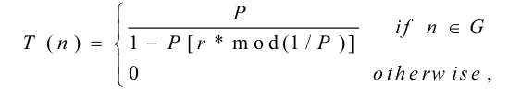
Set-up Phase
Cluster heads are chosen randomly based on the following formula-
Where n = random number b/w 0 & 1
P = cluster-head probability
G= set of nodes that were not cluster-heads in the previous rounds.
If n < T(n), then that node becomes a cluster-head.
Once a node is elected as a cluster head, it cannot become cluster head again until all other nodes of the cluster have become cluster head once. This helps in balancing energy consumption.

Slide 12
Set-up Phase
3 fundamental steps of this phase are-
1) Cluster Head Advertisement: Each node that elected itself a CH for current round broadcasts advertisement message to rest of the nodes using same transmit energy.
2) Cluster Setup: Non-CH nodes keep their receivers on during this phase and decide which cluster to belong to by choosing the CH based on the received signal strength of the advertisement. They send join requests to the chosen CH.
3) Creation of Transmission Schedule: CH creates a TDMA schedule telling each node when it can transmit. It allows the radios of each CM to be turned off during the time of non-transmission and thereby saving a lot of energy.

Slide 13
Steady Phase
In this phase, the cluster nodes send their data to the CH.
The CH then aggregates all the collected data and forwards this data to the base station either directly or via other CH along the static route defined in the source code.
After certain pre-defined time, the network again goes back to the Set-up phase to ensure uniform energy dissipation.

Slide 14
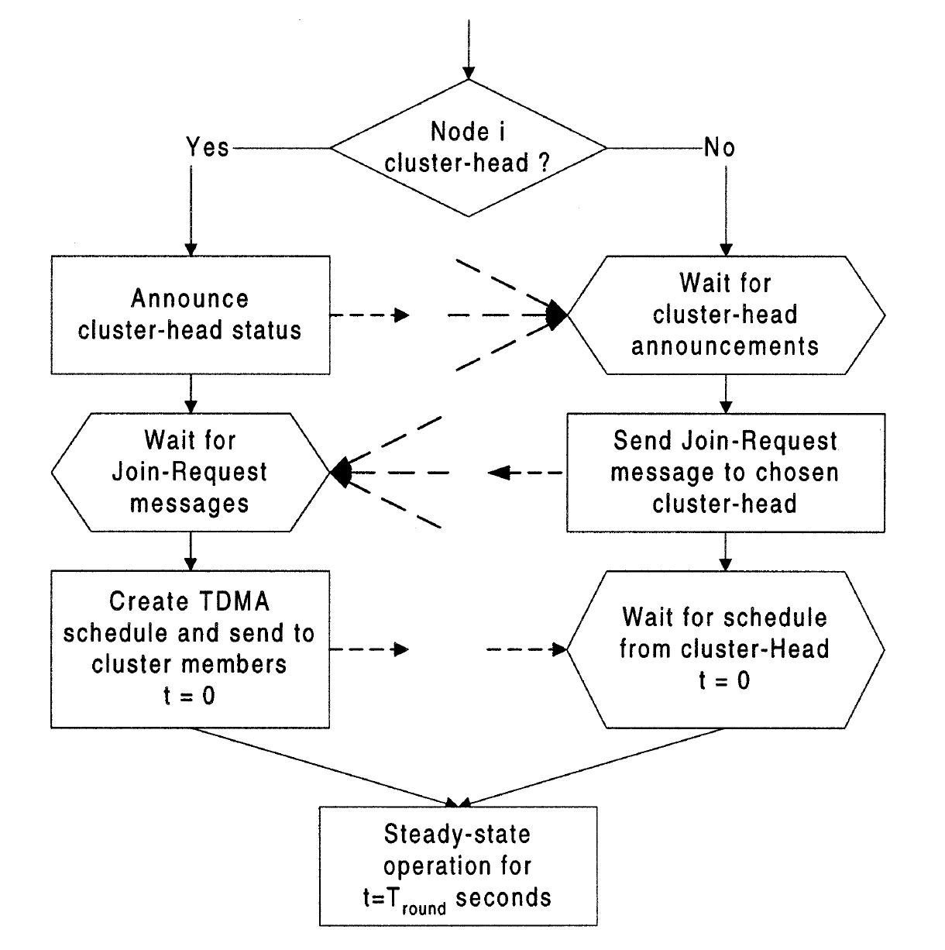

Slide 15
Advantages of LEACH
CH aggregates the whole data which leads to reduction in the traffic of entire network.
A single hop routing from nodes to cluster head saves energy.
It increases the lifetime of sensor nodes.
LEACH is completely distributed as it does not need any control information from base station as well as no global knowledge of the network is required.

Slide 16
Limitations of LEACH
It does not give any idea about the number of cluster-heads in the network.
If a CH dies, the associated cluster will become useless as the data gathered by the cluster nodes will never reach the base station.
Clusters are divided randomly, which results in uneven distribution of clusters (in terms of density, size and cluster head position). This can lead to an increase in the energy consumption.

Slide 17
Variations of LEACH
LEACH-E
LEACH-C
TL-LEACH
Multihop LEACH
LEACH-F
LEACH-ME
LEACH-B
LEACH-M
LEACH-H

