Slide 1
ENGLISH AUTOMATIC TEXT SUMMARIZATION: A DEEP LEARNING APPROACH
Student Name : Chahedaoui ahmed amin
Group : 5300
Scientific Supervisor : Posov Ilya Alexandrovich

Slide 2
MOTIVATION OF OUR RESEARCH AND RESEARCH OBJECTIVES
Text summarization helps to understand what the text is about.
Modern systems achieve results comparable to humans.
Building blocks for such systems, including pretrained deep learning models, are open and available.
There are many types of summaries and they may be adjusted by many parameters, so it is possible to give users a special interface for to experiment with summaries of a text.

Slide 3
GOALS AND OBJECTIVES
Goals:
Implement a text summarization for texts of unspecified topics.
Invent a user interface to view the summary and adjust its parameters, and implement it.

Slide 4
GOALS AND OBJECTIVES
Objectives:
Study existing types of text summarization.
Study different approaches to text summarization including out-dated and state of the art approaches.
Select an approach to implement.
Implement a summarization.
Select a form to display a summary.
Implement a user interface to display a summary and allow adjusting it.

Slide 5
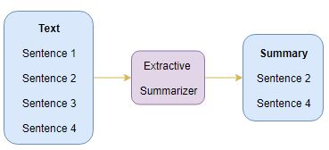
AUTOMATIC EXTRACTIVE SUMMARIZATION
The name gives away what this approach does. We identify the important sentences or phrases from the original text and extract only those from the text. Those extracted sentences would be our summary. The below diagram illustrates extractive summarization:

Slide 6
THE TEXTRANK LIKE ALGORITHMS
Convert Paragraphs to Sentences.
Tokenize the Sentences.
Text Preprocessing (remove all the special characters, stop words and numbers from all the sentences).
Find Weighted Frequency of Occurrence. (TF-IDF or PageRank).
Replace Words by Weighted Frequency in Original Sentences.
Sort Sentences in Descending Order of Sum.

Slide 7
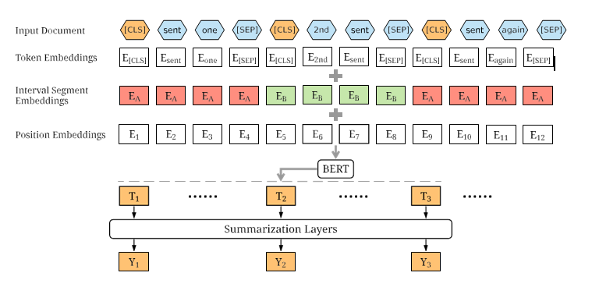
THE OVERVIEW ARCHITECTURE OF THE BERTSUM MODEL.

Slide 8
METHOD THAT INSPIRED THE RESEARCH
The lecture summarization service:
Service allows managing lecture transcripts and summarizations.
BERT model produces embeddings for clustering, using a K-Means model, creating a summary.
The idea for our research is to represent summaries visually as points on the plain, that correspond to sentences of the text.
Clusters of points represent topics inside the text.

Slide 9
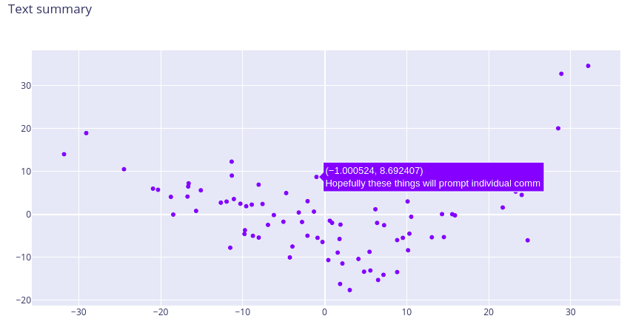
TEXT SUMMARY EXAMPLE

Slide 10
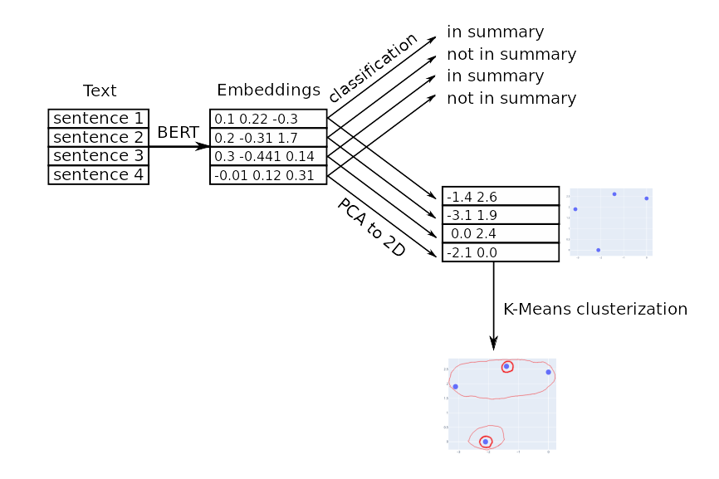
EXTRACTIVE TEXT SUMMARIZATION PIPELINE
Sentences, closest to the cluster centers, form the summary.

Slide 11
RESULTS
Approaches to text summarization are studied.
The approach to implement is selected.
Summarization based on the BERT model with the representation of summaries as a set of sentences-points is implemented.
The user interface for the summarization is party implemented.

Slide 12
CONCLUSION
The capability to properly summarize text is powerful and useful.
Automatic extractive summarization researchers have attempted to solve this problem for the last several years, producing research with decent results.
Most of the approaches leave room for improvement as they utilize dated natural language processing models.
Leveraging the most current deep learning NLP model called BERT, there is a steady improvement on dated approaches sin the quality of summaries, combining context with the most important sentences.

