Slide 1


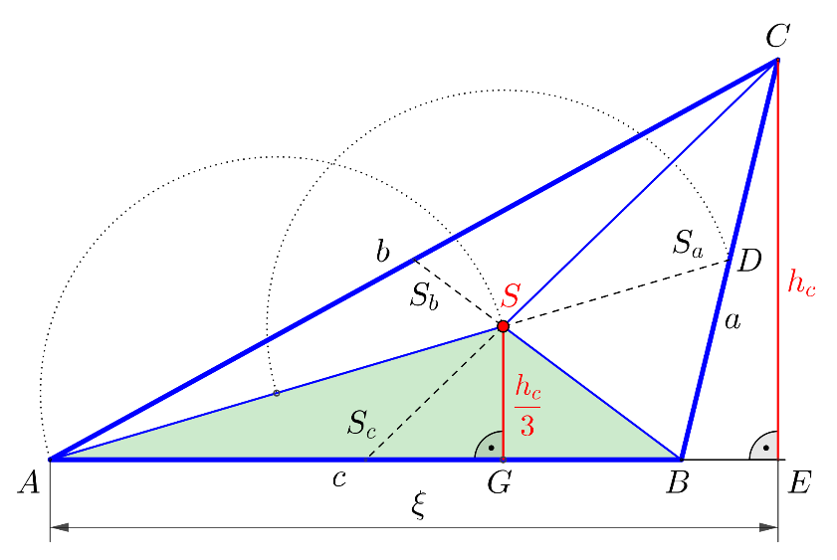
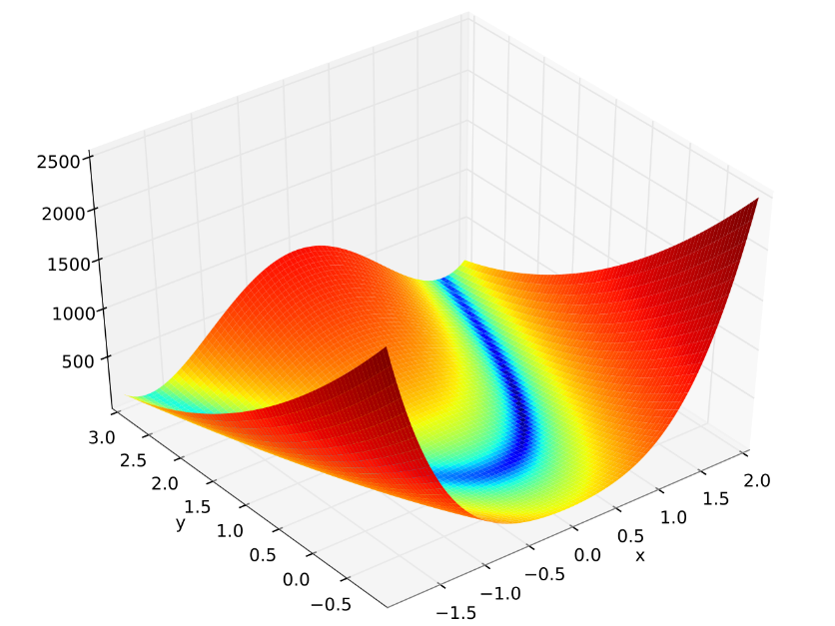
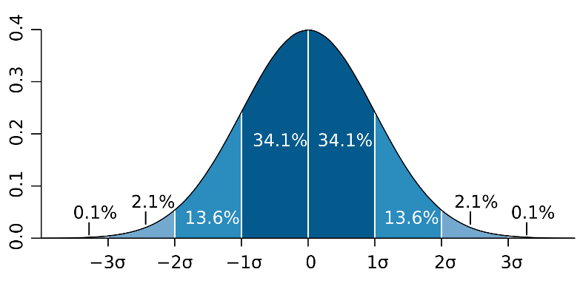
Matlab Tutorial
Introduction and basics for Computational Mathematics
Presented by :
Abderrazak Chahid abderrazak.chahid@kaust.edu.sa

Slide 2
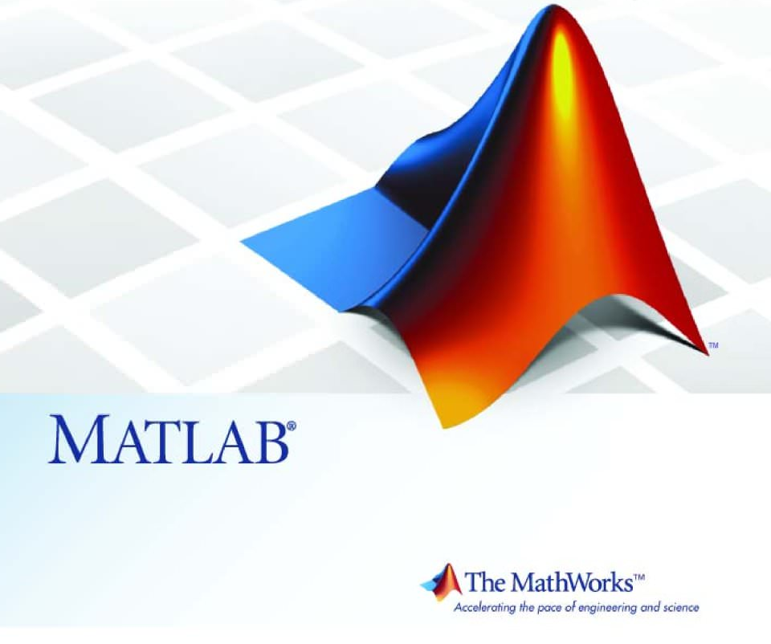
The Tutorial Content
Introduction
Matlab Basics:
MATLAB Environment
Type of Variables
Mathematical operations
Plotting graphs
Scripts and functions
Matlab Advanced tools:
Control flow and operators
Algebra and Calculus
Transforms and advanced operations
Useful resources
Source: https://www.tutorialspoint.com/matlab/index.htm

Slide 3
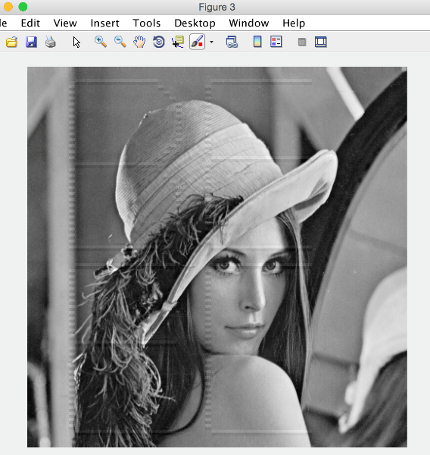
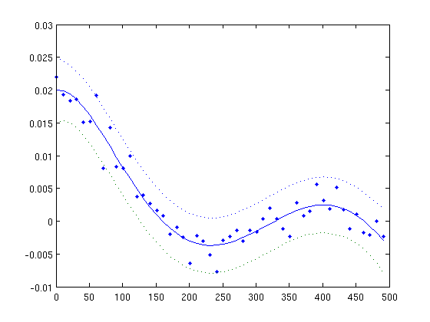
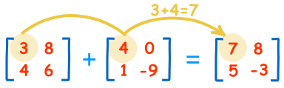
Introduction
MATLAB is used in every facet of computational mathematics. Following are some commonly used mathematical :
Dealing with Matrices and Arrays
2-D and 3-D Plotting and graphics
Linear Algebra
Algebraic Equations
Non-linear Functions
Statistics
Data Analysis
Calculus and Differential Equations
Numerical Calculations
Integration, Transforms
Curve Fitting
Various other special functions

Slide 4
The Tutorial Content
Introduction
Matlab Basics:
MATLAB Environment
Type of Variables
Mathematical operations
Scripts and functions
Matlab Advanced tools:
Control flow and operators
Algebra and Calculus
Transforms and advanced operations
Useful resources

Slide 5
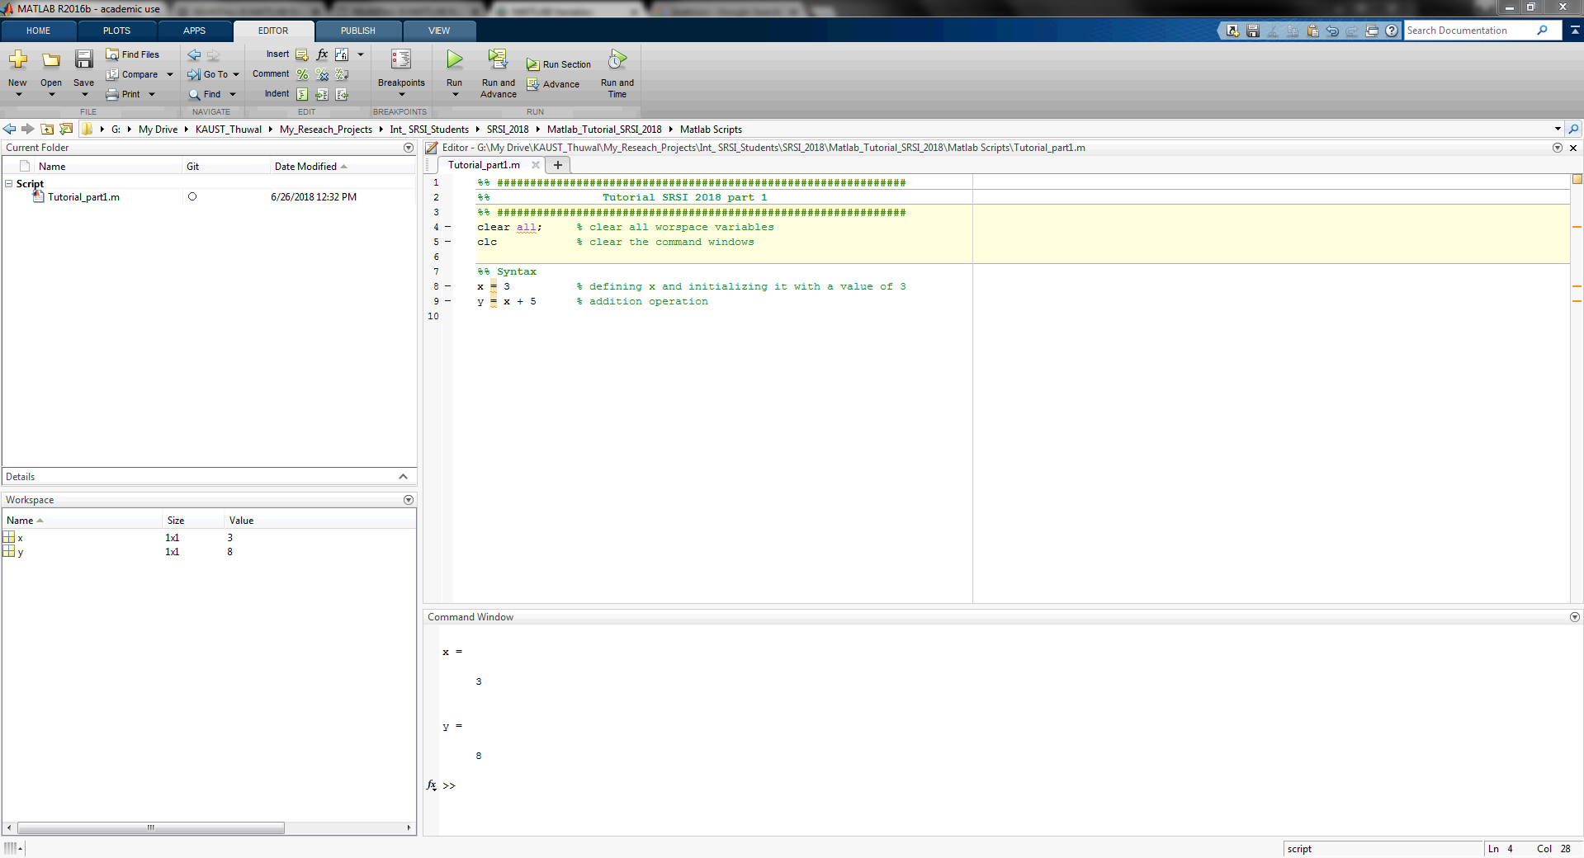
Matlab Basics: Environment

Slide 6
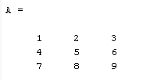
Matlab Basics: Variables
Scalar | Vector | Matrix
x = 3 % defining x y = x + 5 % addition % logical test test= (x==3) | x1 = [1 2 3]; % defining x1 x2 = [10 20 30]; % defining x2 y = x1 + x2 % addition y=[ 11 22 33 ] >> x = 1:2:10 >> y=cos(x) >> plot(x,y) % plot the graph | A = [1 2 3; 4 5 6; 7 8 9]

Slide 7
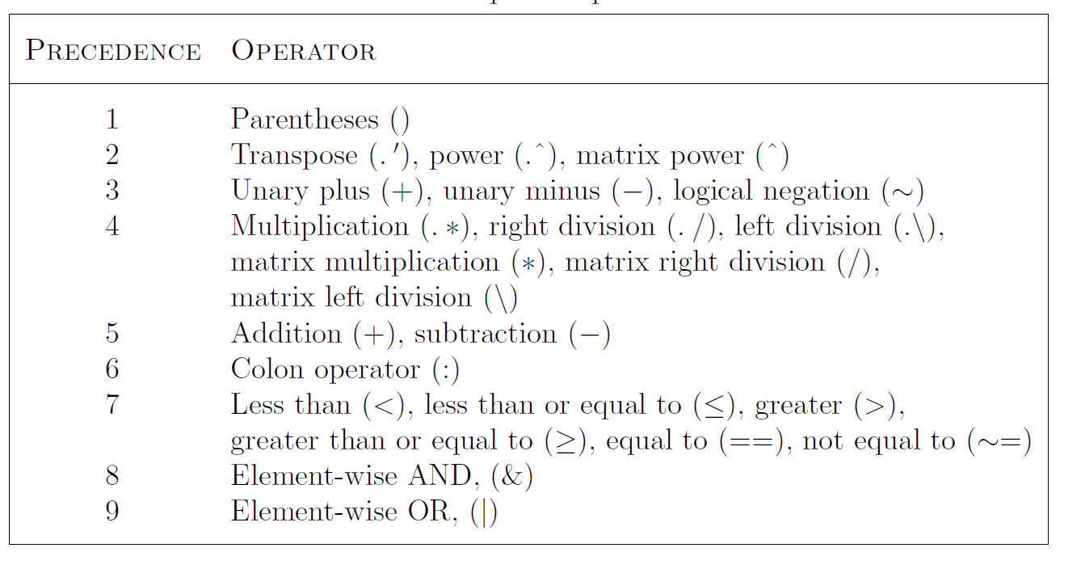
Practices

Slide 8
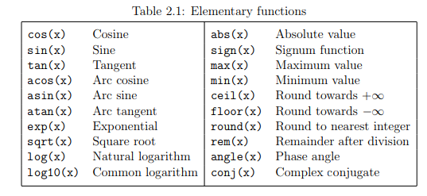
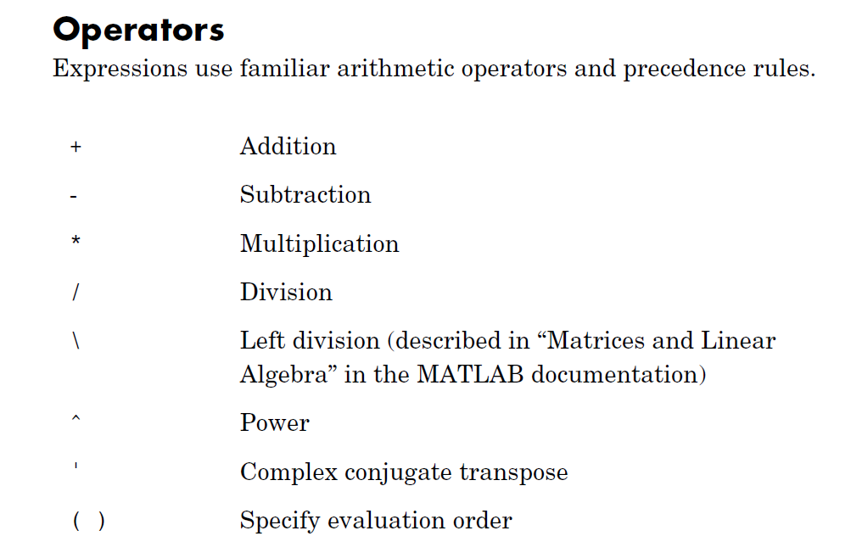
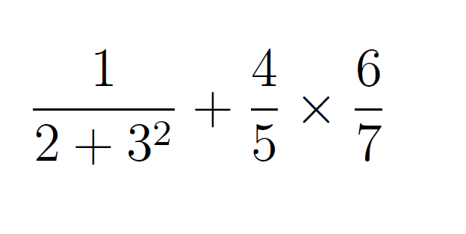
Exercise 1
Create a vector x in the range [0,10] with step 0.1
Plot y1=sin(x)
Compute the mean(y1)
Compute the std(y1)
Repeat 3 and 4 with y2=cos(x)
Plot y1 and y2 in the same figure [use hold on ]
Compute this operation:

Slide 9
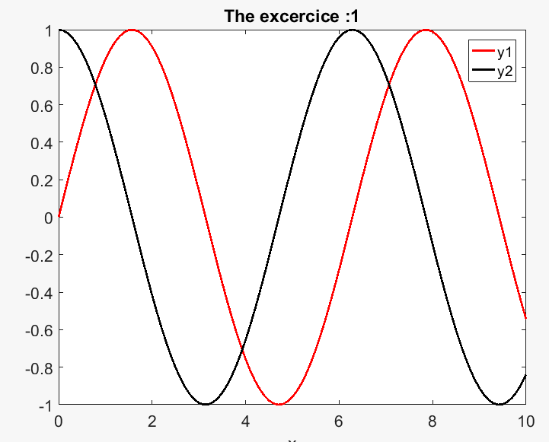
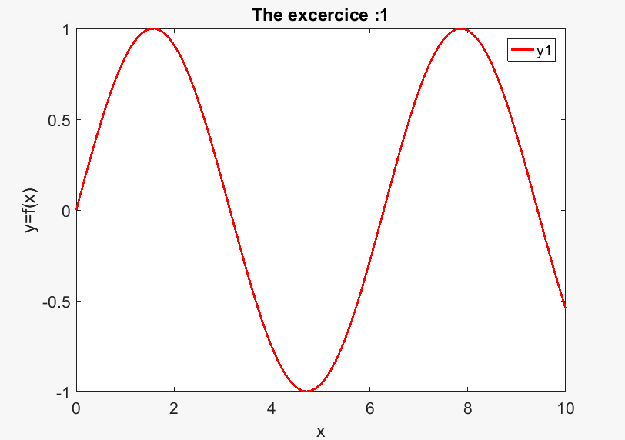
Answers 1

Slide 10
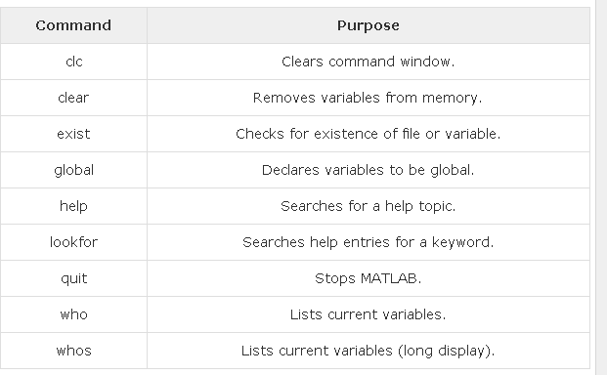
Matlab Basics: Useful commands

Slide 11
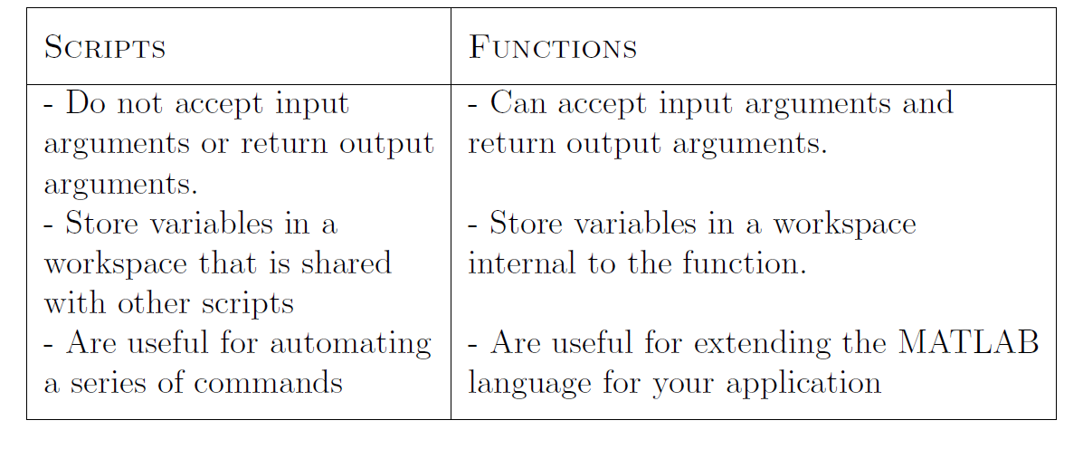
Matlab Basics: Script & Functins
Difference between scripts and functions
Notes:
function [y1,y2] = My_function(x)
y1=sin(x);
y2=cos(x);

Slide 12

Matlab Basics: Script & Functins
Each function consists of a name, user-provided input, and calculated output. For example, the function: my_function(x)
is named my_function,
takes user input inside the parentheses (in this case, x), and
calculate a result.
The user does not see the calculations performed, but just accepts the answer. The function could be regarded as a black box.
Outputs1: y1
Input: x
My_function
Outputs2 : y2
Notes:
function [y1,y2] = My_function(x)
y1=sin(x);
y2=cos(x);

Slide 13
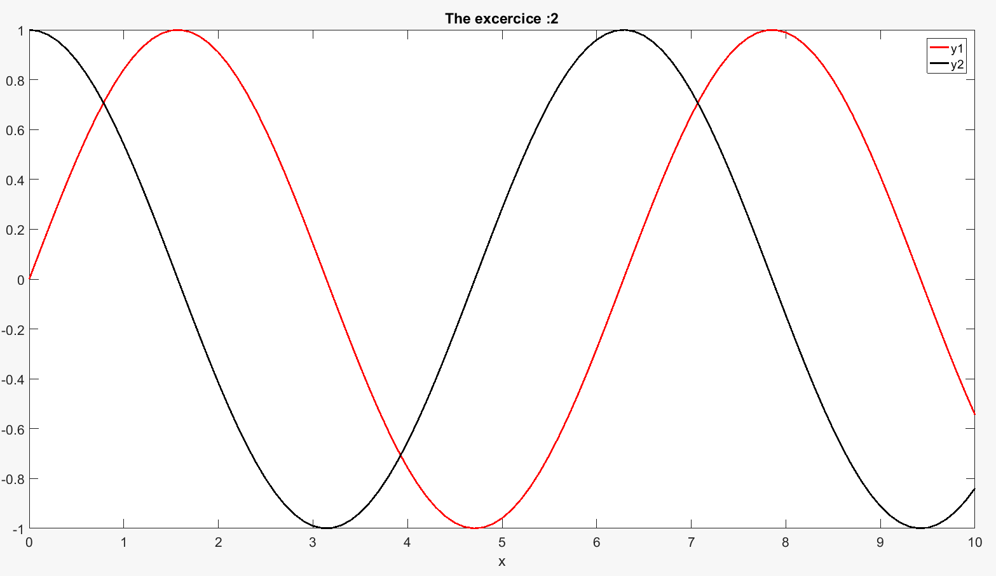
Exercise 2
Solve the pervious exercises using function structure
for the question from 2 to 6 ?

Slide 14
The Tutorial Content
Introduction
Matlab Basics:
MATLAB Environment
Type of Variables
Mathematical operations
Plotting graphs
Scripts and functions
Matlab Advanced tools:
Control flow and operators
Algebra and Calculus
Transforms and advanced operations
Useful resources

Slide 15
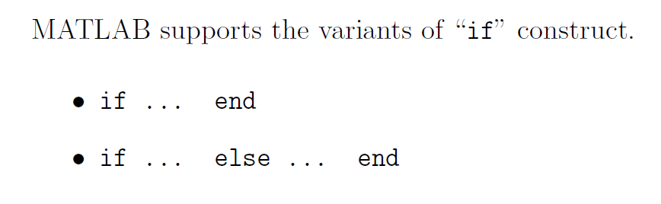

Matlab Advanced: Control flow and operators
The “if...end” structure

Slide 16
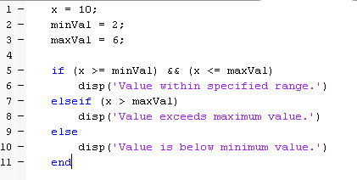
Matlab Advanced: Control flow and operators
The “if...end” structure
Notes:
discr = b*b - 4*a*c;
if discr < 0
disp('Warning: discriminant is negative, roots are
imaginary');
elseif discr == 0
disp('Discriminant is zero, roots are repeated')
else
disp('Roots are real')
End
x = 10; minVal = 2; maxVal = 6; if (x >= minVal) && (x <= maxVal) disp('Value within specified range.') elseif (x > maxVal) disp('Value exceeds maximum value.') else disp('Value is below minimum value.') end

Slide 17
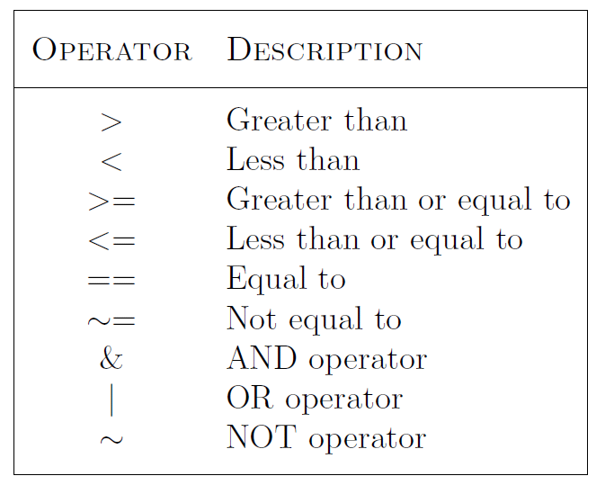
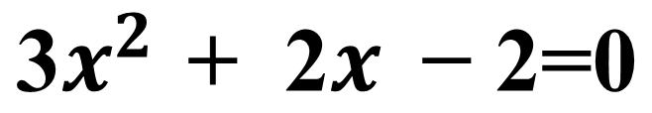

Exercise 3
Solve the equation using if statement:
syms x y
%% One variable
eqns = 2*x^2 + x - 2 == 0;
solution= solve(eqns, x)
$$\text{3}x^{2 }\text{+} \text{2}x \text{−} \text{2}\text{=0}$$
syms x y
%% One variable
eqns = 2*x^2 + x-2 == 0;
solxtion= solve(eqns, x)
2. Solve the equation:
%% Two variables
eqns =[2*x^2 + y^2 == 0,x - y == 1];
vars =[y x];
[solv, solx] = solve(eqns, vars)
$$\left\{\begin{matrix}\text{2}x^{2 }\text{+} \text{2}y^{2 }\text{=} \text{0} \\ x −y \text{=}\text{ 1}\end{matrix}\right.$$
Notes:
syms x y
%% One variable
eqns = 2*x^2 + x - 2 == 0;
solution= solve(eqns, x)

Slide 18
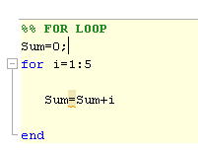
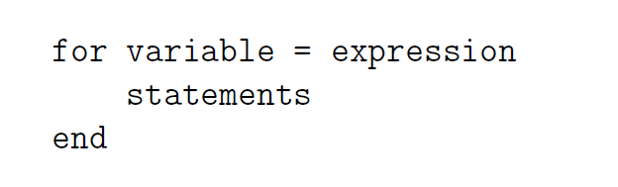
Matlab Advanced: Control flow and operators
The for...end loop

Slide 19
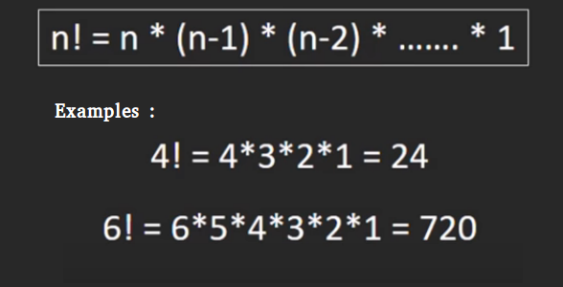
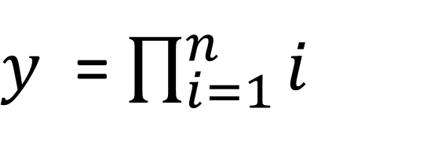
Exercise 4
Compute n!:
$y$ = $\prod_{i=1}^{n}{i }$
%% Answer 4
y=1;
n=10
for i=1:n
y= y * i
end
Notes:
%% FOR LOOP
Sum=0;
for i=1:5
Sum=Sum+i
end
%% Exercise 4
y=0;
M=10
for i=1:M
y=y * i
end

Slide 20
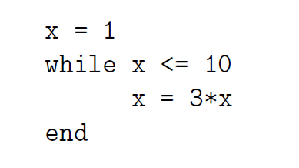
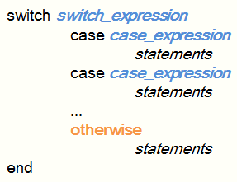
Matlab Advanced: Control flow and operators
The While loop
The Switch cases

Slide 21
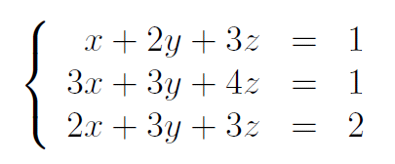
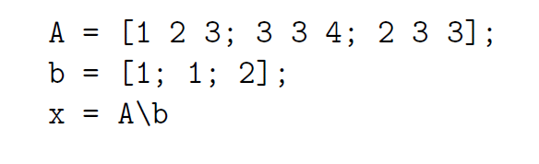
Matlab Advanced: Algebra & Calculus
Solve system of equations

Slide 22
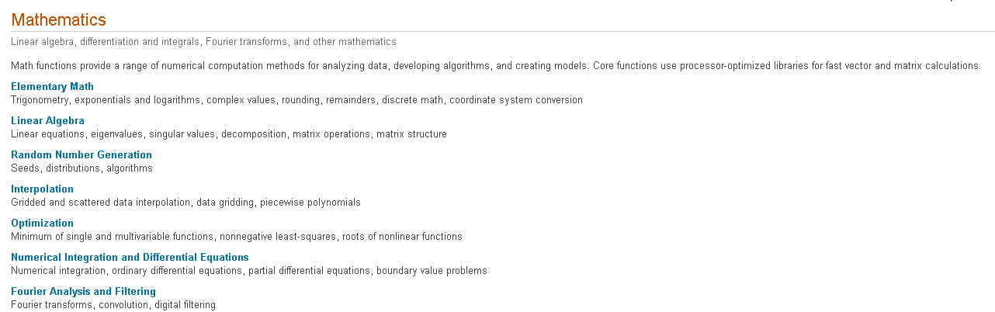
Matlab Advanced: Transforms
Practices based on the Matlab help
https://www.mathworks.com/help/matlab/mathematics.html

Slide 23
Useful Resources
Get started Matlab [74 page]: https://www.mccormick.northwestern.edu/documents/students/undergraduate/introduction-to-matlab.pdf
Matlab tutorial online :
https://www.tutorialspoint.com/matlab/index.htm
Matlab help: https://www.mccormick.northwestern.edu/documents/students/undergraduate/introduction-to-matlab.pdf

