Slide 1
MACHINE LEARNING PROJECT
Self-Supervised Learning
with SimCLR on CIFAR-10
Student Name | Course: Deep Learning | Professor: Dr. Smith | May 2026
SimCLR
Contrastive Learning
ResNet-18
CIFAR-10
Linear Probing
01

Slide 2
INTRODUCTION & OBJECTIVES
02
What Is Self-Supervised Learning?
Self-Supervised Learning (SSL)
Project Objectives
→ Learns representations from unlabeled data using pretext tasks → Avoids expensive manual annotation by generating its own supervision → SimCLR: maximizes agreement between different augmented views of the same image (positive pairs) while repelling negatives
01
Learn visual representations without labels using SimCLR
02
Compare SSL-pretrained vs. supervised-from-scratch models
03
Evaluate quality via linear probing & fine-tuning experiments
04
Visualize learned embeddings with t-SNE & UMAP

Slide 3
PROBLEM STATEMENT
03
The Labeled Data Bottleneck
80%
10×
40%
of real-world data
is unlabeled
more time needed
to annotate at scale
baseline accuracy
without pretraining
Key Question
Can a model learn
meaningful representations
from unlabeled data alone —
without any class labels?

Slide 4
METHODOLOGY / IMPLEMENTATION
04
The SimCLR Pipeline
Input
Image
Data
Augmentation
ResNet-18
Encoder
Contrastive
Loss (NT-Xent)
CIFAR-10
32×32 RGB
Crop, Flip
Color Jitter
f(·)
Projection Head
Temp τ=0.5
Minibatch Neg.
Pretraining Phase
Evaluation Phase
1. Load CIFAR-10 without labels 2. Generate augmented view pairs (x̃ᵢ, x̃ⱼ) 3. Train encoder to minimize NT-Xent loss 4. Save pretrained encoder weights
A. Linear Probe: freeze encoder, train linear layer B. Fine-tuning: unfreeze + fine-tune full network C. Baseline: ResNet-18 trained from scratch (supervised)

Slide 5
TECHNOLOGIES USED
05
Tools & Libraries
🐍 Python 3.10
🔥 PyTorch
🔢 NumPy
Core programming language. Clean syntax, rich ML ecosystem.
Deep learning framework used for model definition, training loops, and GPU acceleration.
Numerical computing for array operations and data preprocessing pipelines.
📊 Matplotlib
🖼️ CIFAR-10
⚙️ scikit-learn
Visualization library for plotting loss curves and prediction results.
Standard benchmark: 60K images across 10 classes. Ideal for SSL experiments.
t-SNE, UMAP, and metrics for embedding visualization and evaluation.

Slide 6
SYSTEM ARCHITECTURE
06
End-to-End Data Flow
CIFAR-10
Input
Data
Augmentation
ResNet-18
Encoder
Projection
Head (MLP)
NT-Xent
Loss
50K train
10K test
RandomCrop
Flip, ColorJitter
512-dim
feature vector
128-dim
embedding
Contrastive
Objective
① SimCLR Pretraining
② Supervised Baseline
• Unlabeled CIFAR-10 (no class info) • Two augmented views per image • Freeze encoder → Linear probe evaluation • Result: 58.87% test accuracy
• Labeled CIFAR-10 from scratch • Standard cross-entropy loss training • Same ResNet-18 architecture • Result: 40.89% test accuracy

Slide 7
RESULTS & TESTING — NUMERICAL EVALUATION
07
Performance Comparison
58.87%
40.89%
~89%
SimCLR Linear Probe
Scratch Linear Probe
Fine-tuned (CIFAR-10)
pretrained_linear_eval
scratch_linear_eval
Full supervised fine-tune
Key Insight
SimCLR pretraining yields a +18pp improvement over random initialization under linear evaluation, confirming that unsupervised representations carry meaningful semantic structure.

Slide 8
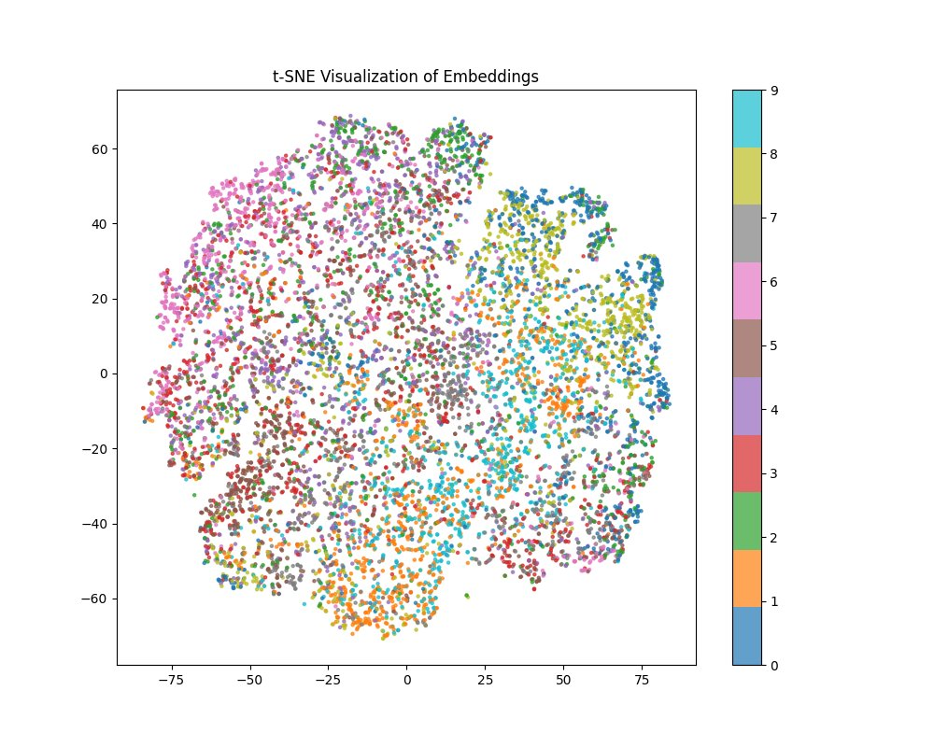
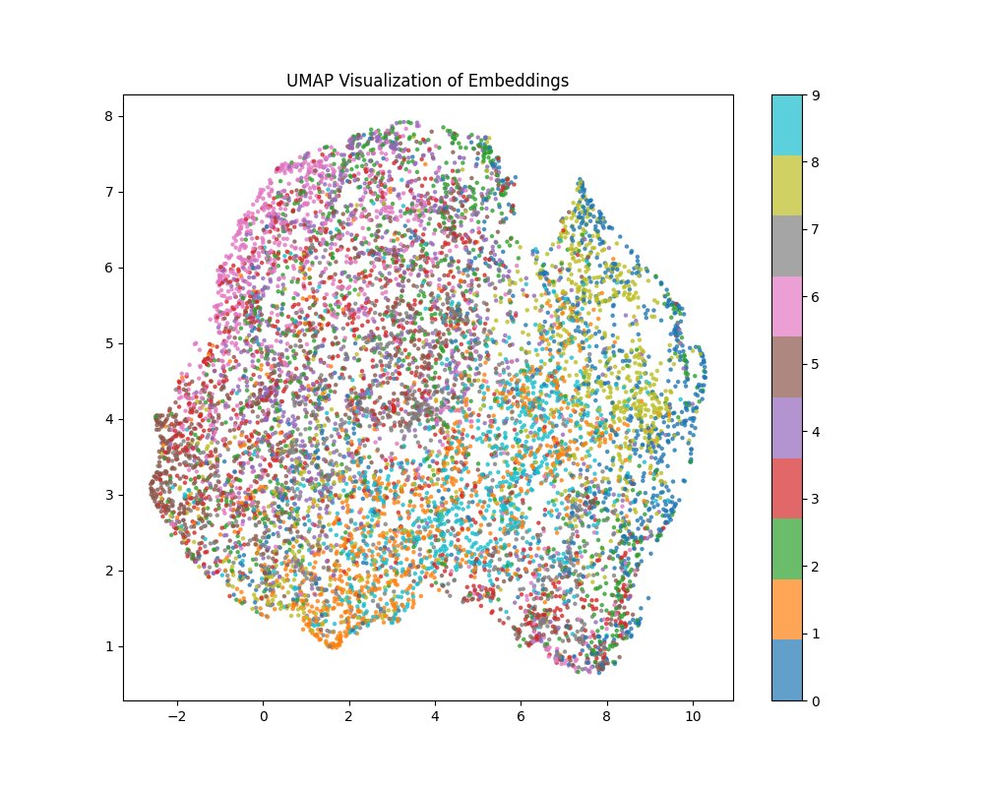
RESULTS & TESTING — EMBEDDING VISUALIZATIONS
08
t-SNE & UMAP of Learned Representations
t-SNE
UMAP
Both projections reveal partial class structure in the learned embedding space — visible color-region clustering despite being trained without labels.

Slide 9
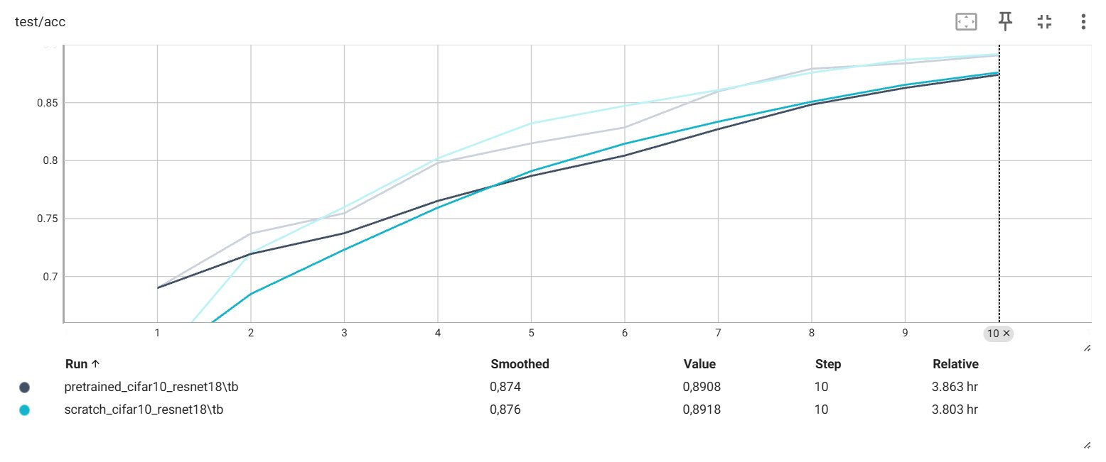
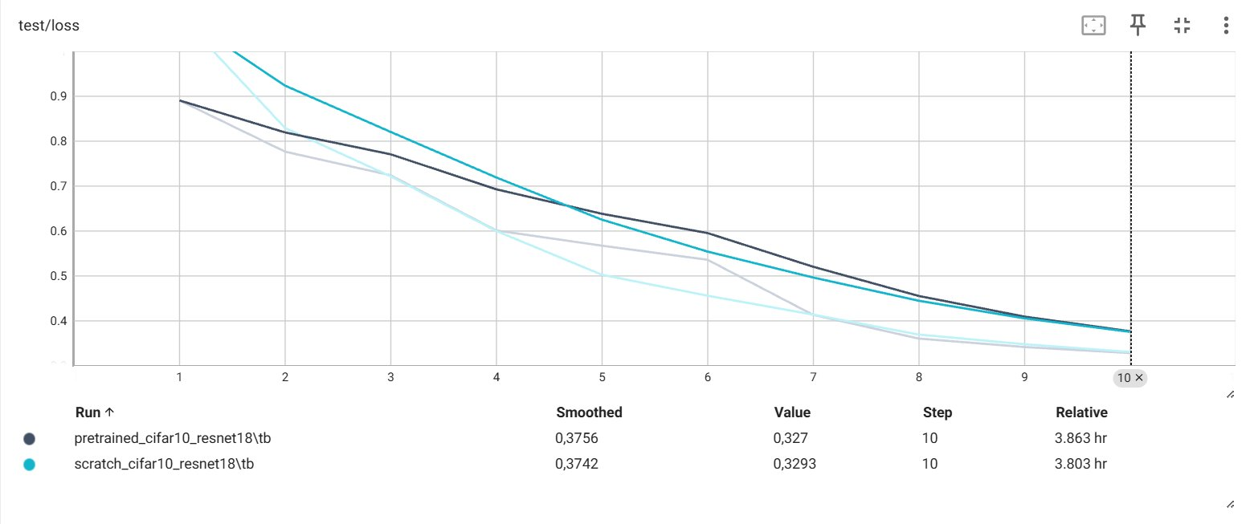
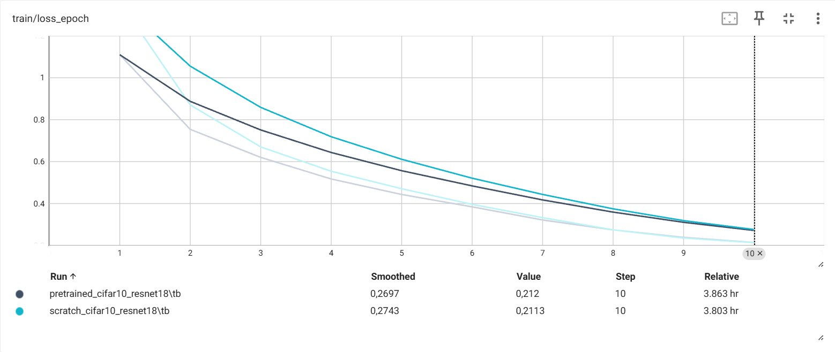
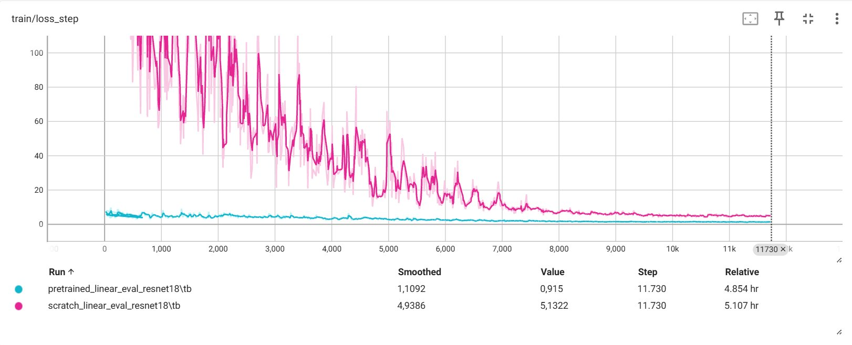
RESULTS & TESTING — TRAINING CURVES
09
Linear Evaluation: Pretrained vs. Scratch
Test Accuracy
Test Loss
Train Loss / Epoch
Train Loss / Step
Pretrained (SimCLR)
Scratch (supervised baseline)

Slide 10
CHALLENGES FACED & SOLUTIONS
10
Challenges & How We Solved Them
01
Contrastive Loss Convergence
⚠ Challenge: NT-Xent loss unstable early in training; high variance in batch negatives. ✓ Solution: Tuned temperature τ=0.5 and used large effective batch size with gradient accumulation.
02
Hyperparameter Sensitivity
⚠ Challenge: SSL is sensitive to augmentation strength, learning rate, and projection head depth. ✓ Solution: Systematic grid search on LR ∈ {0.01, 0.1} with cosine decay. Final LR: 0.1 with warm-up.
03
Computational Constraints
⚠ Challenge: SSL training requires large batches and long schedules to learn good representations. ✓ Solution: Used lightweight ResNet-18 and CIFAR-10 (32×32). Reduced epochs while retaining key trends.

Slide 11
11
CONCLUSION & FUTURE WORK
Takeaways & Next Steps
Summary
Future Extensions
✓ SimCLR successfully learns meaningful visual representations without labels ✓ Linear probing is a reliable, fair metric for SSL quality evaluation ✓ SSL-pretrained models outperform scratch by +18pp under linear probe ✓ Fine-tuning narrows the gap — pretraining advantage is most visible in low-label settings ✓ t-SNE/UMAP confirm partial semantic clustering in the embedding space
→ Add STL-10 dataset for stronger pretraining signal → Experiment with BYOL / MoCo / DINO for comparison → Scale to larger datasets (ImageNet subset) → Explore semi-supervised evaluation protocols → Analyze per-class embedding quality and confusion
Self-supervised learning is a key enabler for low-resource and large-scale vision tasks — and SimCLR is a strong foundation to build upon.

