Slide 1
Consistent AI: AI-Powered Sales Intelligence Suite
Presented By :-
Chahit Luthra- 2210110236
Company:
Consistent Infosystems Pvt. Ltd.
Under Supervision of:-
Dr. Kamal Agarwal
Mr. Subodh Raj Satyal (CTO Consistent Infosystems Pvt. Ltd.)
01

Slide 2

The Problem Statement
The Problem Statement: B2B sales and distribution teams often rely on backward-looking, reactive reporting (like basic dashboards showing past sales). They struggle to:
Identifying which partners are about to churn before they stop buying.
Knowing exactly what to cross-sell or upsell to a specific partner.
Managing dead stock efficiently before it becomes a financial write-off.
Assessing real-time credit risk tied to sales volume. This results in lost revenue, wasted capital in inventory, and missed cross-selling
opportunities because sales reps are operating on intuition rather than predictive data.
02

Slide 3
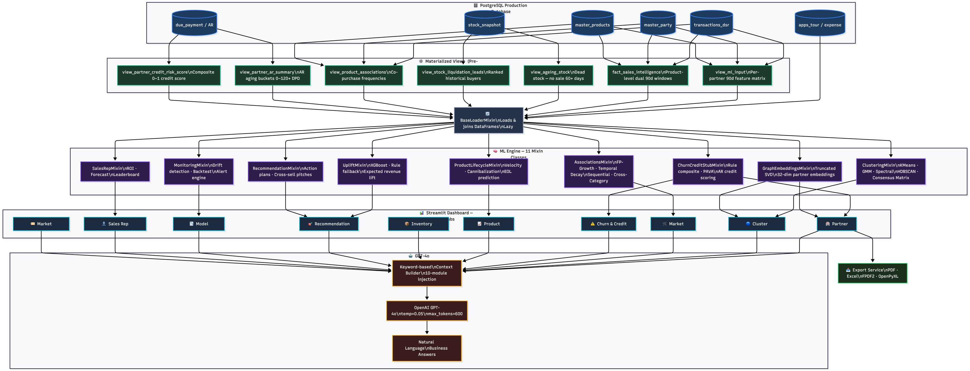
Project Pipeline
01
03

Slide 4
Technology Stack
Database: PostgreSQL (Materialized Views, Relational Schema)
Backend / ML Engine: Python, Scikit-Learn, LightGBM, HDBSCAN
Frontend App: Streamlit (Dynamic interactive dashboards)
02

Slide 5
Database Re-Architecture & PostgreSQL Overhaul
View Name
view_ml_input
fact_sales_intellig ence
view_ageing_stock
view_stock_liquida tion_leads
view_product_ass ociations
view_partner_ar_s ummary
view_partner_cred it_risk_score
What It Does
Per-partner feature matrix — revenue, recency, order count (last 90 days) Product-level revenue with current vs previous 90-day windows Products with stock > 10 units and no sale in 60+ days
Dead stock matched with partners who bought them before
Product co-purchase frequencies for Market Basket Analysis Accounts receivable aging buckets (30/60/90/120/120+ days)
Composite credit risk score (0–1) from AR data
01
04

Slide 6
Partner Segmentation & Clustering Models
The Goal: To move beyond basic geographic or volume-based tiers and segment partners based on true behavioral similarities, purchase velocity, and product mix.
The Approach: The ClusteringMixin employs an ensemble of algorithms including HDBSCAN (for density-based discovery of niche segments) and Gaussian Mixture Models for broad market partitioning.
Key Features Extracted:
RFM (Recency, Frequency, Monetary): Baseline engagement metrics.
Purchase Velocity: Average inter-purchase gaps and acceleration/deceleration trends. Seasonality & Entropy: Detects highly concentrated buyers versus diverse portfolio buyers.
Network/Peer Centrality: Evaluates how similar a partner's purchase vector is to the broader network.
Business Impact: By grouping partners with similar buying patterns asynchronously, sales reps receive targeted strategies for specific clusters—for example, knowing exactly which "Growth Sector" partners look structurally identical to "Premium Tier" partners, highlighting immediate upsell opportunities.
05

Slide 7
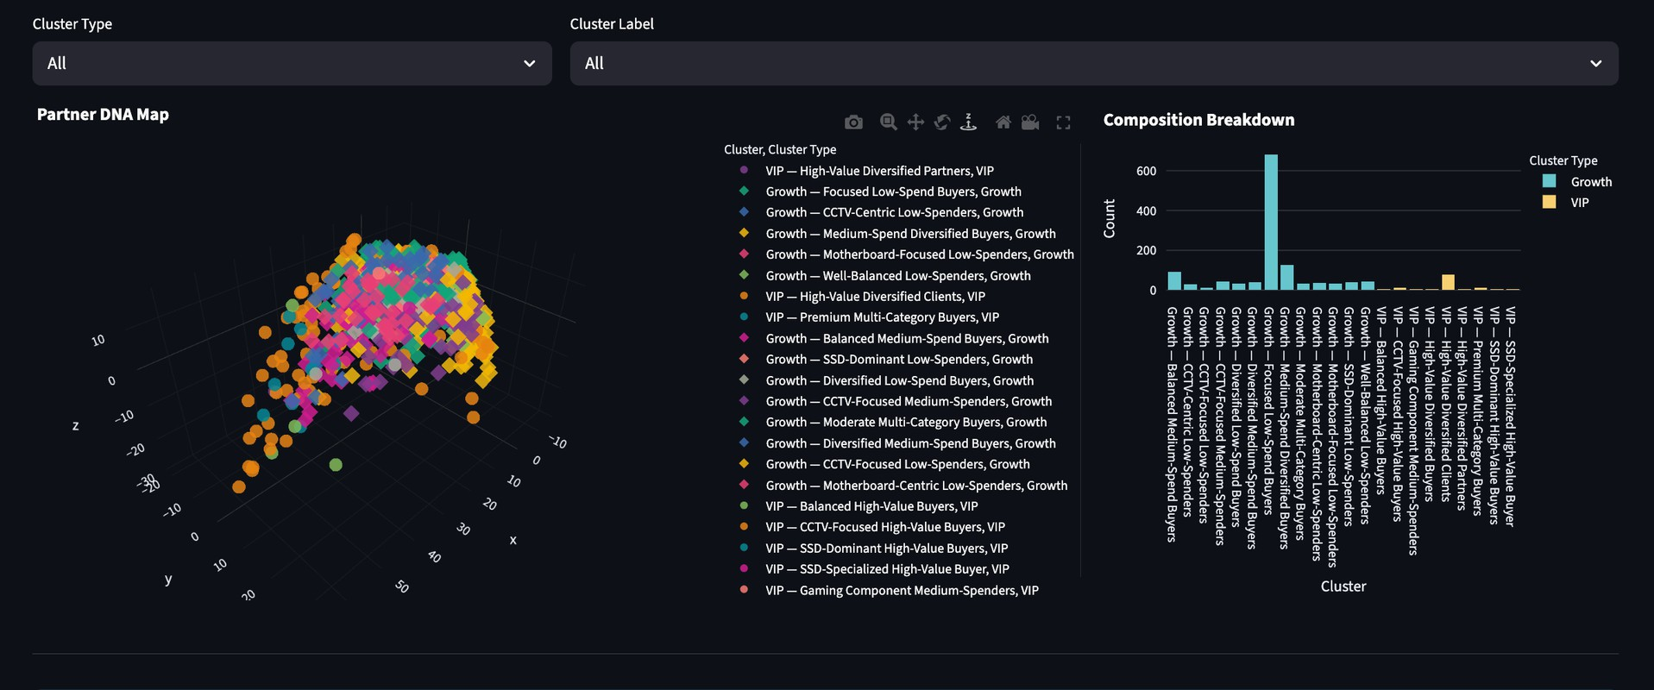
Clustering Map
Total CLusters foormed: 23 Vip Clusters: 8
Growth Clusters: 15
06

Slide 8
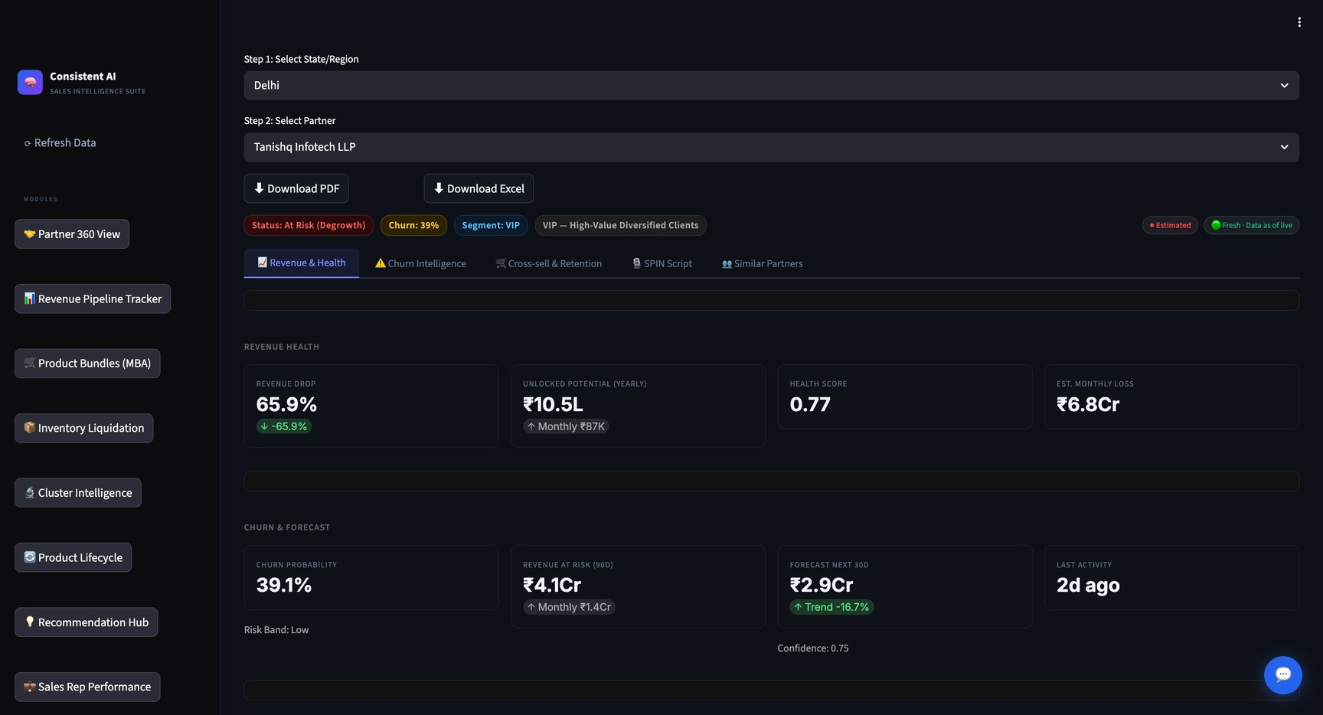
Partner 360° View Tab
06

Slide 9
Predictive Churn & Survival Analysis
The Goal: Identify accounts that are likely to stop purchasing before they actually defect, allowing for proactive retention campaigns.
The Approach: The ChurnCreditMixin transforms the churn problem into a combination of binary classification and time-to-event survival analysis.
The Models:
LightGBM Classifier: Trained on historical temporal windows (comparing 'recent' vs 'previous' periods). Features include revenue drop percentages, payment regularity, and order value changes. The model output true probabilities of churn.
08

Slide 10
Financial Risk & Credit Health Scoring
The Goal: Protect the business's cash flow by identifying partners who are likely to default on payments or significantly delay invoice settlements.
The Approach: Financial risk is treated as a critical parallel dimension to sales churn. While a partner may buy frequently, poor payment behavior negates their value.
Feature Engineering:
Evaluates total outstanding due payments. Calculates payment delays and regularity.
Cross-references outstanding debt against overall spend velocity and assigned credit limits.
Outcome: The system assigns a distinct Credit Risk Score (Low, Medium, High, Critical) which acts as a hard constraint on the dashboard. Sales reps are alerted to withhold further bulk shipments to "High Risk" accounts despite positive sales indicators.
08

Slide 11
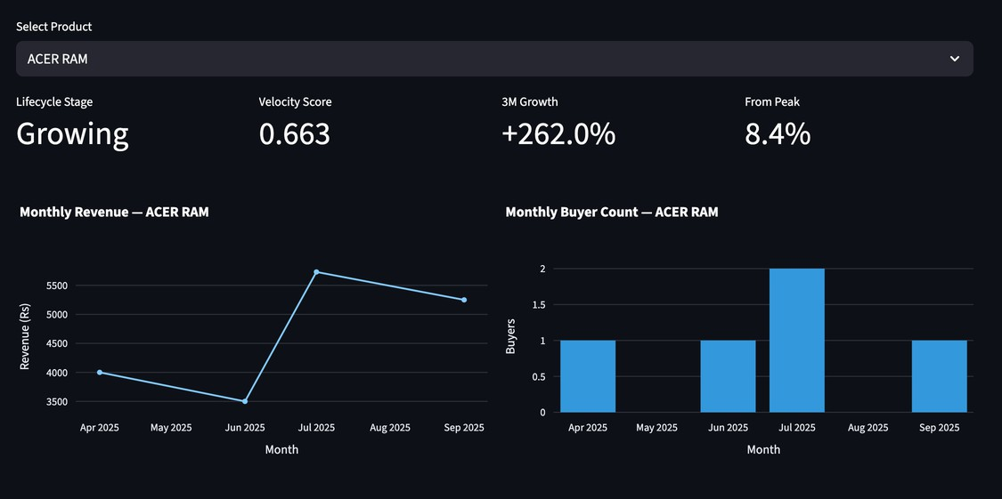
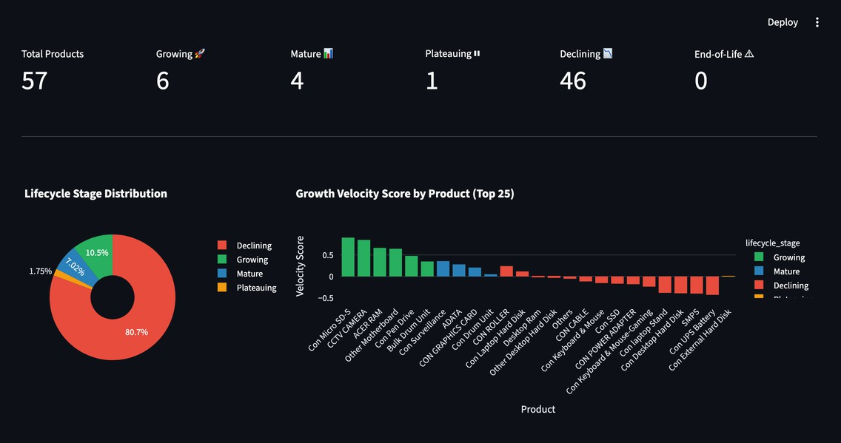

Revenue Forecasting & Lifecycle Management
Demand Forecasting: Utilizes Simple Exponential Smoothing (SES) to forecast the exact revenue demand for the upcoming month based on historically weighted trajectories, giving reps a clear baseline to pitch against.
Growth Velocity Scoring: Evaluates revenue trend slope, buyer count momentum, and transaction intensity to categorize products (e.g., Growth, Mature, Declining).
07

Slide 12
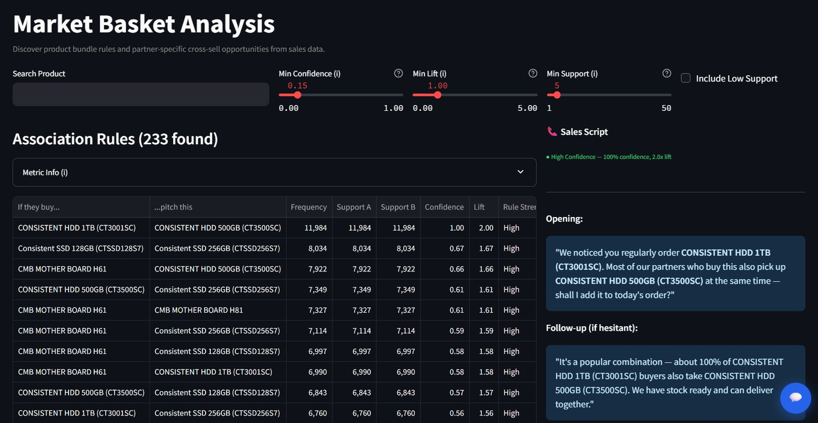
Market Basket Analysis &
Associations
The Goal: Automate cross-selling by discovering hidden purchasing patterns and recommending the next logical product addition to a partner's cart.
The Approach: Powered by the AssociationsMixin and visualized in the Market Basket Tab, the system employs advanced Data Mining techniques.
Algorithms Used:
FP-Growth: Efficiently mines large datasets for frequent itemsets without the computational overhead of Apriori.
Temporally Weighted Rules: Applies an exponential decay to older transactions so that recent market shifts weigh more heavily in product recommendations.
07

Slide 13
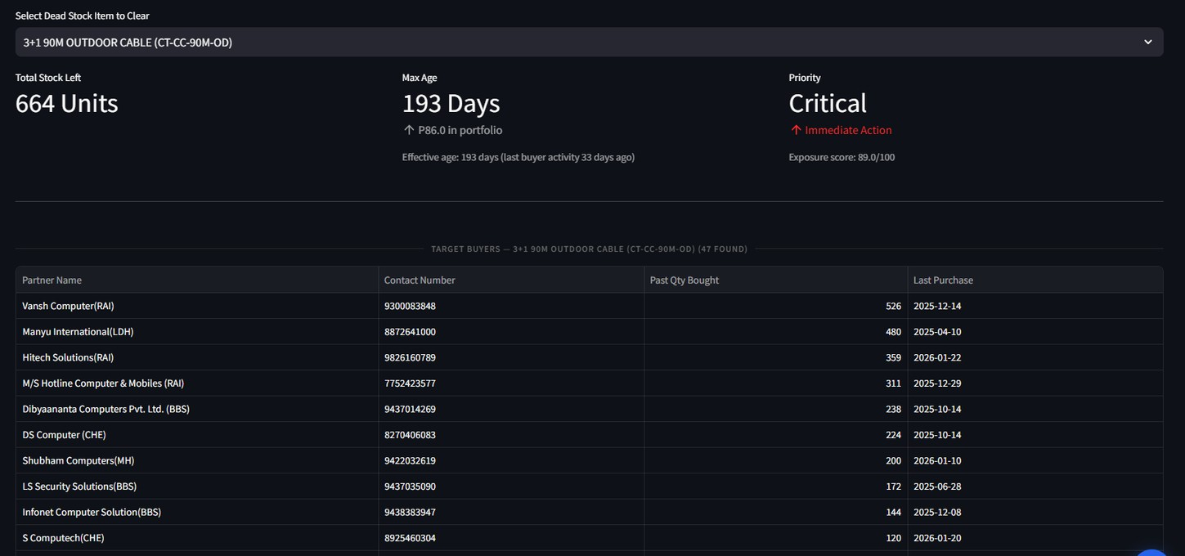
Smart Inventory & Stock
Liquidation
The Goal: Minimize capital tied up in aging
stock by intelligently pairing dead inventory with the buyers most likely to purchase it.
The Approach: The Inventory Liquidation Tab turns a supply chain problem into a targeted sales campaign.
How it Works:
Identification: The view_ageing_stock Postgres view continuously calculates the max age of unsold batches. Products older than predefined thresholds are flagged as Dead Stock.
Lead Generation: The system queries past transaction histories specifically for those dead-stock items.
Targeting: It ranks "Target Buyers" based on their historical purchase volumes of that exact item.
07

Slide 14
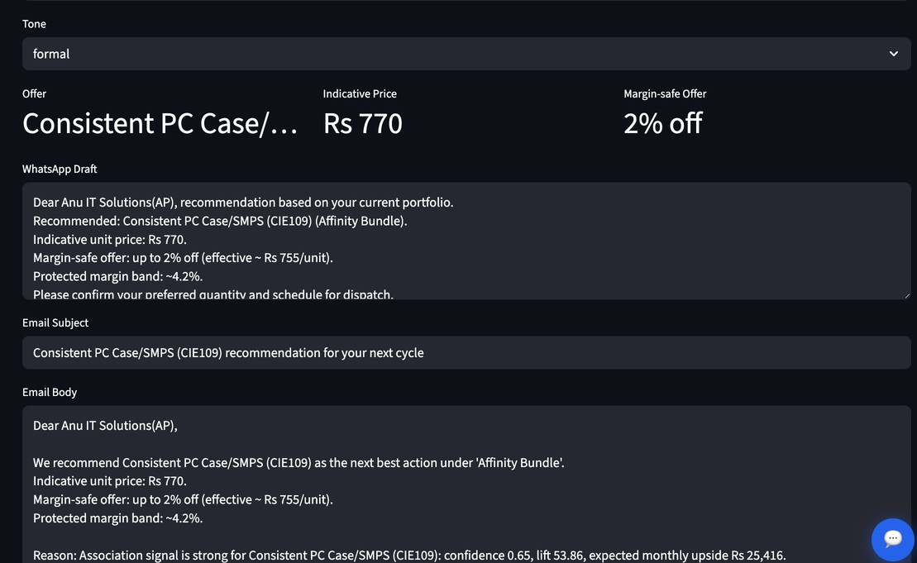
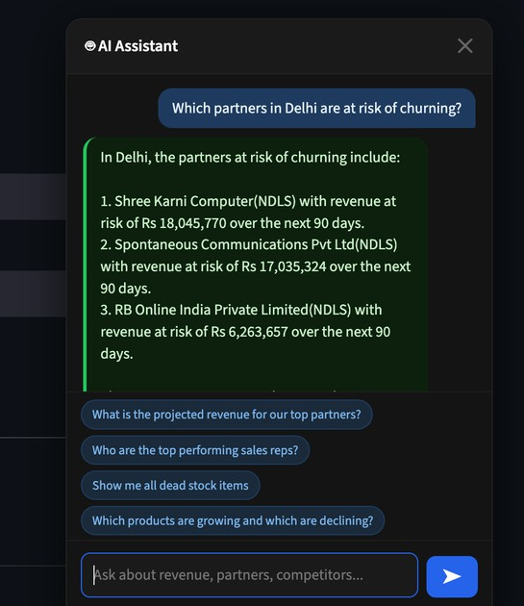
AI Chatbot & Generative AI Integration
The Goal: Provide users with an interactive, natural-language interface to query complex sales intelligence data without needing to navigate dashboards or understand SQL.
Universal Context Awareness (RAG): The Chatbot pre-loads context from all 8 ML modules (Churn, Clustering, Recommendations, Inventory, etc.). When a user asks a question like "Which partners in Delhi are at risk of churning?", the AI instantly cross-references the geographic data with the LightGBM churn probabilities to provide a direct, conversational answer.
AI-Generated Sales Pitches: Instead of just telling a rep what product to sell, the system uses GenAI to auto-generate personalized email and WhatsApp pitch scripts tailored to the buyer's credit risk, purchase history, and cluster profile.
07

Slide 15
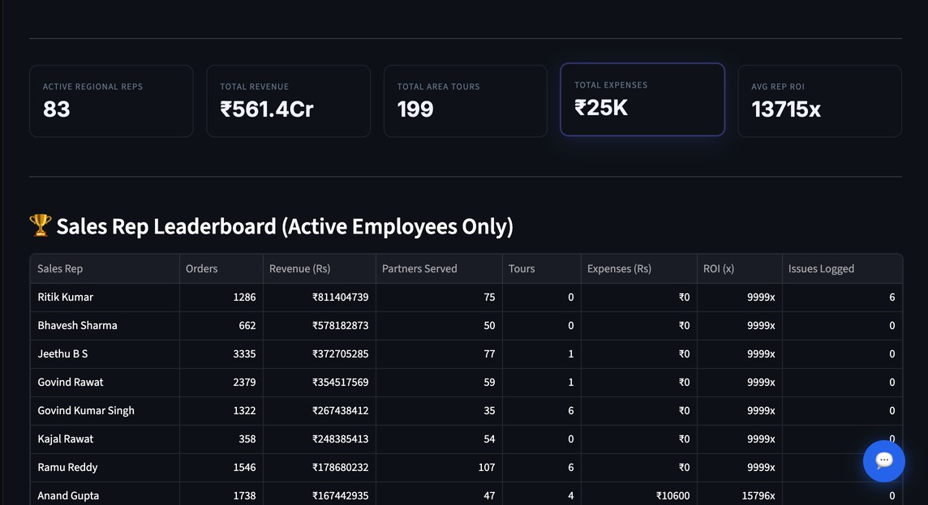
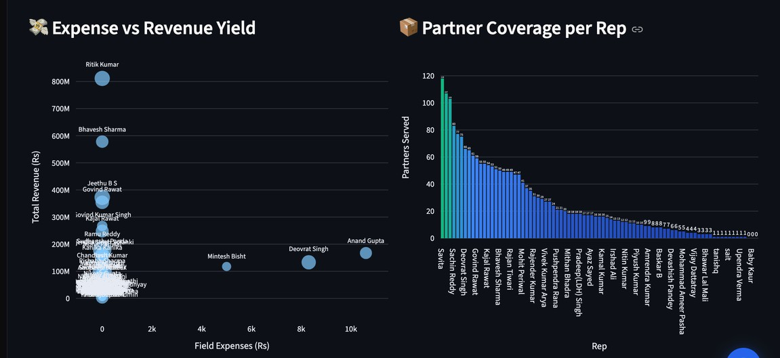
Sales Rep Performance
Sales Rep Performance Tracker
Source
transactions_dsr apps_tour_tourplan apps_tours_expense
Metric
Total orders, revenue, customers served
Field visits / tours taken Travel and field expenses
Revenue ROI = Total Revenue ÷ Total Expenses
Monthly Revenue Forecast per rep (linear regression, 3-month projection) Only active employees with real activity are shown
07

Slide 16
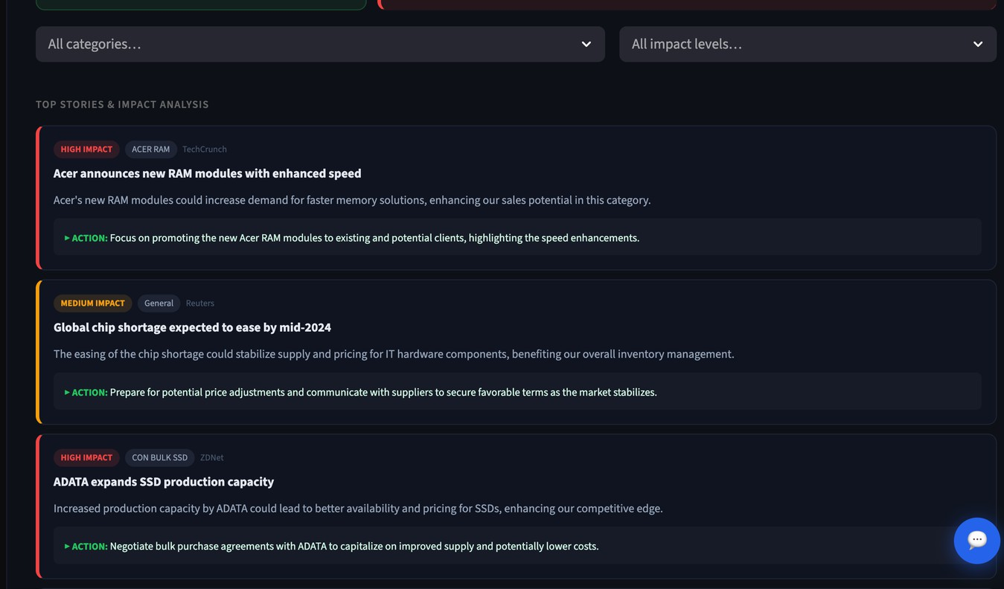
Market Intelligence
Market Intelligence Module:
Tracks competitor pricing per product Auto-raises alerts when a competitor undercuts our price
Severity levels: Critical / High / Medium based on price gap
Real-time market news feed using RSS aggregation
07

Slide 17
Thank You Demo and Q&A
07

