Slide 1

ENVitter

Slide 2
TOPIC
Tackling the Waste collection, Pollution and such pressing Environmental issues via a social network.
Workflow –
Users send issues.
Admin responds to the current request.
Issue assignment.
Status tracked.
Issue resolved.

Slide 3
Why ENVitter ?
ENV=Environment
Itter=Twitter
A confluence of Environment with the existential Social Media Network.

Slide 4
WHY?
Current State of Affairs (Environmental POV)
Deteriorating ecosystem and environmental conditions across the globe
Dearth of Technological solutions (implementable)
Problem – specific Targeting, Planning and Completion
No reporting authority

Slide 5

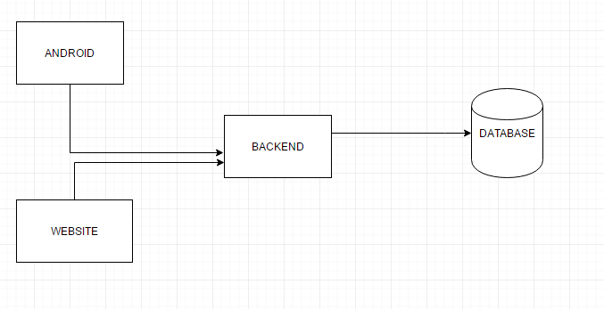



Architecture

Slide 6
TECHNOLOGIES USED
CodeIgniter – an MVC architecture based framework for implementing PHP
AngularJS – Front-end UI, Javascript framework
Android – Mobile application
PHPMyAdmin – SQL Server / Database

Slide 7
INNOVATION
Issue placement
Issue resolution
Appreciation
Status Tracking
Social Media Involvement

Slide 8
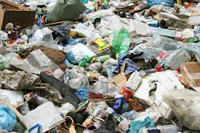
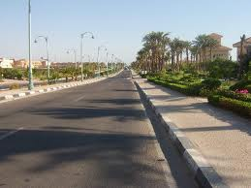
APPRECIATION
BEFORE | AFTER

Slide 9
STAKEHOLDERS
GOVERNMENT OFFICIALS/B.M.C.
ENVIRONMENTAL OFFICIALS
N.G.O.
CONSUMERS/USERS

Slide 10
FUTURE SCOPE
Social Media Interaction (Tweet / Involve Government officials as well as common Indian citizens towards a safer, cleaner environment)
Sensors
Scalable – Involve/Integrate other Social / Infrastructural Issues (For e.g. – Traffic, Road blockages)
Geo-temporal allocation
Volunteering Opportunities

Slide 11
ISSUES - CATEGORIES
GARBAGE COLLECTION
DEFORESTATION
ANIMAL RESCUE
POLLUTION
QUALITY OF AIR

Slide 12
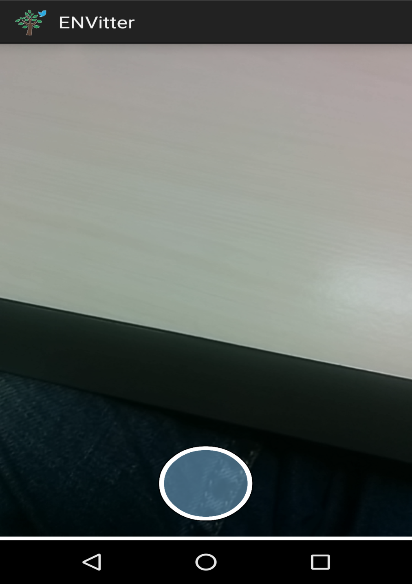

Slide 13
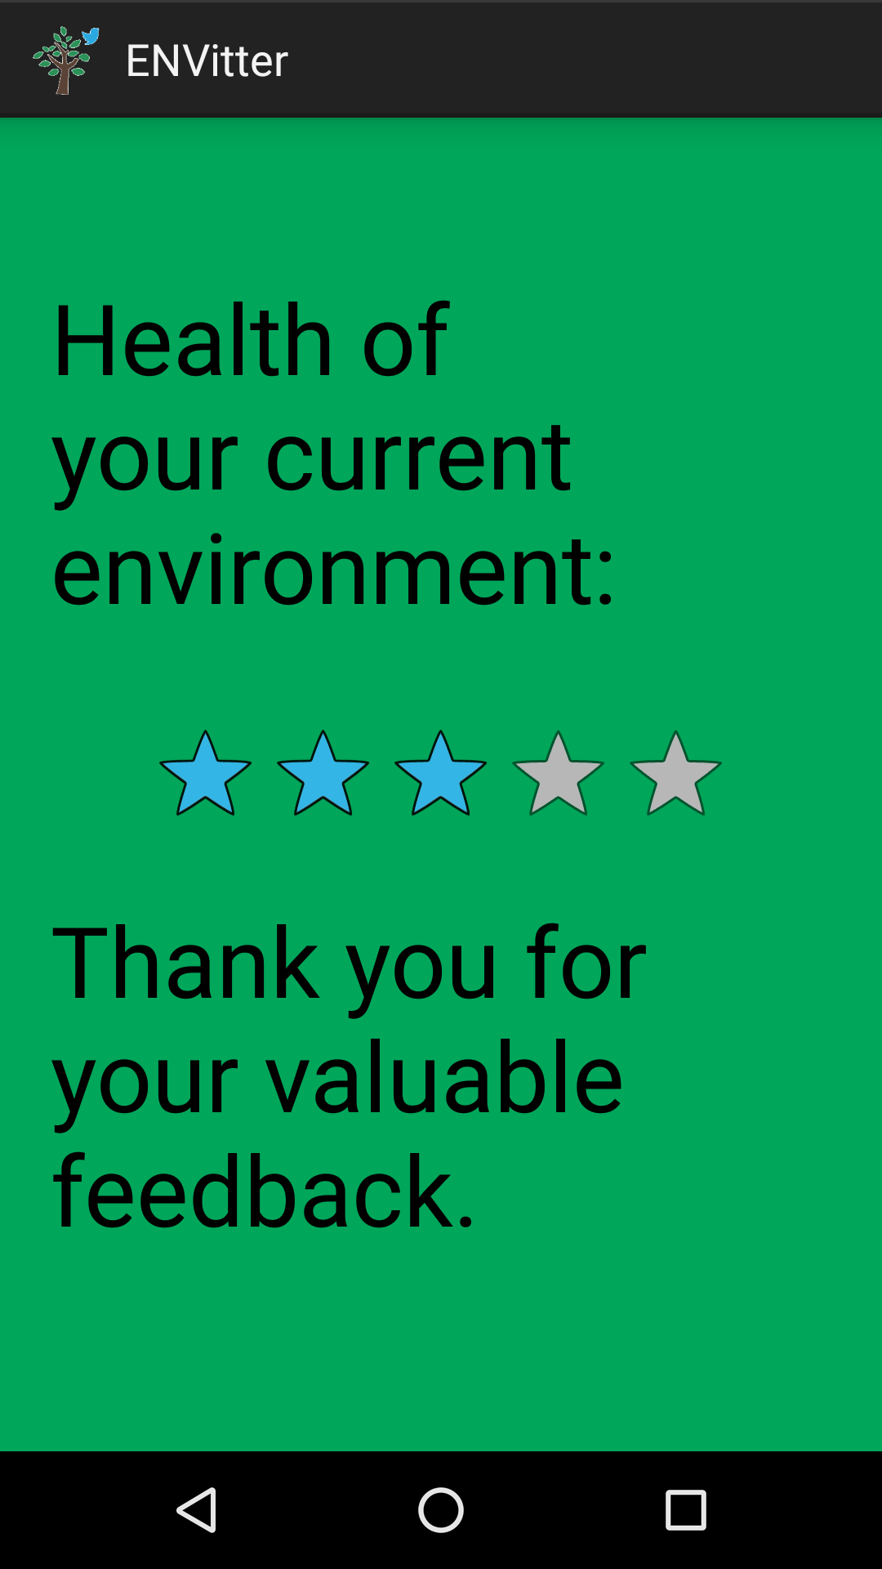
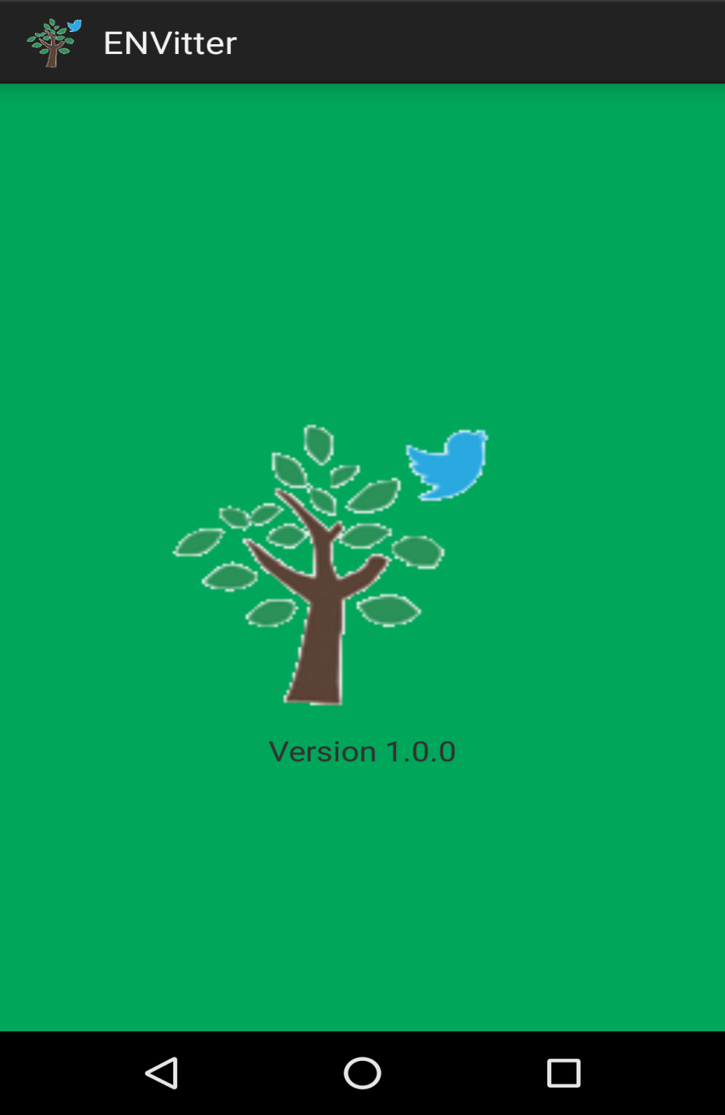

Slide 14
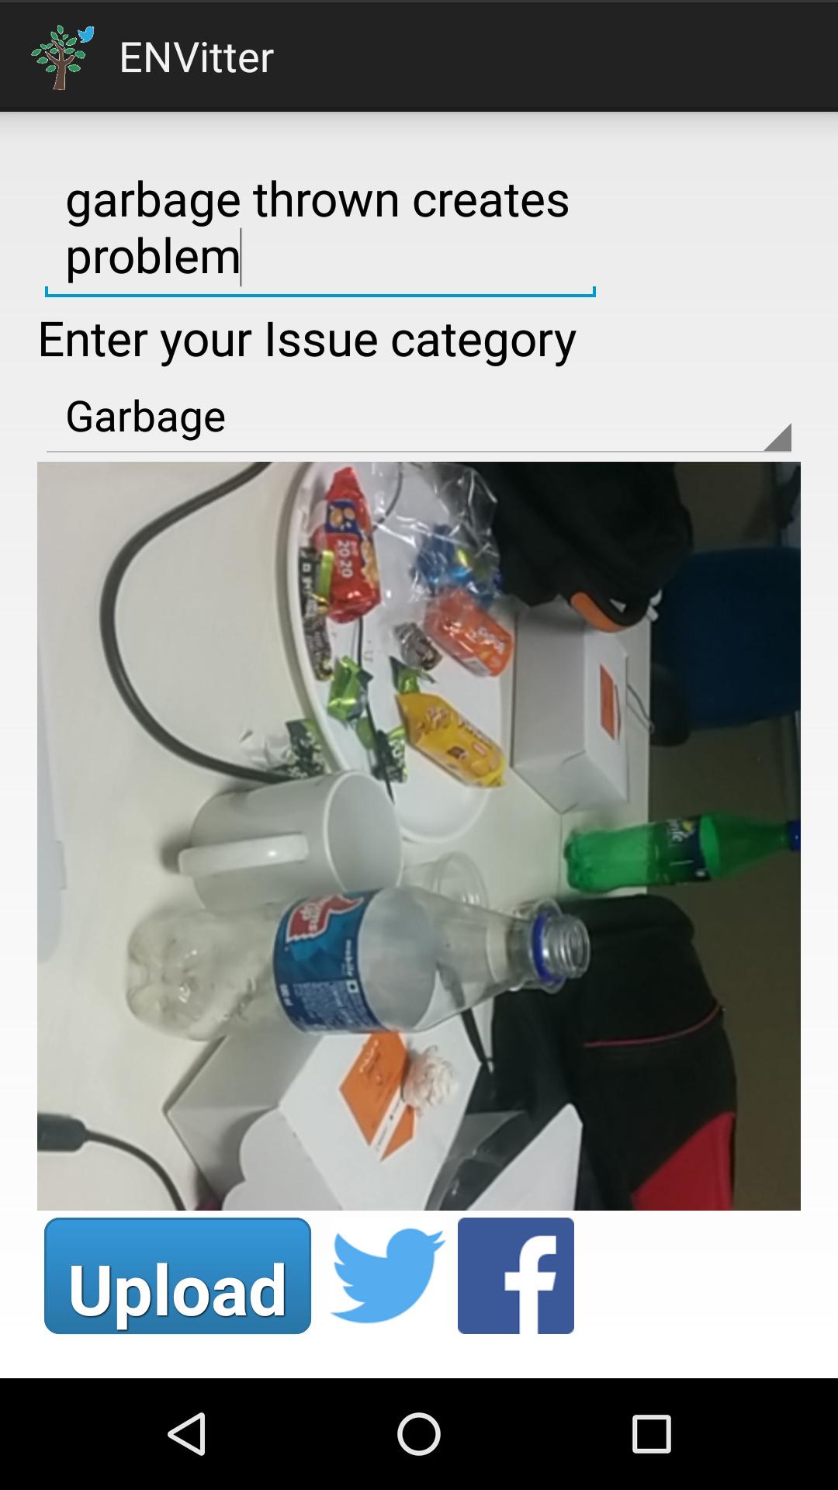
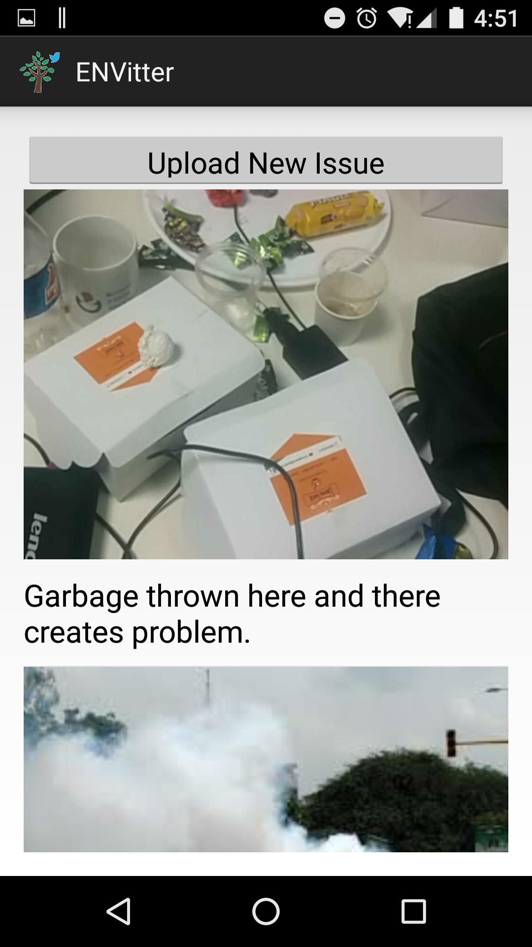

Slide 15
CO-ORDINATION
TECHNOLOGY | TEAM MEMBER
WEBSITE (ADMIN PORTAL) | PRASHANT PATIL LENHERD OLIVERA
ANDROID | CHAITANYA BAPAT JEET KHETAN
SERVICES | SIDDHANT RELE RONAK MEHTA

