Slide 1
FLOWGUARD
FlowGuard
Transformer-Based Network Intrusion Detection System
Multi-class classification of network flows
Computer Networks Project | Team presentation
Presenters: __________________ __________________ __________________
Notes:
Speaker 1 (Project foundations: problem, scope, data and flow inputs). Slide 1.
Good morning. We are presenting FlowGuard, a network intrusion detection research prototype. It classifies completed network flows as benign or one of six attack categories. We will explain the data, models, measured results, and limits of the evidence.
Presenter cue: Add the three presenters' names and confirmed course details before presenting.
Sources: PROJECT_REPORT.pdf; PROJECT_PRESENTATION_FINAL.pptx.

Slide 2
SPEAKER 1 / PROJECT FOUNDATIONS
Problem and project goal
Packet-by-packet inspection is difficult to scale for a student demonstration.
A flow summary turns packets into duration, size, rate, timing and flag statistics.
Goal: classify a completed flow as Benign, DoS, DDoS, Botnet, Port Scan, Brute Force or Infiltration.
The output supports inspection; this prototype does not block traffic.
FlowGuard | Research prototype
02
Notes:
Speaker 1 (Project foundations: problem, scope, data and flow inputs). Slide 2.
The project studies supervised classification of network-flow records. A flow is a summary of traffic between endpoints, so the model works on features extracted from packets rather than raw payload. The intended result is a class prediction to support analysis, not an intrusion prevention action.
Presenter cue: Define a flow in one sentence before listing classes.
Sources: PROJECT_REPORT.pdf, sections 1 and 5; docs/REQUIREMENT_TRACEABILITY.md.

Slide 3
SPEAKER 1 / PROJECT FOUNDATIONS
What the project includes
Implemented in the package
Scope boundaries
Seven-class flow classifier and six baseline comparisons
Temporal and contextual model experiments
Streamlit dashboard, CSV prediction and PCAP replay
Saved checkpoints, metrics, plots and project documentation
CIC-IDS2017 was selected; alternatives were not all evaluated
No custom Mininet, NS-3 or SDN simulation is included
No public hosted site or production deployment is claimed
Live interface capture remains unverified on the source machine
FlowGuard | Research prototype
03
Notes:
Speaker 1 (Project foundations: problem, scope, data and flow inputs). Slide 3.
The delivered project is broad, but we should describe the boundaries as clearly as the features. CIC-IDS2017 was the chosen dataset. Several other datasets were alternatives in the original brief, not training sources. The dashboard is local. Packet replay is included, while physical interface capture still needs validation.
Presenter cue: Do not treat every optional idea in the original checklist as a completed requirement.
Sources: WORK_COMPLETED_AND_TEAM_HANDOFF.pdf, pages 1-2 and 5-6; docs/REQUIREMENT_TRACEABILITY.md.

Slide 4
SPEAKER 1 / PROJECT FOUNDATIONS
Dataset and seven-class test support
Extended feature test split
Class | Test rows
Benign | 450
DoS | 300
DDoS | 300
Botnet | 185
Port Scan | 272
Brute Force | 299
Infiltration | 5
1,811 test flows total. The small Infiltration count limits what its score can establish.
FlowGuard | Research prototype
04
Notes:
Speaker 1 (Project foundations: problem, scope, data and flow inputs). Slide 4.
The seven-class extended feature test contains 1,811 sampled flows. Support is not balanced across classes, and Infiltration has only five examples. That count matters when interpreting its recall or F1. These results describe this fixed sample and do not prove performance on a live network.
Presenter cue: Pause on Infiltration = 5; class support is central to interpreting the metrics.
Sources: results/extended/test_metrics.json; PROJECT_REPORT.pdf, sections 2 and 8.

Slide 5
SPEAKER 1 / PROJECT FOUNDATIONS
Data preparation and split controls
Selected feature vectors were deduplicated; conflicting labels for identical vectors were removed.
The feature benchmark uses stratified 70/15/15 train, validation and test partitions.
Median imputation, signed log transform and standardization are fitted on training rows only.
Validation macro-F1 selects checkpoints; the held-out test split is reserved for reporting.
FlowGuard | Research prototype
05
Notes:
Speaker 1 (Project foundations: problem, scope, data and flow inputs). Slide 5.
The dataset pipeline audits files, maps labels, removes exact selected-feature duplicates and resolves conflicting labels before creating the feature benchmark. Preprocessing is trained only on the training partition, and validation data selects the checkpoint. The report also documents the limits of random splits: related hosts or campaigns may still occur across partitions.
Presenter cue: Say how leakage controls help, then state what they cannot guarantee.
Sources: PROJECT_REPORT.pdf, section 2; results/extended/processed/data_audit.json; docs/REQUIREMENT_TRACEABILITY.md.

Slide 6
SPEAKER 1 / PROJECT FOUNDATIONS
What goes into a model?
Core feature classifier
Context experiments
24 numeric flow statistics
Duration, packet counts and lengths
Rates, inter-arrival times and TCP flags
Strict schema and invalid-row checks
32 numeric context features
Ports, protocol and endpoint indicators
Protocol and state may also use category tokens
Raw IPs group windows and graph edges; state is a FIN/RST proxy
FlowGuard | Research prototype
06
Notes:
Speaker 1 (Project foundations: problem, scope, data and flow inputs). Slide 6.
The core model receives 24 flow statistics. Context experiments add ports, protocol, endpoint-derived features and a state proxy. Raw IP addresses are used to group temporal activity and construct graph edges. Context models use deterministic hash buckets and private-status features, so collisions and dataset-specific topology remain possible.
Presenter cue: Distinguish the core 24-feature input from the larger context input.
Sources: PROJECT_REPORT.pdf, sections 5-6; data/extended/processed/feature_dictionary.csv.

Slide 7
SPEAKER 2 / MODELS AND EVALUATION
Two Transformer tasks
Feature Transformer
Temporal Transformer
One flow becomes feature tokens
Attention relates features within that flow
One output class per flow
Does not model the order of separate flows
Eight flows form an ordered window
Causal mask blocks future-flow influence
The last flow is the prediction target
Windows are non-overlapping and split-contained
FlowGuard | Research prototype
07
Notes:
Speaker 2 (Model design and evaluation: architectures, training and measured results). Slide 7.
There are two distinct attention tasks. The core feature Transformer attends among feature tokens inside one flow. The temporal model attends across a chronological window of eight flow records and predicts the last flow. The CNN, LSTM and GRU baselines scan fixed feature order; they are not temporal traffic models.
Presenter cue: Use this distinction throughout the presentation; do not call every sequence model temporal.
Sources: PROJECT_REPORT.pdf, sections 6-9; docs/DEMO_AND_VIVA.md.

Slide 8
SPEAKER 2 / MODELS AND EVALUATION
Feature Transformer architecture
24 flow values -> training-fitted preprocessing -> value + feature-identity tokens -> CLS token -> 2 encoder layers / 4 heads / dimension 32 -> 7 class logits
The value embedding represents each numeric measurement.
A learned identity embedding tells the encoder which feature each token represents.
The CLS representation feeds the seven-class prediction head.
FlowGuard | Research prototype
08
Notes:
Speaker 2 (Model design and evaluation: architectures, training and measured results). Slide 8.
The feature Transformer tokenizes the 24 input values and adds learned feature identities. A CLS token summarizes the tokens. The encoder has two layers, four attention heads and dimension 32, followed by a seven-class head. It is a feature-relation model for individual flows, not a model of long traffic history.
Presenter cue: Walk left to right and name what each representation means.
Sources: PROJECT_REPORT.pdf, section 7; nids/models.py; artifacts/extended/model_metadata.json.

Slide 9
SPEAKER 2 / MODELS AND EVALUATION
Comparison and training protocol
Models compared
Training controls
Logistic Regression and Random Forest
MLP and CNN
LSTM and GRU
Feature-token Transformer
Shared split and feature rows for the benchmark
Training-only imputation and scaling
Validation macro-F1 chooses the neural checkpoint
One fixed configuration and seed per model
Neural baseline run: AdamW, learning rate 0.001, weighted cross-entropy, batch size 256, gradient clipping and up to 18 epochs.
FlowGuard | Research prototype
09
Notes:
Speaker 2 (Model design and evaluation: architectures, training and measured results). Slide 9.
The seven-model comparison uses matching rows and features. Neural models use AdamW, a learning rate of 0.001, weighted cross-entropy, batch size 256 and gradient clipping, with validation macro-F1 for checkpoint choice. Each model uses one fixed configuration and seed. The evidence is controlled for the delivered split, but not an exhaustive tuning study.
Presenter cue: Mention the one-seed limitation before drawing broad model conclusions.
Sources: PROJECT_REPORT.pdf, sections 7-8; results/extended/model_comparison.csv.

Slide 10
SPEAKER 2 / MODELS AND EVALUATION
Seven-class benchmark results
Key result
Macro-F1 by model (higher is better)
Random Forest
0.9588 macro-F1
Feature Transformer
0.9409 macro-F1
Same sampled seven-class feature split. One configuration and seed per model.
FlowGuard | Research prototype
10
Notes:
Speaker 2 (Model design and evaluation: architectures, training and measured results). Slide 10.
On this fixed split, Random Forest achieved the highest macro-F1 at 0.9588. The feature Transformer scored 0.9409, and CNN scored 0.9539. Random Forest accuracy was 99.23 percent and benign false-positive rate was 0.89 percent; the Transformer reached 97.02 percent accuracy and a 4.44 percent benign false-positive rate. We report the measured baseline winner rather than assuming attention wins.
Presenter cue: Point to the Random Forest bar, then state why this does not prove universal superiority.
Sources: results/extended/model_comparison.csv; PROJECT_REPORT.pdf, section 8.

Slide 11
SPEAKER 2 / MODELS AND EVALUATION
Rare-class support changes the conclusion
5
3 / 5
Infiltration test flows
Transformer detections in this split
Infiltration recall = 0.60; F1 = 0.75 for the feature Transformer.
The result is too small to support a stable rare-attack detection claim.
The benchmark is sampled historical traffic, not the target network.
FlowGuard | Research prototype
11
Notes:
Speaker 2 (Model design and evaluation: architectures, training and measured results). Slide 11.
The Transformer classified three of the five Infiltration test flows correctly, giving 0.60 recall and 0.75 F1 in this split. With only five test examples, a single example changes recall by 20 percentage points. This is an evaluation warning, not evidence that Infiltration detection is dependable.
Presenter cue: Do not hide this result behind overall accuracy.
Sources: results/extended/test_metrics.json; PROJECT_REPORT.pdf, sections 8 and 14.

Slide 12
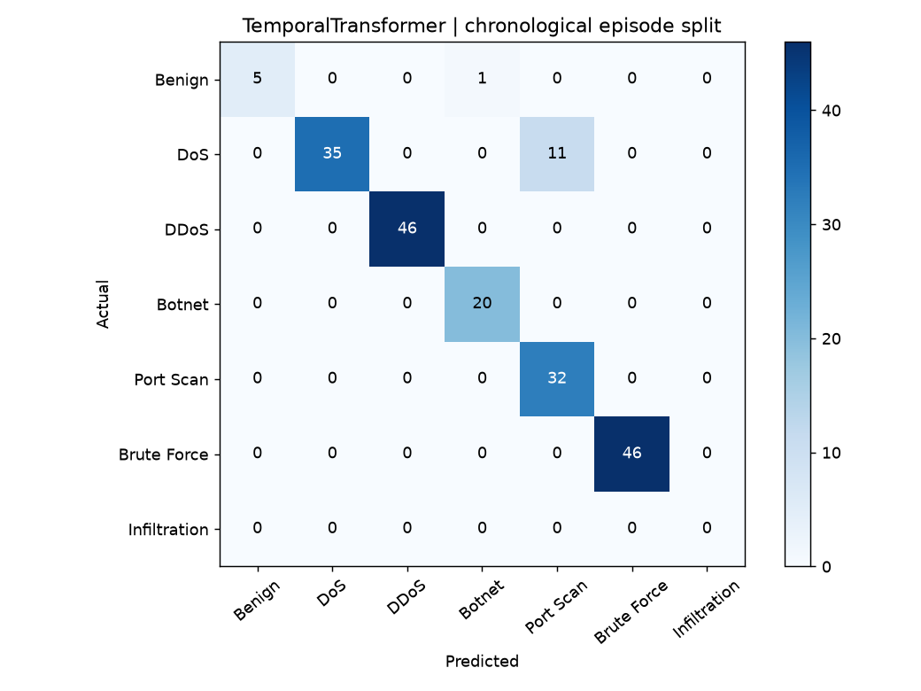
SPEAKER 2 / MODELS AND EVALUATION
Temporal results are a different task
Temporal Transformer
196 held-out endpoints from non-overlapping eight-flow windows
Accuracy 93.88%; seven-label macro-F1 0.8003
No Infiltration endpoint and only six Benign endpoints
Different prediction rows from the individual-flow benchmark
The empty Infiltration row is an evaluation gap, not a zero-error result.
FlowGuard | Research prototype
12
Notes:
Speaker 2 (Model design and evaluation: architectures, training and measured results). Slide 12.
The temporal model predicts the endpoint of complete eight-flow windows. It scored 93.88 percent accuracy and 0.8003 macro-F1 across seven labels on 196 endpoints. The test split contains no Infiltration endpoint and only six Benign endpoints. Those outputs are not directly comparable with the individual-flow benchmark because the evaluation units differ.
Presenter cue: Point out the missing Infiltration support on the confusion matrix.
Sources: results/advanced/test_metrics.json; results/advanced/plots/TemporalTransformer_confusion.png; PROJECT_REPORT.pdf, section 9.

Slide 13
SPEAKER 3 / EXTENSIONS AND PROJECT DEMO
Context models add network signals
Advanced individual-flow experiment
Model | Accuracy | Macro-F1 | Rows
BERTStyleEncoder | 97.19% | 0.9111 | 3,526
TabTransformer | 95.09% | 0.8647 | 3,526
FlowViT | 95.26% | 0.8892 | 3,526
FlowGraphNetwork | 89.17% | 0.6782 | 3,526
These are experiment results, not proof that an architecture generalizes better to another network.
FlowGuard | Research prototype
13
Notes:
Speaker 3 (Extensions and handoff: context models, demo, limitations and conclusion). Slide 13.
The context models use additional network information in different ways. BERTStyleEncoder is a bidirectional feature encoder trained from scratch; TabTransformer embeds categorical inputs; FlowViT uses numerical patches; and the graph network connects flows sharing an endpoint inside a batch. Each produced 3,526 individual-flow test outputs. These experimental rows should be interpreted with the documented protocol and topology limits.
Presenter cue: Explain one model representation; emphasize that BERT-style is not pretrained BERT.
Sources: results/advanced/model_comparison.csv; PROJECT_REPORT.pdf, section 10.

Slide 14
SPEAKER 3 / EXTENSIONS AND PROJECT DEMO
Adaptation studies are simulations
Local FedAvg simulation
Supervised online learning
Three simulated IID clients run in one process
Three aggregation rounds; sample-count weighting
Validation macro-F1: 0.8402 -> 0.8437 -> 0.8491
No distributed transport, privacy or secure aggregation
Predict a chronological chunk before labels are revealed
Update only with observed true labels
Page-Hinkley monitors increased chunk loss
No automatic pseudo-labeling of model predictions
FlowGuard | Research prototype
14
Notes:
Speaker 3 (Extensions and handoff: context models, demo, limitations and conclusion). Slide 14.
The FedAvg experiment simulates three local clients and sample-weighted model aggregation over three rounds; it does not provide a privacy guarantee. The online experiment predicts before revealing true labels and updates with those labels. It is a supervised adaptation study, not unlabeled online learning.
Presenter cue: Use the word simulation; do not claim privacy or real-world drift validation.
Sources: results/advanced/federated_rounds.json; results/advanced/online_prequential.csv; PROJECT_REPORT.pdf, section 11.

Slide 15
SPEAKER 3 / EXTENSIONS AND PROJECT DEMO
Explainability and anomaly flags
SHAP example: 0.199805 reference probability + 0.799384 attribution sum = 0.999189 DDoS probability.
Saved LIME surrogate R-squared is 0.1440, which indicates weak local fit.
Benign-trained Isolation Forest: 1.11% test benign false-alert rate; 1.98% known-attack recall.
These tools describe model behavior; they do not prove causality or zero-day detection.
FlowGuard | Research prototype
15
Notes:
Speaker 3 (Extensions and handoff: context models, demo, limitations and conclusion). Slide 15.
The saved SHAP example reports its reference probability, attribution sum and reconstructed DDoS probability. The LIME example has R-squared 0.1440, which is weak fidelity and limits interpretation. The anomaly flag is based on a benign-trained Isolation Forest, but its known-attack recall is only 1.98 percent. Neither method establishes causal explanations or zero-day reliability.
Presenter cue: Lead with the LIME limitation and the weak anomaly recall.
Sources: PROJECT_REPORT.pdf, section 12; results/explanations/shap.csv; results/extended/anomaly_metrics.json.

Slide 16
SPEAKER 3 / EXTENSIONS AND PROJECT DEMO
Packet replay and capture path
PCAP / passive IPv4 TCP-UDP capture -> bounded bidirectional flow aggregation -> saved classifier -> JSONL prediction events
Synthetic replay: 48 packets became 12 completed flows.
Recorded run: 0.207 seconds, about 58 flows per second on the tiny sample.
No attack ground truth was attached to the synthetic replay.
Npcap is required for live capture; physical interface operation was not verified.
FlowGuard | Research prototype
16
Notes:
Speaker 3 (Extensions and handoff: context models, demo, limitations and conclusion). Slide 16.
The monitor groups IPv4 TCP and UDP packets into bounded bidirectional flows, predicts completed flows and writes JSONL records. The synthetic replay processed 48 packets into 12 events in 0.207 seconds, about 58 flows per second. This tiny plumbing run is not a production benchmark or attack-accuracy evaluation. Live capture requires Npcap and target-interface validation.
Presenter cue: Describe this as packet-to-event plumbing, not real-time attack detection.
Sources: results/pcap_replay.summary.json; PROJECT_REPORT.pdf, section 13; nids/capture.py; scripts/monitor.py.

Slide 17
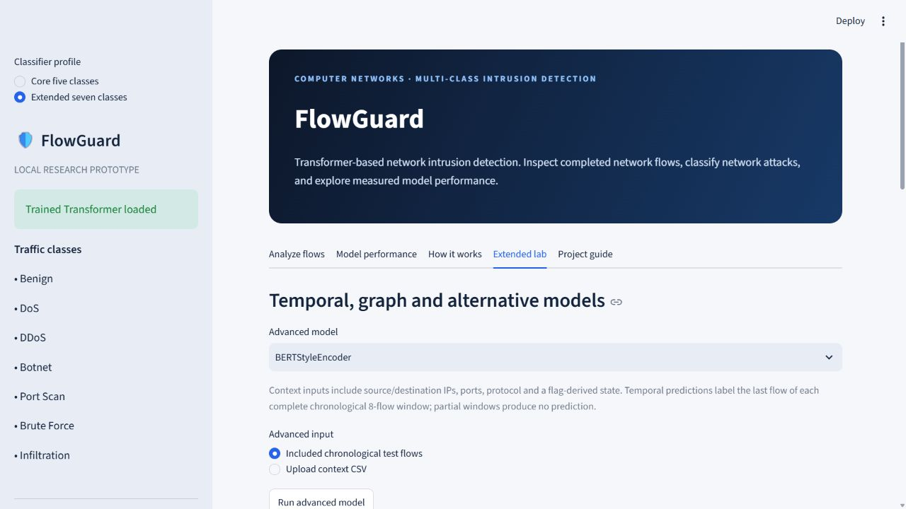
SPEAKER 3 / EXTENSIONS AND PROJECT DEMO
Local dashboard demonstration
Demo sequence
Open the local app at http://127.0.0.1:8502.
Choose Extended seven classes and classify included examples.
Show Model performance and per-class support.
If time allows, open Extended lab and run one saved model.
This interface is local to the running computer; it is not a public website.
FlowGuard | Research prototype
17
Notes:
Speaker 3 (Extensions and handoff: context models, demo, limitations and conclusion). Slide 17.
The dashboard provides profile selection, sample classification, metrics, model comparisons and an Extended lab. We can show the current local app at http://127.0.0.1:8502. Start with included samples, open performance and class support, then show one advanced model if time permits. If the app is unavailable, use the supplied screenshot and do not claim that physical capture was demonstrated.
Presenter cue: Presenter 3 controls the screen. Presenter 2 handles metric questions.
Sources: docs/screenshots/extended_lab.jpg; app.py; CODEX_HANDOFF.md.

Slide 18
SPEAKER 3 / EXTENSIONS AND PROJECT DEMO
What remains to validate
Install Npcap and validate physical capture on an authorized interface.
Measure feature-extraction parity against the training data definition.
Add more rare Infiltration examples and independent host or campaign holdouts.
Repeat model runs across seeds and test external datasets and target-network false alerts.
FlowGuard | Research prototype
18
Notes:
Speaker 3 (Extensions and handoff: context models, demo, limitations and conclusion). Slide 18.
The main follow-up work is validation. Physical capture needs an installed driver and interface testing. The packet extractor must be compared with the training feature definitions. The experiments need more rare-class sequences, stronger host or campaign holdouts, more seeds and external datasets. Target-network false-alert rates and load also need evaluation before considering deployment.
Presenter cue: Present these as the next research steps; do not imply they have already been done.
Sources: WORK_COMPLETED_AND_TEAM_HANDOFF.pdf, pages 4 and 6; PROJECT_REPORT.pdf, section 14.

Slide 19
SPEAKER 3 / EXTENSIONS AND PROJECT DEMO
Conclusion and selected references
Conclusion
Selected references
A reproducible research prototype joins flow classification, model comparisons and a local demo.
Random Forest led the delivered feature benchmark; the Transformer did not win this run.
No claim of production readiness, new architecture or zero-day reliability is supported.
Sharafaldin et al. (2018), CIC-IDS2017
Vaswani et al. (2017), Attention Is All You Need
Kipf and Welling (2016), Graph Convolutional Networks
McMahan et al. (2017), Federated Averaging; Lundberg and Lee (2017), SHAP
FlowGuard | Research prototype
19
Notes:
Speaker 3 (Extensions and handoff: context models, demo, limitations and conclusion). Slide 19.
To conclude, this project provides a reproducible implementation and an honest evaluation of established methods. In this benchmark, Random Forest outperformed the feature Transformer. The project does not establish architecture novelty, production readiness or zero-day reliability. Thank you; we are ready for questions. Full references are in the report.
Presenter cue: Close together and invite questions. Add confirmed names and institution details before submission.
Sources: PROJECT_REPORT.pdf, references and section 14; docs/REQUIREMENT_TRACEABILITY.md.

