Slide 1
Diffusion Filtering analysis

Slide 2
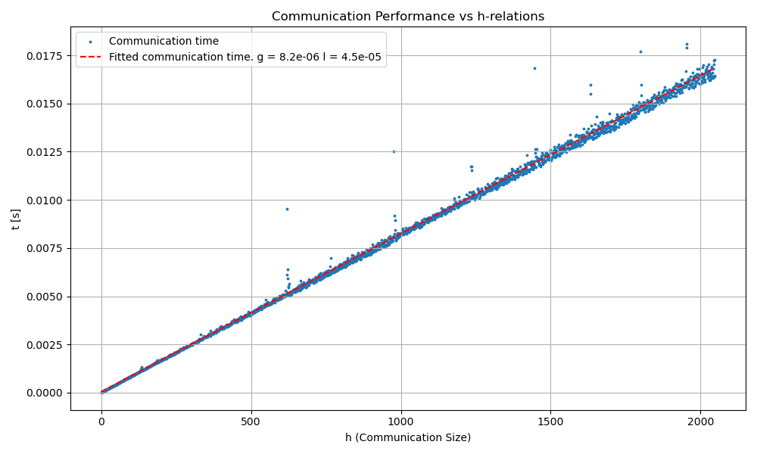
Benchmarking data

Slide 3
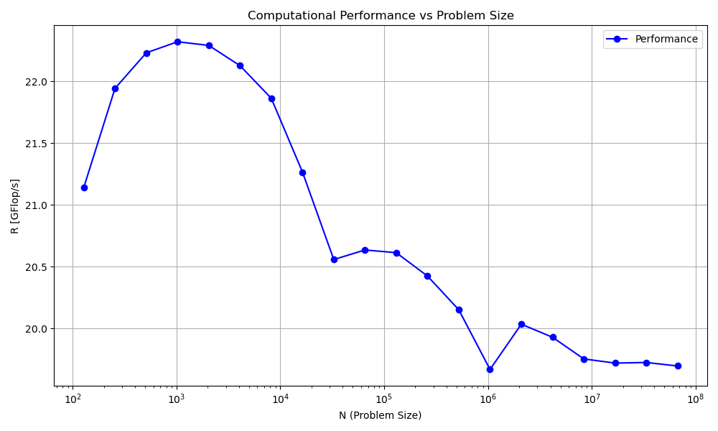
Benchmarking data

Slide 4
Algorithm key points
- Filter the entire image globally. No local filtering
- Innerproduct algorithm used: butterfly reduction
- Always uses square distribution for processors.
So only works for processors which are perfect squares
- Take problem size with a grain of salt.
Pixels are added so that n/sqrt(p) is an integer

Slide 5
Cost analysis of CG algorithm
OR

Slide 6
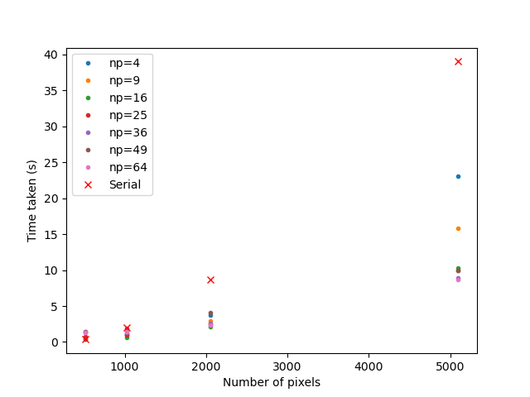
Results
Lambda = 0.1
Sigma = 0.5

Slide 7
Amdahls and gustafsons law
Serial part ~ 10%
Parallel part ~ 90%
Predicted Amdahl speedup: ~9
Actual speed up: ~4
n = 5096; p = 64

Slide 8
Results
Lambda = 0.1
Sigma = 0.5

