Slide 1
MVVM [#3]
By CHAICHANA SRASOM
Mobile: 064-985-9632 Email: Chaichana.ss@sp-vt.com
Address : 5/1 Moo 8, Samrong-Nue, Muang, Samutprakarn 10270
Email: sales@sp-vt.com , Tel: +662-186-4572 , +662-186-4584 , Fax: +662-186-4573

Slide 2
WPF Template
git clone https://github.com/Chaichanaspvt/Training_wpf.git
git pull origin master
git pull --rebase origin master

Slide 3
Structure Project
Model
ViewModels
Views
Camera_Manager
Environment
Toolbase_Manager
Binding
Ui design
Image and etc.
HEnige_Manager
Path ,data In/out
---- Develop
---- Project

Slide 4
UI Design
Design by WPF

Slide 5
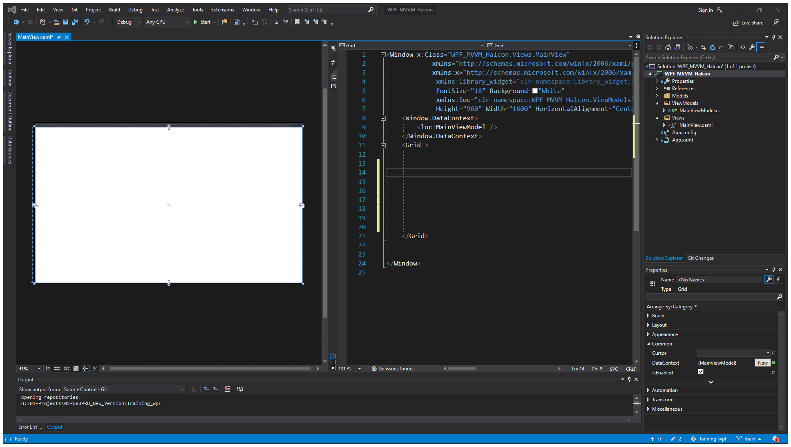

Slide 6
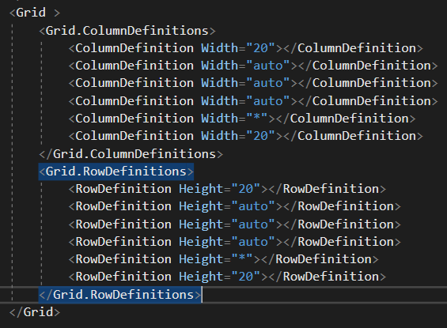
Grid Format
Column 0
0,0 | 0,1
1,0
Row 0

Slide 7
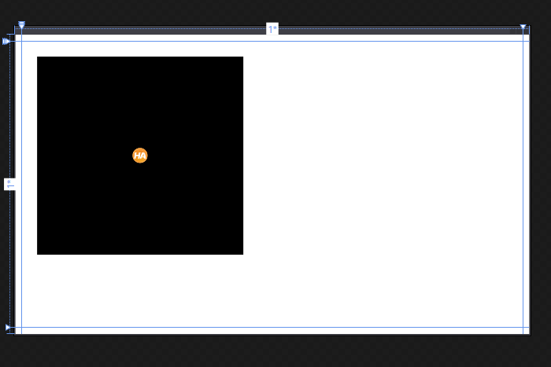
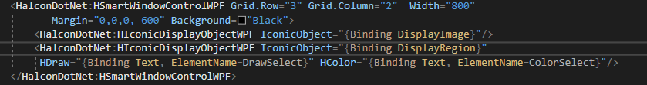
HsmartWindowWPF
<HalconDotNet:HIconicDisplayObjectWPF IconicObject="{Binding DisplayImage}"/>
<HalconDotNet:HIconicDisplayObjectWPF IconicObject="{Binding DisplayRegion}"

Slide 8
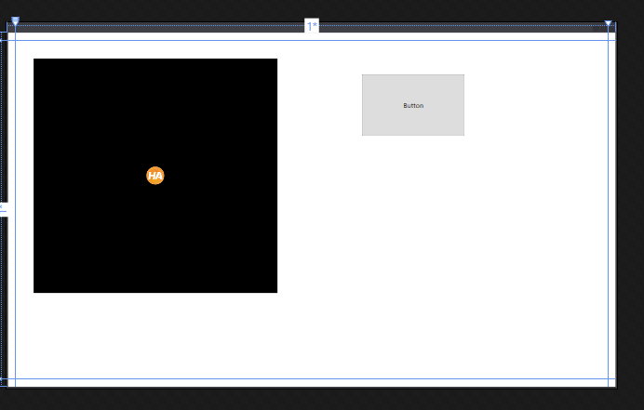

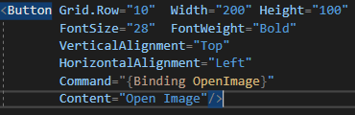
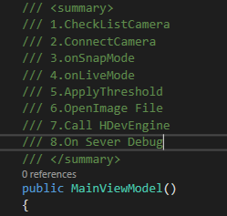
Button and Function
Open Image button
Command list

