Slide 1

CUSTOMER HEALTH SCORE
PRESENTED BY : CHAIMA JELASSI

Slide 2
OUTLINE
INTRODUCTION
DATA QUALITY & IMPLEMENTATION
FINDINGS
ALTERNATIVE SOLUTION
LIMITS & FURTHER AMELIORATIONS

Slide 3

INTRODUCTION
Notes:
For the implementation of ths test I used SQL FOR THE DATA INTEGRATION AND TRANSFORMATION
POWERBI DESKTOP FOR THE REPORTING

Slide 4

DATA QUALITY & IMPLEMENTATION
CUSTOMERS
CONTRACTS
PRODUCT USAGE
CERTIFICATIONS
NET PROMOTER SCORE
SUPPORT TICKETS
Notes:
I worked only with customers who have a contract status = "renewed_or_still_active".
2. The product usage Tab collects the activity of customers per month. ( several lines per customer )
3. The cetifications Tab collects data about the certifications taken by customers. ( several lines per customer )
4. The net promoter score Tab collects data about the ratings of the product by customers. ( several lines per customer )
5. The support tickets Tab collects data about the tickets opened by customers. ( several lines per customer )
6. For 2,3,4,and 5, I processed data and got a line per customer as an output. 7. Categorical Features selected were converted to numerical.

Slide 5

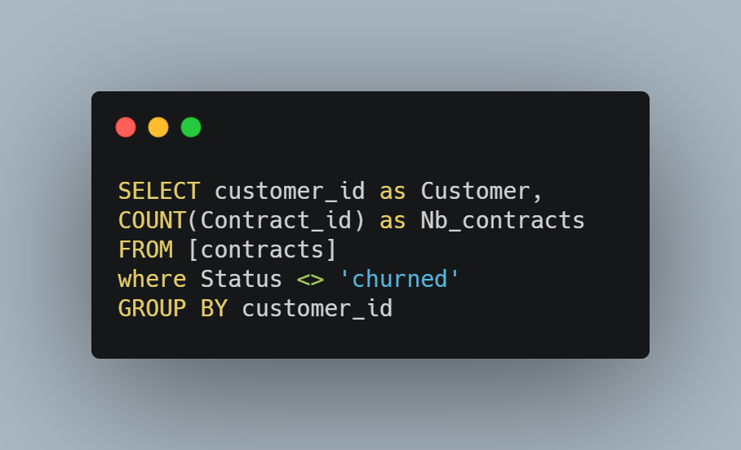
DATA QUALITY & IMPLEMENTATION
Kept customers with contract status <> “churn“ : 535 customer
Notes:
I worked only with customers who have a contract status = "renewed_or_still_active".
2. The product usage Tab collects the activity of customers per month. ( several lines per customer )
3. The cetifications Tab collects data about the certifications taken by customers. ( several lines per customer )
4. The net promoter score Tab collects data about the ratings of the product by customers. ( several lines per customer )
5. The support tickets Tab collects data about the tickets opened by customers. ( several lines per customer )
6. For 2,3,4,and 5, I processed data and got a line per customer as an output. 7. Categorical Features selected were converted to numerical.

Slide 6
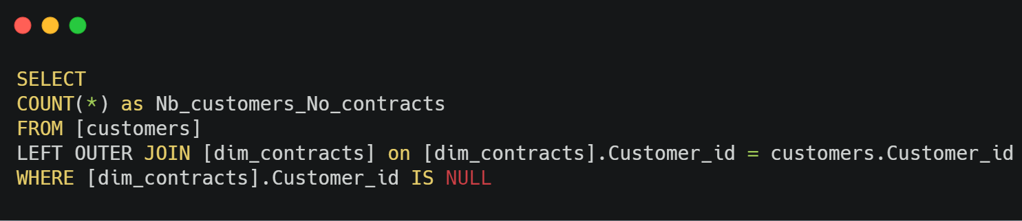
DATA QUALITY & IMPLEMENTATION
Excluded customers with no contratcs ➔ 45 customer
Notes:
I worked only with customers who have a contract status = "renewed_or_still_active".
2. The product usage Tab collects the activity of customers per month. ( several lines per customer )
3. The cetifications Tab collects data about the certifications taken by customers. ( several lines per customer )
4. The net promoter score Tab collects data about the ratings of the product by customers. ( several lines per customer )
5. The support tickets Tab collects data about the tickets opened by customers. ( several lines per customer )
6. For 2,3,4,and 5, I processed data and got a line per customer as an output. 7. Categorical Features selected were converted to numerical.

Slide 7




DATA QUALITY & IMPLEMENTATION
CERTIFICATIONS
PRODUCT USAGE
certif_level
days_of_activity
NET PROMOTER SCORE
SUPPORT TICKETS
nps_score
Satisfaction_score
What features to select for the Customer Health Score calculation?
Notes:
[NB_certifications] AS [Number of certifications],
[Final_certification_Scores],
[Final_nps_scores],
[nb_tickets] as [Number of Tickets],
[Final_support_tickets_Scores] ,
[Nb_months] as [Number of activity months],
all_activity_in_days as [Number days of activity],
Nb_active_users as [Number of Active Users],
Total_hours as [Number hours of activity],
[Final_product_usage_score],

Slide 8




DATA QUALITY & IMPLEMENTATION
PRODUCT USAGE
Final_product_usage_score
Avg_score_per_month
Customer
PRODUCT USAGE
days_of_activity

Slide 9
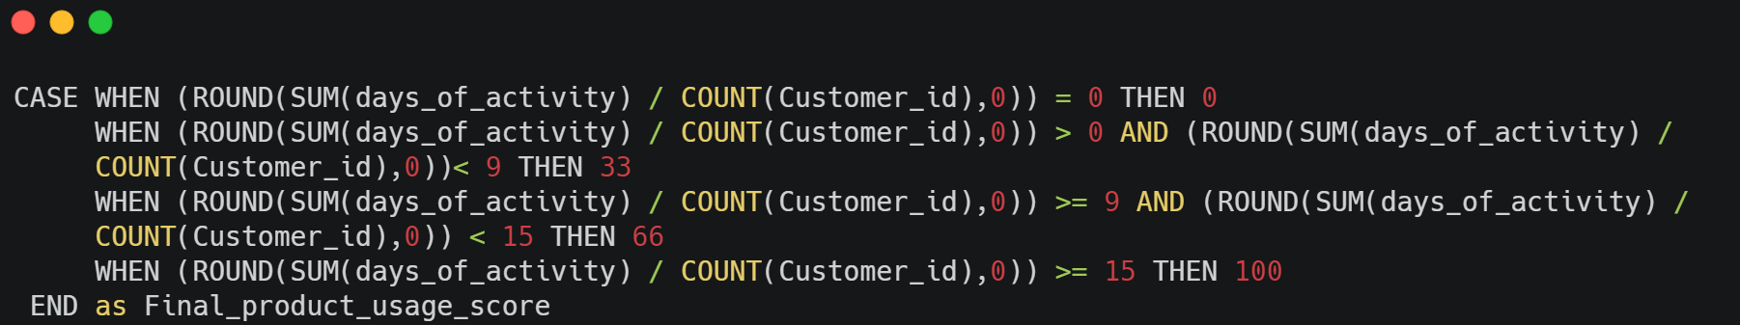
DATA QUALITY & IMPLEMENTATION
PRODUCT USAGE

Slide 10
DATA QUALITY & IMPLEMENTATION
NET PROMOTER SCORE
Final_nps_scores
Avg_score_nps
Customer
NET PROMOTER SCORE
Nps_score
Notes:
The net promoter score Tab collects data about the ratings of the product by customers. ( several lines per customer )

Slide 11
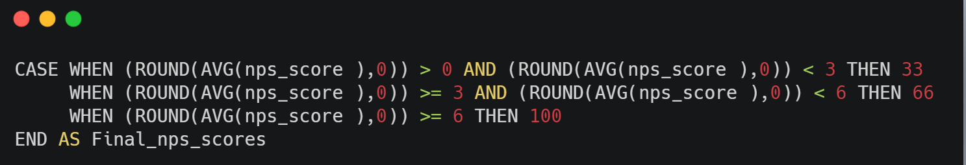
DATA QUALITY & IMPLEMENTATION
NET PROMOTER SCORE
Notes:
The net promoter score Tab collects data about the ratings of the product by customers. ( several lines per customer )

Slide 12

DATA QUALITY & IMPLEMENTATION
SUPPORT TICKETS
Final_support_tickets_Scores
Customer
SUPPORT TICKETS
Satisfaction_score
Satisfaction_Scores
_Numerical
Avg_support
_tickets_scores

Slide 13
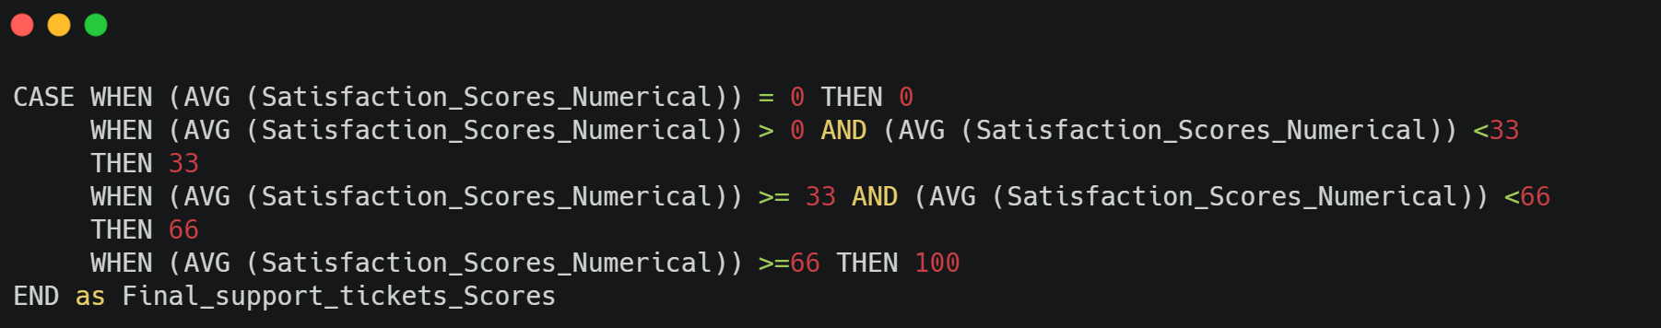
DATA QUALITY & IMPLEMENTATION
SUPPORT TICKETS

Slide 14
DATA QUALITY & IMPLEMENTATION
CERTIFICATIONS
Customer
CERTIFICATIONS
Certif_level
Certification_score_Numerical
Avg_certification_Scores
Final_certification_Scores

Slide 15
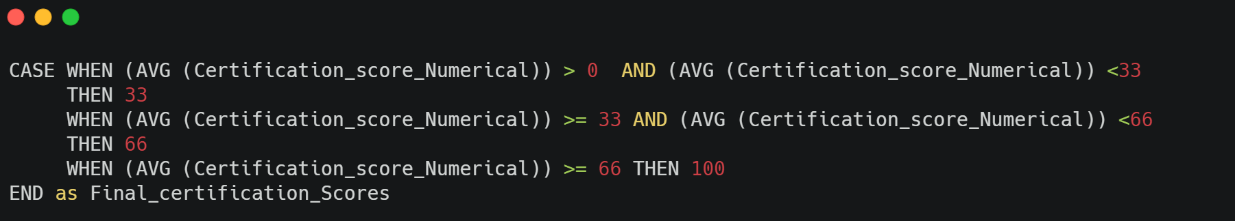
DATA QUALITY & IMPLEMENTATION
CERTIFICATIONS

Slide 16
DATA QUALITY & IMPLEMENTATION
TO SUM UP
Categorical Features selected were converted to numerical.
Scale of the selected features final scores calculated is an interval of 0..100.
Processed data and had one customer per line as an output.
Notes:
I worked only with customers who have a contract status = "renewed_or_still_active".
2. The product usage Tab collects the activity of customers per month. ( several lines per customer )
3. The cetifications Tab collects data about the certifications taken by customers. ( several lines per customer )
4. The net promoter score Tab collects data about the ratings of the product by customers. ( several lines per customer )
5. The support tickets Tab collects data about the tickets opened by customers. ( several lines per customer )
6. For 2,3,4,and 5, I processed data and got a line per customer as an output. 7. Categorical Features selected were converted to numerical.

Slide 17


DATA QUALITY & IMPLEMENTATION
CALCULATION
30%
30%
30%
10%
PRODUCT USAGE
NET PROMOTER SCORE
SUPPORT TICKETS
CERTIFICATION
$$CHS= \sum{(Final scores ∗Percentages) }$$
Notes:
product usage: 30% from the global CHS Score
net promoter: score 30% from the global CHS Score
satisfaction: 30% from the global CHS Score
certification: 10% from the global CHS Score

Slide 18
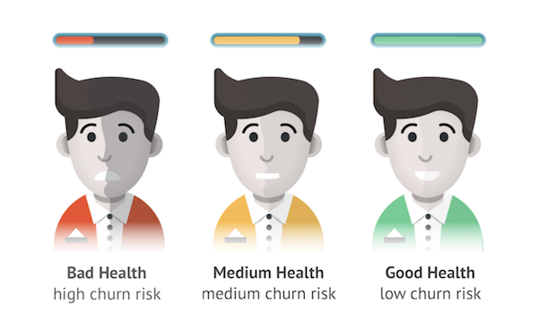
FINDINGS

Slide 19
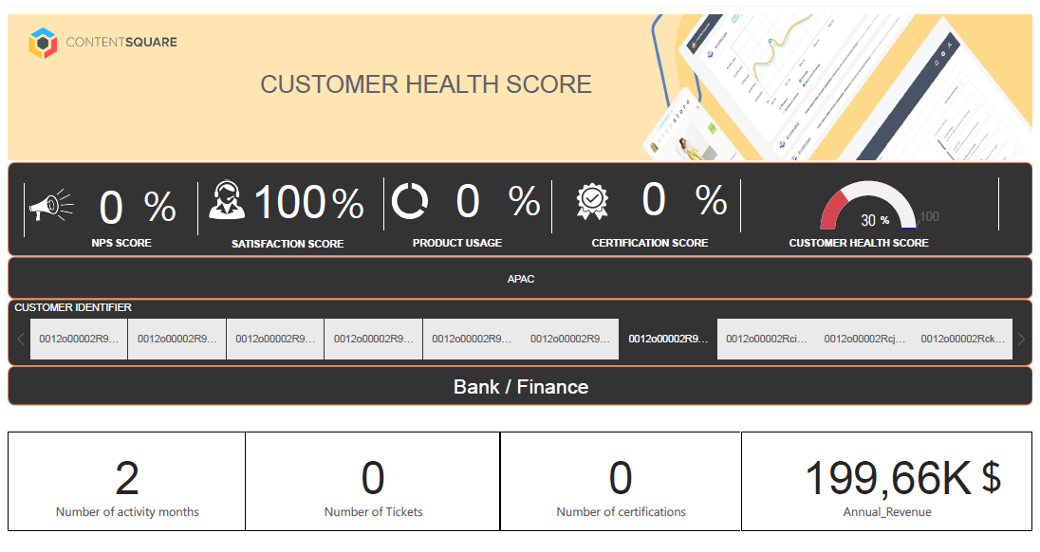
FINDINGS

Slide 20
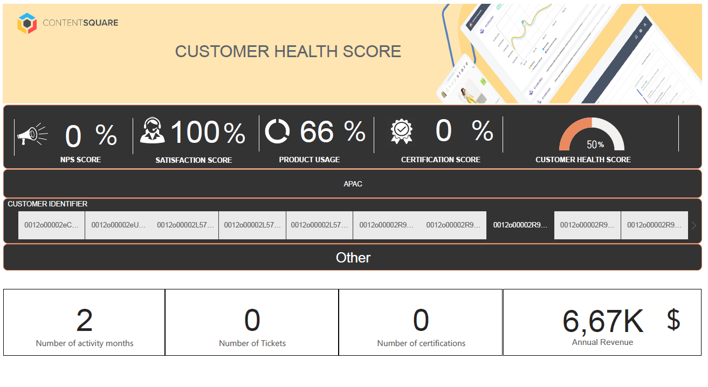
FINDINGS

Slide 21
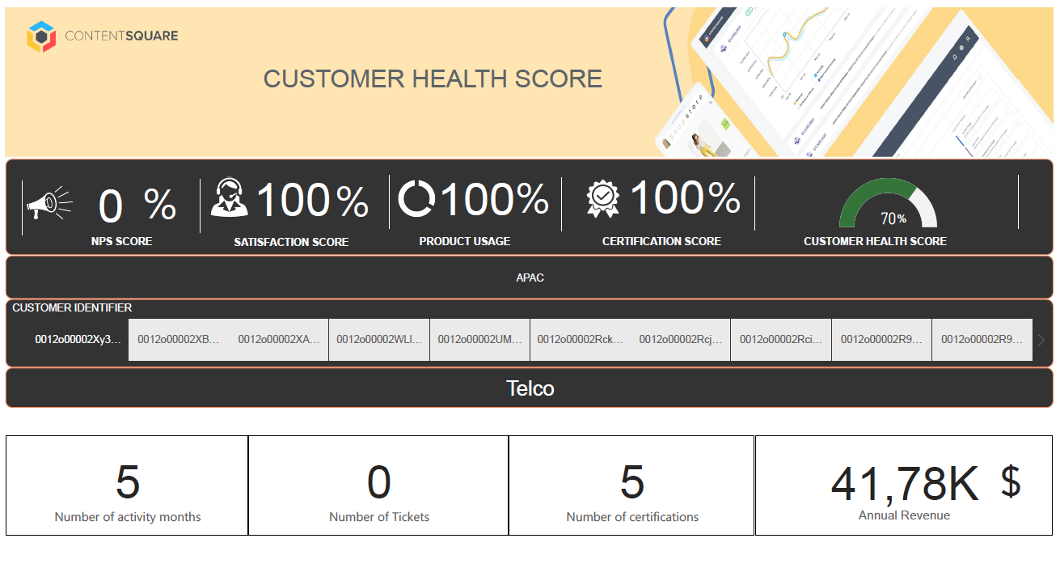
FINDINGS

Slide 22
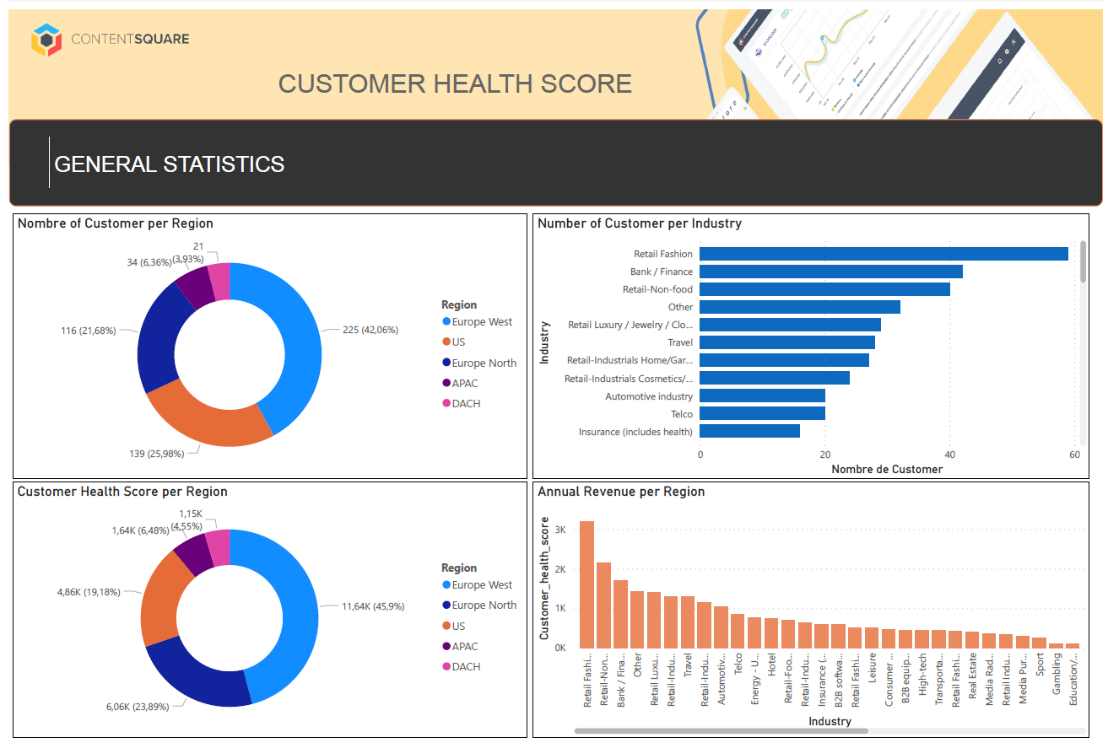
FINDINGS
Notes:
To validate the CHS score calculated

Slide 23
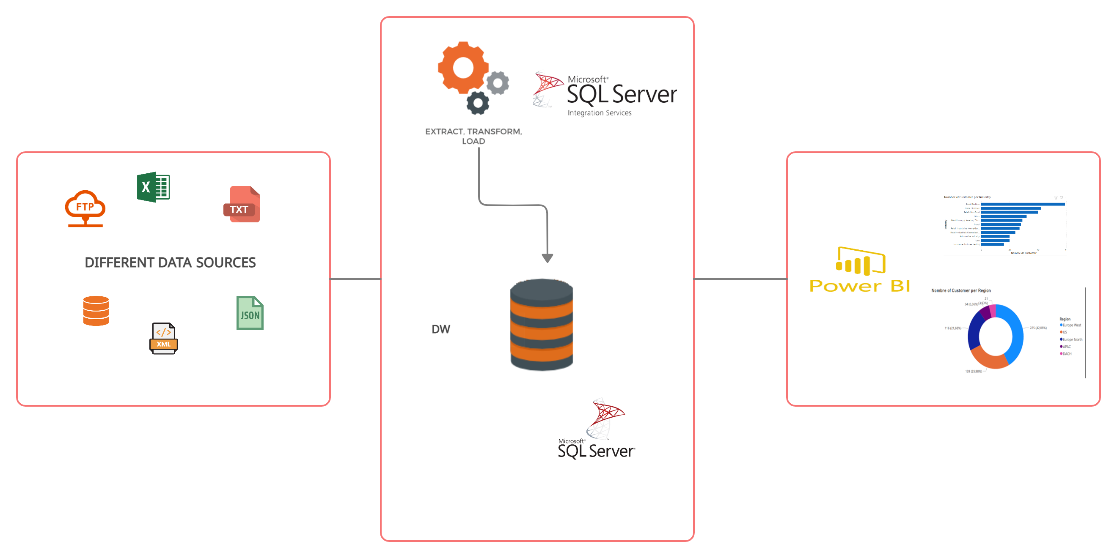
ALTERNATIVE SOLUTIONS
Notes:
This will be my etl schema if each sheet came from diffrent source/tool

Slide 24
LIMITS & FURTHER AMELIORATIONS
Each customer is unique ➔ Adapt the formula based on that.
Eg: if a customer did not take any certification ➔ the feature does not have to be included in the score.
Exclude Final_support_tickets_Scores from the formula and replace it with NB_tickets to have a more accurate score.
Eg: if the customer is satisfied with the application and he is not struggling ➔ will not open support tickets.
To base the calculation upon the NB_tickets opened by the customer instead of his satisfaction_score.
Add new features to the calculation of CHS:
Eg : add external data to see if the C-level execs are users of your solution?
Notes:
Each customer is unique ➔ Adapt the formula based on that.
Eg: if a customer did not take any certification ➔ the feature does not have to be included in the score.
Exclude Final_support_tickets_Scores from the formula and replace it with NB_tickets to have a more accurate score.
Eg: if the customer is satisfied with the application and he is not struggling ➔ will not open support tickets.
To base the calculation upon the NB_tickets opened by the customer instead of his satisfaction_score.
Add new features to the calculation of CHS:
Eg : add external data to see if the C-level execs are users of your solution? I believe that is a good features to add to the score.

Slide 25
THANK YOU

