Slide 1
Security at Application layer level
PGP

Slide 2
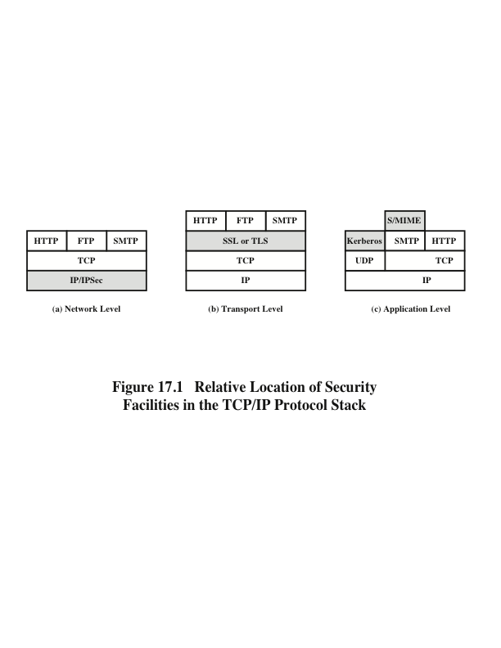
Notes:
A number of approaches to providing Web security are possible. The various approaches
that have been considered are similar in the services they provide and, to
some extent, in the mechanisms that they use, but they differ with respect to their
scope of applicability and their relative location within the TCP/IP protocol stack.
Figure 17.1 illustrates this difference. One way to provide Web security is
to use IP security (IPsec) (Figure 17.1a). The advantage of using IPsec is that it is
transparent to end users and applications and provides a general-purpose solution.
Furthermore, IPsec includes a filtering capability so that only selected traffic need
incur the overhead of IPsec processing.
Another relatively general-purpose solution is to implement security just
above TCP (Figure 17.1b). The foremost example of this approach is the Secure
Sockets Layer (SSL) and the follow-on Internet standard known as Transport
Layer Security (TLS). At this level, there are two implementation choices. For full
generality, SSL (or TLS) could be provided as part of the underlying protocol suite
and therefore be transparent to applications. Alternatively, SSL can be embedded
in specific packages. For example, Netscape and Microsoft Explorer browsers come
equipped with SSL, and most Web servers have implemented the protocol.
Application-specific security services are embedded within the particular
application. Figure 17.1c shows examples of this architecture. The advantage of this
approach is that the service can be tailored to the specific needs of a given application.

Slide 3
Email Security
email is one of the most widely used and regarded network services
currently message contents are not secure
may be inspected either in transit
or by suitably privileged users on destination system
Notes:
In virtually all distributed environments, electronic mail is the most heavily used network-based application. But current email services are roughly like "postcards”, anyone who wants could pick it up and have a look as its in transit or sitting in the recipients mailbox.

Slide 4
Email Security Enhancements
confidentiality
protection from disclosure
authentication
of sender of message
message integrity
protection from modification
non-repudiation of origin
protection from denial by sender
Notes:
With the explosively growing reliance on electronic mail for every conceivable purpose, there grows a demand for authentication and confidentiality services. What we want is something more akin to standard mail (contents protected inside an envelope) if not registered mail (have confidence about the sender of the mail and its contents). That is, the “classic” security services listed are desired.

Slide 5
Pretty Good Privacy (PGP)
widely used de facto secure email
developed by Phil Zimmermann
selected best available crypto algs to use
integrated into a single program
on Unix, PC, Macintosh and other systems
originally free, now also have commercial versions available
Notes:
The Pretty Good Privacy (PGP) secure email program, is a remarkable phenomenon, has grown explosively and is now widely used. Largely the effort of a single person, Phil Zimmermann, who selected the best available crypto algorithms to use & integrated them into a single program, PGP provides a confidentiality and authentication service that can be used for electronic mail and file storage applications. It runs on a wide range of systems, in both free & commercial versions.

Slide 6
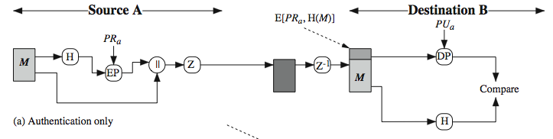
PGP Operation – Authentication
sender creates message
make SHA-1160-bit hash of message
attached RSA signed hash to message
receiver decrypts & recovers hash code
receiver verifies received message hash
Notes:
The actual operation of PGP, as opposed to the management of keys, consists of four services: authentication, confidentiality, compression, and e-mail compatibility. Stallings Figure 18.1a illustrates the digital signature service provided by PGP. This is the digital signature scheme discussed in Chapter 13 and illustrated in Figure 13.2. The sequence is as listed. Note this assumes use of RSA digital signatures, created using the sender's private key, and verified with the sender's public key. Recent PGP versions also support the use of DSS signatures. Signatures can also be detached from a message/file and sent/stored separately. This can be useful to maintain a separate signature log of all messages sent or received; or on an executable program to detect subsequent virus infection, or when more than one party must sign a document.

Slide 7
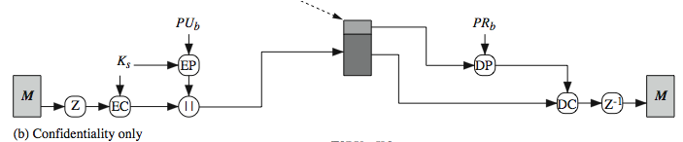
PGP Operation – Confidentiality
sender forms 128-bit random session key
encrypts message with session key
attaches session key encrypted with RSA
receiver decrypts & recovers session key
session key is used to decrypt message
Notes:
Another basic service provided by PGP is confidentiality, provided by encrypting messages to be transmitted or to be stored locally as files, using symmetric encryption algorithms CAST-128, IDEA or 3DES in 64-bit cipher feedback (CFB) mode. The randomly chosen session key used for this is sent encrypted using the recipient’s public RSA key. The steps used in this process are as listed. Stallings Figure 18.1b illustrates the sequence. Recent PGP versions also support the use of ElGamal (a Diffie-Hellman variant) for session-key exchange.

Slide 8
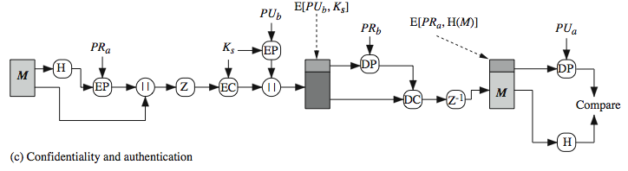
PGP Operation – Confidentiality & Authentication
can use both services on same message
create signature & attach to message
encrypt both message & signature
attach RSA/ElGamal encrypted session key
Notes:
As Stallings Figure 18.1c illustrates, both confidentiality & authentication services may be used for the same message. Firstly a signature is generated for the plaintext message and prepended to the it. Then the plaintext message plus signature is encrypted using CAST-128 (or IDEA or 3DES), and the session key is encrypted using RSA (or ElGamal). This sequence is preferable to the opposite: encrypting the message and then generating a signature for the encrypted message. It is generally more convenient to store a signature with a plaintext version of a message. Furthermore, for purposes of third-party verification, if the signature is performed first, a third party need not be concerned with the symmetric key when verifying the signature. In summary, when both services are used, the sender first signs the message with its own private key, then encrypts the message with a session key, and then encrypts the session key with the recipient's public key.

Slide 9
PGP Operation – Compression
by default PGP compresses message after signing but before encrypting
so can store uncompressed message & signature for later verification
& because compression is non deterministic
uses ZIP compression algorithm
Notes:
By default PGP compresses the message after applying the signature but before encryption. This has the benefit of saving space both for e-mail transmission and for file storage. The signature is generated before compression for the reasons shown. The compression algorithm used is ZIP, and is indicated by Z for compression and Z–1 for decompression in Figure 18.1. It is described in Online Appendix O.

Slide 10
PGP Operation – Email Compatibility
when using PGP we’ll have binary data to send (encrypted message etc)
however email was designed only for text
hence PGP must encode raw binary data into printable ASCII characters
uses radix-64 algorithm
maps 3 bytes to 4 printable chars
also appends a CRC
PGP also segments messages if too big
Notes:
When PGP is used, at least part of the block to be transmitted is encrypted, and thus consists of a stream of arbitrary 8-bit octets. However many electronic mail systems only permit the use of ASCII text. To accommodate this restriction, PGP provides the service of converting the raw 8-bit binary stream to a stream of printable ASCII characters. It uses radix-64 conversion, in which each group of three octets of binary data is mapped into four ASCII characters. The use of radix 64 expands a message by 33%. Fortunately, the session key and signature portions of the message are relatively compact, and the plaintext message has been compressed, often by more than enough to compensate for the radix-64 expansion. This format also appends a CRC to detect transmission errors. See Stallings Appendix 18A for a description.
PGP also automatically subdivides a message that is too large for a single email, into segments that are small enough to send.

Slide 11
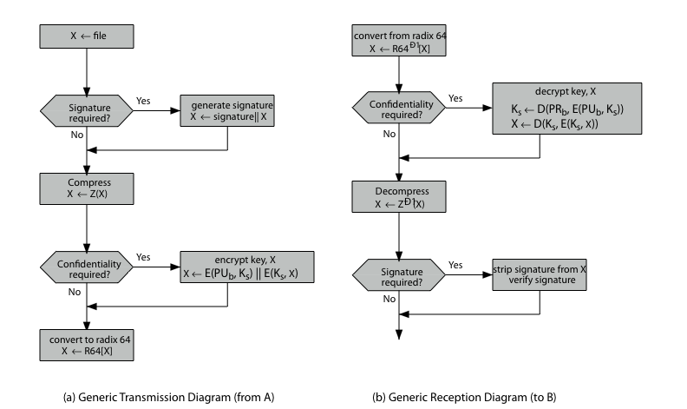
PGP Operation – Summary
Notes:
Stallings Figure 18.2 illustrates the general operation of PGP, and the relationship between the services discussed. On transmission, if it is required, a signature is generated using a hash code of the uncompressed plaintext. Then the plaintext, plus signature if present, is compressed. Next, if confidentiality is required, the block (compressed plaintext or compressed signature plus plaintext) is encrypted and pre-pended with the public-key-encrypted symmetric encryption key. Finally, the entire block is converted to radix-64 format.
On reception, the incoming block is first converted back from radix-64 format to binary. Then, if the message is encrypted, the recipient recovers the session key and decrypts the message. The resulting block is then decompressed. If the message is signed, the recipient recovers the transmitted hash code and compares it to its own calculation of the hash code.

Slide 12
PGP Session Keys
need a session key for each message
of varying sizes: 56-bit DES, 128-bit CAST or IDEA, 168-bit Triple-DES
generated using ANSI X12.17 mode
uses random inputs taken from previous uses and from keystroke timing of user
Notes:
PGP makes use of four types of keys: one-time session symmetric keys, public keys, private keys, and passphrase-based symmetric keys.
Each session key is associated with a single message and is used only for the purpose of encrypting and decrypting that message, using a symmetric encryption algorithm, such as CAST-128 and IDEA with 128-bit keys; or 3DES with a 168-bit key. Random numbers are generated using the ANSI X12.17 generator, with inputs based on keystroke input from the user, where both the keystroke timing and the actual keys struck are used to generate a randomized stream of numbers. Stallings Online Appendix P discusses PGP random number generation techniques in more detail.

Slide 13
PGP Public & Private Keys
since many public/private keys may be in use, need to identify which is actually used to encrypt session key in a message
could send full public-key with every message
but this is inefficient
rather use a key identifier based on key
is least significant 64-bits of the key
will very likely be unique
also use key ID in signatures
Notes:
Since many public/private keys may be in use with PGP, there is a need to identify which key is actually used to encrypt the session key for any specific message. You could just send the full public-key with every message, but this is inefficient. Rather PGP use a key identifier based on the least significant 64-bits of the key, which will very likely be unique. Then only the much shorter key ID would need to be transmitted with any message. A key ID is also required for the PGP digital signature.

Slide 14
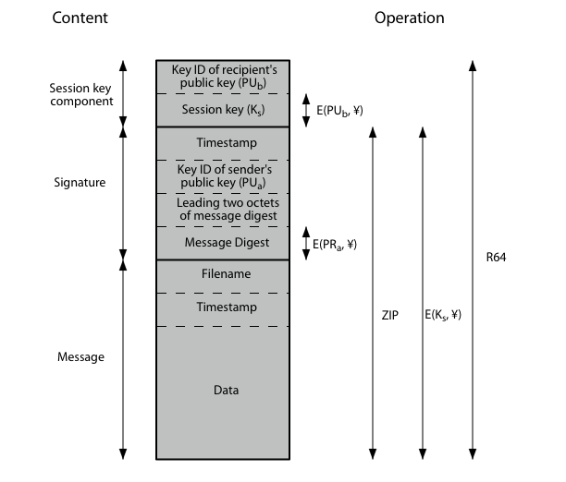
PGP Message Format
Notes:
Stallings Figure 18.3 shows the format of a transmitted PGP message. A message consists of three components: the message component, a signature (optional), and a session key component (optional). The message component includes the actual data to be stored or transmitted, as well as a filename and a timestamp that specifies the time of creation. The signature component includes a timestamp, encrypted SHA-1 message digest, leading two digest octets for verification, and the Key ID of the sender’s public key. The session key component includes the session key and the identifier of the recipient's public key that was used by the sender to encrypt the session key. The entire block is usually encoded with radix-64 encoding.

Slide 15
PGP Key Rings
each PGP user has a pair of keyrings:
public-key ring contains all the public-keys of other PGP users known to this user, indexed by key ID
private-key ring contains the public/private key pair(s) for this user, indexed by key ID & encrypted keyed from a hashed passphrase
security of private keys thus depends on the pass-phrase security
Notes:
Keys & key IDs are critical to the operation of PGP. These keys need to be stored and organized in a systematic way for efficient and effective use by all parties. PGP uses a pair of data structures, one to store the users public/private key pairs - their private-key ring; and one to store the public keys of other known users, their public-key ring. The private keys are kept encrypted using a block cipher, with a key derived by hashing a pass-phrase which the user enters whenever that key needs to be used. As in any system based on passwords, the security of this system depends on the security of the password, which should be not easily guessed but easily remembered.

Slide 16
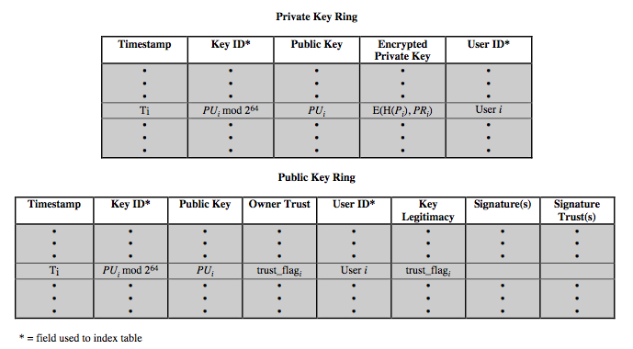
PGP Key Rings
Notes:
Stallings Figure 18.4 shows the general structure of a private-key ring. We can view the ring as a table, in which each row represents one of the public/private key pairs owned by this user. The private-key ring can be indexed by either User ID or Key ID. The actual private key itself encrypted using CAST-128 (or IDEA or 3DES) keyed using a user supplied passphrase.
Figure 18.4 also shows the general structure of a public-key ring. This data structure is used to store public keys of other users that are known to this user. The public-key ring can be indexed by either User ID or Key ID.

Slide 17
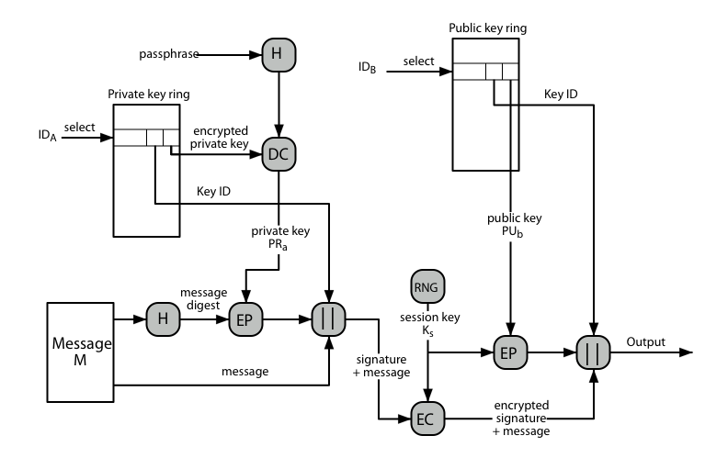
PGP Message Generation
Notes:
Stallings Figure 18.5 illustrates how these key rings are used in message transmission to implement the various PGP crypto services (ignoring compression and radix-64 conversion for simplicity). The sending PGP entity performs the following steps:
1. Signing the message:
a. PGP retrieves the sender's private key from the private-key ring using your_userid as an index. If your_userid was not provided in the command, the first private key on the ring is retrieved.
b. PGP prompts the user for the passphrase to recover the unencrypted private key.
c. The signature component of the message is constructed.
2. Encrypting the message:
a. PGP generates a session key and encrypts the message.
b. PGP retrieves the recipient's public key from the public-key ring using her_userid as an index.
c. The session key component of the message is constructed.

Slide 18
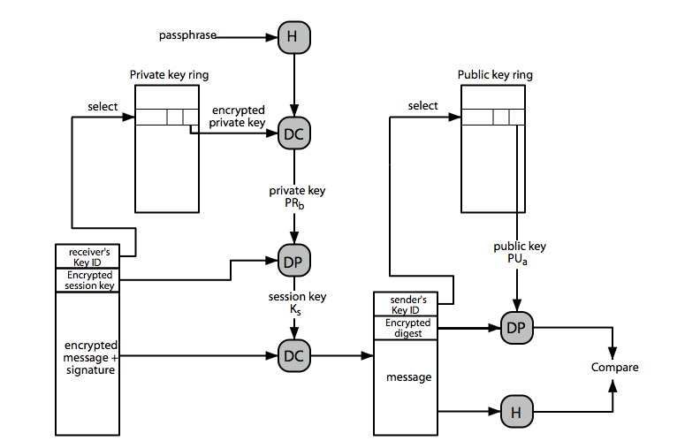
PGP Message Reception
Notes:
Stallings Figure 18.6 then illustrates how these key rings are used in message reception to implement the various PGP crypto services (again ignoring compression and radix-64 conversion for simplicity). The receiving PGP entity performs the following steps:
1. Decrypting the message:
a. PGP retrieves the receiver's private key from the private-key ring, using the Key ID field in the session key component of the message as an index.
b. PGP prompts the user for the passphrase to recover the unencrypted private key.
c. PGP then recovers the session key and decrypts the message.
2. Authenticating the message:
a. PGP retrieves the sender's public key from the public-key ring, using the Key ID field in the signature key component of the message as an index.
b. PGP recovers the transmitted message digest.
c. PGP computes the message digest for the received message and compares it to the transmitted message digest to authenticate.

Slide 19
PGP Key Management
rather than relying on certificate authorities
in PGP every user is its own CA
can sign keys for users they know directly
forms a “web of trust”
trust keys have signed
can trust keys others have signed if have a chain of signatures to them
key ring includes trust indicators
users can also revoke their keys
Notes:
The PGP documentation notes that “This whole business of protecting public keys from tampering is the single most difficult problem in practical public key applications”. Its solution is to support a variety of formal and informal environments, in which any user can act as a “CA” to certify another user’s public key, and then act as a “trusted introducer” to other users, thus forming a “web of trust”. PGP provides a convenient means of using trust, associating trust with public keys, and exploiting trust information. The key ring is regularly processed to derive trust indicators for keys in it. Associated with each such entry is a key legitimacy field that indicates the extent to which PGP will trust that this is a valid public key for this user; the higher the level of trust, the stronger is the binding of this user ID to this key. PGP allows a user to revoke their current public key, either because compromise is suspected or simply to avoid the use of the same key for an extended period.

Slide 20
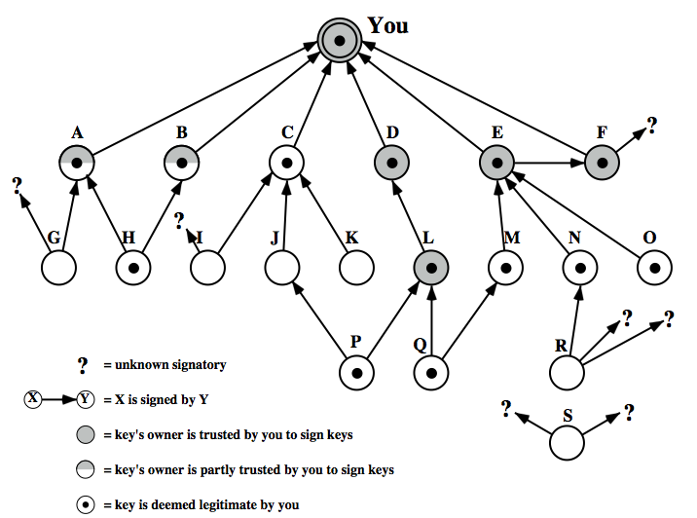
PGP Trust Model Example
Notes:
Stallings Figure 18.7 provides an example of the way in which signature trust and key legitimacy are related. The figure shows the structure of a public-key ring. The user has acquired a number of public keys, some directly from their owners and some from a third party such as a key server. The node labeled "You" refers to the entry in the public-key ring corresponding to this user. This key is legitimate and the OWNERTRUST value is ultimate trust. Each other node in the key ring has an OWNERTRUST value of undefined unless some other value is assigned by the user. In this example, this user has specified that it always trusts the following users to sign other keys: D, E, F, L. This user partially trusts users A and B to sign other keys. So the shading, or lack thereof, of the nodes in Figure 18.7 indicates the level of trust assigned by this user. The tree structure indicates which keys have been signed by which other users. If a key is signed by a user whose key is also in this key ring, the arrow joins the signed key to the signatory. If the key is signed by a user whose key is not present in this key ring, the arrow joins the signed key to a question mark, indicating that the signatory is unknown to this user.

