Slide 1
Security at transport layer level
SSl/TLS

Slide 2
Transport-layer security (TLS)
widely deployed security protocol above the transport layer
supported by almost all browsers, web servers: https (port 443)
provides:
confidentiality: via symmetric encryption
integrity: via cryptographic hashing
authentication: via public key cryptography
history:
early research, implementation: secure network programming, secure sockets
secure socket layer (SSL) deprecated [2015]
TLS 1.3: RFC 8846 [2018]

Slide 3
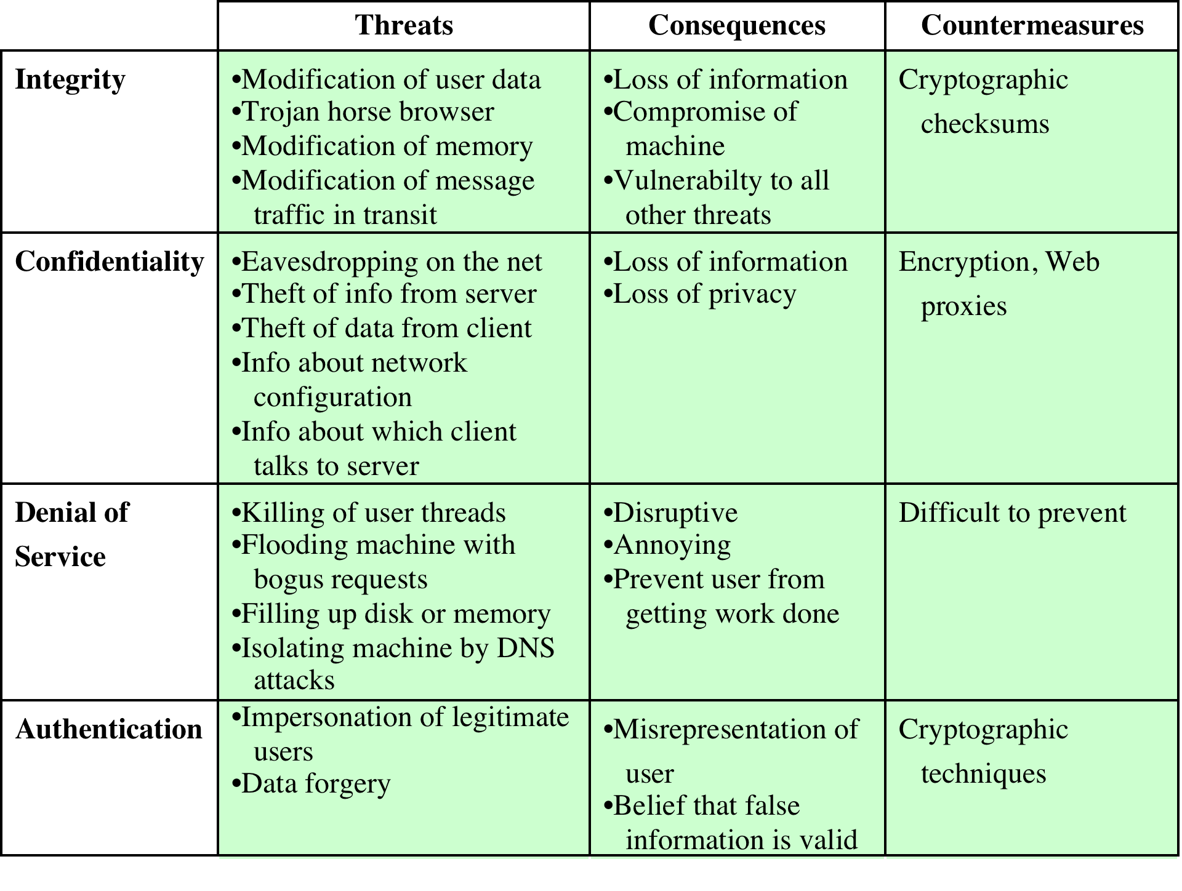
Table 17.1 A Comparison of Threats on the Web
Notes:
Table 17.1 provides a summary of the types of security threats faced when using
the Web. One way to group these threats is in terms of passive and active attacks.
Passive attacks include eavesdropping on network traffic between browser and
server and gaining access to information on a Web site that is supposed to be restricted.
Active attacks include impersonating another user, altering messages in
transit between client and server, and altering information on a Web site.
Another way to classify Web security threats is in terms of the location of the
threat: Web server, Web browser, and network traffic between browser and server.
Issues of server and browser security fall into the category of computer system security;
Part Six of this book addresses the issue of system security in general but is also
applicable to Web system security. Issues of traffic security fall into the category of
network security and are addressed in this chapter.

Slide 4
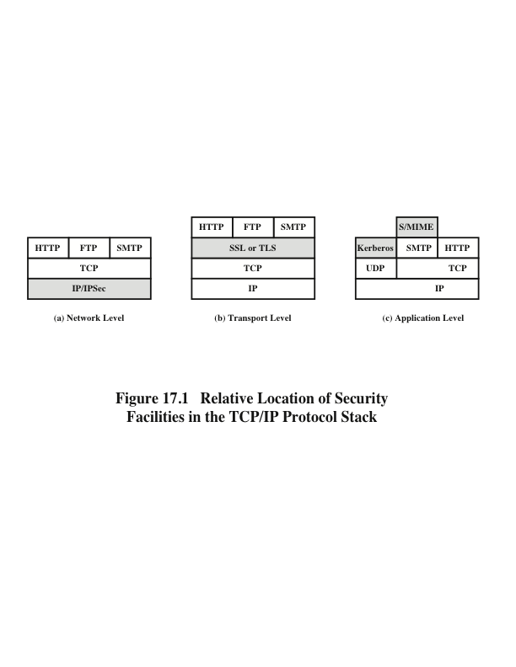
Notes:
A number of approaches to providing Web security are possible. The various approaches
that have been considered are similar in the services they provide and, to
some extent, in the mechanisms that they use, but they differ with respect to their
scope of applicability and their relative location within the TCP/IP protocol stack.
Figure 17.1 illustrates this difference. One way to provide Web security is
to use IP security (IPsec) (Figure 17.1a). The advantage of using IPsec is that it is
transparent to end users and applications and provides a general-purpose solution.
Furthermore, IPsec includes a filtering capability so that only selected traffic need
incur the overhead of IPsec processing.
Another relatively general-purpose solution is to implement security just
above TCP (Figure 17.1b). The foremost example of this approach is the Secure
Sockets Layer (SSL) and the follow-on Internet standard known as Transport
Layer Security (TLS). At this level, there are two implementation choices. For full
generality, SSL (or TLS) could be provided as part of the underlying protocol suite
and therefore be transparent to applications. Alternatively, SSL can be embedded
in specific packages. For example, Netscape and Microsoft Explorer browsers come
equipped with SSL, and most Web servers have implemented the protocol.
Application-specific security services are embedded within the particular
application. Figure 17.1c shows examples of this architecture. The advantage of this
approach is that the service can be tailored to the specific needs of a given application.

Slide 5
Secure Sockets Layer (SSL)
One of the most widely used security services
A general purpose service implemented as a set of protocols that rely on TCP
Could be provided as part of the underlying protocol suite and therefore be transparent to applications
Can be embedded in specific packages
Notes:
One of the most widely used security services is the Secure Sockets Layer (SSL) and
the follow-on Internet standard known as Transport Layer Security (TLS), the latter
defined in RFC 5246. SSL is a general-purpose service implemented as a set of
protocols that rely on TCP. At this level, there are two implementation choices. For
full generality, SSL (or TLS) could be provided as part of the underlying protocol
suite and therefore be transparent to applications. Alternatively, SSL can be embedded
in specific packages. For example, most browsers come equipped with SSL,
and most Web servers have implemented the protocol.
This section is devoted to a discussion of SSLv3, and next section describes the
principal differences between SSLv3 and TLS.

Slide 6
SSL Architecture
Two important SSL concepts are:
SSL connection
A transport that provides a suitable type of service
For SSL such connections are peer-to-peer relationships
Connections are transient
Every connection is associated with one session
SSL session
An association between a client and a server
Created by the Handshake Protocol
Define a set of cryptographic security parameters which can be shared among multiple connections
Are used to avoid the expensive negotiation of new security parameters for each connection
Notes:
Two important SSL concepts are the SSL session and the SSL connection,
which are defined in the specification as follows.
• Connection: A connection is a transport (in the OSI layering model definition)
that provides a suitable type of service. For SSL, such connections are
peer-to-peer relationships. The connections are transient. Every connection is
associated with one session.
• Session: An SSL session is an association between a client and a server.
Sessions are created by the Handshake Protocol. Sessions define a set of cryptographic
security parameters which can be shared among multiple connections.
Sessions are used to avoid the expensive negotiation of new security
parameters for each connection.
Between any pair of parties (applications such as HTTP on client and
server), there may be multiple secure connections. In theory, there may also be
multiple simultaneous sessions between parties, but this feature is not used in
practice.
There are a number of states associated with each session. Once a session is established,
there is a current operating state for both read and write (i.e., receive and
send). In addition, during the Handshake Protocol, pending read and write states
are created. Upon successful conclusion of the Handshake Protocol, the pending
states become the current states.

Slide 7
A session state is defined by the following parameters:
Session identifier
An arbitrary byte sequence chosen by the server to identify an active or resumable session state
Peer certificate
An X509.v3 certificate of the peer; this element of the state may be null
Compression method
The algorithm used to compress data prior to encryption
Cipher
spec
Specifies the bulk data encryption algorithm and a hash algorithm used for MAC calculation; also defines cryptographic attributes such as the hash_size
Master
secret
48-byte secret shared between the client and the server
Is
resumable
A flag indicating whether the session can be used to initiate new connections
Notes:
A session state is defined by the following parameters.
• Session identifier: An arbitrary byte sequence chosen by the server to identify
an active or resumable session state.
• Peer certificate: An X509.v3 certificate of the peer. This element of the state
may be null.
• Compression method: The algorithm used to compress data prior to
encryption.
• Cipher spec: Specifies the bulk data encryption algorithm (such as null, AES,
etc.) and a hash algorithm (such as MD5 or SHA-1) used for MAC calcula tion.
It also defines cryptographic attributes such as the hash_size.
• Master secret: 48-byte secret shared between the client and the server.
• Is resumable: A flag indicating whether the session can be used to initiate new
connections.

Slide 8
A connection state is defined by the following parameters:
Server and client random
Byte sequences that are chosen by the server and client for each connection
Server write MAC secret
The secret key used in MAC operations on data sent by the server
Client write MAC secret
The secret key used in MAC operations on data sent by the client
Server write key
The secret encryption key for data encrypted by the server and decrypted by the client
Client write key
The symmetric encryption key for data encrypted by the client and decrypted by the server
Initialization vectors
When a block cipher in CBC mode is used, an initialization vector (IV) is maintained for each key
Sequence numbers
Each party maintains separate sequence numbers for transmitted and received messages for each connection
This field is first initialized by the SSL Handshake Protocol
The final ciphertext block from each record is preserved for use as the IV with the following record
When a party sends or receives a change cipher spec message, the appropriate sequence number is set to zero
Sequence numbers may not exceed 2⁶⁴ - 1
Notes:
A connection state is defined by the following parameters.
• Server and client random: Byte sequences that are chosen by the server and
client for each connection.
• Server write MAC secret: The secret key used in MAC operations on data
sent by the server.
• Client write MAC secret: The secret key used in MAC operations on data sent
by the client.
• Server write key: The secret encryption key for data encrypted by the server
and decrypted by the client.
• Client write key: The symmetric encryption key for data encrypted by the client
and decrypted by the server.
• Initialization vectors: When a block cipher in CBC mode is used, an initialization
vector (IV) is maintained for each key. This field is first initialized by
the SSL Handshake Protocol. Thereafter, the final ciphertext block from each
record is preserved for use as the IV with the following record.
• Sequence numbers: Each party maintains separate sequence numbers for
transmitted and received messages for each connection. When a party sends
or receives a change cipher spec message, the appropriate sequence number is
set to zero. Sequence numbers may not exceed 2⁶⁴ - 1.

Slide 9
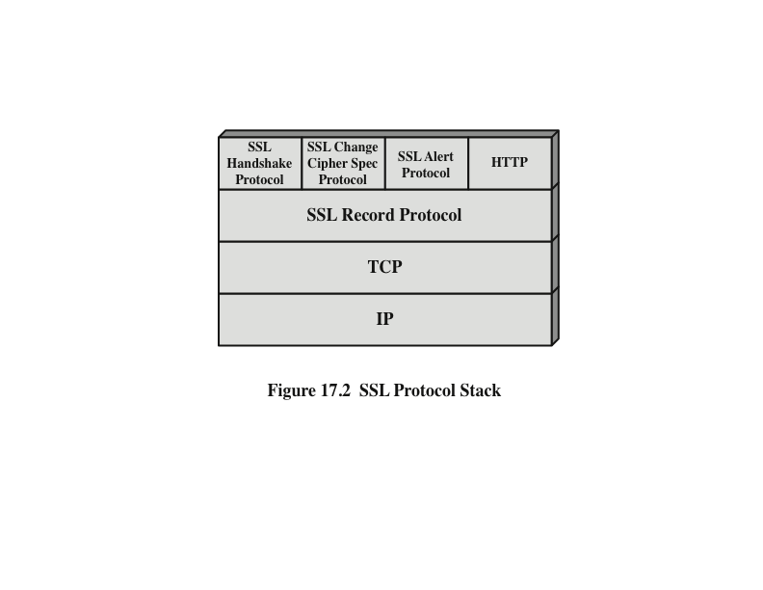
Notes:
SSL is designed to make use of TCP to provide a reliable end-to-end secure service.
SSL is not a single protocol but rather two layers of protocols, as illustrated in
Figure 17.2.
The SSL Record Protocol provides basic security services to various higher layer
protocols. In particular, the Hypertext Transfer Protocol (HTTP), which
provides the transfer service for Web client/server interaction, can operate on top
of SSL. Three higher-layer protocols are defined as part of SSL: the Handshake
Protocol, The Change Cipher Spec Protocol, and the Alert Protocol. These
SSL-specific protocols are used in the management of SSL exchanges and are
examined later in this section.

Slide 10
SSL Record Protocol
The SSL Record Protocol provides two services for SSL connections
Confidentiality
The Handshake Protocol defines a shared secret key that is used for conventional encryption of SSL payloads
Message integrity
The Handshake Protocol also defines a shared secret key that is used to form a message authentication code (MAC)
Notes:
SSL Record Protocol defines two services for SSL connections:
• Confidentiality: The Handshake Protocol defines a shared secret key that is used for conventional encryption of SSL payloads. The message is compressed before being concatenated with the MAC and encrypted, with a range of ciphers being supported as shown.
• Message Integrity: The Handshake Protocol also defines a shared secret key that is used to form a message authentication code (MAC), which is similar to HMAC

Slide 11
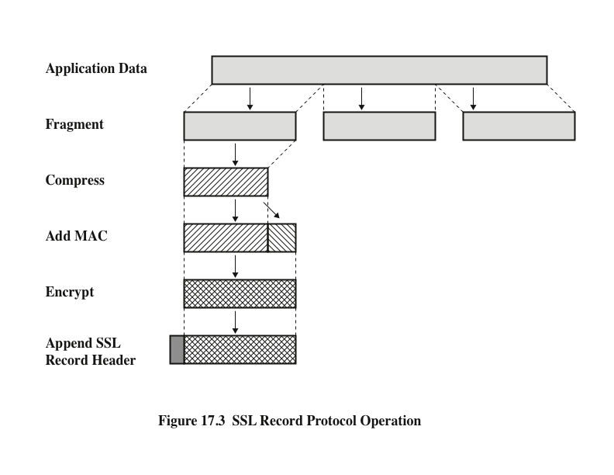
Notes:
Figure 17.3 indicates the overall operation of the SSL Record Protocol. The
Record Protocol takes an application message to be transmitted, fragments the data
into manageable blocks, optionally compresses the data, applies a MAC, encrypts,
adds a header, and transmits the resulting unit in a TCP segment. Received data
are decrypted, verified, decompressed, and reassembled before being delivered to
higher-level users.
The first step is fragmentation. Each upper-layer message is fragmented into
blocks of 2¹⁴ bytes (16384 bytes) or less. Next, compression is optionally applied.
Compression must be lossless and may not increase the content length by more than
1024 bytes. In SSLv3 (as well as the current version of TLS), no compression algorithm
is specified, so the default compression algorithm is null.
The next step in processing is to compute a message authentication code over
the compressed data. For this purpose, a shared secret key is used.
Next, the compressed message plus the MAC are encrypted using symmetric
encryption. Encryption may not increase the content length by more than 1024
bytes, so that the total length may not exceed 2¹⁴ + 2048.
For stream encryption, the compressed message plus the MAC are encrypted.
Note that the MAC is computed before encryption takes place and that the MAC is
then encrypted along with the plaintext or compressed plaintext.
For block encryption, padding may be added after the MAC prior to encryption.
The padding is in the form of a number of padding bytes followed by a onebyte
indication of the length of the padding. The total amount of padding is the
smallest amount such that the total size of the data to be encrypted (plaintext plus
MAC plus padding) is a multiple of the cipher’s block length. An example is a plaintext
(or compressed text if compression is used) of 58 bytes, with a MAC of 20 bytes
(using SHA-1), that is encrypted using a block length of 8 bytes (e.g., DES). With
the padding-length byte, this yields a total of 79 bytes. To make the total an integer
multiple of 8, one byte of padding is added.

Slide 12
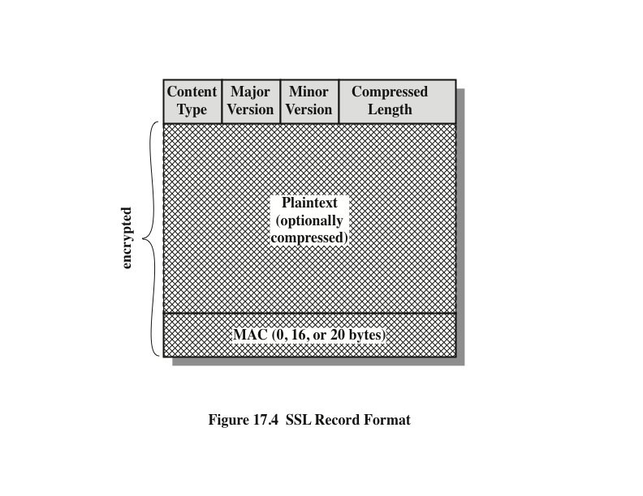
Notes:
The final step of SSL Record Protocol processing is to prepare a header consisting
of the following fields:
• Content Type (8 bits): The higher-layer protocol used to process the enclosed
fragment.
• Major Version (8 bits): Indicates major version of SSL in use. For SSLv3, the
value is 3.
• Minor Version (8 bits): Indicates minor version in use. For SSLv3, the value
is 0.
• Compressed Length (16 bits): The length in bytes of the plaintext fragment
(or compressed fragment if compression is used). The maximum value is
2¹⁴ + 2048.
The content types that have been defined are change_cipher_spec ,
alert , handshake , and application_data . The first three are the SSL-specific
protocols, discussed next. Note that no distinction is made among the various applications
(e.g., HTTP) that might use SSL; the content of the data created by such
applications is opaque to SSL.
Figure 17.4 illustrates the SSL record format.

Slide 13
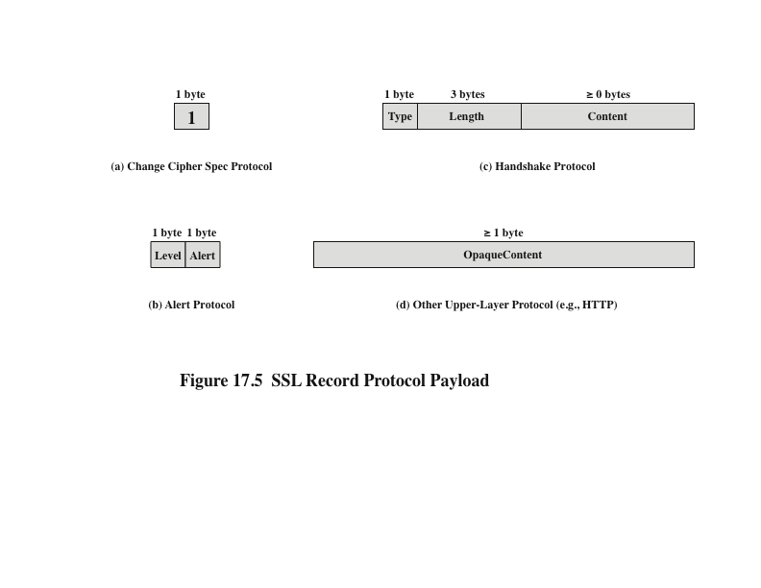
Notes:
The Change Cipher Spec Protocol is one of the three SSL-specific protocols that
use the SSL Record Protocol, and it is the simplest. This protocol consists of a single
message (Figure 17.5a), which consists of a single byte with the value 1. The sole
purpose of this message is to cause the pending state to be copied into the current
state, which updates the cipher suite to be used on this connection.
The Alert Protocol is used to convey SSL-related alerts to the peer entity. As with
other applications that use SSL, alert messages are compressed and encrypted, as
specified by the current state.
Each message in this protocol consists of two bytes (Figure 17.5b). The first
byte takes the value warning (1) or fatal (2) to convey the severity of the message.
If the level is fatal, SSL immediately terminates the connection. Other connections
on the same session may continue, but no new connections on this session
may be established. The second byte contains a code that indicates the specific
alert.
The most complex part of SSL is the Handshake Protocol. This protocol allows
the server and client to authenticate each other and to negotiate an encryption and
MAC algorithm and cryptographic keys to be used to protect data sent in an SSL
record. The Handshake Protocol is used before any application data is transmitted.
The Handshake Protocol consists of a series of messages exchanged by client
and server. All of these have the format shown in Figure 17.5c.

Slide 14
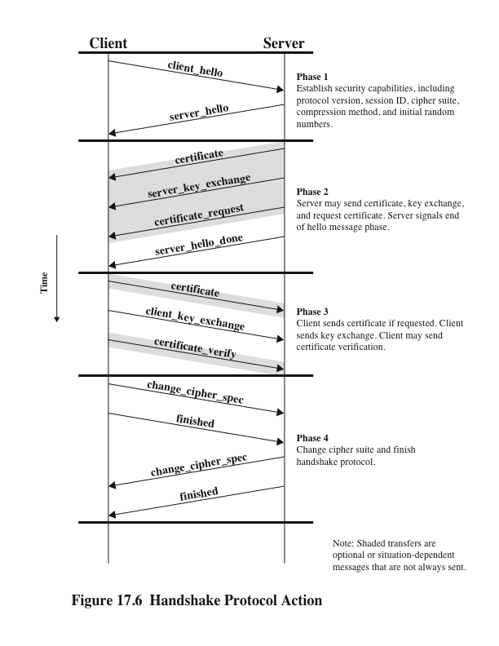
Notes:
Figure 17.6 shows the initial exchange needed to establish a logical connection
between client and server. The exchange can be viewed as having four phases.

Slide 15
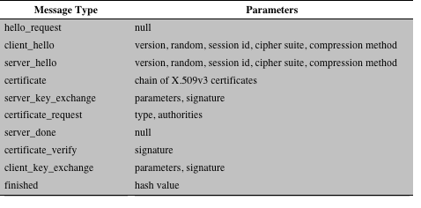
Table 17.2 SSL Handshake Protocol Message Types
Notes:
Each message has
three fields:
• Type (1 byte): Indicates one of ten messages. Table 17.2 lists the defined
message types.
• Length (3 bytes): The length of the message in bytes.
• Content (# 0 bytes): The parameters associated with this message; these are
listed in Table 17.2.

Slide 16
Cryptographic Computations
Two further items are of interest:
A pre_master_secret is generated by the client, encrypted with the server’s public key and sent to the server (until TLSv1.2) or by using Diffie-Hellman algorithm.
The creation of a shared master secret by means of the key exchange
The shared master secret is a one-time 48-byte value generated for this session by means of secure key exchange
master_secret = PRF(pre_master_secret, ‘master secret’, clienthello.random || serverhello.random)
PRF: Pseudo Random Function
Notes:
Two further items are of interest: (1) the creation of a shared master secret by means
of the key exchange and (2) the generation of cryptographic parameters from the
master secret.
The shared master secret is a one-time 48-byte value
(384 bits) generated for this session by means of secure key exchange. The creation
is in two stages. First, a pre_master_secret is exchanged. Second, the master_
secret is calculated by both parties. For pre_master_secret exchange, there
are two possibilities.
• RSA: A 48-byte pre_master_secret is generated by the client, encrypted
with the server’s public RSA key, and sent to the server. The server decrypts
the ciphertext using its private key to recover the pre_master_secret.
• Diffie-Hellman: Both client and server generate a Diffie-Hellman public key.
After these are exchanged, each side performs

Slide 17
Cryptographic Computations
The generation of cryptographic parameters from the master secret
CipherSpecs require
a client write MAC secret,
a server write MAC secret,
a client write key,
a server write key,
a client write IV
and a server write IV
which are generated from the master secret in that order
These parameters are generated from the master secret by hashing the master secret into a sequence of secure bytes of sufficient length for all needed parameters

Slide 18
Transport Layer Security (TLS)
An IETF standardization initiative whose goal is to produce an Internet standard version of SSL
Is defined as a Proposed Internet Standard in RFC 5246
RFC 5246 is very similar to SSLv3
Differences include:
Version number
Message Authentication Code
Pseudorandom function
Alert keys
Cipher suites
Client certificate types
Certificate_verify and Finished Messages
Cryptographic computations
Padding
Notes:
TLS is an IETF standardization initiative whose goal is to produce an Internet standard
version of SSL. TLS is defined as a Proposed Internet Standard in RFC 5246.
RFC 5246 is very similar to SSLv3. In this section, we highlight the differences.
Version Number
The TLS Record Format is the same as that of the SSL Record Format (Figure 17.4),
and the fields in the header have the same meanings. The one difference is in version
values. For the current version of TLS, the major version is 3 and the minor version is 3.
Message Authentication Code
There are two differences between the SSLv3 and TLS MAC schemes: the actual
algorithm and the scope of the MAC calculation. TLS makes use of the HMAC
algorithm defined in RFC 2104.
The MAC calculation covers all of the fields covered by the SSLv3 calculation,
plus the field TLSCompressed.version , which is the version of the protocol
being employed.
Pseudorandom Function
TLS makes use of a pseudorandom function referred to as PRF to expand secrets
into blocks of data for purposes of key generation or validation. The objective is to
make use of a relatively small shared secret value but to generate longer blocks of
data in a way that is secure from the kinds of attacks made on hash functions and
MACs.
TLS supports all of the alert codes defined in SSLv3 with the exception of
no_certificate . A number of additional codes are defined in TLS.
Cipher Suites
There are several small differences between the cipher suites available under SSLv3
and under TLS:
• Key Exchange: TLS supports all of the key exchange techniques of SSLv3
with the exception of Fortezza.
• Symmetric Encryption Algorithms: TLS includes all of the symmetric encryption
algorithms found in SSLv3, with the exception of Fortezza.
Client Certificate Types
TLS defines the following certificate types to be requested in a certificate_
request message: rsa_sign, dss_sign, rsa_fixed_dh, and dss_fixed_dh.
These are all defined in SSLv3. In addition, SSLv3 includes rsa_ephemeral_dh,
dss_ephemeral_dh, and fortezza_kea. Ephemeral Diffie-Hellman involves
signing the Diffie-Hellman parameters with either RSA or DSS. For TLS, the rsa_
sign and dss_sign types are used for that function; a separate signing type is
not needed to sign Diffie-Hellman parameters. TLS does not include the Fortezza
scheme.
certificate_verify and Finished Messages
In the TLS certificate_verify message, the MD5 and SHA-1 hashes are calculated
only over handshake_messages. Recall that for SSLv3, the hash calculation
also included the master secret and pads. These extra fields were felt to add no
additional security.
As with the finished message in SSLv3, the finished message in TLS is a hash
based on the shared master_secret, the previous handshake messages, and a
label that identifies client or server. The calculation is somewhat different.
Cryptographic Computations
The pre_master_secret for TLS is calculated in the same way as in SSLv3. As
in SSLv3, the master_secret in TLS is calculated as a hash function of the pre_
master_secret and the two hello random numbers.
As with SSLv3, the key_block is a function
of the master_secret and the client and server random numbers, but for
TLS, the actual algorithm is different.
Padding
In SSL, the padding added prior to encryption of user data is the minimum amount
required so that the total size of the data to be encrypted is a multiple of the cipher’s
block length. In TLS, the padding can be any amount that results in a total that is a
multiple of the cipher’s block length, up to a maximum of 255 bytes. For example,
if the plaintext (or compressed text if compression is used) plus MAC plus padding.
length byte is 79 bytes long, then the padding length (in bytes) can be 1, 9, 17, and so
on, up to 249. A variable padding length may be used to frustrate attacks based on
an analysis of the lengths of exchanged messages.

Slide 19

HTTPS (HTTP over SSL)
Refers to the combination of HTTP and SSL to implement secure communication between a Web browser and a Web server
The HTTPS capability is built into all modern Web browsers
A user of a Web browser will see URL addresses that begin with https:// rather than http://
If HTTPS is specified, port 443 is used, which invokes SSL
Documented in RFC 2818, HTTP Over TLS
There is no fundamental change in using HTTP over either SSL or TLS and both implementations are referred to as HTTPS
When HTTPS is used, the following elements of the communication are encrypted:
URL of the requested document
Contents of the document
Contents of browser forms
Cookies sent from browser to server and from server to browser
Contents of HTTP header
Notes:
HTTPS (HTTP over SSL) refers to the combination of HTTP and SSL to implement
secure communication between a Web browser and a Web server.
The HTTPS capability is built into all modern Web browsers. Its use depends
on the Web server supporting HTTPS communication. For example, some
search engines do not support HTTPS. Google provides HTTPS as an option:
https://google.com.
The principal difference seen by a user of a Web browser is that URL (uniform
resource locator) addresses begin with https:// rather than http://. A normal
HTTP connection uses port 80. If HTTPS is specified, port 443 is used, which
invokes SSL.
When HTTPS is used, the following elements of the communication are
encrypted:
• URL of the requested document
• Contents of the document
• Contents of browser forms (filled in by browser user)
• Cookies sent from browser to server and from server to browser
• Contents of HTTP header
HTTPS is documented in RFC 2818, HTTP Over TLS . There is no fundamental
change in using HTTP over either SSL or TLS, and both implementations are
referred to as HTTPS.

Slide 20
Connection Initiation
For HTTPS, the agent acting as the HTTP client also acts as the TLS client
The client initiates a connection to the server on the appropriate port and then sends the TLS ClientHello to begin the TLS handshake
When the TLS handshake has finished, the client may then initiate the first HTTP request
All HTTP data is to be sent as TLS application data
There are three levels of awareness of a connection in HTTPS:
At the HTTP level, an HTTP client requests a connection to an HTTP server by sending a connection request to the next lowest layer
Typically the next lowest layer is TCP, but is may also be TLS/SSL
At the level of TLS, a session is established between a TLS client and a TLS server
This session can support one or more connections at any time
A TLS request to establish a connection begins with the establishment of a TCP connection between the TCP entity on the client side and the TCP entity on the server side
Notes:
For HTTPS, the agent acting as the HTTP client also acts as the TLS client. The
client initiates a connection to the server on the appropriate port and then sends
the TLS ClientHello to begin the TLS handshake. When the TLS handshake has
finished, the client may then initiate the first HTTP request. All HTTP data is to be
sent as TLS application data. Normal HTTP behavior, including retained connections,
should be followed.
There are three levels of awareness of a connection in HTTPS. At the HTTP
level, an HTTP client requests a connection to an HTTP server by sending a connection
request to the next lowest layer. Typically, the next lowest layer is TCP,
but it also may be TLS/SSL. At the level of TLS, a session is established between a
TLS client and a TLS server. This session can support one or more connections at
any time. As we have seen, a TLS request to establish a connection begins with the
establishment of a TCP connection between the TCP entity on the client side and
the TCP entity on the server side.

Slide 21
Connection Closure
An HTTP client or server can indicate the closing of a connection by including the line Connection: close in an HTTP record
The closure of an HTTPS connection requires that TLS close the connection with the peer TLS entity on the remote side, which will involve closing the underlying TCP connection
TLS implementations must initiate an exchange of closure alerts before closing a connection
A TLS implementation may, after sending a closure alert, close the connection without waiting for the peer to send its closure alert, generating an “incomplete close”
An unannounced TCP closure could be evidence of some sort of attack so the HTTPS client should issue some sort of security warning when this occurs
Notes:
An HTTP client or server can indicate the closing of a connection by including the
following line in an HTTP record: Connection: close . This indicates that the
connection will be closed after this record is delivered.
The closure of an HTTPS connection requires that TLS close the connection
with the peer TLS entity on the remote side, which will involve closing the underlying
TCP connection. At the TLS level, the proper way to close a connection is for
each side to use the TLS alert protocol to send a close_notify alert. TLS implementations
must initiate an exchange of closure alerts before closing a connection.
A TLS implementation may, after sending a closure alert, close the connection
without waiting for the peer to send its closure alert, generating an “incomplete
close”. Note that an implementation that does this may choose to reuse the session.
This should only be done when the application knows (typically through detecting
HTTP message boundaries) that it has received all the message data that it
cares about.
HTTP clients also must be able to cope with a situation in which the underlying
TCP connection is terminated without a prior close_notify alert and
without a Connection: close indicator. Such a situation could be due to a
programming error on the server or a communication error that causes the TCP
connection to drop. However, the unannounced TCP closure could be evidence of
some sort of attack. So the HTTPS client should issue some sort of security warning
when this occurs.

Slide 22
Public-Key Certificates
certificates allow key exchange without real-time access to public-key authority
a certificate binds identity to public key
usually with other information such as period of validity, rights of use …
with all contents signed by a trusted Public-Key or Certificate Authority (CA)
can be verified by anyone who knows the public-key authorities public-key
Notes:
An HTTP client or server can indicate the closing of a connection by including the
following line in an HTTP record: Connection: close . This indicates that the
connection will be closed after this record is delivered.
The closure of an HTTPS connection requires that TLS close the connection
with the peer TLS entity on the remote side, which will involve closing the underlying
TCP connection. At the TLS level, the proper way to close a connection is for
each side to use the TLS alert protocol to send a close_notify alert. TLS implementations
must initiate an exchange of closure alerts before closing a connection.
A TLS implementation may, after sending a closure alert, close the connection
without waiting for the peer to send its closure alert, generating an “incomplete
close”. Note that an implementation that does this may choose to reuse the session.
This should only be done when the application knows (typically through detecting
HTTP message boundaries) that it has received all the message data that it
cares about.
HTTP clients also must be able to cope with a situation in which the underlying
TCP connection is terminated without a prior close_notify alert and
without a Connection: close indicator. Such a situation could be due to a
programming error on the server or a communication error that causes the TCP
connection to drop. However, the unannounced TCP closure could be evidence of
some sort of attack. So the HTTPS client should issue some sort of security warning
when this occurs.

Slide 23
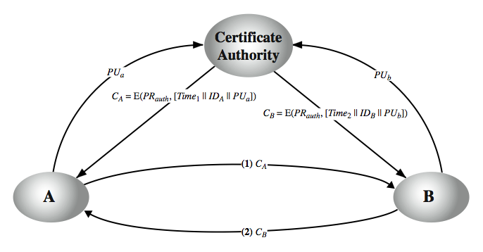
Public-Key Certificates
Notes:
An HTTP client or server can indicate the closing of a connection by including the
following line in an HTTP record: Connection: close . This indicates that the
connection will be closed after this record is delivered.
The closure of an HTTPS connection requires that TLS close the connection
with the peer TLS entity on the remote side, which will involve closing the underlying
TCP connection. At the TLS level, the proper way to close a connection is for
each side to use the TLS alert protocol to send a close_notify alert. TLS implementations
must initiate an exchange of closure alerts before closing a connection.
A TLS implementation may, after sending a closure alert, close the connection
without waiting for the peer to send its closure alert, generating an “incomplete
close”. Note that an implementation that does this may choose to reuse the session.
This should only be done when the application knows (typically through detecting
HTTP message boundaries) that it has received all the message data that it
cares about.
HTTP clients also must be able to cope with a situation in which the underlying
TCP connection is terminated without a prior close_notify alert and
without a Connection: close indicator. Such a situation could be due to a
programming error on the server or a communication error that causes the TCP
connection to drop. However, the unannounced TCP closure could be evidence of
some sort of attack. So the HTTPS client should issue some sort of security warning
when this occurs.

Slide 24
X.509 Authentication Service
part of CCITT X.500 directory service standards
distributed servers maintaining user info database
defines framework for authentication services
directory may store public-key certificates
with public key of user signed by certification authority
also defines authentication protocols
uses public-key crypto & digital signatures
algorithms not standardized, but RSA recommended
X.509 certificates are widely used
have 3 versions
Notes:
An HTTP client or server can indicate the closing of a connection by including the
following line in an HTTP record: Connection: close . This indicates that the
connection will be closed after this record is delivered.
The closure of an HTTPS connection requires that TLS close the connection
with the peer TLS entity on the remote side, which will involve closing the underlying
TCP connection. At the TLS level, the proper way to close a connection is for
each side to use the TLS alert protocol to send a close_notify alert. TLS implementations
must initiate an exchange of closure alerts before closing a connection.
A TLS implementation may, after sending a closure alert, close the connection
without waiting for the peer to send its closure alert, generating an “incomplete
close”. Note that an implementation that does this may choose to reuse the session.
This should only be done when the application knows (typically through detecting
HTTP message boundaries) that it has received all the message data that it
cares about.
HTTP clients also must be able to cope with a situation in which the underlying
TCP connection is terminated without a prior close_notify alert and
without a Connection: close indicator. Such a situation could be due to a
programming error on the server or a communication error that causes the TCP
connection to drop. However, the unannounced TCP closure could be evidence of
some sort of attack. So the HTTPS client should issue some sort of security warning
when this occurs.

Slide 25
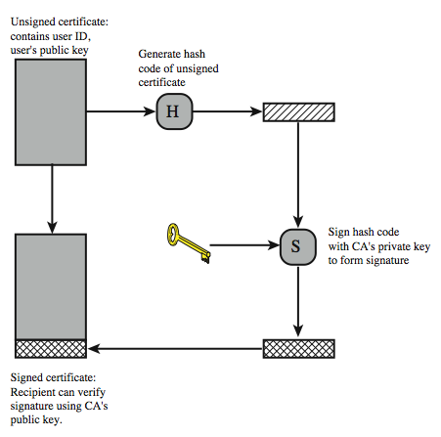
X.509 Certificate Use

Slide 26
X.509 Certificates
issued by a Certification Authority (CA), containing:
version V (1, 2, or 3)
serial number SN (unique within CA) identifying certificate
signature algorithm identifier AI
issuer X.500 name (name of the CA)
period of validity TA (from - to dates)
subject X.500 name A (name of owner)
subject public-key info Ap (algorithm, parameters, key)
issuer unique identifier (v2+)
subject unique identifier (v2+)
extension fields (v3)
signature (hash of all fields in certificate)
notation CA<<A>> denotes certificate for A signed by CA
Notes:
An HTTP client or server can indicate the closing of a connection by including the
following line in an HTTP record: Connection: close . This indicates that the
connection will be closed after this record is delivered.
The closure of an HTTPS connection requires that TLS close the connection
with the peer TLS entity on the remote side, which will involve closing the underlying
TCP connection. At the TLS level, the proper way to close a connection is for
each side to use the TLS alert protocol to send a close_notify alert. TLS implementations
must initiate an exchange of closure alerts before closing a connection.
A TLS implementation may, after sending a closure alert, close the connection
without waiting for the peer to send its closure alert, generating an “incomplete
close”. Note that an implementation that does this may choose to reuse the session.
This should only be done when the application knows (typically through detecting
HTTP message boundaries) that it has received all the message data that it
cares about.
HTTP clients also must be able to cope with a situation in which the underlying
TCP connection is terminated without a prior close_notify alert and
without a Connection: close indicator. Such a situation could be due to a
programming error on the server or a communication error that causes the TCP
connection to drop. However, the unannounced TCP closure could be evidence of
some sort of attack. So the HTTPS client should issue some sort of security warning
when this occurs.

Slide 27
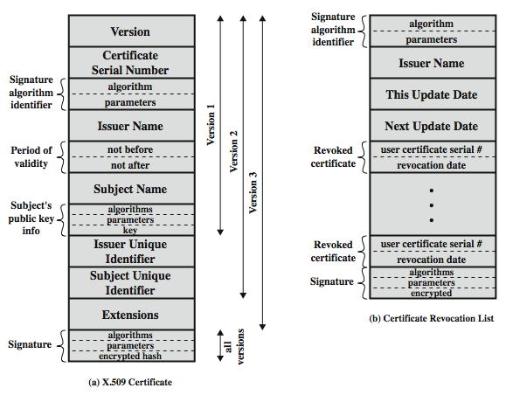
X.509 Certificates
Notes:
An HTTP client or server can indicate the closing of a connection by including the
following line in an HTTP record: Connection: close . This indicates that the
connection will be closed after this record is delivered.
The closure of an HTTPS connection requires that TLS close the connection
with the peer TLS entity on the remote side, which will involve closing the underlying
TCP connection. At the TLS level, the proper way to close a connection is for
each side to use the TLS alert protocol to send a close_notify alert. TLS implementations
must initiate an exchange of closure alerts before closing a connection.
A TLS implementation may, after sending a closure alert, close the connection
without waiting for the peer to send its closure alert, generating an “incomplete
close”. Note that an implementation that does this may choose to reuse the session.
This should only be done when the application knows (typically through detecting
HTTP message boundaries) that it has received all the message data that it
cares about.
HTTP clients also must be able to cope with a situation in which the underlying
TCP connection is terminated without a prior close_notify alert and
without a Connection: close indicator. Such a situation could be due to a
programming error on the server or a communication error that causes the TCP
connection to drop. However, the unannounced TCP closure could be evidence of
some sort of attack. So the HTTPS client should issue some sort of security warning
when this occurs.

Slide 28
Obtaining a Certificate
any user with access to CA can get any certificate from it
only the CA can modify a certificate
because cannot be forged, certificates can be placed in a public directory
Notes:
An HTTP client or server can indicate the closing of a connection by including the
following line in an HTTP record: Connection: close . This indicates that the
connection will be closed after this record is delivered.
The closure of an HTTPS connection requires that TLS close the connection
with the peer TLS entity on the remote side, which will involve closing the underlying
TCP connection. At the TLS level, the proper way to close a connection is for
each side to use the TLS alert protocol to send a close_notify alert. TLS implementations
must initiate an exchange of closure alerts before closing a connection.
A TLS implementation may, after sending a closure alert, close the connection
without waiting for the peer to send its closure alert, generating an “incomplete
close”. Note that an implementation that does this may choose to reuse the session.
This should only be done when the application knows (typically through detecting
HTTP message boundaries) that it has received all the message data that it
cares about.
HTTP clients also must be able to cope with a situation in which the underlying
TCP connection is terminated without a prior close_notify alert and
without a Connection: close indicator. Such a situation could be due to a
programming error on the server or a communication error that causes the TCP
connection to drop. However, the unannounced TCP closure could be evidence of
some sort of attack. So the HTTPS client should issue some sort of security warning
when this occurs.

Slide 29
CA Hierarchy
if both users share a common CA then they are assumed to know its public key
otherwise CA's must form a hierarchy
use certificates linking members of hierarchy to validate other CA's
each CA has certificates for clients (forward) and parent (backward)
each client trusts parents certificates
enable verification of any certificate from one CA by users of all other CAs in hierarchy
Notes:
An HTTP client or server can indicate the closing of a connection by including the
following line in an HTTP record: Connection: close . This indicates that the
connection will be closed after this record is delivered.
The closure of an HTTPS connection requires that TLS close the connection
with the peer TLS entity on the remote side, which will involve closing the underlying
TCP connection. At the TLS level, the proper way to close a connection is for
each side to use the TLS alert protocol to send a close_notify alert. TLS implementations
must initiate an exchange of closure alerts before closing a connection.
A TLS implementation may, after sending a closure alert, close the connection
without waiting for the peer to send its closure alert, generating an “incomplete
close”. Note that an implementation that does this may choose to reuse the session.
This should only be done when the application knows (typically through detecting
HTTP message boundaries) that it has received all the message data that it
cares about.
HTTP clients also must be able to cope with a situation in which the underlying
TCP connection is terminated without a prior close_notify alert and
without a Connection: close indicator. Such a situation could be due to a
programming error on the server or a communication error that causes the TCP
connection to drop. However, the unannounced TCP closure could be evidence of
some sort of attack. So the HTTPS client should issue some sort of security warning
when this occurs.

Slide 30
Certificate Revocation
certificates have a period of validity
may need to revoke before expiry, eg:
user's private key is compromised
user is no longer certified by this CA
CA's certificate is compromised
CA’s maintain list of revoked certificates
the Certificate Revocation List (CRL)
users should check certificates with CA’s CRL
Notes:
An HTTP client or server can indicate the closing of a connection by including the
following line in an HTTP record: Connection: close . This indicates that the
connection will be closed after this record is delivered.
The closure of an HTTPS connection requires that TLS close the connection
with the peer TLS entity on the remote side, which will involve closing the underlying
TCP connection. At the TLS level, the proper way to close a connection is for
each side to use the TLS alert protocol to send a close_notify alert. TLS implementations
must initiate an exchange of closure alerts before closing a connection.
A TLS implementation may, after sending a closure alert, close the connection
without waiting for the peer to send its closure alert, generating an “incomplete
close”. Note that an implementation that does this may choose to reuse the session.
This should only be done when the application knows (typically through detecting
HTTP message boundaries) that it has received all the message data that it
cares about.
HTTP clients also must be able to cope with a situation in which the underlying
TCP connection is terminated without a prior close_notify alert and
without a Connection: close indicator. Such a situation could be due to a
programming error on the server or a communication error that causes the TCP
connection to drop. However, the unannounced TCP closure could be evidence of
some sort of attack. So the HTTPS client should issue some sort of security warning
when this occurs.

Slide 31
Certificate Extensions
has been recognised that additional information is needed in a certificate
email/URL, policy details, usage constraints
rather than explicitly naming new fields defined a general extension method
extensions consist of:
extension identifier
critical indicator
extension value
Notes:
An HTTP client or server can indicate the closing of a connection by including the
following line in an HTTP record: Connection: close . This indicates that the
connection will be closed after this record is delivered.
The closure of an HTTPS connection requires that TLS close the connection
with the peer TLS entity on the remote side, which will involve closing the underlying
TCP connection. At the TLS level, the proper way to close a connection is for
each side to use the TLS alert protocol to send a close_notify alert. TLS implementations
must initiate an exchange of closure alerts before closing a connection.
A TLS implementation may, after sending a closure alert, close the connection
without waiting for the peer to send its closure alert, generating an “incomplete
close”. Note that an implementation that does this may choose to reuse the session.
This should only be done when the application knows (typically through detecting
HTTP message boundaries) that it has received all the message data that it
cares about.
HTTP clients also must be able to cope with a situation in which the underlying
TCP connection is terminated without a prior close_notify alert and
without a Connection: close indicator. Such a situation could be due to a
programming error on the server or a communication error that causes the TCP
connection to drop. However, the unannounced TCP closure could be evidence of
some sort of attack. So the HTTPS client should issue some sort of security warning
when this occurs.

Slide 32
Certificate Extensions
key and policy information
convey info about subject & issuer keys, plus indicators of certificate policy
certificate subject and issuer attributes
support alternative names, in alternative formats for certificate subject and/or issuer
certificate path constraints
allow constraints on use of certificates by other CA’s
Notes:
An HTTP client or server can indicate the closing of a connection by including the
following line in an HTTP record: Connection: close . This indicates that the
connection will be closed after this record is delivered.
The closure of an HTTPS connection requires that TLS close the connection
with the peer TLS entity on the remote side, which will involve closing the underlying
TCP connection. At the TLS level, the proper way to close a connection is for
each side to use the TLS alert protocol to send a close_notify alert. TLS implementations
must initiate an exchange of closure alerts before closing a connection.
A TLS implementation may, after sending a closure alert, close the connection
without waiting for the peer to send its closure alert, generating an “incomplete
close”. Note that an implementation that does this may choose to reuse the session.
This should only be done when the application knows (typically through detecting
HTTP message boundaries) that it has received all the message data that it
cares about.
HTTP clients also must be able to cope with a situation in which the underlying
TCP connection is terminated without a prior close_notify alert and
without a Connection: close indicator. Such a situation could be due to a
programming error on the server or a communication error that causes the TCP
connection to drop. However, the unannounced TCP closure could be evidence of
some sort of attack. So the HTTPS client should issue some sort of security warning
when this occurs.

