Slide 1

Indivisa
Corporate actions, settled in one atomic batch,
without exposing the register.
Settled on Canton DevNet · run it yourself in one command
CHAIN-EXPERTS · HACKCANTON SEASON 3
Notes:
A bond pays its coupon to hundreds of holders. Today that is spreadsheets and batch files. We make it one transaction.

Slide 2
THE PROBLEM
02 / 15
A distribution is N separate payments.
There is no moment at which the run is definitively finished. Some holders are paid, some are not, and the difference is worked by hand for days afterwards.
$3.42m
3–10%
<40%
+23%
a year in asset-servicing errors, per market participant
error rates, described as routine
straight-through processing on voluntary events
annual growth in asset-servicing costs
Source: Canton Network, Post-Trade Transformation (2025). Not our figures.
Notes:
These are not our numbers. They are from Canton Network's own post-trade research. Error rates between three and ten per cent are described there as routine: levels called unacceptable elsewhere in capital markets.

Slide 3
THE PROBLEM
03 / 15
And it cannot simply move onto a public chain.
Paying a coupon publicly publishes the register. Every holder's position size becomes readable by every other holder, by their competitors, and by anyone else, at the moment the coupon pays.
·
A bondholder register is not public information, and in many markets is protected by data-protection or banking-secrecy rules.
·
It is commercially sensitive in all of them: it is the client list.
·
That is why this workflow has not moved to a transparent ledger.
Notes:
This is the thing that stops corporate actions moving onto a public chain. It is not that nobody thought of it.

Slide 4
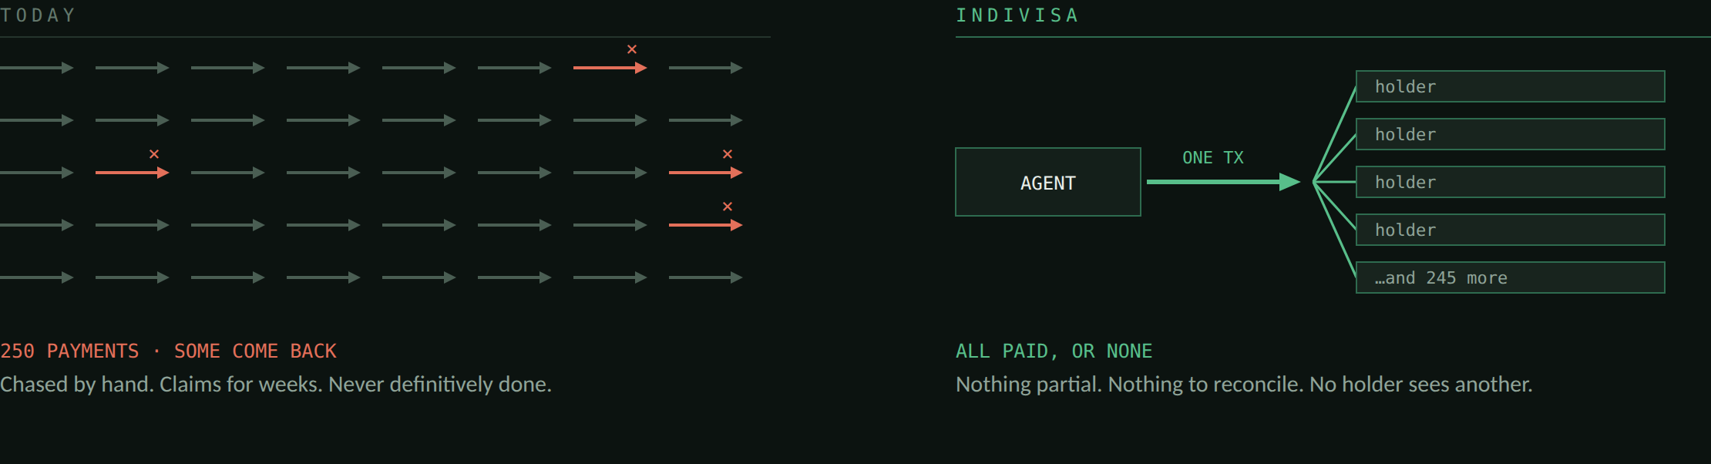
WHAT IT DOES
04 / 15
One transaction. Every holder paid at the same instant, or nobody.
Notes:
The paying agent presses one button. Either every holder is paid, or nothing moves. And each holder's own node receives its own line and nothing about anyone else.

Slide 5
WHAT IT DOES
05 / 15
THE VALUE, IN THE OPERATIONS MANAGER'S TERMS
The run is finished when the transaction commits.
The event closes the same day
The exception queue is empty
Nothing to chase next week
Not after working the 29% of income events that do not go straight through, on Canton’s own published figures. The transaction commits, and that is the answer.
There is no partial state to work. The class of exception “some paid, some not” stops existing.
No claims tail, no reconciliation against four systems, no explaining to the issuer what happened.
And the register never leaves the paying agent.
Notes:
This is the slide that matters to the buyer. Everything else is how it is done.

Slide 6
WHAT IT DOES
06 / 15
Four steps, and only the last one moves money.
01
Once, at onboarding: each holder signs one standing agreement with the paying agent.
02
Record date: the register is snapshotted and entitlements calculated, rounded so the parts sum to the announced total exactly.
03
Before payment: the agent sets aside the cash and prepares one allocation per holder.
04
Payment date: one settlement. Every leg, or none.
Holders authorise once, at onboarding. Never per coupon.
Notes:
Step one is the real-world "give the paying agent your account details". After that, every coupon lands with no action from the holder. The standard requires the receiver's authority on every leg; we collect it once.

Slide 7
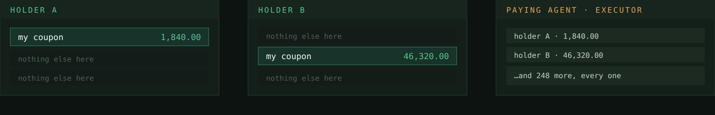
WHY NOW
07 / 15
Token Standard V2 made this possible in June.
CIP-0112, approved 12 June 2026: multi-leg settlement where the executor sees every leg and each participant sees only its own. Its worked example is trading and netting. CIP-112 did not design this. It enabled it.
The striped rows are not hidden. Those amounts were never delivered to that node.
Notes:
The worked example in the CIP is trading and netting, not corporate actions. We are taking a new primitive somewhere its authors did not.

Slide 8
THE PROOF
08 / 15
CANTON DEVNET · 24 SEPTEMBER 2026
It ran on the real network.
Five holders paid in a single transaction, 8,421.88 USD. The deliberate failure was run first and refused: one holder not ready, nobody paid.
1220652e2e4d32822c39d2ad72088e163eed04718ad1108998001b01aa3483ff466b
That is a real update id on the public test network. Full record: docs/devnet-run.md
Notes:
That update id is a real transaction on Canton DevNet. We ran both halves: the refusal first, then the settlement.

Slide 9
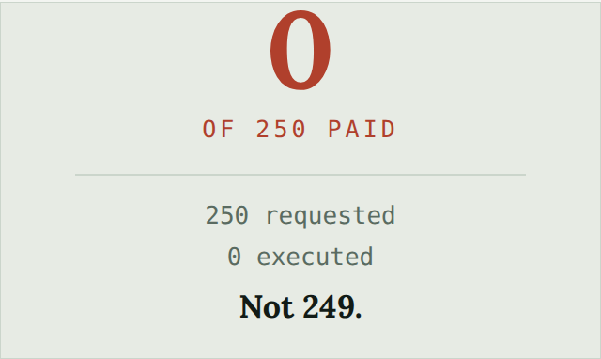
THE PROOF
09 / 15
Don't take our word for it. Run it.
cd quickstart && docker compose up
·
A five-participant Canton network, the real contracts, twenty holders.
·
One holder deliberately left out. Press the button: refused, and the ledger names them.
·
Fix it, press again: settled.
·
Nothing to install but Docker. No account anywhere.
Notes:
We would rather you did not take our word for any of this. One command gives you the whole thing on your own machine.

Slide 10
THE PROOF
10 / 15
Measured, not estimated.
HOLDERS IN ONE TRANSACTION | SETTLES IN | TRANSACTION SIZE
250 | 1.6 s | 440 KB
1,000 | 11.1 s | 1.67 MB
A thousand holders: days of reconciliation become 11.1 seconds, and it is final.
A realistic run reaches Canton's 10 MB transaction budget near 6,400 holders. Method and the second ceiling: docs/benchmark.md
Notes:
Nobody had published how many legs fit in a CIP-112 batch, so we measured it, and the method is in the repo.

Slide 11
CONTROL
11 / 15
In institutional systems, four-eyes authorisation is a requirement, not a feature.
A run can name an approver: a decentralised party, through BitSafe's Decentralization Manager. One optional field. The product is unchanged without it.
One approval
→
the ledger refuses
Two of three
→
settles
The threshold is enforced by the ledger, not by our code. In the local demo all three nodes are ours; on DevNet the second is BitSafe's. Four-eyes needs a way back out: a request can be withdrawn until it executes, and both the asking and the withdrawal stay in the ledger history. After settlement there is nothing to withdraw: the correction is a new payment, not an edit.
Notes:
Real paying agents have four-eyes controls. Below the threshold this is not our code being careful. It is the ledger refusing.

Slide 12
HONEST
12 / 15
What we are not claiming.
REAL
SIMULATED
NOT ATTEMPTED
The ledger, the contracts, the settlement, the refusal, the privacy, the DevNet update id, the governance engine and its threshold. Every number on screen.
The cash is TestTokenV2, the standard's own reference asset, not Canton Coin, chosen because it is signed by owner and admin, so it forces the same receiver-authorisation case. Holders and positions are generated. Three approver nodes on one machine are not three independent operators.
Corporate-action announcement data. Chainlink, with DTCC and Swift, is attacking that layer. We do the payment layer, and saying so makes the position sharper.
We would rather tell you this than have you find it.
Notes:
We would rather tell you this than have you find it.

Slide 13
HONEST
13 / 15
KNOWN, DESIGNED, NOT YET BUILT
Scoping a run is the first thing we build next.
If 5 of 250 holders are not ready, the batch refuses for all 250. A paying agent needs to settle the 245 today and carry the 5 into a second run. The batch stays all-or-nothing; its membership becomes a decision, not an accident. The model supports it. The workflow, and the audit trail that says why five were held back, are not written.
·
Access control: an operator signs in before the console reads or writes anything, and the check sits in the proxy that holds the credentials, not in the page. There are no roles yet: no maker-checker, where one person prepares a run and another releases it. For a payout that is the control an auditor asks about first.
·
The set-up surface: the console settles a run; it does not keep the register. Holders, positions and the schedule come from systems a paying agent already runs, and in the demo a script stands in for them. That boundary is deliberate, and it is why Indivisa works against registers that already exist.
·
Production onboarding: holders sign through a real client, not a script.
·
The scheduled agent: today a person presses the button; in production a daemon watches payment dates.
·
Real cash: a production run settles Canton Coin or a registry's own token. The model never names the asset, so this is a field and one registry adapter, not a rewrite.
·
MainNet: the DevNet run proves the path; MainNet is a deployment decision, not a code change. We run validator infrastructure, and it is the first thing after submission.
Notes:
Known gaps, stated before anyone asks. Scoping is the one that matters operationally.

Slide 14
NEXT
14 / 15
The buyer is the independent debt paying agent and the corporate trustee, first.
·
A few hundred firms worldwide: independent debt paying agents, corporate trustees, and the issuer-services arms of custodian banks. Small, named, and each running thousands of events a year.
·
Dividends and redemptions are the same engine: the same run, a different event type.
·
It works against registers that already exist: the bond is not tokenized; only the cash is a Token Standard V2 asset.
·
The benchmark is a contribution in its own right: the first published figures for CIP-112 batch settlement, going to the Canton forum whatever happens here.
Notes:
The bond stays where it is. That matters commercially: the industry does not have to tokenize every instrument before any of this is useful.

Slide 15
Indivisa
One transaction. Every holder paid at the same instant, or nobody.
And no holder sees another.
Settled on Canton DevNet · 1220652e…f466b
Run it yourself: cd quickstart && docker compose up
GITHUB.COM/CHAIN-EXPERTS/INDIVISA · APACHE-2.0 · CHAIN-EXPERTS
Notes:
One transaction. Every holder paid at the same instant, or nobody. And no holder sees another.

