Slide 1
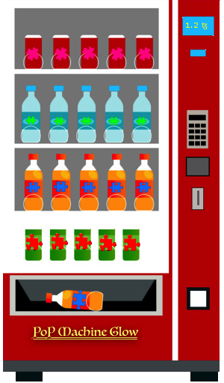
PoP Machine Glow
A decentralized oracle for zero knowledge proofs and
verification on the Tezos network
Chain of Insight team—D. Taylor, J. Dechant, J. May

Slide 2
Overview
Introduction
Technical overview
DApp demo

Slide 3
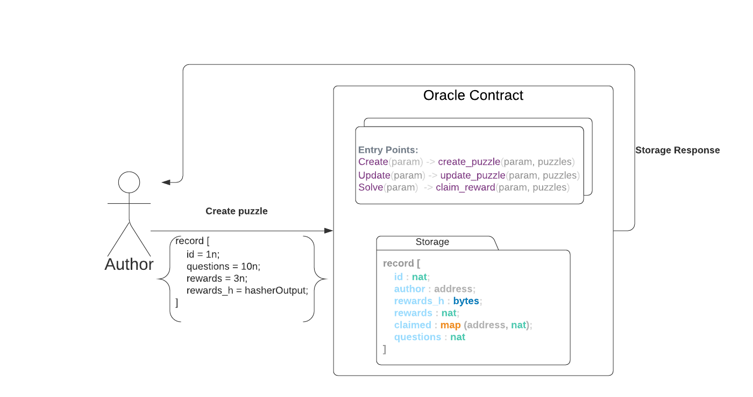

Slide 4
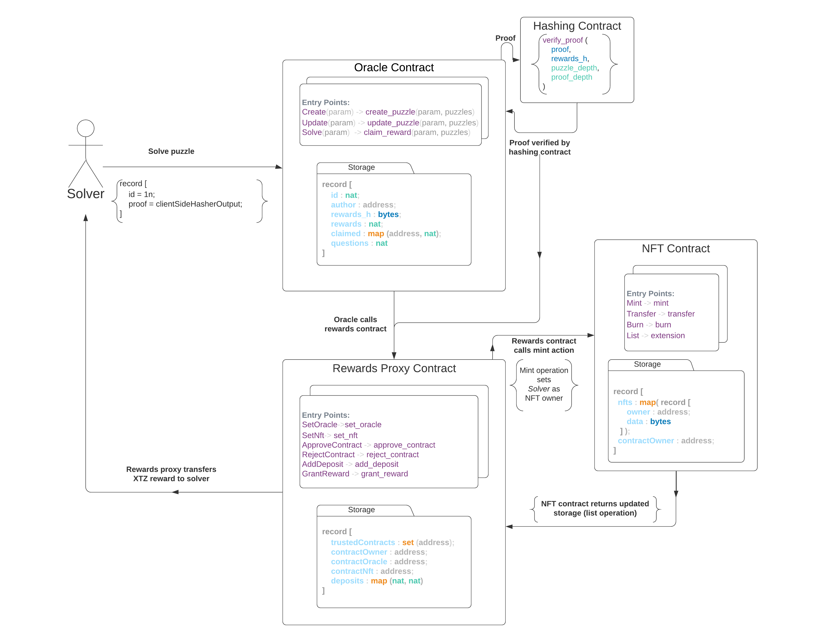

Slide 5
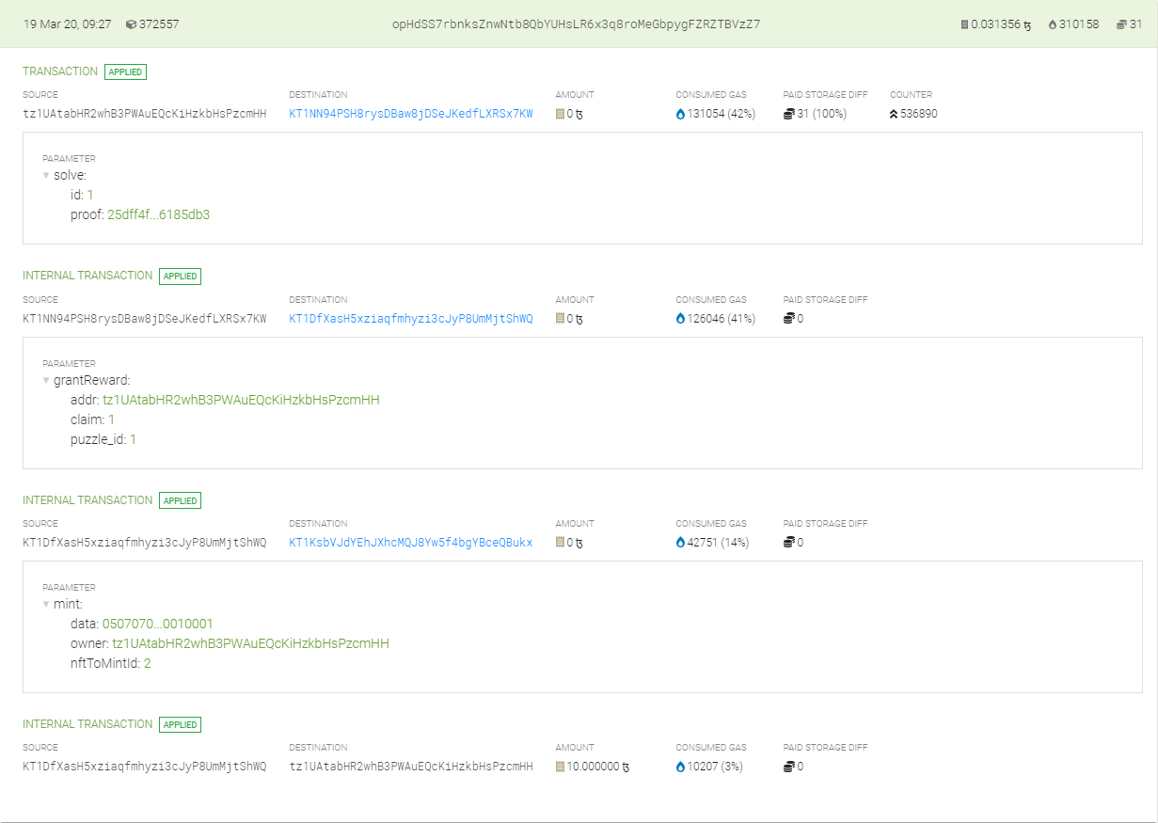

Slide 6
Live Demo

