Slide 1
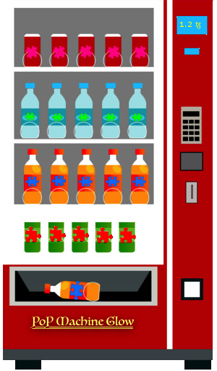
PoP Machine Glow
A decentralized oracle for zero knowledge proofs and
verification on the Tezos network
Chain of Insight team—D. Taylor, J. Dechant, J. May
Notes:
- Hello everyone, we're the Chain of Insight team, presenting our project “PoP Machine Glow”, and we'd like to tell you about how we built a framework for producing lightweight zero-knowledge proofs on the Tezos blockchain.
**** CUT FOR TIME? ****
Just to give you some insight into who we are, we've got...
- Josh Dechant - Lead protocol developer
- John May - Software developer and mathematician
- Drew Taylor - Project manager, software developer
**** CUT FOR TIME? ****

Slide 2


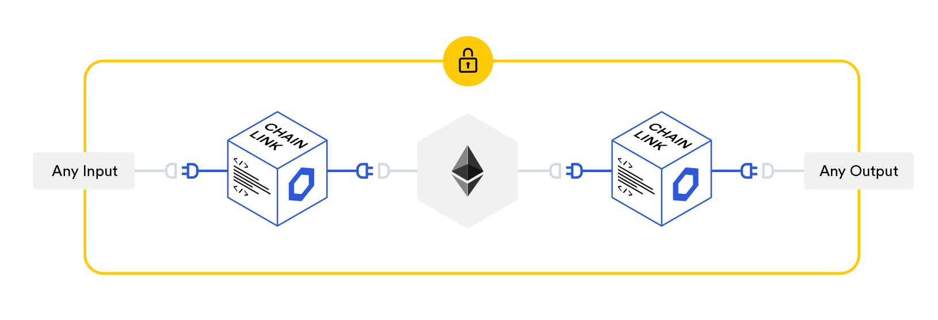

Secret Sharing Schemes
Notes:
- So, what we're talking about here is blockchain secret sharing schemes.
- You've already heard about other secret sharing protocols for blockchain, like Enigma and ChainLink which are using Intel SGX secure hardware as a layer 2 network, so these solutions require additional infrastructure
- Of course, you've also heard of zero knowledge cryptography strategies like the infamous zk-SNARKS

Slide 3
Proof Capabilities
Integer Comparisons
Trusted 3rd Party Setup
Good for verifying:
Good for verifying:
Times
Dates
Money
Vector points (graphs)
Game scores & rewards
Etc.
Self sovereign identity (SSO)
Restricted purchases (tobacco, alcohol, etc.)
Notes:
- Unlike zk-SNARKS, our framework is capable only of proving integer comparisons
- That means it's good for verifying information like: times, dates, money, vector points, game scores, etc.
***
- However, we can also produce a limited type of general knowledge proofs, using a trusted 3rd party provider like you see happening in ChainLink's protocol
- This type of proof can be used to prove and verify data such as:
- Self sovereign identity (SSO)
- Purchasing restricted goods (tobacco, alcohol, gambling, etc.)

Slide 4
Trusted 3rd Party Setup
Good for verifying:
Self sovereign identity (SSO)
Restricted purchases (tobacco, alcohol, online gambling, etc.)
Notes:
- Our proof system is also capable of producing a limited type of general knowledge proofs, but that requires a trusted 3rd party provider like you see happening in ChainLink.
- This type of proof can be used to prove and verify data such as:
- Self sovereign identity (SSO)
- Purchasing restricted goods (tobacco, alcohol, gambling, etc.)

Slide 5
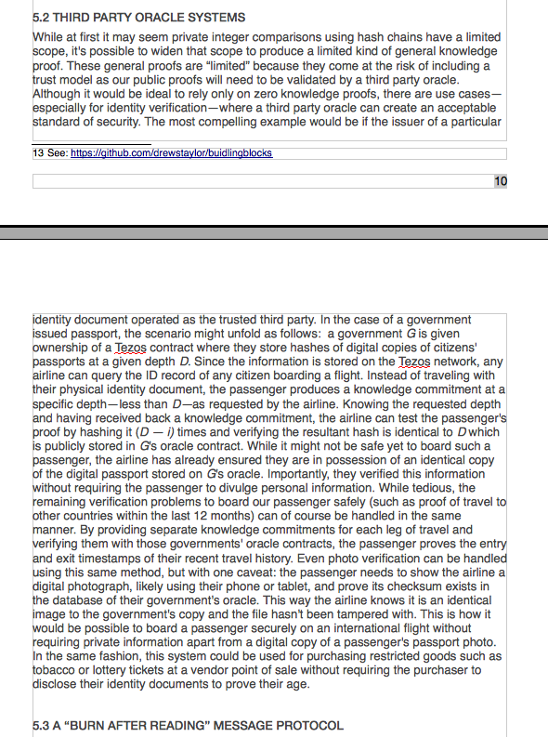
Notes:
- In the “3rd Party Oracle Systems” section of our research paper we provide a full walk through of how to safely board a passenger, on an international flight, using only zero knowledge proofs instead of requiring them to show their passport as proof of identity
- While it seems like an extreme claim, you'll have to take a look at our research paper to appreciate the fullness, robustness and eleagance of our solution for self sovereign identity

Slide 6



Zero Knowledge Proofs on Mobile?!
vs.
zk-SNARKs
PoPMG
Notes:
- The big limitation of zk-SNARKs is they require a high amount of compute resources to generate knowledge commitments. It's simply infeasible to generate SNARKS from a mobile device or even from a reasonably powered laptop.
- To use zero knowledge proofs in a common everyday scenario on typical hardware just isn't feasible at this time, so obviously need something better...
- Here's where PoPMG comes to the rescue!
- So without further-ado check out how our proofs work in action, and how our knowledge commitments are formed using our hash chaining improvement for hash locked on chain transactions

Slide 7
Live Demo
Notes:
- Now we're not going to wait for any transactions to confirm right now, as we don't even we need to
- That's because kind of the point of our zero knowledge proofs is for anyone to be able to run the calculations on their own hardware
- but I'm actually already logged with TezBridge—which is like MetaMask for Tezos—and you can see my testnet balance up here at the top
-

Slide 8
Notes:
CONCLUSION:
So that's our story of how it's now possible to generate and prove a wide variety of zero knowledge proofs even from a mobile device.
Thanks so much for joining us on this journey!
Please let us know if you have any questions for us

