Slide 1

interoperability and bridges
elizabeth
@noot

Slide 2
0.
solidity

Slide 3
solidity: unique features
msg.sender, msg.value
transfer
payable and non payable functions
fallback function
events

Slide 4
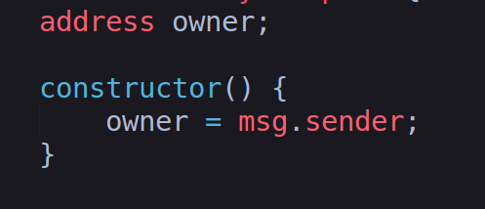
solidity: unique features

Slide 5
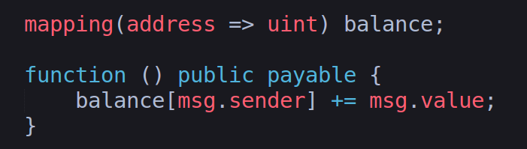
solidity: unique features

Slide 6
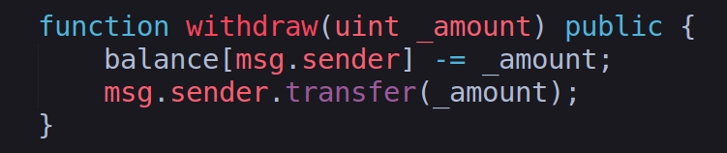
solidity: unique features

Slide 7
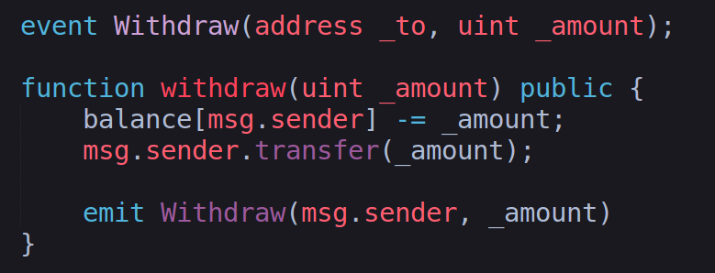
solidity: unique features

Slide 8
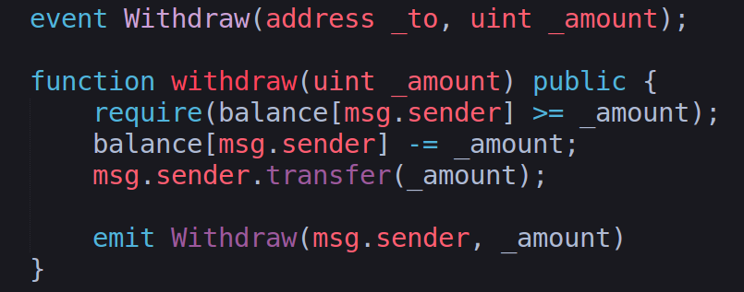
solidity: unique features

Slide 9
1.
background

Slide 10
definitions
proof of authority (PoA): consensus mechanism in which blocks are finalized by a known group of validators
sidechain: a copy of the (ethereum) main chain that communicated with the mainnet

Slide 11
definitions
public/private keypair: public key is distributed to others; private key is kept secret
signing: done with one's private key; others can verify who it is with the corresponding public key

Slide 12
interoperability
the ability of technologies to interact with other technologies
blockchains interacting with other blockchains to form a system
key for scalability

Slide 13
bridging between blockchains
we don't want our blockchains to be isolated systems
for example, bridging the mainnet with a PoA sidechain allows for virtually free transactions on the sidechain

Slide 14
bridging: main idea
deploy contracts on both sides
contracts contain deposit() and withdraw() functions which can be sent ether or tokens
an event is emitted upon a call to one of these functions

Slide 15
bridging: main idea
create a client that will watch for events happening in these contracts
when an event occurs on one chain, client will submit a transaction on the other chain

Slide 16
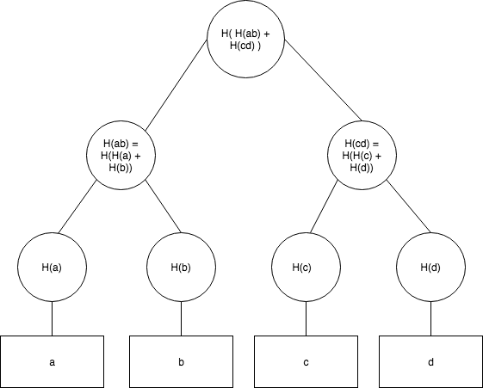
bridge validation:
option 1 - merkle tree proofs

Slide 17
bridge validation:
option 2: known set of validators
option 2: known set of validators
validators confirm deposits and submit signed messages saying the deposit occurred

Slide 18
PoA bridge
bridge between mainnet and a sidechain with a known bridge validator set stored in a contract

Slide 19
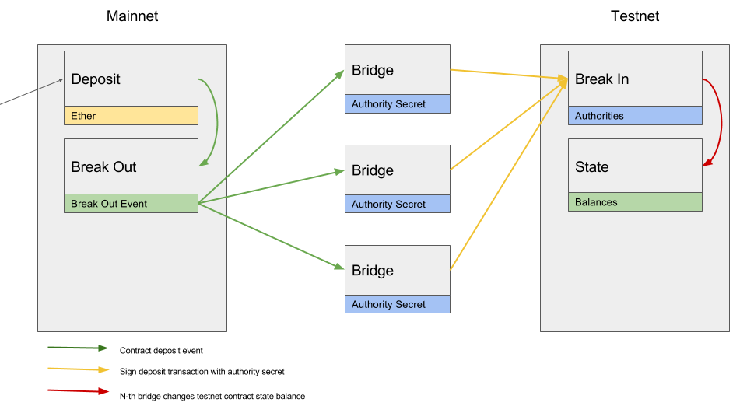

Slide 20
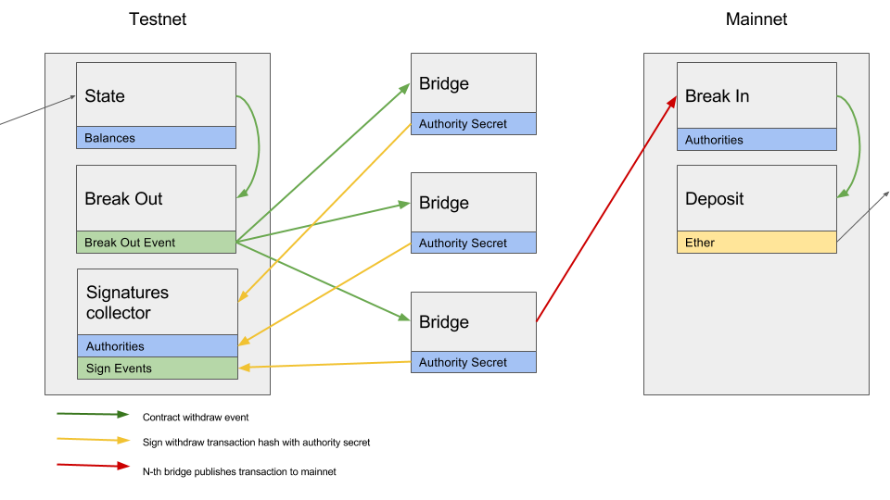

Slide 21
2.
contracts
fork of PoA bridge contracts
https://github.com/noot/poa-bridge

Slide 22
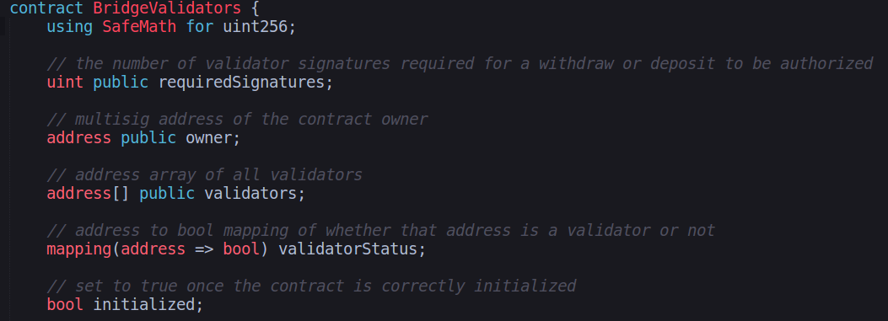
bridge validator contract

Slide 23
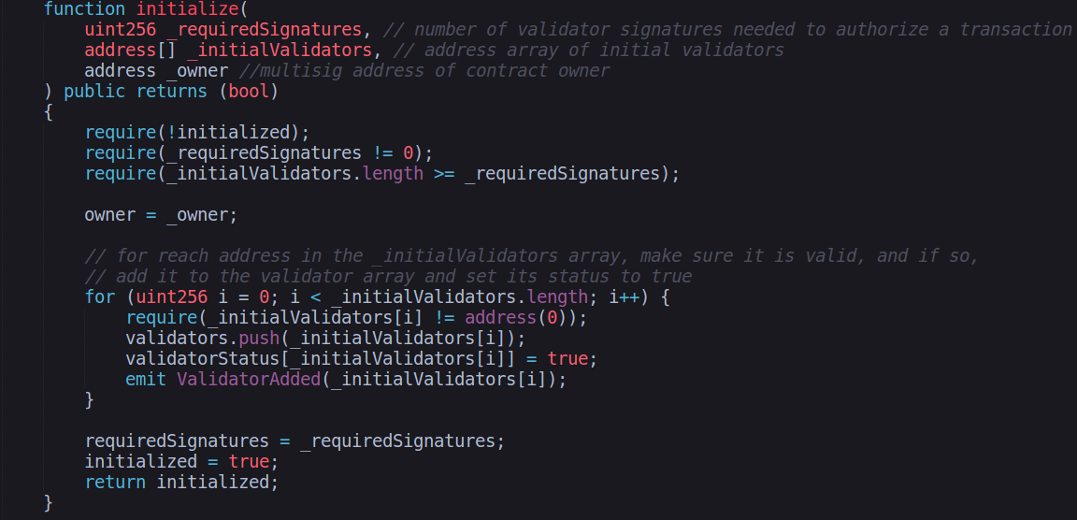
bridge validator contract

Slide 24
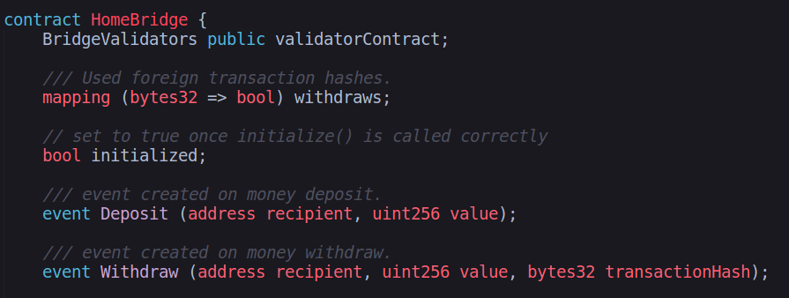
home bridge contract

Slide 25
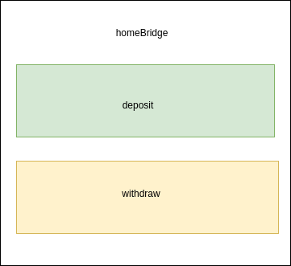
home bridge contract

Slide 26
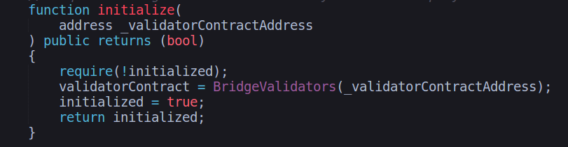
home bridge contract

Slide 27
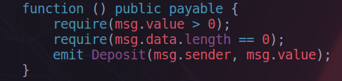
home bridge contract

Slide 28
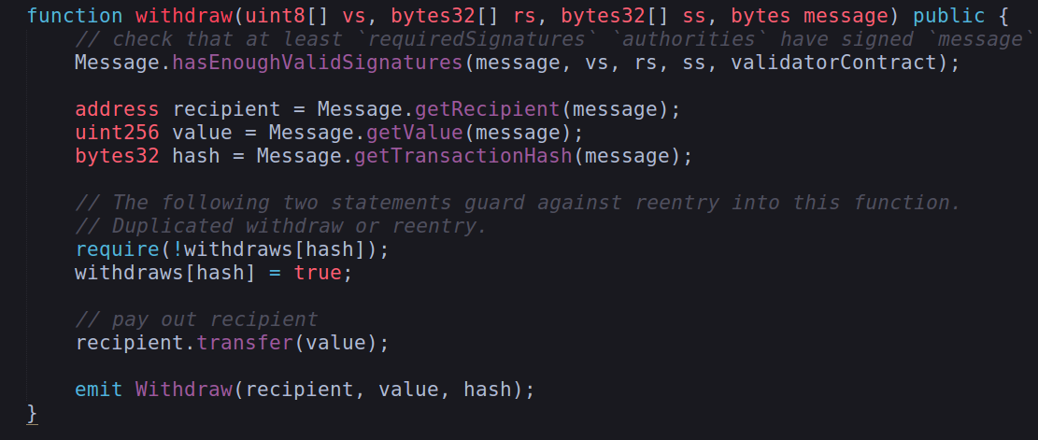
home bridge contract

Slide 29
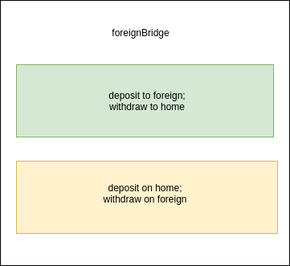
foreign bridge contract

Slide 30
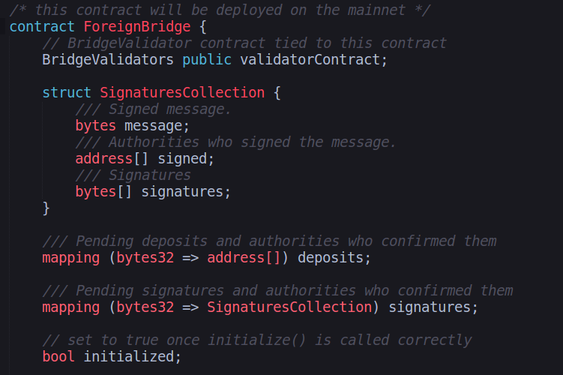
foreign bridge contract

Slide 31
foreign bridge contract

Slide 32
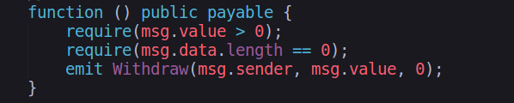
foreign bridge contract

Slide 33
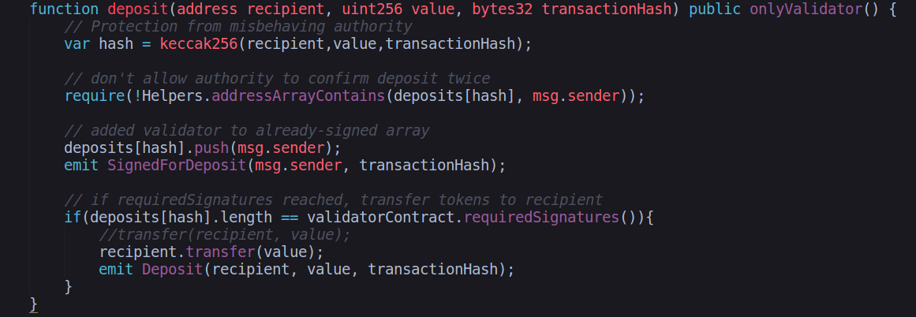
foreign bridge contract

Slide 34
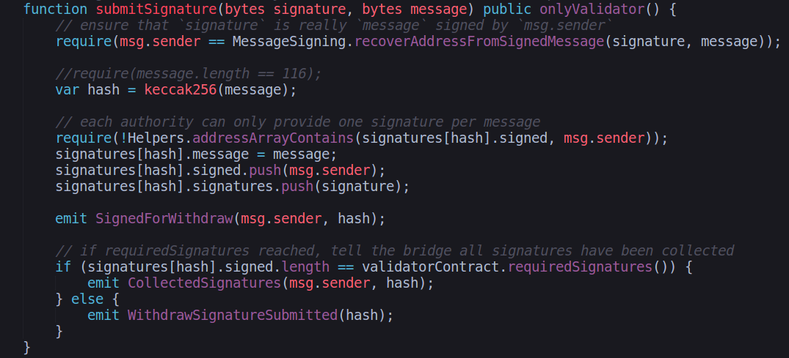
foreign bridge contract

Slide 35
3.
demo

Slide 36
sources
https://github.com/paritytech/parity-bridge
https://github.com/poanetwork/poa-bridge
https://hackernoon.com/merkle-tree-introduction-4c44250e2da7

Slide 37

Questions?
We are hiring!
Rust, JavaScript (React.js), and Solidity
If interested, please send your resume and other relevant information to careers@chainsafe.io

