Slide 1
Auditing as a Service
CS528 - Cloud Computing
Mentors: Sahil Tikale - Naved Ansari
Ali Raza - Rushi Patel - Chenxi Li - Kevin Liang

Slide 2
Background
Bare Metal Clouds
Bare metal machines instead of virtual machines
Current bare metal clouds also do provisioning
Each tenants may have different requirements
How do we ensure different tenants can share the cloud?
Tenant does not have the flexibility

Slide 3
Background
Hardware Isolation Layer (HIL)*
Provides isolated network of nodes
Exokernel for the cloud
Provides as little abstractions as possible
Allows tenants to choose provisioning system and other services
Move resources between multiple clusters
Allows security sensitive applications to use public clouds
* Hennessey, Jason, et al. "HIL: designing an exokernel for the data center." Proceedings of the Seventh ACM Symposium on Cloud Computing. ACM, 2016.

Slide 4
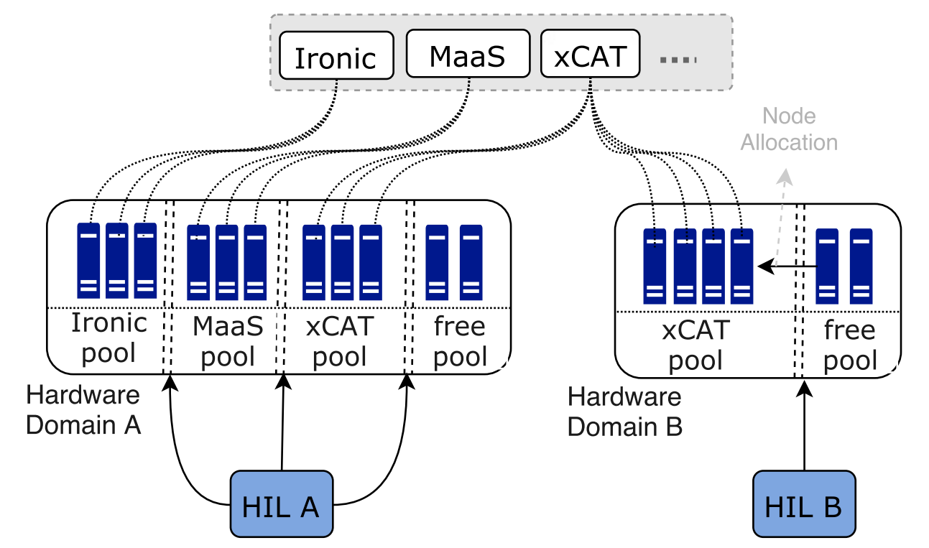
Hardware Isolation Layer
Hennessey, Jason, et al. "HIL: designing an exokernel for the data center." Proceedings of the Seventh ACM Symposium on Cloud Computing. ACM, 2016.

Slide 5
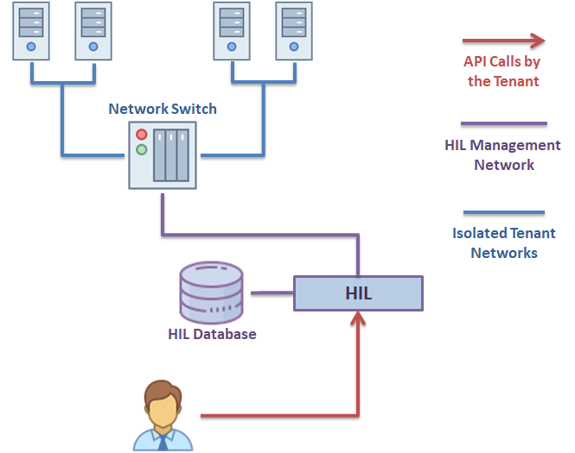
Motivation

Slide 6
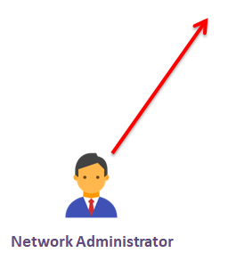
Motivation
What if the switch state is changed without updating the HIL database?

Slide 7
Motivation
What if the user does not trust the administrator?

Slide 8
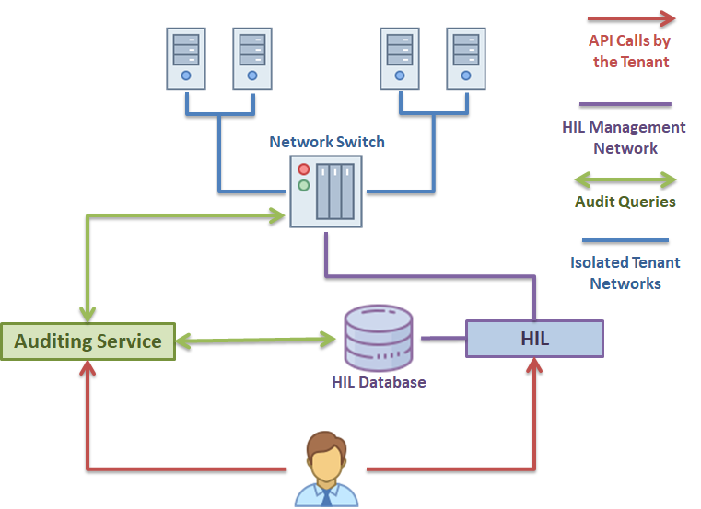
Auditing as a Service
Query the switch state
Query HIL database
Check and report discrepancies

Slide 9
Planning
Understanding / Knowledge Building
Design
Backend Development
REST API

Slide 10
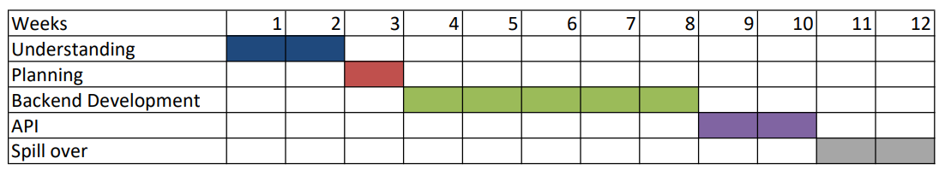
Timeline

Slide 11
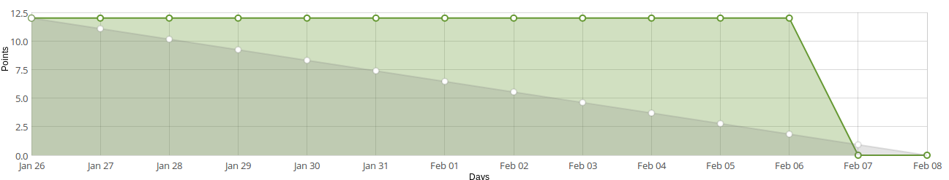
First Sprint
Still learning how to use Taiga
User Stories:
Read HIL paper
Create presentation

Slide 12
Next Sprint (starting)
User Stories:
Setup HIL simulation environment
Install VM with CentOS or RHEL
Install HIL and create simple isolated network
Get familiar with Open vSwitch
Understand HIL code
Look into REST API
Look at network switch driver implementation

Slide 13
User Stories
Read HIL Paper (Done)
Create Powerpoint for Project Introduction (Done)
Setup HIL simulation environment
Understanding HIL code
Understand REST API features
List out features available in audit system
Design REST API interface
Create Backend Audit System
Create test cases for Audit system
Test features of audit with software simulated HIL
Create CLI application to interact with audit system

