Slide 1
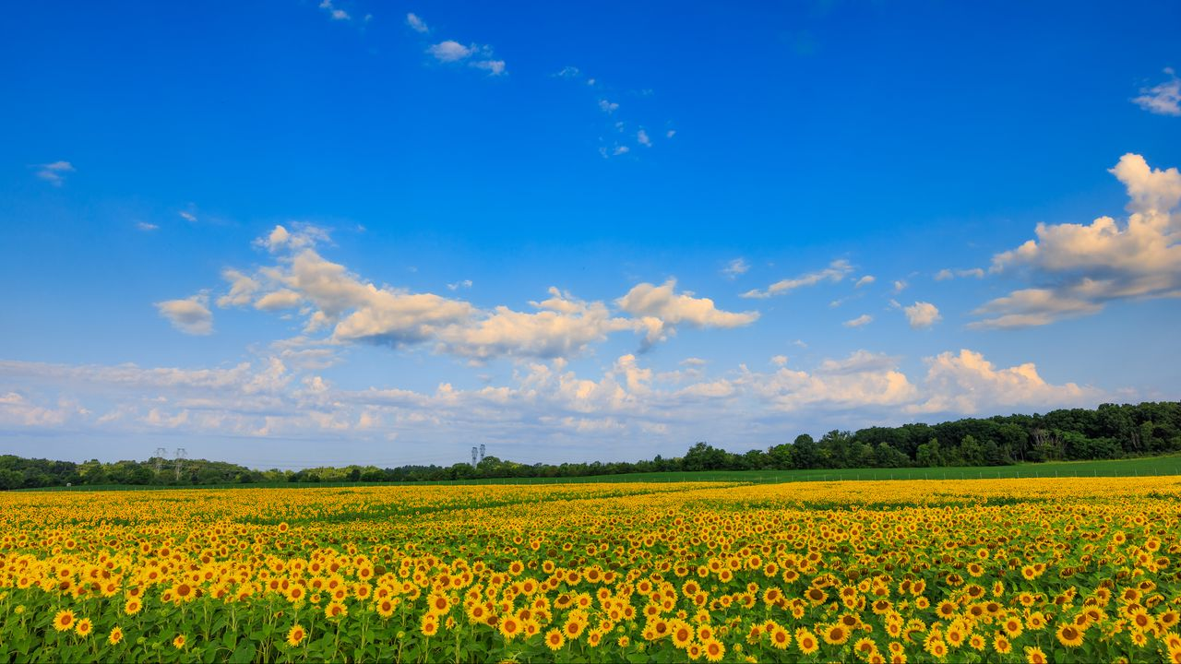
My summer 2026
Нагаев Данил

Slide 2
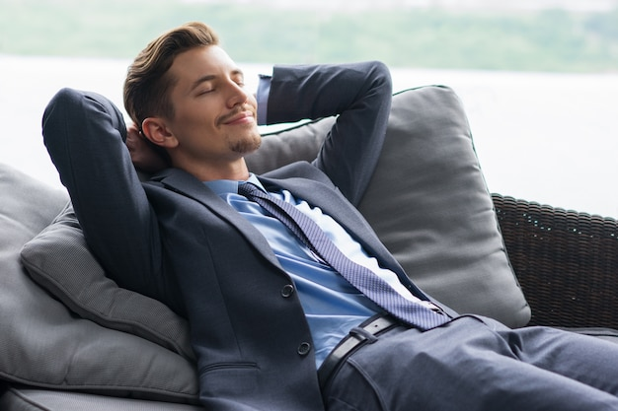
My plans
just get plenty of sleep and take a break from studying

Slide 3

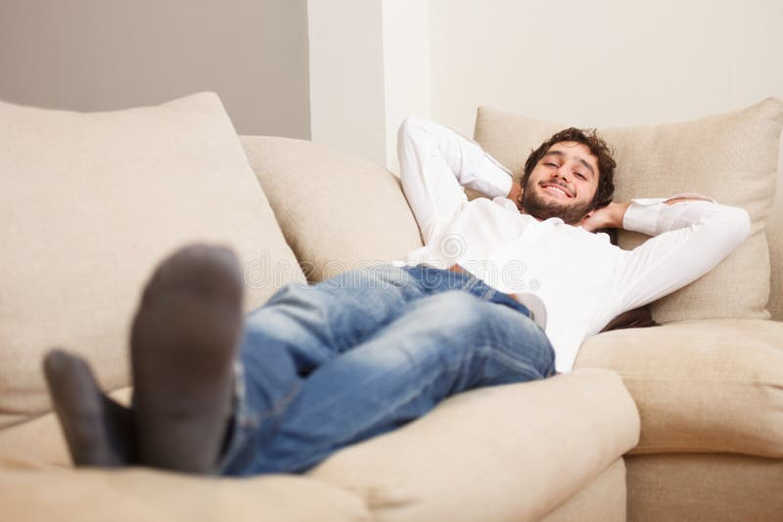
And I met all the plans

Slide 4

The most memorable event
FIFA World cup

Slide 5
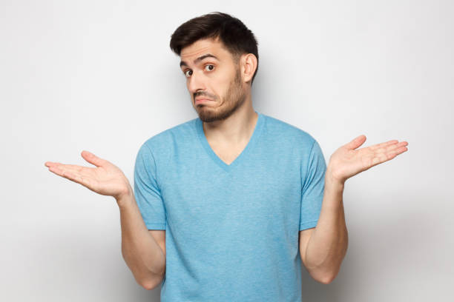
Everything went as expected, and everything worked out.

Slide 6

The summer was completely ordinary—just fast as always.

