Slide 1


Snake Game
By: Shivani Kapadia, Oliver Calandra, Jahmaro Gordon, Surya Singh

Slide 2


Outline & Member’s Tasks
z

Slide 3

Members
z
Shivani
Oliver
Jahmaro
Surya
Notes:
Introduce ourselves and then what we did on the project.
Example "Hi, I'm Oliver, I worked on the snake and the pit and also floated around helping"

Slide 4

Outline
z
Snake
Pit
Trophy
Main menu
Notes:
The snake was made using a structure set up and characters are added at the tail
The pit was made by first getting the size of the terminal and then generating characters top to bottom and left to right
The trophy was also made using a structure set up
The main menu was made

Slide 5
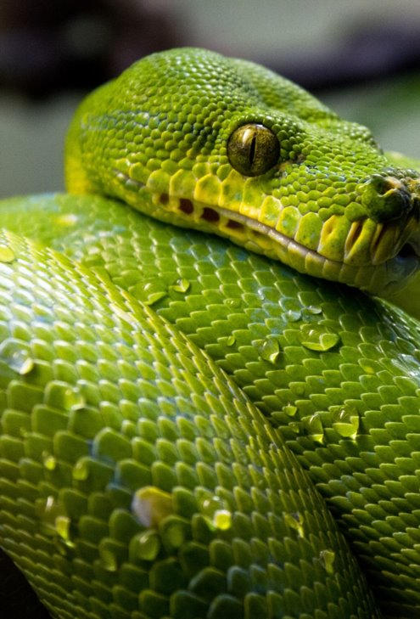
Outline
z
Snake
Pit
Trophy
Main menu
Notes:
The snake was made using a structure set up and characters are added at the tail
The pit was made by first getting the size of the terminal and then generating characters top to bottom and left to right
The trophy was made using variables and a random int generator within the program
The main menu was made

Slide 6

Outline
z
Snake
Pit
Trophy
Main menu
Notes:
The snake was made using a structure set up and characters are added at the tail
The pit was made by first getting the size of the terminal and then generating characters top to bottom and left to right
The trophy was made using variables and a random int generator within the program
The main menu was made

Slide 7

Outline
z
Snake
Pit
Trophy
Main menu
Notes:
The snake was made using a structure set up and characters are added at the tail
The pit was made by first getting the size of the terminal and then generating characters top to bottom and left to right
The trophy was made using variables and a random int generator within the program
The main menu was made

Slide 8
Outline
z
Snake
Pit
Trophy
Main menu
Notes:
The snake was made using a structure set up and characters are added at the tail
The pit was made by first getting the size of the terminal and then generating characters top to bottom and left to right
The trophy was made using variables and a random int generator within the program
The main menu was made

Slide 9

Start Game
z

Slide 10

Main Menu
z

Slide 11
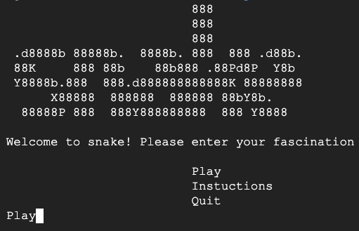
Welcome to Snake
Snake logo
Main menu display with options:
Play
Instructions
Quit

Slide 12
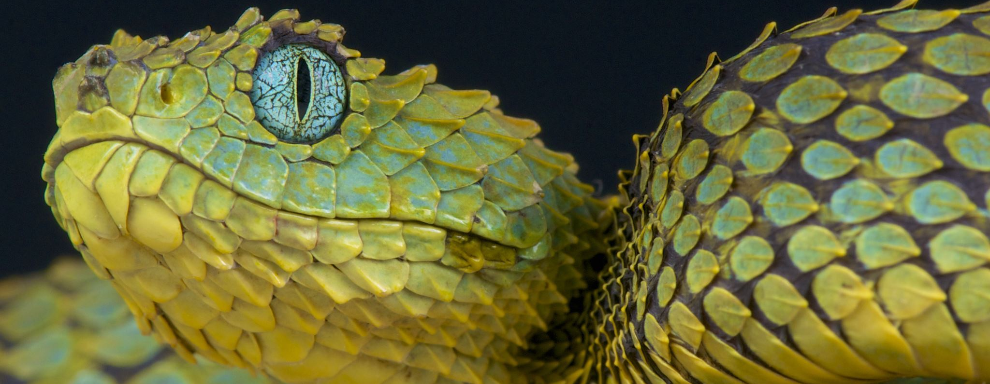
Snake Pit
z

Slide 13
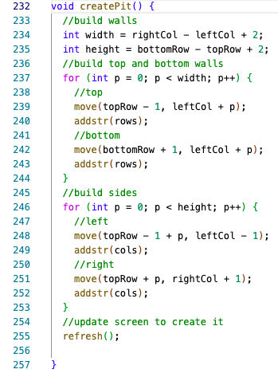
Enter the Pit
Notes:
This is our code for the snake pit, first it goes into a method that gets the screen size and this is what builds the pit.

Slide 14
The Snake
z

Slide 15
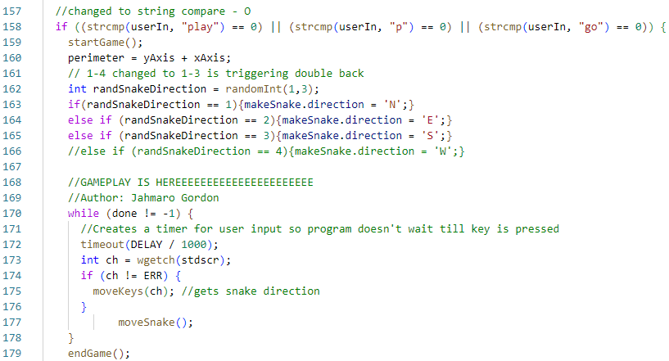
The Initial Snake Length and Movement
z
Length is set to 3 total (including the head)
Movement is dictated by both WASD and arrow keys
The speed is set to 1
Notes:
Jah
Inside the main loop I defined a loop that will constantly update the snake
I created a timer for the user input and

Slide 16
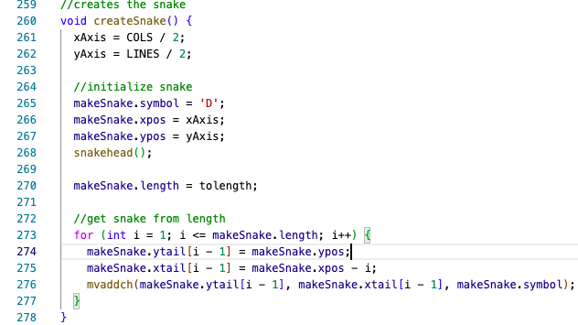

Slide 17
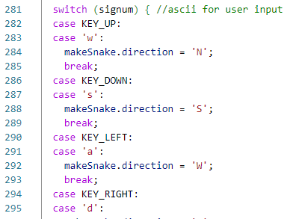
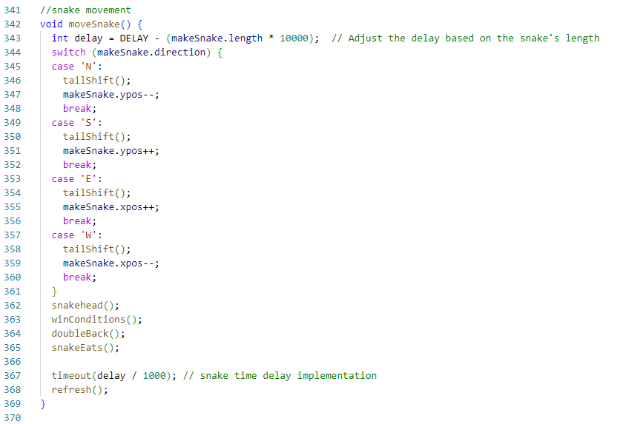
Snake Movement
z

Slide 18

The Trophies
z

Slide 19
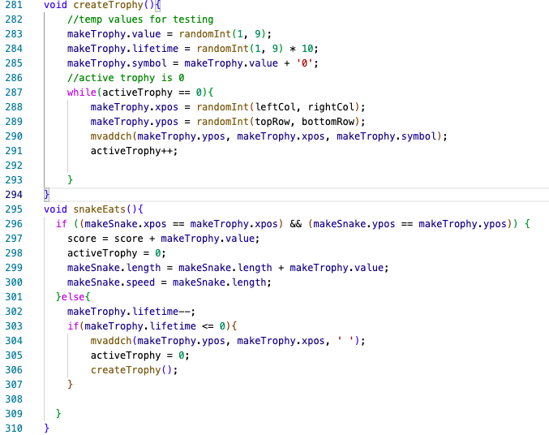
Points, Display, Movements, & Expiration
z
Notes:
Here are the 2 trophy methods where the trophy is created and where the snake eating it is handled.

Slide 20

Game Over Scenarios
z
This Photo by Unknown Author is licensed under CC BY-NC

Slide 21
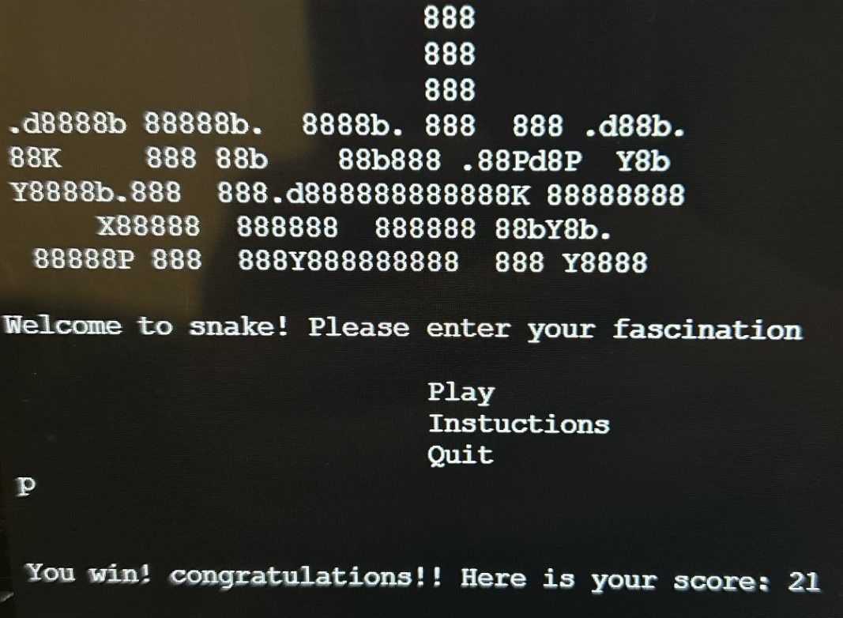
Game Over Conditions
Win
Lose
If the snake length is greater than or equal to the perimeter/2.
If you touch the border or run into yourself

Slide 22
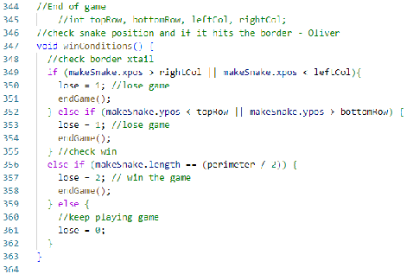
End game code:

Slide 23

Demo
z

