Slide 1

MACHINE FAILURE PREDICTION PROJECT

Slide 2
INTRODUCTION
Chainy Jain
Data Science June Batch 2024
jainchainy427@gmail.com

Slide 3
Overview
This project predicts the machine failure based on the sensor data collected from various machines
Includes a variety of sensor readings as well as the recorded machine failure
COLUMN DESCRIPTION
footfall: The number of people or objects passing by the machine.
temp Mode: The temperature mode or setting of the machine.
AQ: Air quality index near the machine.
USS: Ultrasonic sensor data, indicating proximity measurements.
CS: Current sensor readings, indicating the electrical current usage of the machine.
VOC: Volatile organic compounds level detected near the machine.

Slide 4
RP: Rotational position or RPM (revolutions per minute) of the machine parts.
IP: Input pressure to the machine.
Temperature: The operating temperature of the machine.
fail: Binary indicator of machine failure (1 for failure, 0 for no failure).
Independent variables –
footfall, temp Mode, AQ, USS, CS, VOC, RP, IP, Temperature
Dependent variable -
fail

Slide 5
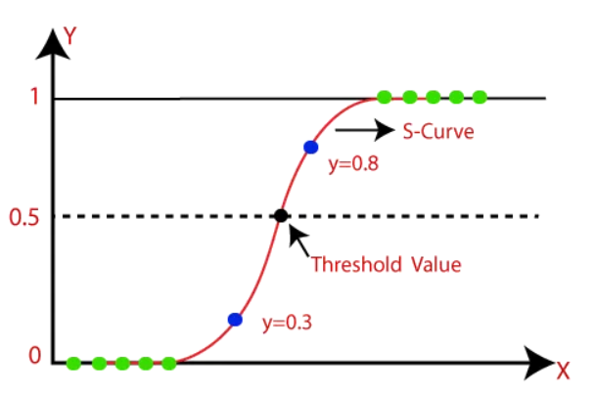
LOGISTIC REGRESSION
Supervised learning algorithm
Used for classification task
Linear Regression + Sigmoid function
Analyse the relationship between two data factors

Slide 6
Output
Accuracy - 0.87
Precision – 0.85
Recall – 0.89
F1-score – 0.87
Confusion matrix – [ [ 88 14 ] [ 10 77 ] ]

Slide 7
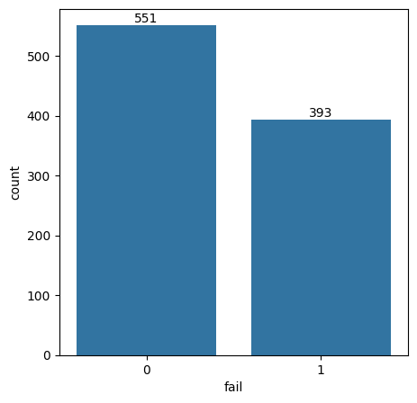
Output plot

Slide 8
THANK YOU

