Slide 1
BDI Hackathon 2026 · PhenoInsure Tech
Monotonic XGBoost + PR-AUC
Metabolic disease screening — three real-cohort experiments, re-evaluated
Obesity (MTBLS242 NMR) · T2DM clinical (NHANES) · T2DM urine NMR (MTBLS1)

Slide 2
What changed, and why
Monotonic constraints
Headline metric: PR-AUC
• From literature, not from the data: each constrained feature's direction is a citable disease/metabolomics finding — never the sign of that feature's own correlation with this specific sample.
• Conservative by design: a feature is only constrained when there's a defensible reason. Everything uncertain — including all 105 unidentified NMR chemical-shift buckets in Experiment C, which have no chemical identity to reason about — is left unconstrained rather than guessed.
• Example calls: hippurate/citrate ↓ and ketone bodies ↑ in diabetic urine (this dataset's own published finding, Salek et al. 2007); BCAAs ↑ and glycine ↓ in obesity (Newgard 2009, Wang 2011); age/BP/triglycerides ↑ and HDL/albumin ↓ for T2DM risk.
• Rejected an earlier version: a correlation-sign approach was tried first, but it constrained known sample-context artifacts (e.g. a surgical skin-prep contaminant) as if they were biology, and a NaN-handling bug silently under-constrained NHANES. Literature-based directions avoid both failure modes.
• Replaces ROC-AUC as the reported cross-validation metric in all 3 notebooks + the script.
• Why: ROC-AUC can look optimistic under class imbalance. NHANES diabetes prevalence is only 14.3% — PR-AUC tracks precision at the recall levels a screening program actually operates at.
• Same rigor kept: stratified/subject-grouped 5-fold CV, held-out folds only, provenance + eval method stated on every figure.
Monotonic XGBoost + PR-AUC
Bridge AI Summit NMR 2026

Slide 3
Results summary (held-out PR-AUC)
Experiment | Data | Eval | PR-AUC | Baseline | Monotone (+/–/0)
A — Obesity | MTBLS242 serum NMR, n=177 | Stratified 5-fold | 0.984 ± 0.014 | 0.599 | 8 / 3 / 10
B — T2DM clinical | NHANES 2013–14, n=6,113 | Stratified 5-fold | 0.416 ± 0.030 | 0.143 | 9 / 2 / 2
C — T2DM urine NMR | MTBLS1, n=132 (42 subj) | Subject-grouped 5-fold | 0.976 ± 0.022 | 0.364 | 28 / 4 / 188
• All three PR-AUCs sit well above their class-imbalance baseline (chance = prevalence).
• Experiment C caveat: naive vs. subject-grouped PR-AUC (0.969 vs 0.976) being close only rules out same-*person* leakage — it says nothing about the 100% control/diabetes vs. acquisition-batch confound in this cohort (see slide 6). Treat 0.976 as a ceiling.
• Experiment B is the honesty check twice over: PR-AUC ≈ 0.42 (~2.9x lift over the 0.143 baseline) is the real number once HbA1c and glucose — which define the label — are excluded, AND it is lower than a correlation-tuned constraint set would score (~0.46) — the cost of choosing directions for defensibility, not for fit.
Monotonic XGBoost + PR-AUC
Bridge AI Summit NMR 2026

Slide 4
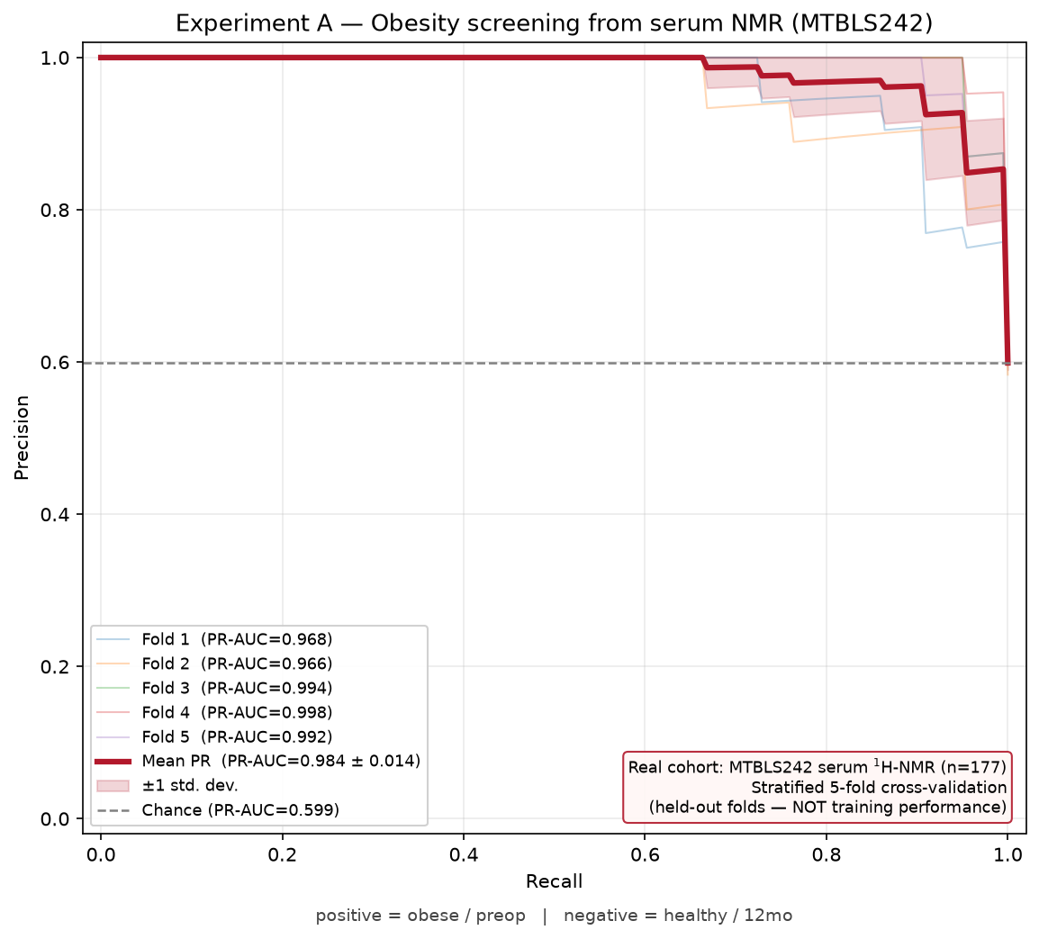
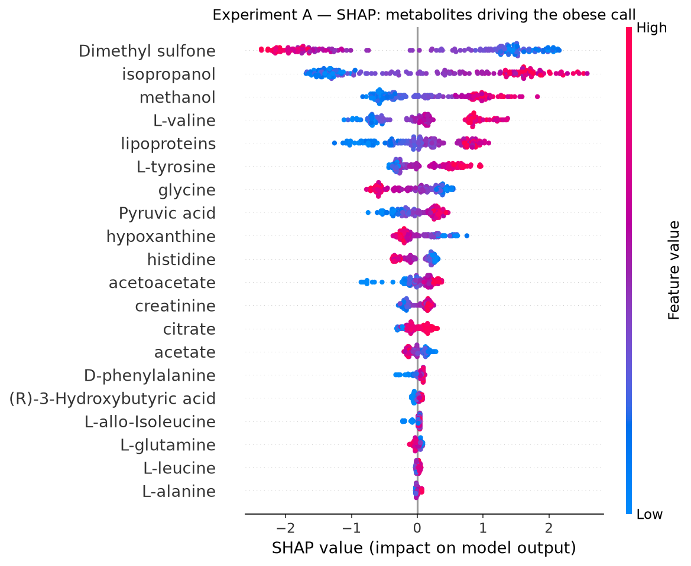
Experiment A — Obesity (MTBLS242 serum NMR)
obese/preop n=106 vs healthy/12mo n=71 · 21 metabolites, log1p · XGBoost max_depth=3
• PR-AUC 0.984 ± 0.014 (baseline 0.599). Monotone: BCAAs, aromatic amino acids, alanine, lipoproteins, lactate ↑; glycine, glutamine, histidine ↓ (11/21 constrained). Top SHAP drivers dimethyl sulfone/isopropanol/methanol are exogenous artifacts — deliberately left unconstrained, not treated as obesity biology.
Experiment A — Obesity (MTBLS242 serum NMR)
Bridge AI Summit NMR 2026

Slide 5
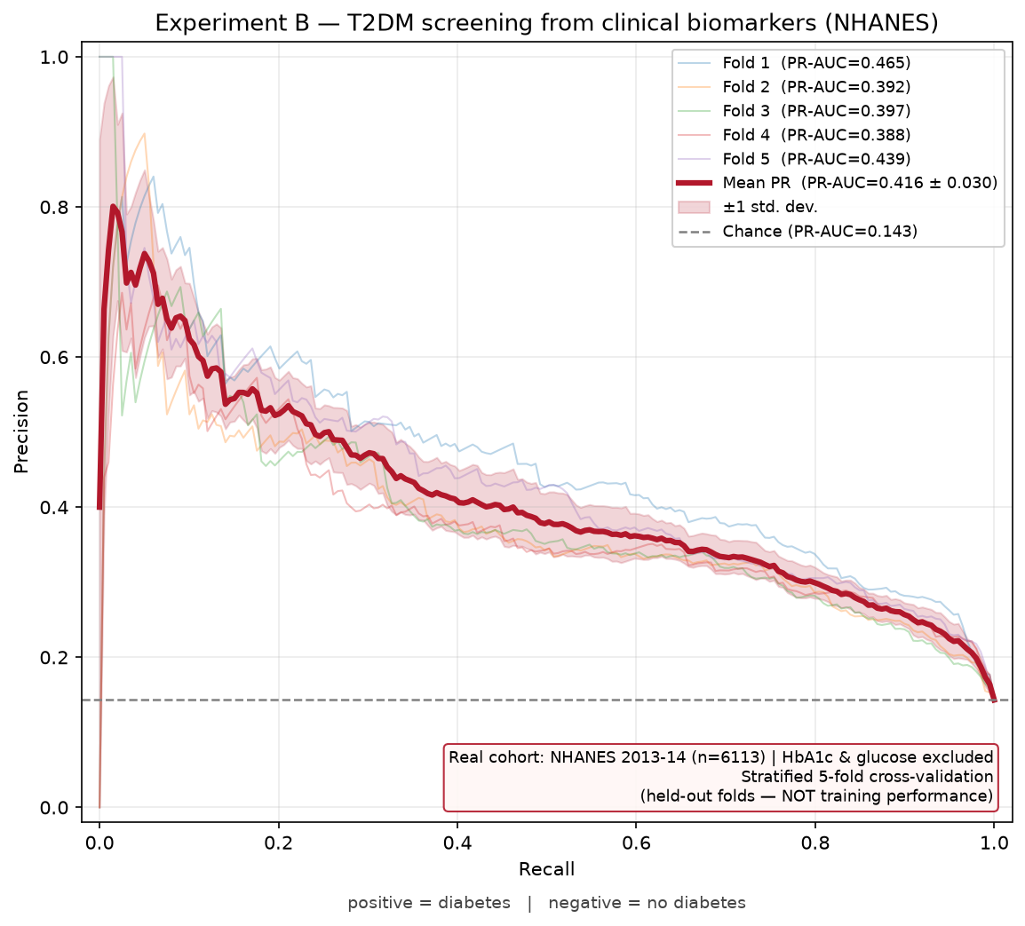
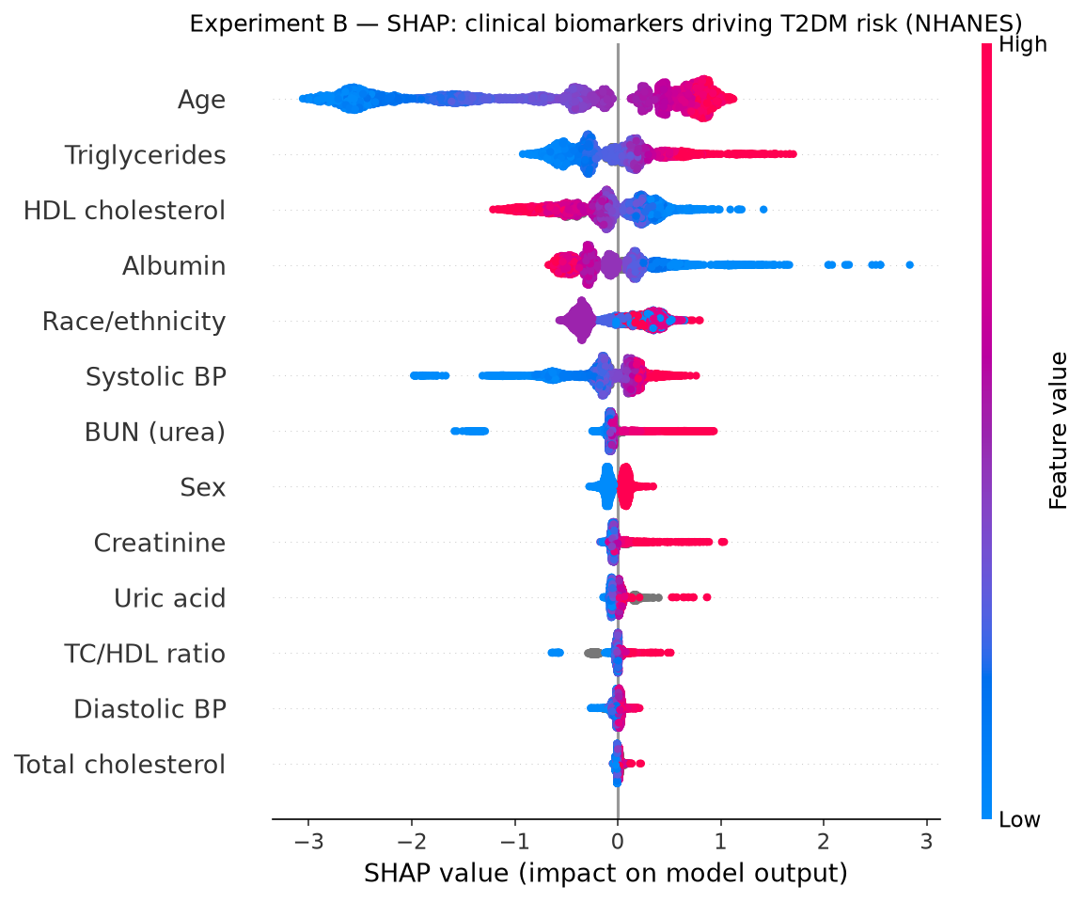
Experiment B — T2DM clinical (NHANES 2013–14)
diabetes prevalence 14.3% · 13 routine features, HbA1c + glucose excluded · leakage-free
• PR-AUC 0.416 ± 0.030 (baseline 0.143, ~2.9x lift). Monotone: age, systolic + diastolic BP, BUN, triglycerides, creatinine, uric acid, TC/HDL, total cholesterol ↑; HDL, albumin ↓ (11/13 constrained; sex/race left unconstrained as nominal categories).
Experiment B — T2DM clinical (NHANES 2013–14)
Bridge AI Summit NMR 2026

Slide 6
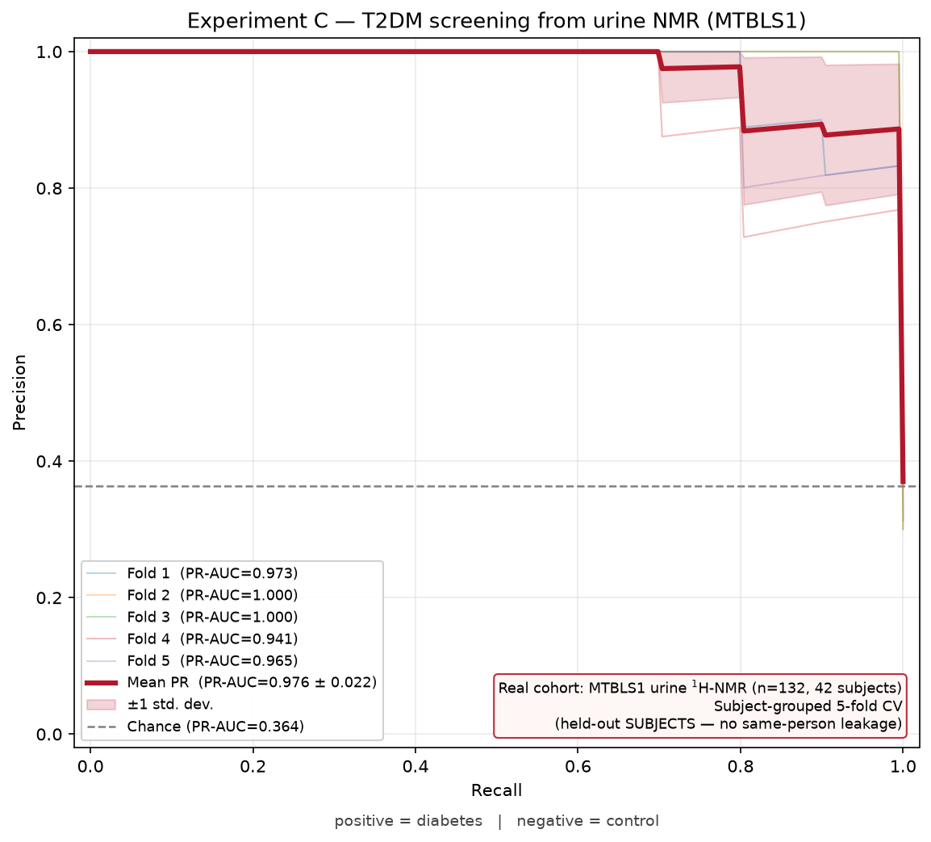
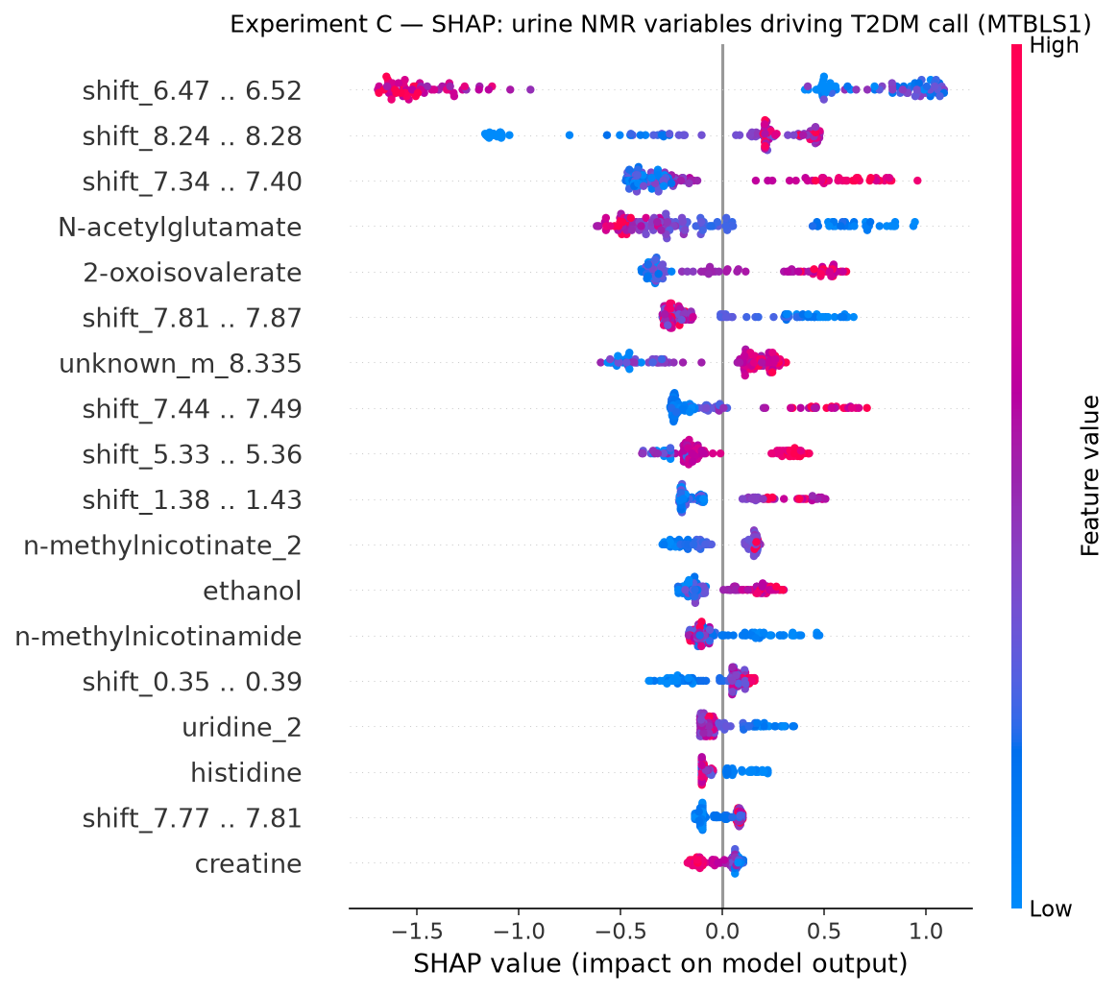
Experiment C — T2DM urine NMR (MTBLS1)
48 diabetes vs 84 control, 42 subjects · 220 NMR variables · StratifiedGroupKFold
• PR-AUC 0.976 ± 0.022 subject-grouped (naive 0.969). Monotone: hippurate/citrate ↓ (Salek 2007), ketone bodies/α-hydroxybutyrate/allantoin ↑, aminoaciduria pattern ↑ (32/220 constrained).
• ⚠ Batch confound: every control sample is one acquisition batch, every diabetes sample another — label is 100% predictable from batch alone. Subject-grouping doesn't fix this. Treat PR-AUC as a ceiling, not confirmed biology.
Experiment C — T2DM urine NMR (MTBLS1)
Bridge AI Summit NMR 2026

Slide 7
Honest caveats
• Experiment C has a 100% batch/label confound. Every control sample is one acquisition batch (ADG19007u), every diabetes sample another (ADG10003u). Subject-grouped CV rules out same-*person* leakage, not same-*batch* leakage — this PR-AUC cannot be separated from a scan-session artifact. Treat it as a ceiling, not confirmed biology.
• Real cohorts, held-out folds only. No synthetic spectra; every PR-AUC above is cross-validated, never training performance.
• Literature citations should be spot-checked before judge Q&A. Directions were assigned from recalled disease/metabolomics literature (Newgard 2009, Wang 2011, Würtz et al., Gall 2010, Salek 2007) — worth an independent literature check before presenting, same as any cited claim.
• Monotonic constraints are a guardrail, not a performance trick. They encode 'this direction shouldn't flip on retrain', not a causal claim — most NMR variables (all unidentified peaks, plus identified ones without a confident direction) are left unconstrained on purpose.
• Experiment A caveat: preop vs 12-months-post-op are cohort extremes; part of the SHAP signal (isopropanol) is surgical sample context, not metabolism.
• Not biomarker evidence by itself: distinct from any NMR–NHANES fusion analysis, which used simulated NMR values and is pipeline validation only, not real biology.
Monotonic XGBoost + PR-AUC
Bridge AI Summit NMR 2026

