Slide 1

Kenya Financial Inclusion Risk Prediction

Slide 2

Project Objective
Predict individuals at risk of financial exclusion in Kenya.
1
Use machine learning to support financial inclusion policies.
2
Provide transparent and explainable predictions.
3
Enable targeted interventions for vulnerable groups.
4

Slide 3
Business Problem
Millions remain outside formal financial systems.
Financial exclusion limits economic growth and resilience.
Manual identification of high-risk groups is inefficient.

Slide 4
Dataset Overview
Source: Kenya FinAccess 2021 Survey.
Contains demographic, socioeconomic and behavioral indicators.
Features include education, age, location, employment and financial behavior.
Target variable: Financially Excluded vs Included.

Slide 5
Data Preparation Pipeline
Missing categorical values filled using most frequent category.
Missing numerical values filled using median imputation.
OneHotEncoder transformed categorical variables.
StandardScaler normalized numerical features.

Slide 6
Why Preprocessing Matters
Ensures clean and consistent input data.
Reduces model bias caused by missing values.
Improves model stability and predictive reliability.
Prevents data leakage during training and testing.

Slide 7
Models Evaluated
Dummy Classifier: Baseline comparison model.
Logistic Regression: Simple and interpretable classifier.
Random Forest: Ensemble model capturing non-linear patterns.
Gradient Boosting: Sequential boosting model optimized for performance.

Slide 8

Why Multiple Models Were Tested
Different algorithms capture different data patterns.
Linear models improve interpretability.
Tree-based models improve complex pattern detection.
Comparing models ensures robust final model selection.

Slide 9

Evaluation Metrics Explained
Accuracy: Overall percentage of correct predictions.
Recall: Ability to correctly identify excluded individuals.
Precision: Reliability of positive predictions.
F1 Score: Balance between recall and precision.
ROC-AUC: Measures overall classification quality.

Slide 10

Understanding Model Trade-Offs
High accuracy alone is not enough in imbalanced datasets.
Recall was prioritized to avoid missing excluded individuals.
False negatives are costly because vulnerable people may be ignored.
Balanced metrics were used for fair model comparison.

Slide 11

Best Model Selection
Gradient Boosting achieved the strongest overall predictive performance.
It captured complex nonlinear relationships in the data.
Provided better balance between accuracy and generalization.
Selected as final production-ready model for explainability analysis.

Slide 12
Why Gradient Boosting Performed Best
Builds trees sequentially to correct previous errors.
Handles mixed feature interactions effectively.
Reduces bias while maintaining strong predictive power.
Works well with structured socioeconomic survey data.

Slide 13

Model Explainability with SHAP
SHAP explains how features influence predictions.
Shows why an individual was classified as excluded.
Improves transparency and trust .
Supports policy interpretation and stakeholder confidence.

Slide 14
Key SHAP Insights
Low education increased exclusion risk significantly.
Rural residence strongly contributed to exclusion predictions.
Youth populations showed higher vulnerability.
Socio-economic status influenced financial inclusion outcomes.

Slide 15

Feature Importance Analysis
Education level was among the strongest predictors.
Employment and income indicators improved inclusion probability.
Geographic location influenced access to financial services.
Behavioral variables captured financial engagement patterns.

Slide 16
Project Impact
Supports evidence-based financial inclusion policies.
Can help banks target underserved populations.
Improves transparency in predictive decision systems.
Demonstrates responsible and explainable AI application in Kenya.

Slide 17
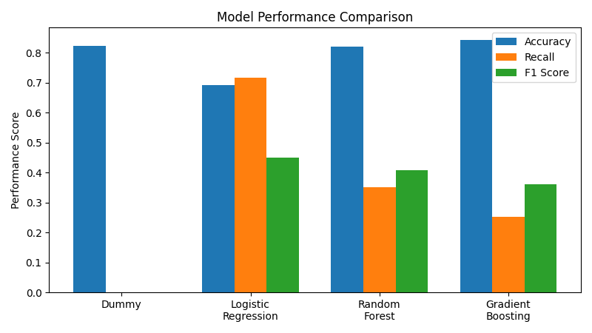
Model Performance Comparison

Slide 18

Deployment Overview Analysis
Final Gradient Boosting model deployed using Flask
Saved model, preprocessing pipeline and metadata for reproducibility
Enables non-technical users to generate predictions
Demonstrates an end-to-end machine learning workflow
Goal: Convert a trained model into a practical decision-support application.

Slide 19
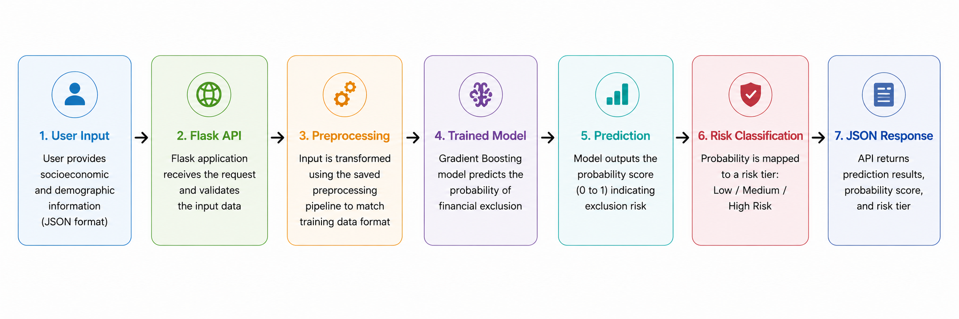
Deployment Architecture & Workflow
Core Assets:
Trained model pipeline (.joblib)
Feature schema (.json)
Model metadata
Sample input templates
Ensures consistent preprocessing and reliable predictions in production.

Slide 20

Business Value & Impact
Risk Classification:
Low Risk: <40%
Medium Risk: 40–70%
High Risk: >70%
Business Benefits:
Accessible predictions for stakeholders
Supports targeted financial inclusion programs
Enables future dashboard and API integration
Demonstrates production-ready deployment
Takeaway: Deployment turns model outputs into actionable insights.

Slide 21

Conclusion
Machine learning successfully identified financial exclusion patterns.
Gradient Boosting delivered the strongest overall predictive performance.
SHAP explainability improved model transparency and trust.
The project demonstrates to improve and support financial inclusion in Kenya.

Slide 22

Kenya Financial Inclusion Risk Prediction
Key Contributions
Defined a data-driven approach to identify individuals at risk of financial exclusion in Kenya
Cleaned, prepared and explored FinAccess data to uncover key patterns
Built and compared multiple machine learning models to predict exclusion risk
Applied SHAP, Mutual Information and Permutation Importance to explain predictions
Generated actionable recommendations for policymakers and financial institutions
Deployed a production-ready prediction system for decision support
Final Takeaway:
"By combining data analysis, predictive modeling, SHAP and deployment, we developed an end-to-end solution to support financial inclusion in Kenya."
Thank You for Your Time

