Slide 1




ANALYSIS OF NREGA IMPLEMENTATION AND IMPACT
Data Analysis and Insights
presentaion by Chaitalee Rajendra Patil
Internship Program
Date 22/06/2024

Slide 2
INTRODUCTION
The National Rural Employment Guarantee Act (NREGA) is a transformative government scheme aimed at providing rural households with guaranteed wage employment opportunities.
This project aims to analyze the implementation and impact of NREGA across different states and districts in India using data analytics techniques.

Slide 3
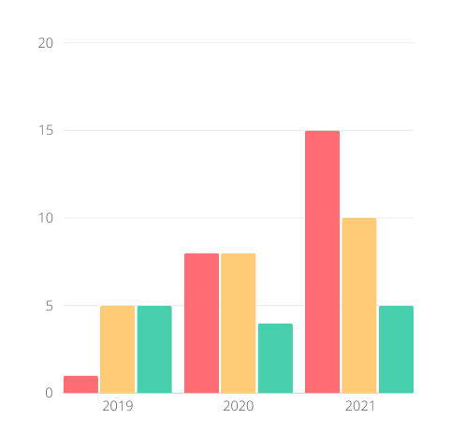
PROBLEM STATEMENT
How effective is NREGA in providing employment opportunities to rural households?
Are there regional disparities in the implementation and outcomes of the scheme?
What is the utilization of the allocated budget, and how does it correlate with employment generation?
What are the key factors contributing to the completion of NREGA works, and are there any roadblocks to its success?
Can data-driven insights guide policymakers and administrators in optimizing the scheme's impact?

Slide 4
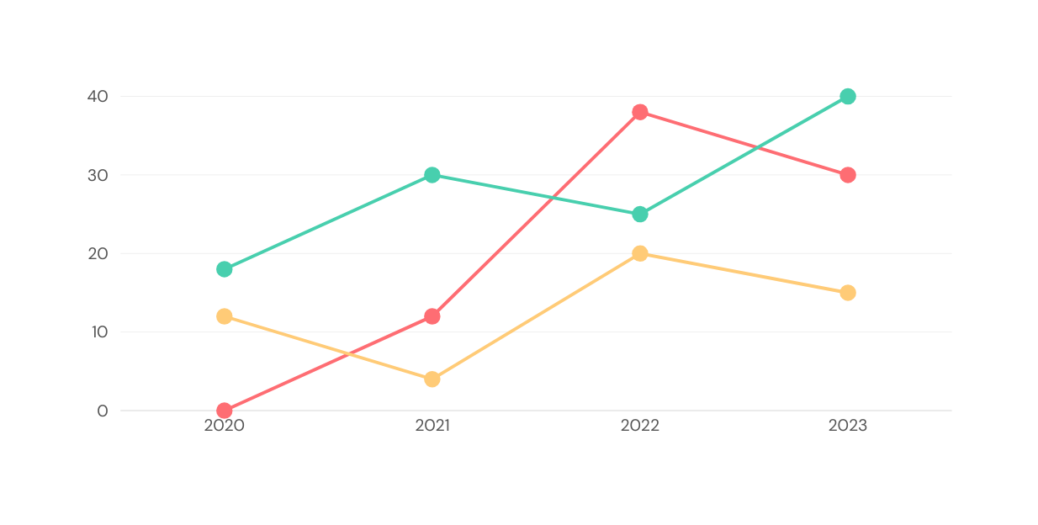
DATASET INFORMATION
The dataset is sourced from official government records and includes 28 columns such as job cards, worker details, budget allocation, work completion statistics, and expenditure.
It offers a comprehensive view of the progress and challenges faced by the NREGA program.

Slide 5
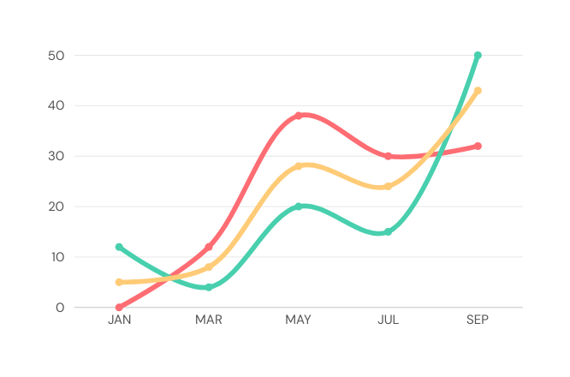
METHODOLOGY
Data preprocessing and cleaning to ensure data quality.
Exploratory data analysis (EDA) to identify patterns, trends, and disparities.
Data visualization techniques to present key findings effectively.
Drawing actionable insights to inform policymakers and administrators.

Slide 6
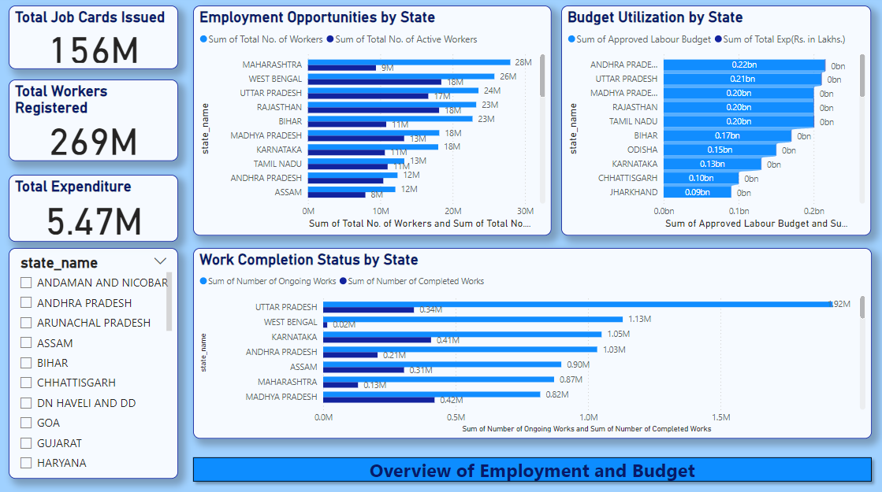

Slide 7
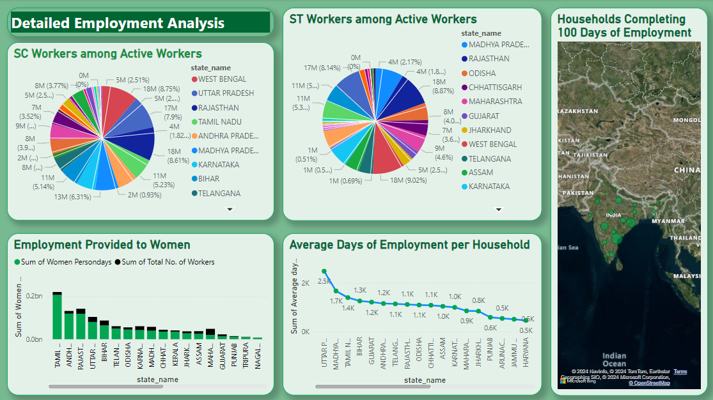

Slide 8
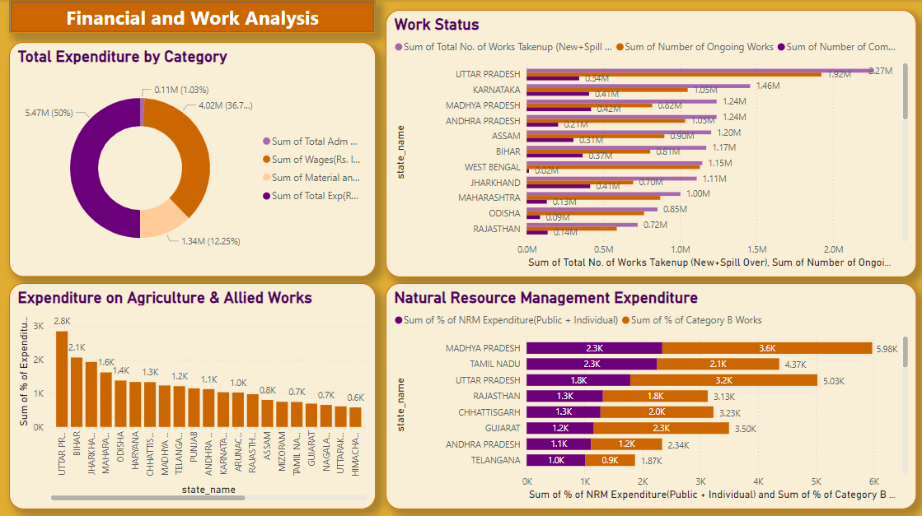

Slide 9
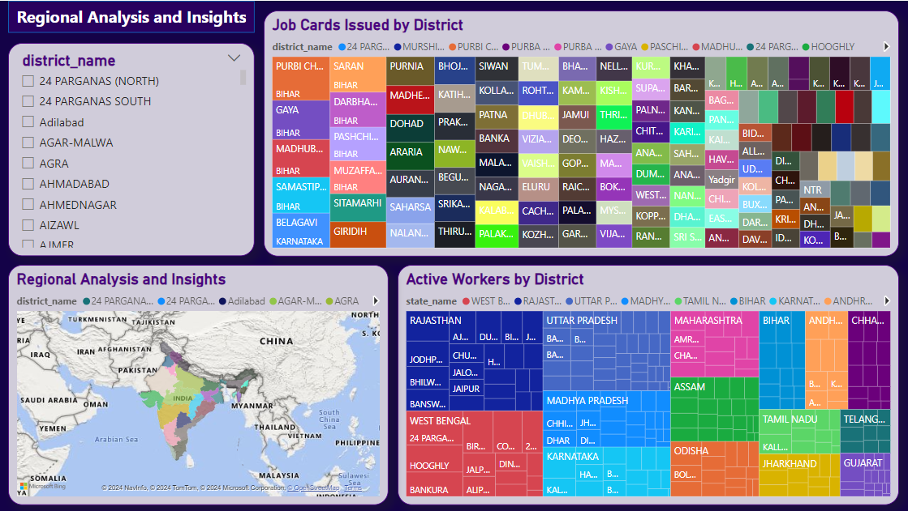

Slide 10
INSIGHTS AND ANALYSIS
NREGA has been effective in providing employment opportunities, but there are significant regional disparities.
Budget utilization varies by state and directly correlates with employment generation.
Key factors affecting work completion include budget allocation, regional policies, and administrative efficiency.

Slide 11
CONCLUSIONS AND RECOMMENDATIONS
NREGA effectively provides employment but needs better regional balance.
Improved budget allocation and monitoring can enhance employment generation.
Recommendations for policymakers include focusing on regions with low performance and optimizing budget utilization for better impact.

Slide 12
THANK YOU
Chaitalee Patil
Mentorness Intern

