Slide 1

MovieBuzz: Forecasting Movie’s Success
GROUP ID: 33
SANJANA P. ANAOKAR : 1214022
RIA N. MARWAHA : 1214023
POOJA S. KARKERA:1214047
CHAITALI P. TANAWADE:1214048
GUIDE -
Ms DEEPTI PATOLE
K.J.SOMAIYA COLLEGE OF ENGINEERING

Slide 2
CONTENTS
PROBLEM DEFINITION
LITERATURE SURVEY
FUNCTIONAL AND NON-FUNCTIONAL REQUIREMENTS
TECHNOLOGIES USED
TIME LINE CHART
SOFTWARE DESIGN DOCUMENT
SOFTWARE TEST DOCUMENT
OVERVIEW
FUTURE SCOPE
REFERENCES

Slide 3
PROBLEM DEFINITION
Movie business in India is a billion dollar industry employing thousands of people, as such success or failure of a movie can have profound effect on the stake holders.
This project will generate box-office forecasts for a movie.
Success of a movie is influenced by various factors like time of its release, lead actor and actress, director, etc.
MovieBuzz helps in forecasting the results such as:
Movie’s verdict in terms of: Flop, Semi-hit, Super-hit and Block-buster.
It’s box office revenue prediction.
Region where the movie will do good business.
Suggestion for the movie’s release month .
Rating of the movie.

Slide 4
LITERATURE REVIEW
1.TITLE: Prediction of Movies Box Office Performance Using Social Media.
From this paper we analysed the various factors that could be considered for calculating the success rate. The factors are actor, actress and directors popularity ,their twitters follower count, etc. We also Analysed the concept of sentiment analyses from the same Box-Office opening prediction of Movies through Data Mining
Data mining algorithms such as min- max normalization, k-means clustering, Naive Bayesian classification algorithms are used.
2.TITLE: Predicting the Near-Weekend Ticket Sales Using Web-based External Factors and Box-office Data.
This paper focuses on movie ticket sales to forecast the near-weekend sales using box-office data and other external factors such as start ratings, movie ratings etc.
Linear modeling is used to develop a model which is highly accurate to predict the ticket sales of near future.

Slide 5
FUNCTIONAL REQUIREMENTS
1. Collection of Data: Data is collected from various websites like Wikipedia, Koimoi, Boxoffice-india and Bollywood hungama.
2. Preprocessing of Data: The collected data is pre-processed in macro enabled Microsoft Excel using VBA coding.
3. Uploading of the pre-processed data from admin interface to Microsoft SQL server 2012:The system administrator will be given a separate login page where he/she can login and can upload the data from an excel sheet to the database.
4. Normalization of training data: The Net gross of the movies are normalized using the min-max normalization algorithm.
5. Creation of model: The model is created to forecast results using regression modelling using the data in database.

Slide 6
FUNCTIONAL REQUIREMENTS
6. Generation of forecasting results:
Our project generates 5 forecasted outputs they are as follows -
1. Movie’s performance in terms of blockbuster, semi-hit, super-hit and flop.
2. Movie rating prediction in the range of 0-10.
3 Region where movie will do good business.
4. Estimated Box-office revenue.
5. Suggestion of release month.
7. Display the result on webpage:
The user enters parameters like Actor, Actress, Genre, Director & Release month and above mentioned outputs are displayed in an output window.

Slide 7
NON-FUNCTIONAL REQUIREMENTS
Availability
The system should be available to the user 24x7.
Maintainability
New movie name can be added to the system.
Performance
The system should be checked for bugs and errors at regular intervals in order to increase accuracy and performance.
Link for SRS: SRS

Slide 8
TECHNOLOGIES USED
Software Requirements:
Operating System: Windows 7 & above.
Front-End: Visual Studio C# .NET with ASP .NET.
Back-End: MS SQL SERVER 2012.
Pre-processing: MACRO ENABLED Microsoft excel.
Documentation : Latex and Microsoft Word.
Hardware Requirements:
Processor – i3/i5/i7
Hard Disk – 250 GB & above
Ram: 2 GB and above

Slide 9
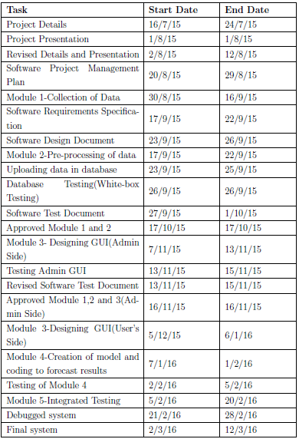
TIMELINE CHART
The entire project team is responsible for the successful delivery of the product. Each team member will be involved in all the project activities mentioned below:
Link for SPMP: SPMP

Slide 10
SOFTWARE DESIGN DOCUMENT(SDD)
List of all design documents developed is as shown:
1. Use case diagram
2. Class Diagram
3. Dataflow Diagram
4. Activity Diagram
Link for SDD - SDD

Slide 11
SOFTWARE TEST DOCUMENT
The software features tested are:
(1) Data Pre-processing testing
(2) Testing Admin login authentication
(3) Testing uploading of data through GUI by admin
(4) Testing table selection
(5) Testing script for uploading data in the database
(6) Testing Forecasting script(Movie verdict script)
(7) Testing Forecasting script(release month suggestion script)
(8) Testing Movie verdict page
(9) Testing of reset form button
(10) Testing of Movie details page
Test-cases in table format
STD

Slide 12
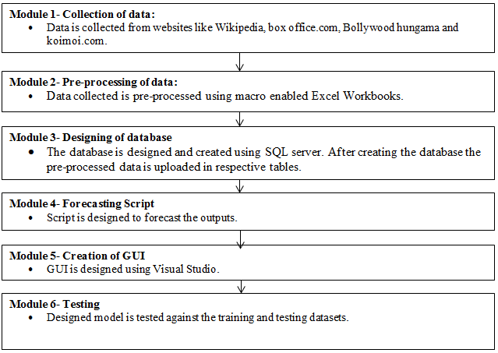
OVERVIEW
Implementation Document Link: Implementation

Slide 13
SCOPE FOR FUTURE WORK
In this website application we have tried to incorporate all basic features which the
target audience want. Apart from these features following features can be added
to enhance the functionalities and appeal of the application
Age-wise suggestion of movies.
Near Weekend ticket sales.
Suggestions for best actor, actress based on genre of the movie.
Number of screens the movie should be allotted.

Slide 14
REFERENCES
Krushikanth R. Apala, Merin Jose, Supreme Motnam, C.-C. Chan, Kathy J. Liszka, and Federico de Gregorio,” Prediction of Movies Box Office Performance Using Social Media”, ACM International Conference on Advances in Social Networks Analysis and Mining,2013 IEEE
Arundeep Kaur, AP Gurpinder Kaur,”Predicting Movie Success: Review of Existing Literature”, International Journal of Advanced Research in Computer Science and Software Engineering, Volume 3, Issue 6, June 2013.
Mahesh Joshi, Dipanjan Das, Kevin Gimpel and Noah A. Smith.” Movie Reviews and Revenues: An Experiment in Text Regression” NAACL- HLT, 2010
http://intelligencemining.blogspot.in/2009/07/data-preprocessing-normalization.html
http://www.stat.yale.edu/Courses/1997-98/101/linmult.htm
https://en.wikipedia.org/wiki/Lists_of_Bollywood_films
http://www.koimoi.com
http://www.boxofficeindia.com
http://www.bollywoodhungama.com/box-office/top-grossers

Slide 15
THANK YOU

