Slide 1

Real-Time Stock Market Data Forecasting
Presented by:
Agre Yash
Bairagi Aditi
Pitale Chaitanya
Chaudhari Sakshi
Thakur Kshitija
Sanjivani College of Engineering
Date: 18/05/2025

Slide 2
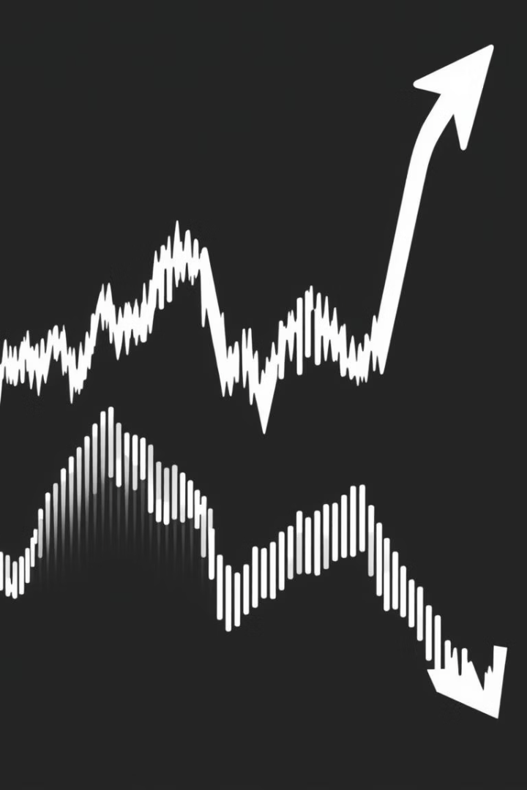
Problem Statement: Challenges in Market Forecasting
Financial Market Challenges
Fat-tailed distributions causing extreme events
Non-stationary time series patterns
Sudden unpredictable market behavior shifts
Objective
Predict stock price movement accurately using historical indicators

Slide 3

Objective & Scope of the Forecasting Study
Objective
Scope
Build and compare models forecasting stock direction using technical indicators
Yahoo Finance data for AAPL stock (2020–2025)
Models: Random Forest, XGBoost, Gradient Boosting, LSTM
Indicators: RSI, MACD, SMA, Volatility
Evaluate accuracy and performance metrics

Slide 4
Dataset & Feature Engineering
Data Source & Period
Target Variable
Yahoo Finance, Apple Inc. (AAPL) from 2020 to 2025
1 → Price goes up next day
Features
0 → Price goes down next day
Open, High, Low, Close, Volume
Daily Return (% change)
RSI (momentum), MACD (trend)
SMA-5 (moving average), Volatility (std dev)

Slide 5





Preprocessing & Handling Class Imbalance
Step 1
Dropped NaN values from rolling indicator calculations
Step 2
Shifted target variable by 1 day to prevent leakage
Step 3
Train/Test split chronologically: 80% train, 20% test
Step 4
Applied SMOTE to balance target classes in training data

Slide 6





Models Implemented for Stock Direction Prediction
Random Forest
XGBoost
Gradient Boosting
Ensemble of decision trees for robust classification
Gradient boosting optimized for speed and performance
Sequential boosting of weak learners to minimize errors
LSTM
Neural network capturing long-term dependencies in time series

Slide 7
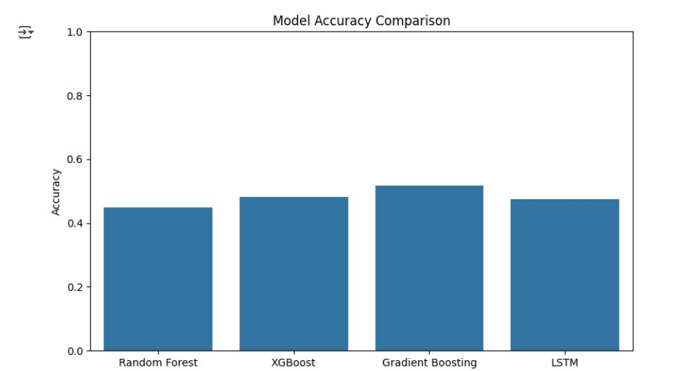
Model Results (Accuracy)
Random Forest: Good at predicting price going down, but bad at predicting price going up. Accuracy: 45%.
XGBoost: Slightly better, but still misses many "up" days. Accuracy: 48%.
Gradient Boosting: Best overall — balanced predictions for both up and down days. Accuracy: 52%.
LSTM: Uses past trends, okay at predicting down days, struggles with up days. Accuracy: 48%.
Output: All models find "price going up" hard to predict. Gradient Boosting performs best. LSTM can improve with more training.

Slide 8
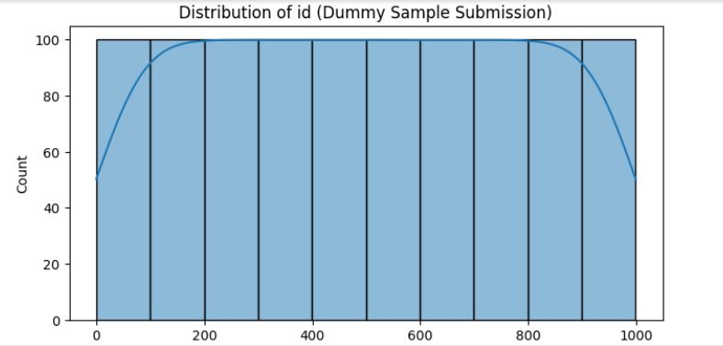
Visualizations & Insights
📊 Accuracy Bar Plot
Visual comparison of model accuracies
📈 Distribution Plots
Examination of numeric feature distributions including Close price, Volume, and RSI

Slide 9
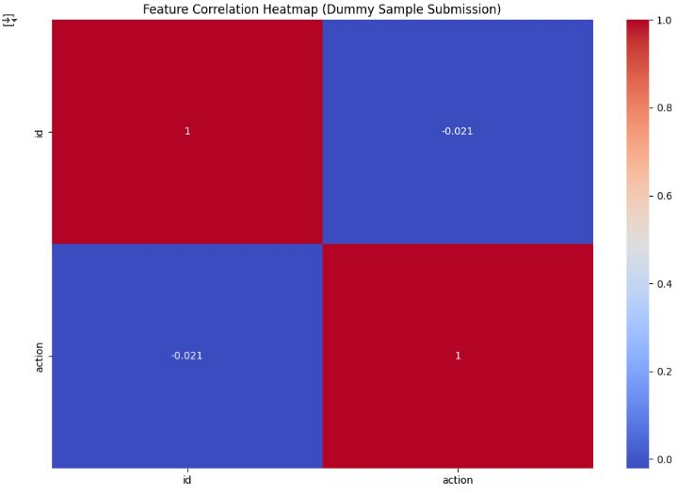
📉 Correlation Heatmap
Analysis of feature interdependencies such as Close & SMA and RSI & MACD

Slide 10
Challenges Faced
Financial time series exhibit non-stationary behavior, complicating modeling
Missing values arise from rolling indicator calculations and require careful handling
Significant class imbalance impacts accuracy of up/down price predictions
LSTM models demand extensive tuning and longer training periods for improvement

Slide 11
Conclusion & Future Work
Successfully built and compared 4 models for stock direction prediction
Tree-based models performed well, while LSTM offered deeper insight into trends
Future Improvements:
Hyperparameter tuning
Use more stocks for generalization
Incorporate macroeconomic indicators

Slide 12
References:
Scikit-learn Random Forest Documentation
XGBoost Documentation
Keras LSTM Layer Documentation

