Slide 1

CODE SEARCH UTILITY
Team – Lost Christmas
Problem Statement:
Developers face difficulties finding relevant code snippets that follow internal practices, which slows productivity and increases errors.

Slide 2
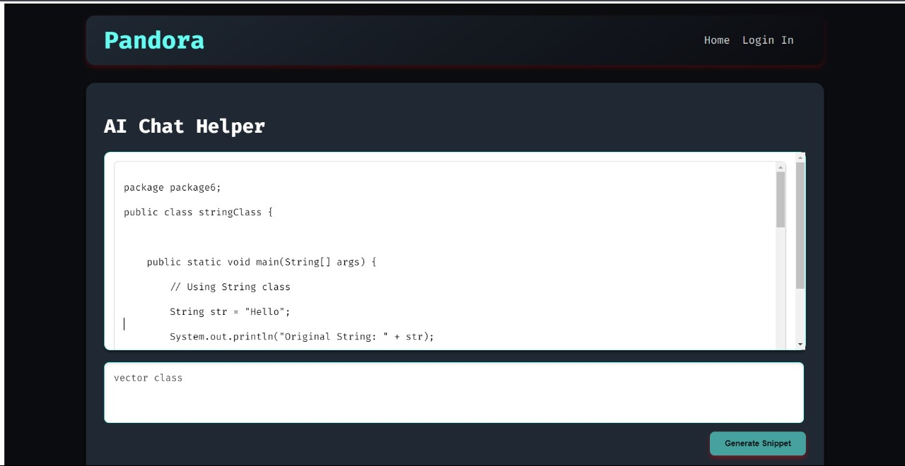
Project Overview
Objective:
Develop a chatbot utility that assists developers in retrieving code snippets that align with company-specific technical standards.
Solution:
Our chatbot utility solves the challenge of finding code snippets by using Natural Language Processing (NLP) to interpret developer queries. This allows developers to request code in plain language, without manually searching repositories. The system integrates with Azure DevOps, efficiently searching across multiple repositories to provide the most relevant snippets.
By enforcing internal guidelines, the tool reduces errors, improves code consistency, and streamlines development. This makes it easier for both new and experienced developers to follow best practices, ultimately boosting productivity.
.

Slide 3
Key Features
Hugging Face NLP:
Interprets natural language queries and converts them into structured code searches.
Fine-tuned for recognizing technical terms and specific coding requirements.
Azure DevOps API Integration:
Efficiently retrieves relevant code snippets based on developer queries.
Intuitive Chat Interface:
Provides a user-friendly chat interface for querying code snippets.
Can be integrated into IDEs like VS Code or used as a standalone web tool.

