Slide 1
ASSIGNMENT PRESENTATION

Slide 2
Contents
Introduction
01
Introduction
Introduction to the assignment and the stack used.
02
Learning and Hurdles
Learnings and Hurdles
What technologies I have learnt during this assignment and the difficulties faced .
03
Timeline
Timeline
The timeline for the development of the assignment
04
Outcome
Outcome
What I learnt from completing this assignment

Slide 3
Introduction

Slide 4
Requirements
Technology Stack
Must develop a basic webpage that displays nutrition information of various food items.
Implement select functionality to display items based on selected category of food.
Delete selected food items.
Sort the Items in alphabetical order when clicked on Name.
Typescript
NEXT.js
React.js
Graphql
Tachyons

Slide 5
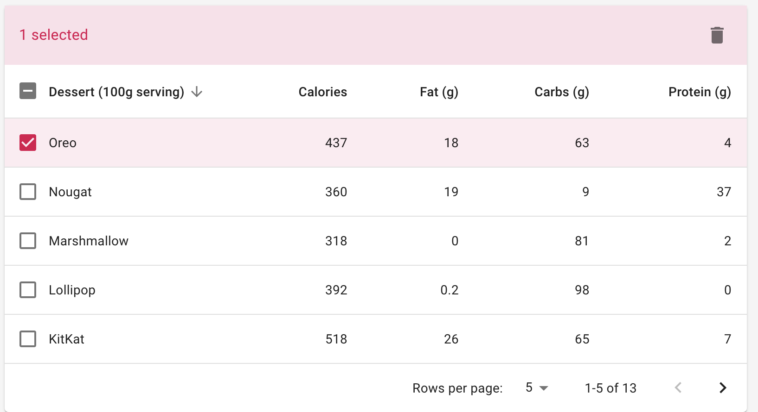
Final Ui
The Picture to the right depicts the final Ui .

Slide 6
Learnings and Hurdles

Slide 7
Technologies
React.js
React.js
A JavaScript library for building user interfaces
TypeScript
Strict syntactical superset of JavaScript that adds optional static typing to the language.
TypeScript
Next.js
Next.js gives you the best developer experience with all the features you need for production: hybrid static & server rendering, TypeScript support, smart bundling, route pre-fetching, and more..
Next.js
Tachyons
Tachyons
Create fast loading, highly readable, and 100% responsive interfaces with as little css as possible.

Slide 8
Technologies
Graphql
Graphql
Graphql provides a complete and understandable description of the data in your API, gives clients the power to ask for exactly what they need and nothing more
WebPack
Webpack
At its core, webpack is a static module bundler for modern JavaScript applications.
Git
Git
Git is a free and open-source distributed version control system designed to handle everything from small to very large projects with speed and efficiency.

Slide 9
Technologies
React.js
React.js
A JavaScript library for building user interfaces
TypeScript
Strict syntactical superset of JavaScript that adds optional static typing to the language.
TypeScript
Next.js
Next.js gives you the best developer experience with all the features you need for production: hybrid static & server rendering, TypeScript support, smart bundling, route pre-fetching, and more..
Next.js
Tachyons
Create fast loading, highly readable, and 100% responsive interfaces with as little css as possible.
Tachyons
Graphql

Slide 10

React.js

Slide 11
Learnings
Hurdles
Components
Props
React Hooks
Dealing with side effects
Custom React Hooks
Understanding where to use Hooks
Passing Dependencies to UseEffect Hook

Slide 12

TypeScript

Slide 13
Learnings
Hurdles
Understood why using TypeScript might result in more robust software
Supported Types
Type inference
Type script for Functions
Integrating Typescript with react.
Determining the type for data retrieved from events like mouse click.

Slide 14

Next.js

Slide 15
Learnings
Hurdles
Structuring the files based on routes
Linking Next to React
Pre-Rendering
Haven't experienced a lot of Hands-on

Slide 16
TACHYONS
Tachyons

Slide 17
Learnings
Hurdles
Class names for achieving different CSS styles
How to integrate with React
Couldn’t find a lot of information or examples online .

Slide 18

Graphql

Slide 19
Learnings
Hurdles
Developing a Api end point
Connecting to the Api and querying from frontend
How to Query
Using Network tab to monito the requests and responses
Graphiql playground to test querys
Why it is better.
Understanding the implementation of Apollo Client

Slide 20

Webpack

Slide 21
Learnings
Hurdles
In the Process of learning
Why it is used .
Nothing as of now.

Slide 22

Git

Slide 23
Learnings
Hurdles
Using pull , add, commit, push, status, checkout, branch commands.
Understanding when to create branches.
Why Git is useful.
Had trouble initially because of the VPN , using proxy solved the issue.

Slide 24


Timeline
Understanding the requirements
04
June
Understanding the functionalities of the assignment.
Developing a vague idea on how to implement.
05
Research Phase
June
Developing a idea on how to approach.
Understanding the needs and outlining the topics to be learnt

Slide 25

Timeline
Learning
06-09
June
Learned Typescript, React
Developed V-01 of the assignment using React , Typescript and using static data
10-16
Learning
June
Learned Graphql.
Developed the V-02 of the assignment using React ,Typescript , Node.js , Express and got the data from Mongo db

Slide 26

Timeline
Launch
17-20
June
Learned Next.js
Developed the Final version using all the stack.
Implemented Sort Functionality.
Developed a Api end point using Graphql to query.

Slide 27
Outcome
To use Git for version control.
Advantages of using Graphql and Typescript.
How to debug the code using console and network tabs.
Building an API.
Structuring of the Project.

Slide 28
Chaitanya Atluri

