Slide 1
The Battle of Neighbourhoods

Slide 2
Problem
Many People move from other countries to Canada and immigrants need to do a lots of research for houses at cheaper house and reputed schools.
This project is for those people who are looking for ease of access to Cafe, School, Super market, medical shops, grocery shops, mall, theatre, hospital.
This will increase the awareness for the people moving into the city from other places of the country.

Slide 3
North York
North York is one of the six administrative districts of Toronto, Ontario, Canada. It is located directly north of York, Old Toronto and East York, between Etobicoke to the west and Scarborough to the east.
The district's central business district is known as North York Centre, which was the location of the former city's government and major corporate headquarters.
North York Centre continues to be one of Toronto's major corporate areas with many office buildings and businesses.
The former city hall of North York, the North York Civic Centre, is located within North York City Centre

Slide 4
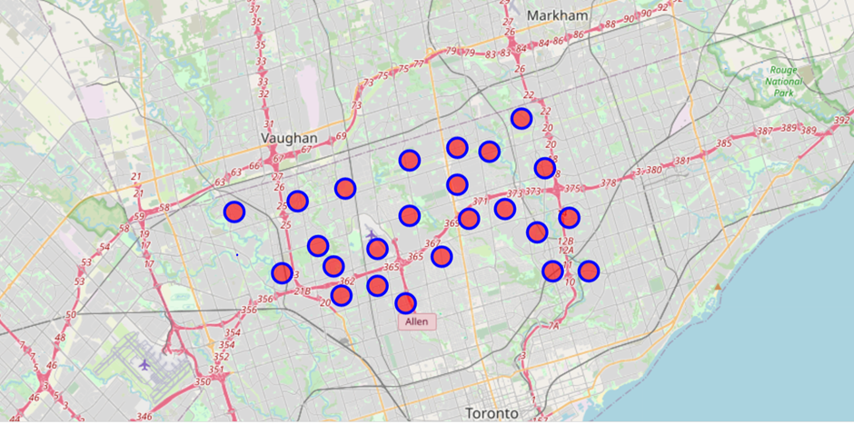
Map of North York

Slide 5
Map of North York after clustering

Slide 6
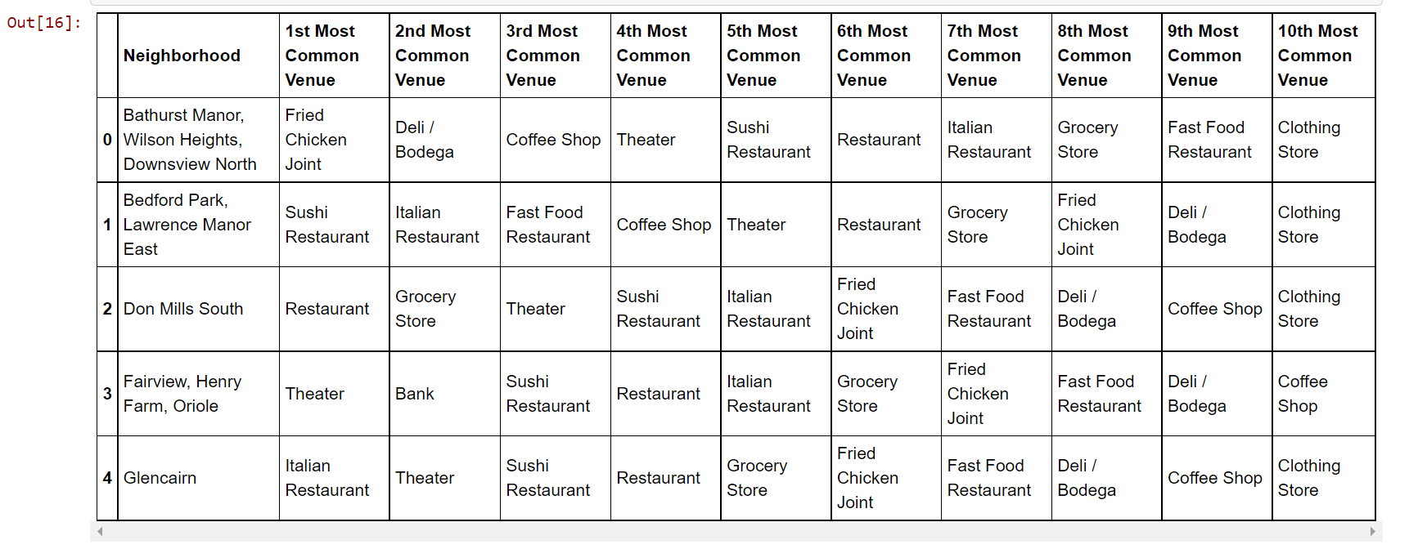
Most Common venues in North York

Slide 7
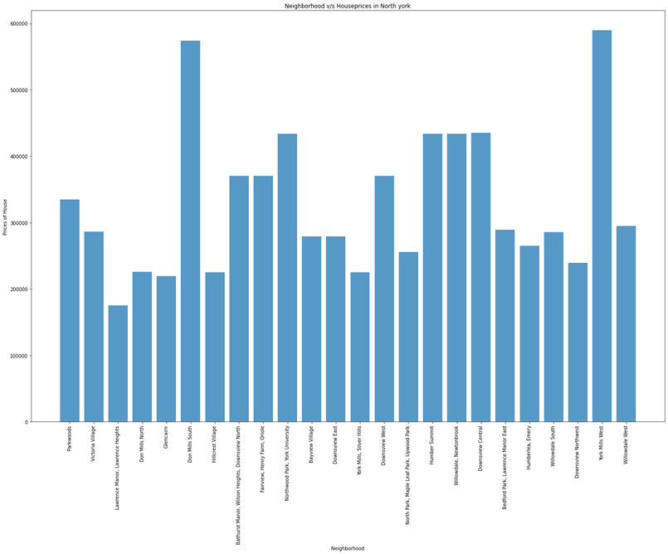
Housing prices in North York

Slide 8
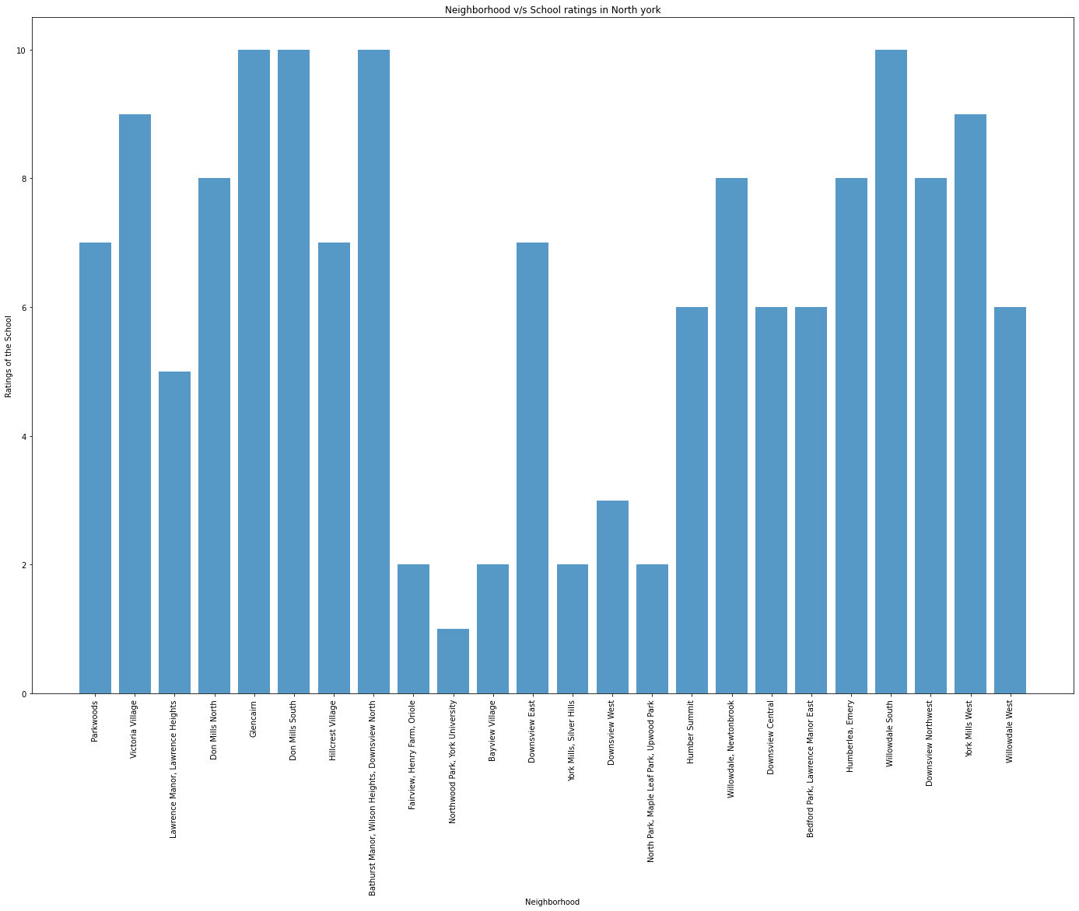
School ratings in North York

Slide 9
Conclusion
Now from the results the user can select the best school for their kids and also best homes at cheaper price in North York Neighbourhood.

