Slide 1

Student Suds
Laundry Pickup & Delivery for College Students
Chaitanya Rachakunta

Slide 2
Description of Business Concept
Provides laundry pickup and delivery service for college students on and around campus
Designed to help students who lack time or motivation to do laundry regularly
Students can schedule pickups through an app or website
Clothes are picked up, cleaned, and returned within 24 hours
Offers additional services such as iterations and ironing
Saves students time and reduces stress while ensuring clean clothes

Slide 3
Customer Value Proposition
Saves students time by handling one of the most time-consuming chores: laundry
Allows more time for eating, sleeping, studying, working, and socializing
Hassle-free alternative to laundromats and campus laundry rooms
No waiting, carrying heavy loads, or dealing with app issues from other services
Guarantees efficient, high-quality cleaning and delivery
Affordable pricing tailored to a college student’s budget

Slide 4

Vision Statement: To make college life easier by providing the most convenient, reliable, and affordable laundry service that saves students time and reduces stress.
Mission Statement:
1. Provide convenient, affordable, and reliable laundry pickup and delivery services for college students
2. Offer fast 24-hour turnaround with quality cleaning
3. Include add-on options such as ironing
4. Save students time, reduce stress, and provide an alternative to crowded dorm laundry rooms
5. Combine app-based and in-person options for flexibility
6. Help students live cleaner, more balanced lives while focusing on academic and social success

Slide 5
Statement of Core Values
Convenience: We make student life easier by providing quick, simple, and reliable laundry pickup and delivery.
Affordability: Our services are priced with students in mind, ensuring accessibility without sacrificing quality.
Reliability: We deliver consistent service and ensure proper handling of clothing.
Innovation: Through our app, students can easily schedule pickups, track orders, and manage services.
Sustainability: We prioritize usage of eco-friendly detergents and energy saving washers/dryers to reduce our environmental footprint.
Community Commitment: We support campus involvement and community by providing student employment opportunities

Slide 6
Financial and
Strategic
Objectives
Market Expansion
Target entering two new international markets within the next 12 months.
Technological Advancement
Focus on integrating AI and ML to enhance operational efficiency and product offerings.
Innovation Culture
Cultivate a culture of innovation to support rapid development of new ideas.
Implement comprehensive sustainability practices across all operations.
Sustainability Initiatives

Slide 7
Corporate Social Responsibility Key Initiatives and Rationale
CSR Initiative | Rationale
Eco-Friendly Laundry Practice | Partner with detergent brands that follow CSR and eco-friendly practices/use energy-efficient machines Lowers the environmental footprint Appeals to eco-conscious students who value sustainability.
Campus Community Partnership: Offer free laundry services for campus charity events or low-income students once a month. | Strengthens community ties and cements Student Suds into campus life Low-cost actions that create good results, attract attention, and differentiate our services.
Hire student workers part-time and provide flexible scheduling | Supports student employees by ensuring ethical labor practices/boosting morale. Happy, trained workers will take more care and provide a better service.

Slide 8
New Service:
Dry Cleaning Laundry Service
Dry cleaning services for specific items that need more specific handling in comparison to everyday clothing.
Students are unable to clean certain items with dorm laundry machines.
Ex. Formal suits/dresses, lab coats, large winter coats, formal dresses
Providing this additional service attracts a wider range of students and increases convenience for students.

Slide 9
National Expansion Decision, Approach, and Rationale
National Expansion Decision
Rationale for Decision
Our business is based on college students
Great number of universities and colleges throughout the country
Allows our business to expand into other college campuses like Rutgers
Approach: Franchising
Rationale for Approach
Franchising lets Student Suds grow fast with less financial risk
Yes
Local operators bring campus knowledge and accountability.
Enables nationwide growth without requiring large internal resources.
Training and support from the main company ensure consistent service quality.

Slide 10
Canada Opportunities, Challenges, Overall Rationale
Canada Opportunities
Shared language
Cultural closeness with US
Long-term trade relationship
Similar student/university needs to US
Canada Challenges
Different labor standards and tax regimes
French language requirements in some parts
Environmental and wastewater rules
Competition with local laundromats
Overall Rationale
Canada is the easiest and safest country for international expansion (cultural, political, and legal systems like US)
Provides global experience with lower risk before moving into harder markets like India or Germany.

Slide 11
Expansion and Entry Strategy & Rationale
Expansion Strategy
Combo
Rationale
Laundry processes should stay the same for maximum efficiency
Certain aspects can be customized to fit local preferences
Entry Strategy
Joint Venture
Rationale
Pairs our business model with a local partner who can handle the hirings, permits, area access, etc.
Allows us to launch faster with fewer mistakes then if we did it on our own.

Slide 12
Laundry Attendant Information
Key Responsibilities
Inspect clothing items for stains
Treat stains (need based)
Sort clothes into proper washing cycle, run washer/dryer, package orders
Maintain a clean and organized workspace to help ensure efficiency and top-notch customer service
Qualifications
Deep understanding of laundry care
Prior experience in handling textiles
Ability to stay focused in fast-paced environments and respect others' belongings.
Detail-oriented and strong time management skills
Advertising Plan
Post job listings on LinkedIn, Handshake, and Indeed
Distribute flyers and posters in Rutgers dorms, student centers, and dining halls.
Promote openings on campus social media pages and GroupMegroup chats.
Criteria for Selection
Prior customer service or retail experience preferred
Strong references from previous jobs
Positive and professional attitude
Strong references from previous jobs
Compensation Plan
Starting pay for part-time employees ranges from $15-18 an hour
Benefits for part-time: free/discounted laundry service, flexible scheduling for students.
Benefits for full-time: health, dental, and vision insurance

Slide 13
Employee Motivation Initiatives
Monthly Employee Recognition Program
Reward outstanding employees for accuracy and customer satisfaction through an Employee of the Month award
Award comes with small bonus and public recognition
Top performers gain increased promotion opportunities
Flexible Scheduling for Students
Offer shifts that accommodate class times and exam weeks
Allow students to swap shifts as needed
Promotes a healthy work-life balance and reduces stress
Reward outstanding employees for accuracy and customer satisfaction through an Employee of the Month award

Slide 14
Actions to Achieve Higher Levels of Engagement
Host monthly idea-sharing meetings for employee input.
Hold regular feedback loops and one-on-one meetings.
Provide training and mentorship for growth.
Strengthen a culture of teamwork, trust, and recognition.
Support work-life balance with flexibility and mental-health resources.
Celebrate achievements and share success stories.

Slide 15
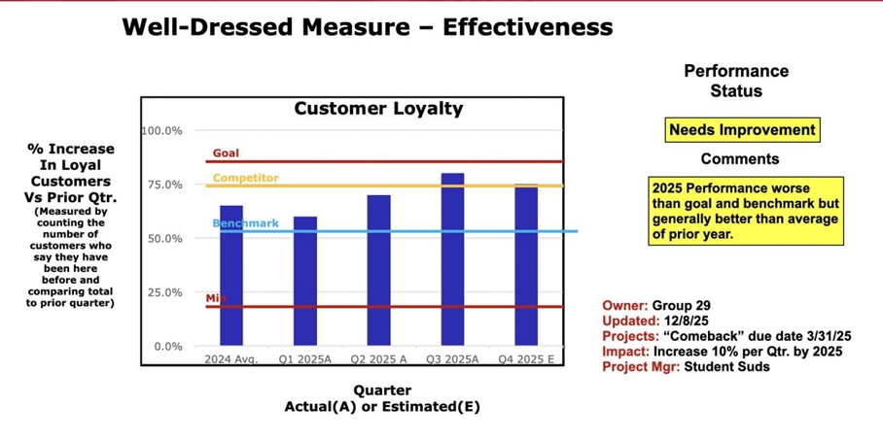
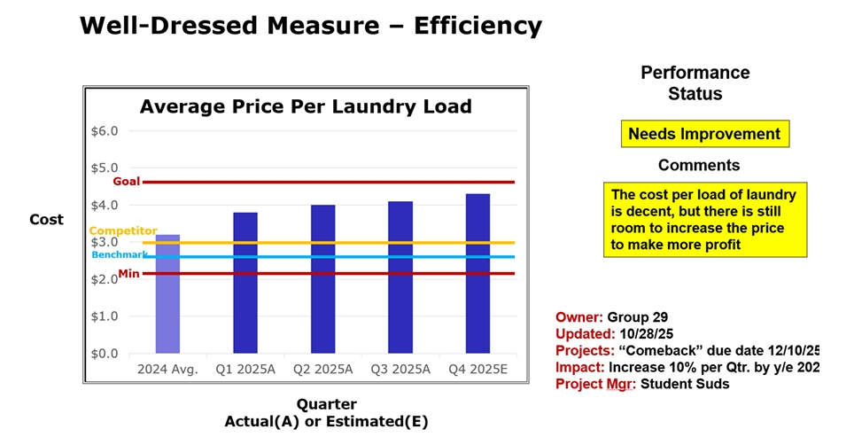
Effectiveness and Efficiency Charts

Slide 16
Initiatives to Improve Processes
Focus on Improvement Initiative | Effectiveness
Current Performance | Currently, about 70% of customers return each month, but there are occasional complaints about delayed deliveries and inconsistent pickup times.
Targeted Performance | Increase monthly returning customers to 85%
Improvement Initiative | Add real-time tracking in the app for pickup and delivery status. Introduce a loyalty program (every 5th laundry load free). Send app/text notifications for pickup, cleaning, and delivery updates. Train staff to improve turnaround time and customer service.

Slide 17

Acquisition: Not An Option
1. Selling would hurt employees, customers, and partners who helped build the company.
2. If the business sold, new owners would have no experience and might ruin the business.
3. It would also lead to a lack of control, decrease in service quality, and loss of jobs for students.
4. Keeping the company ensures long-term stability, protects jobs, and maintains trust. The money isn’t worth risking everything the company stands for.

Slide 18
Student Suds Success
Solves a real problem for students by saving time and reducing stress
Reliable, affordable, and high-quality laundry service with 24-hour turnaround
Strong convenience through an easy-to-use app and flexible scheduling
Added services (dry cleaning, ironing) increase value and attract more customers
CSR initiatives and eco-friendly practices build trust and positive reputation
Motivated student workers supported by flexible scheduling and recognition programs
Efficient operations and consistent service quality boost satisfaction and loyalty
Smart expansion strategy through franchising and low-risk international entry

