Slide 1
Smart Waste Management Database System (SWMDS)

Slide 2
Objectives & Scope
01

Slide 3
Introduction
Objectives:
Boost efficiency
minimize environmental impact
promote data-driven decision-making
enhance waste reduction & recycling
streamline communication & collaboration
facilitate public awareness & engagement
Scope:
Urban waste management
adaptable for various city scales
compliance with regulations
data quality & accuracy, compatibility
security & privacy, scalability, functionality, integration, and user groups

Slide 4
User Requirements
02

Slide 5
User Requirements
Real-time data on waste collection points
Waste collection route optimization
Vehicle location and maintenance tracking
Waste disposal metrics and trends reporting

Slide 6
How SWMDS Meets User Requirements
Real-time data collection through advanced sensors
Route optimization algorithms
Vehicle data storage and updates
Data-driven performance analysis

Slide 7
Business Rules
03

Slide 8
Business Rules
Waste generators registration and classification
Waste collection points and vehicles requirements
Collection routes and waste management facilities regulations
Users access levels and waste collection schedules

Slide 9
04
Diagrams

Slide 10
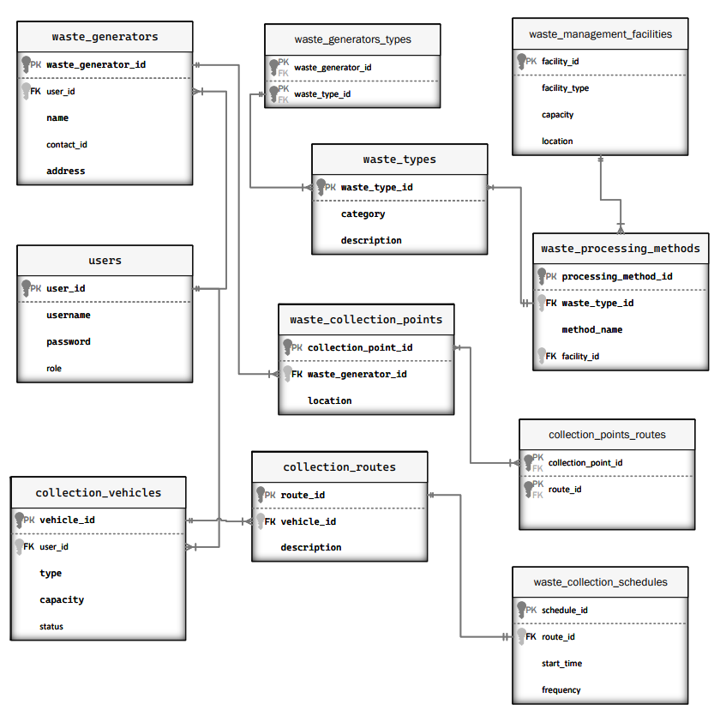
ER Diagram

Slide 11
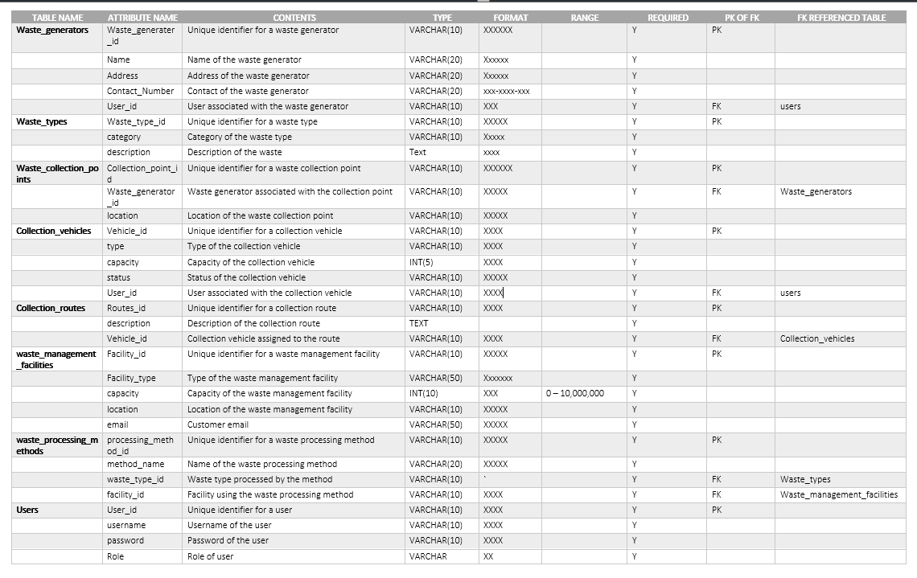
System Data Dictionary

Slide 12

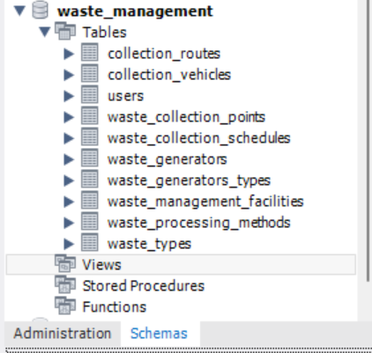
Database in DBMS

Slide 13
Data Retrieval & Report
05

Slide 14
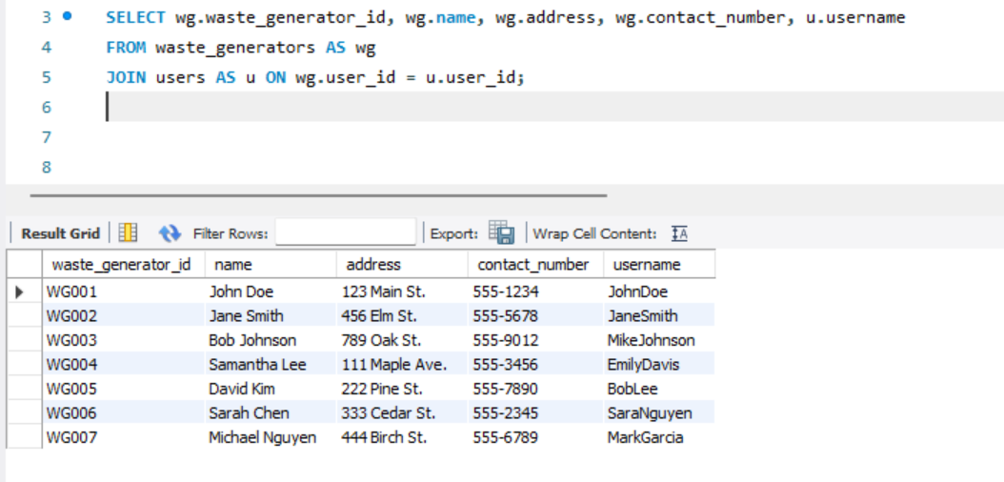
Query 1 :
Retrieve the list of waste generators along with their contact information and assigned user's username.

Slide 15
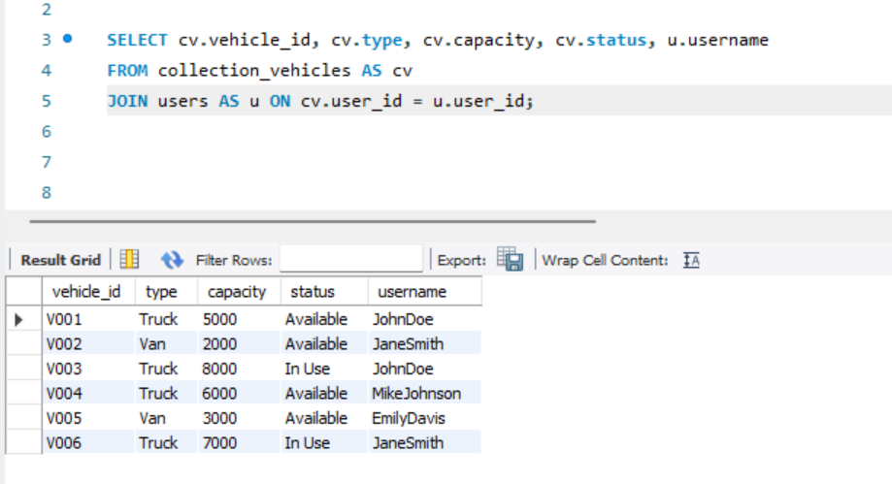
Query 2 :
Retrieve the list of collection vehicles along with their capacity, current status, and assigned user's username.

Slide 16
Conclusion
SWMDS: A comprehensive, data-driven solution for urban waste management
Benefits: Improved efficiency, reduced environmental impact, informed decision-making, enhanced waste reduction & recycling, and better communication & collaboration
Adaptable and scalable for various city sizes and future advancements
Integrates with GIS, IoT devices, and data analytics tools for enhanced effectiveness
Customizable access levels and interfaces tailored to different user groups' needs

