Slide 1
Agentic AI Health Symptom Checker
CAPSTONE PROJECT
Presented By:
Chaitanya Bhargava-Banarsidas Chandiwala Institute of Information Technology, BCIIT, Delhi-Computer Applications

Slide 2
OUTLINE
Problem Statement (Should not include solution)
Proposed System/Solution
System Development Approach (Technology Used)
Result (Output Image)
Conclusion
Future Scope
References

Slide 3
Problem Statement
Many individuals face difficulty in accessing reliable health guidance. Searching symptoms online often results in misinformation and confusion. Language barriers and limited healthcare access worsen the challenge. Current symptom checkers lack accuracy, context, and trusted data sources.

Slide 4
Proposed Solution
The proposed system aims to address the challenge of providing accurate, accessible, and safe health guidance by analyzing user‑reported symptoms in natural language. This involves leveraging verified medical databases, AI‑driven health symptom analysis, and multilingual support to deliver reliable, educational, and referral‑based health recommendations. The solution will consist of the following components:
Data Collection:
Collect user symptom descriptions via chat or voice, prompting follow‑up questions to clarify more details.
Retrieve verified medical data from trusted sources like WHO, CDC, and government health portals by embedding Google search and provide evidence‑based suggestions.
Data Preprocessing:
Convert unstructured user descriptions into structured health data, handling typo errors, incomplete sentences, and multilingual inputs.
Extract key features such as symptom severity, duration, and related health factors for deeper analysis.
AI Symptom Analysis & Instruction Engine:
Provide step‑by‑step, instruction‑led guidance including probable causes, home remedies, urgency level, self‑care tips, and when to consult a doctor.
Deployment:
Build a multilingual, user‑friendly chatbot interface available on mobile and web platforms.
Integrate privacy, security, and compliance standards (HIPAA, GDPR) to protect sensitive health information.
Evaluation:
Measure accuracy, clarity of instructions, and user satisfaction against expert medical assessments.
Continuously improve the AI model and instruction logic with new medical data based on user feedback.
Result

Slide 5
System Approach
The "System Approach" section outlines the overall strategy and methodology for developing and implementing the Agentic AI Health Symptom Checker. Here's a suggested structure for this section:
System requirements
Hardware Requirements (for development & testing):
Processor: Intel i5 / AMD Ryzen 5 or higher
RAM: 8 GB minimum (16 GB recommended)
Storage: 256 GB SSD or higher
Software Requirements:
IBM Cloud Lite account (free tier for development)
Web browser (Chrome/Edge/Firefox latest version)
Python 3.8+ (optional if integrating with custom backend)
Internet connection (required to access IBM Cloud services)
Library required to build the model
Python
IBM Watsonx
LangChain

Slide 6
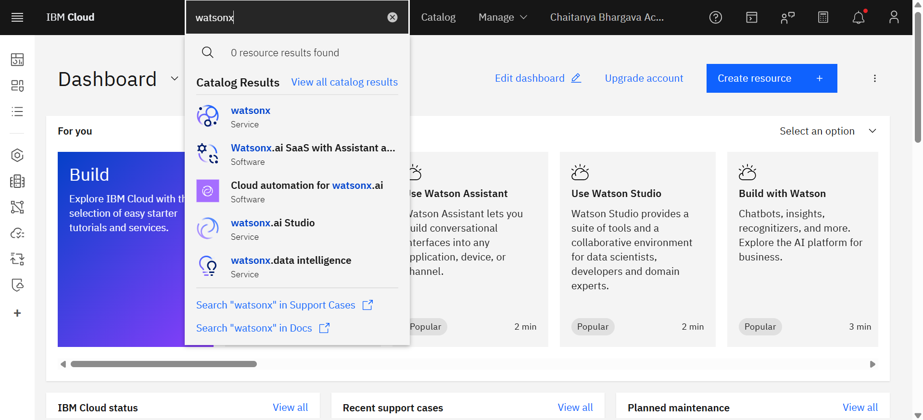
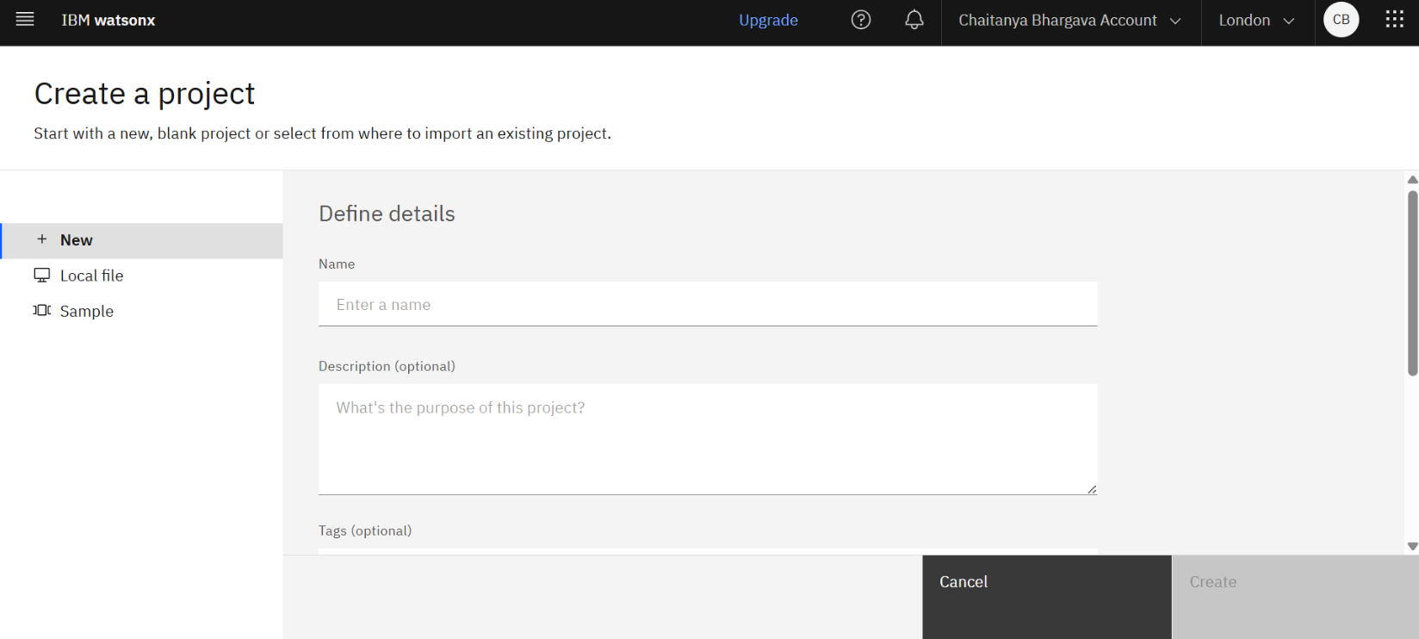
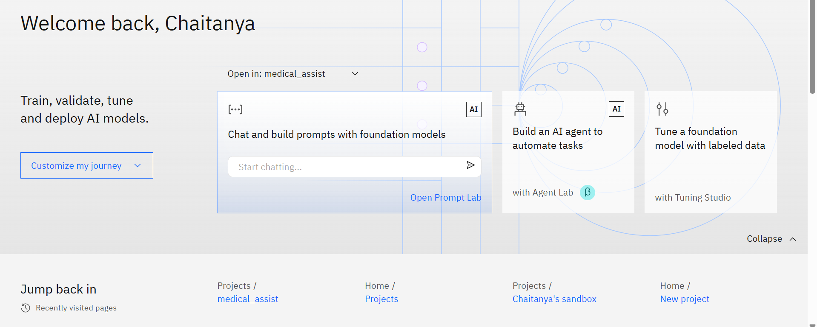
Result
Step 1: Search for Watsonx in IBM Cloud Console Log in to your IBM Cloud account at cloud.ibm.com. On the dashboard, click the search bar at the top and type "watsonx". A list of related services such as watsonx.ai, watsonx.data intelligence, and watsonx.ai Studio will appear under Catalog Results. Select “watsonx” from that list.
Step 2: Create a New Project in Watsonx After selecting Watsonx from the catalog, you will be directed to the project creation page. Click on New in the left sidebar to start a blank project.
Step 3: Open Agent Lab On the Watsonx welcome page, click "Build an AI agent to automate tasks" to open Agent Lab.

Slide 7
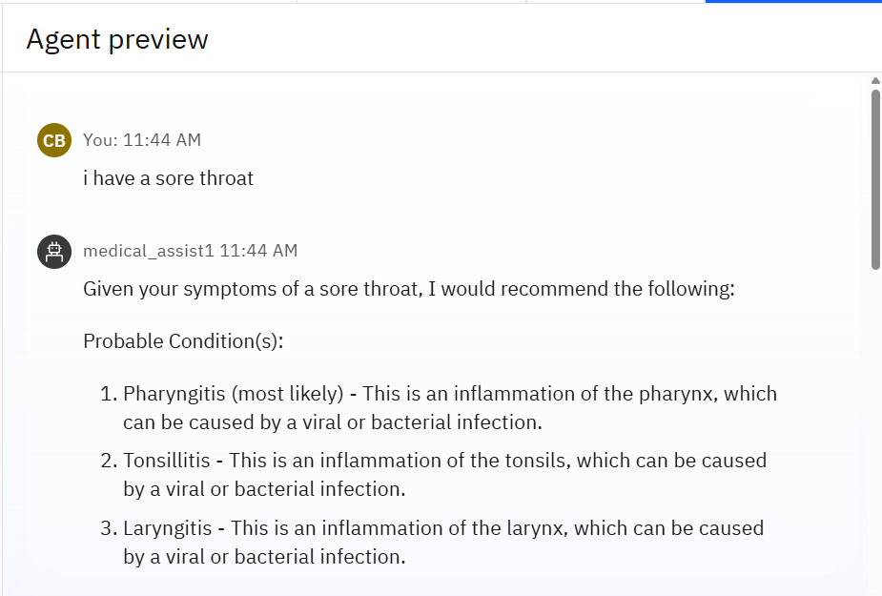
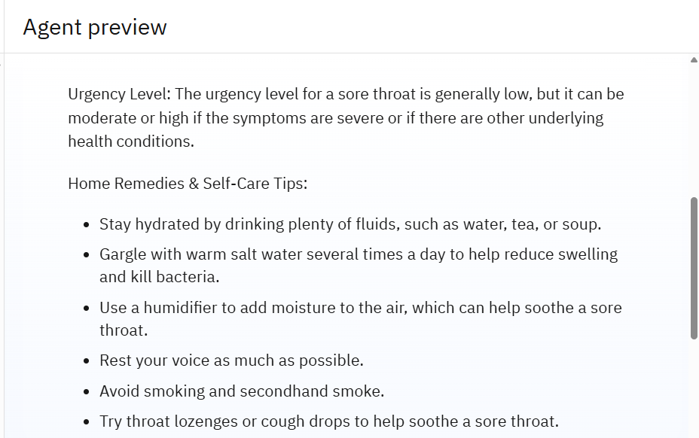
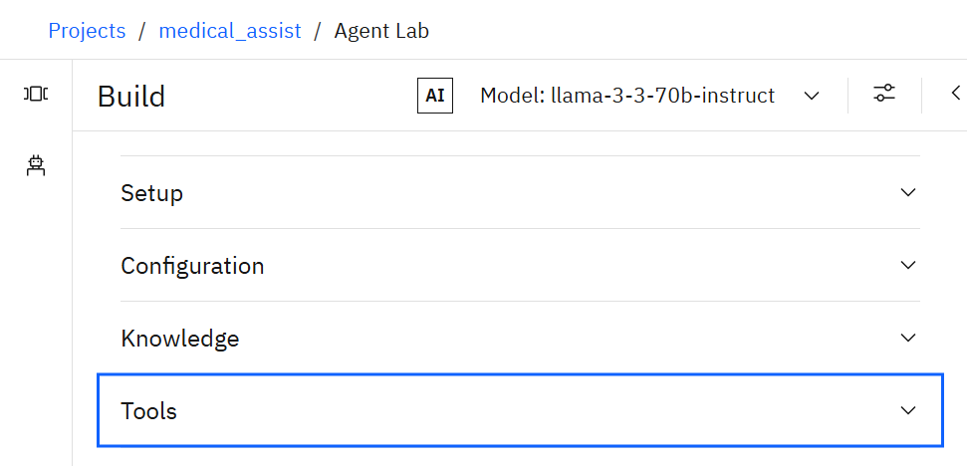
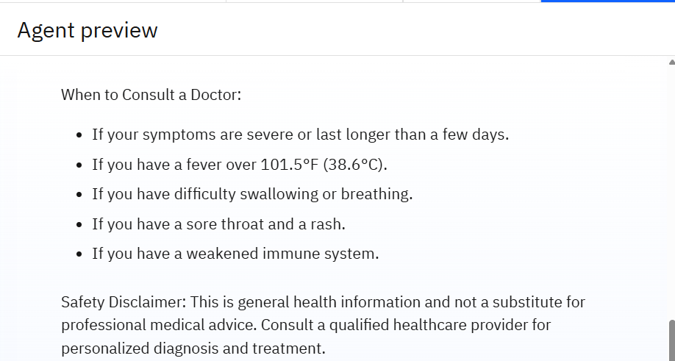
Result
Input & Output of AI AGENT
Step 5: Instruction - Role: You are a professional virtual health assistant.
Task: Based on the given user-reported symptoms, analyze and respond with clear, structured health guidance.
Input: User Symptoms: {{user_input}}
Output Format:
Probable Condition(s): Provide 2–3 possible conditions that match the symptoms, ranked from most likely to less likely.
Urgency Level: Categorize as Low, Moderate, or High urgency, with a short explanation.
Home Remedies & Self‑Care Tips: Suggest safe, evidence-based remedies that can be tried at home (if applicable).
When to Consult a Doctor: Clearly specify warning signs or symptom progression that should prompt medical consultation.
Safety Disclaimer: Always include — "This is general health information and not a substitute for professional medical advice. Consult a qualified healthcare provider for personalized diagnosis and treatment.“
Step 4: Explore Build Options in Agent Lab
In the Build section of Agent Lab, you’ll find four key configuration areas:
Setup: Define your agent’s name, description, and basic settings.
Configuration: Choose and customize the foundation model and system instructions.
Knowledge: Add documents or data sources your agent can reference.
Tools: Connect APIs or functions your agent can call during conversations.

Slide 8
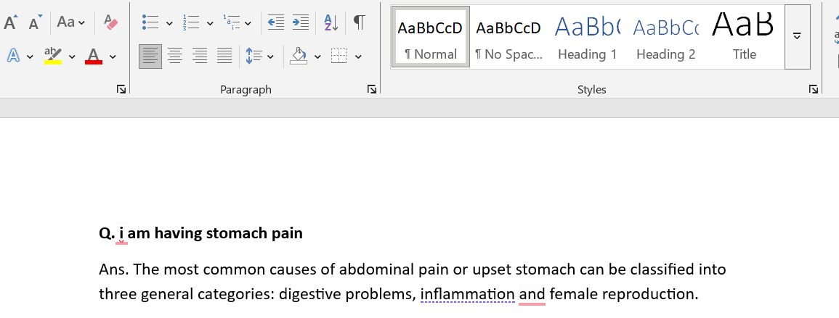
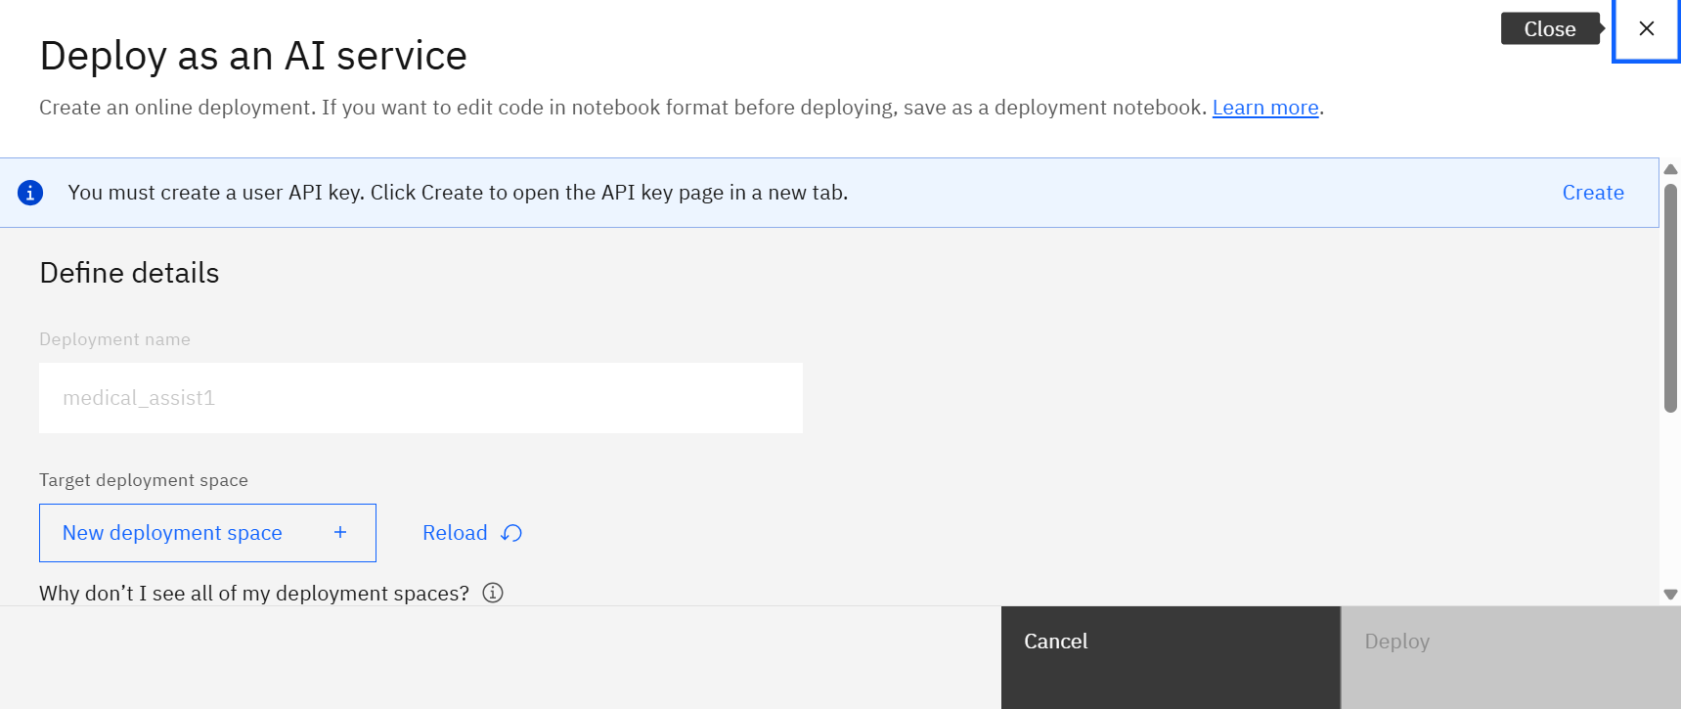
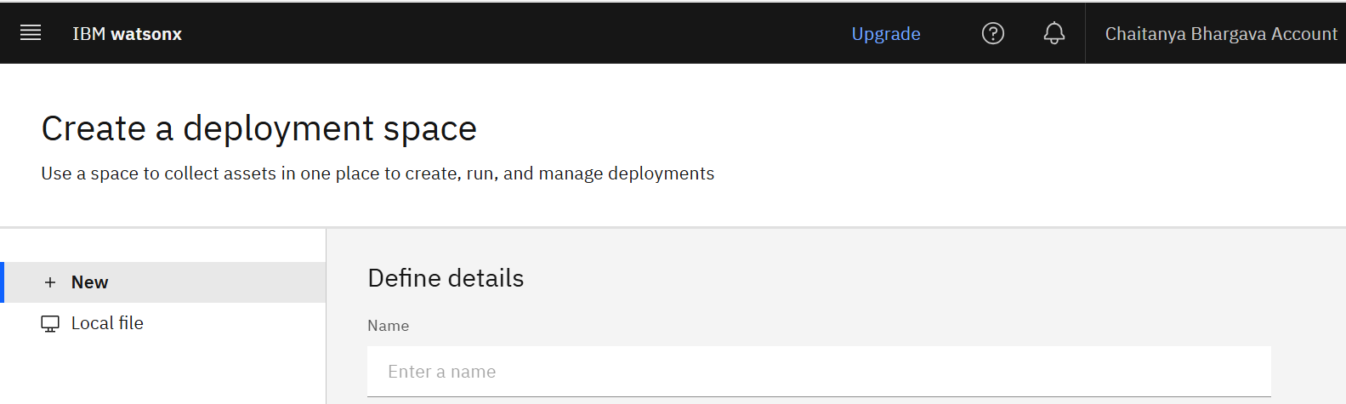
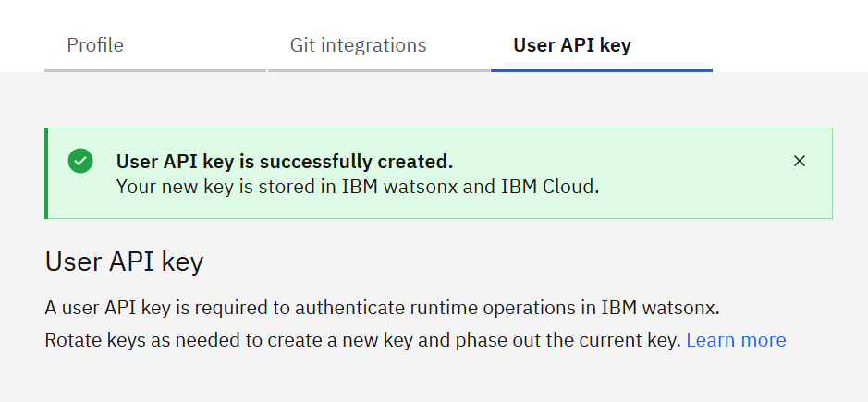
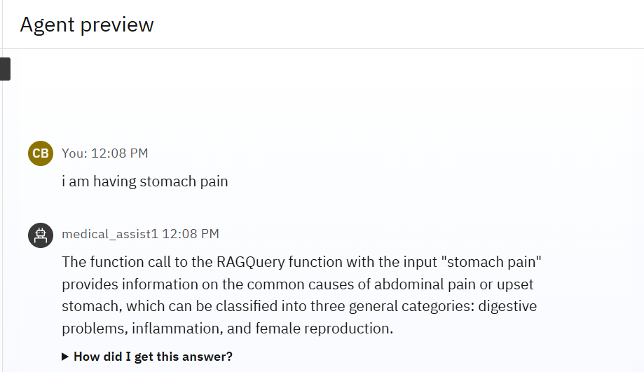
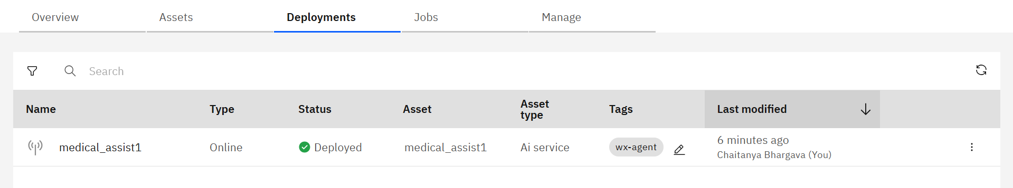
Result
Step 7: Deployment
Step 6: RAG File
RAG Output

Slide 9
Conclusion
The Agentic AI Health Symptom Checker, built using IBM Watsonx, successfully interprets user‑reported symptoms, accesses verified medical data, and delivers structured and detailed, multilingual health guidance. It helps users understand probable conditions, home remedies, urgency levels, and self‑care measures while promoting timely medical consultation.
Key challenges included integrating trusted health data, ensuring privacy compliance, and fine‑tuning and improving symptom analysis across languages. Future improvements could include wearable device integration, expanded medical datasets, and advanced predictive analytics.
This solution enhances health awareness, reduces misinformation, and provides safe, AI‑led health guidance for diverse populations.

Slide 10
Future scope
The Agentic AI Health Symptom Checker can be further enhanced by integrating additional health data sources, such as wearable device readings, regional disease trends, and real‑time public health alerts. The symptom analysis algorithm can be optimized for faster, more accurate results through continuous AI model refinement and fine-tuning by inclusion with advanced medical datasets.
The system can expand to support more languages, regional medical guidelines, and integration with telemedicine services for direct doctor consultations. Future upgrades could leverage emerging technologies like edge AI for offline health guidance, predictive analytics for early disease detection, and advanced conversational AI for more human‑like, context‑aware interactions.
By evolving in these directions, the solution can become a comprehensive, globally accessible, and trustworthy digital health companion.

Slide 11
References
IBM Watsonx Documentation – Build AI solutions with IBM watsonx https://cloud.ibm.com/watsonx/overview
Wang, Y., & Kung, L. (2020). “AI in healthcare: Opportunities and challenges” – Journal of Medical Systems, 44(9), 1‑12.
Rajpurkar, P., Chen, E., Banerjee, O., & Topol, E. J. (2022). “AI in health and medicine” – Nature Medicine, 28, 31–38.

Slide 12

IBM Certifications
Screenshot/ credly certificate( getting started with AI)

Slide 13

IBM Certifications
Screenshot/ credly certificate( Journey to Cloud)

Slide 14

IBM Certifications
Screenshot/ credly certificate( RAG Lab)

Slide 15
THANK YOU

