Slide 1
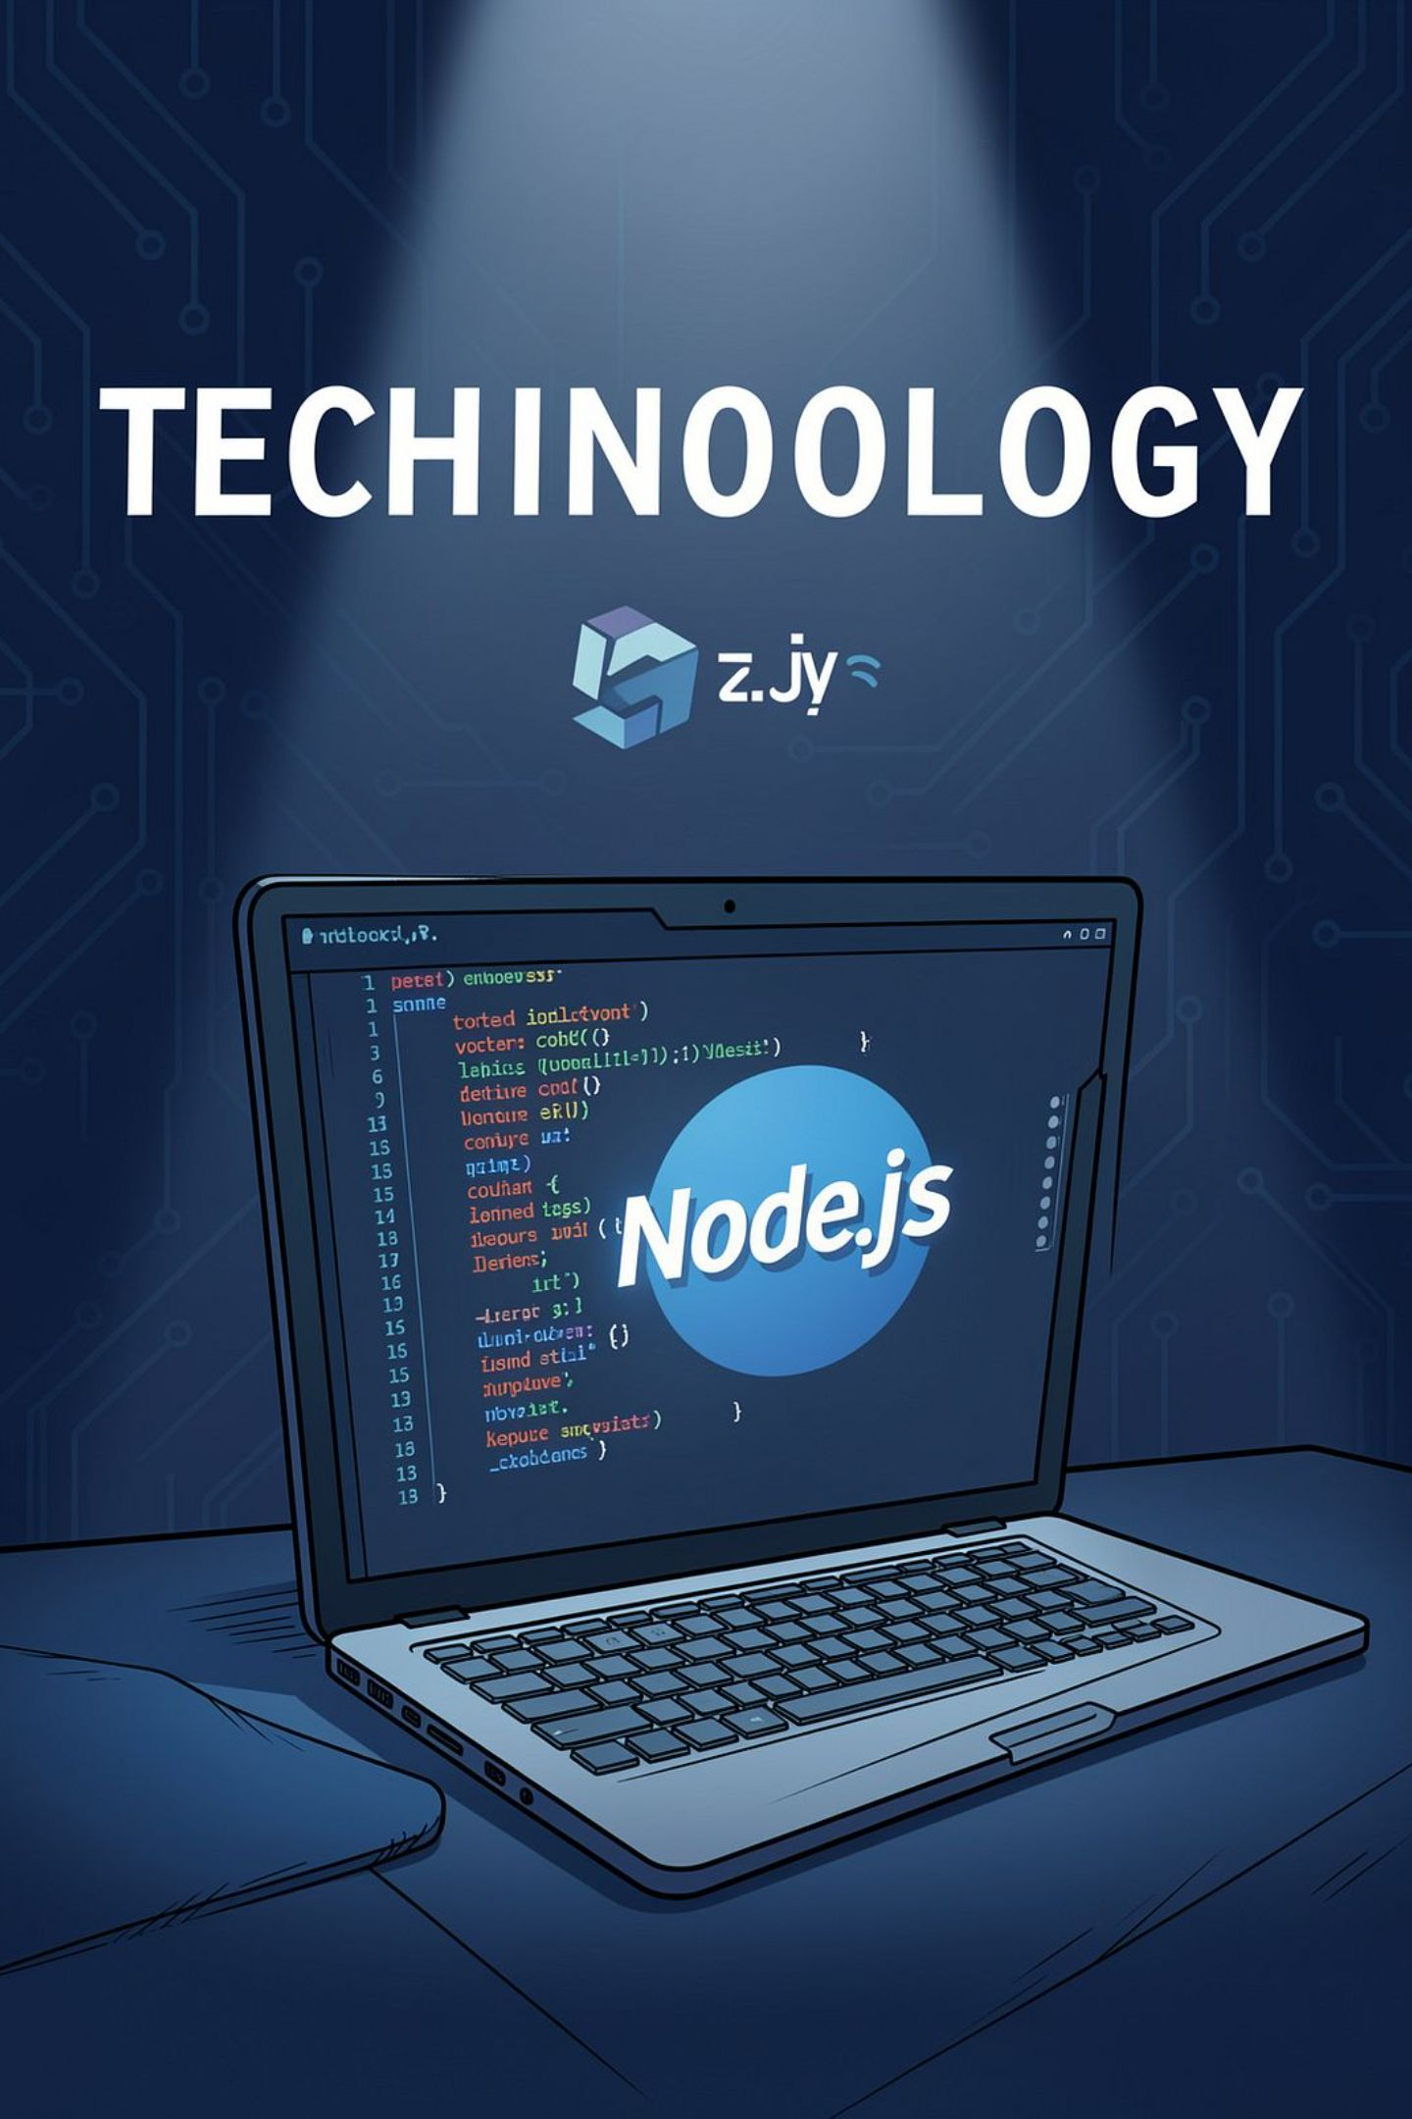
User Authentication and Homepage Development Using Node.js
Name: M. Akhil Kumar
Course: B.Tech CSE (AI & ML) —
Section CSM-C
Subject: Node.js Lab

Slide 2

Introduction
What is Node.js? — A JavaScript runtime that runs server-side code, enabling fast event-driven web servers.
What is User Authentication? — Verifying a user's identity so they can access protected resources.
Why is authentication important? — Protects user data, enforces access control, and prevents unauthorized actions.

Slide 3
Technologies Used
Node.js
Express.js
Backend JavaScript runtime for building scalable servers.
Lightweight web framework for routing and middleware.
HTML & CSS
MongoDB
Frontend interface and layout for login & homepage.
Document database to store user profiles and credentials.
bcrypt
Sessions / JWT
Password hashing and secure verification library.
Methods to maintain authenticated user state across requests.

Slide 4
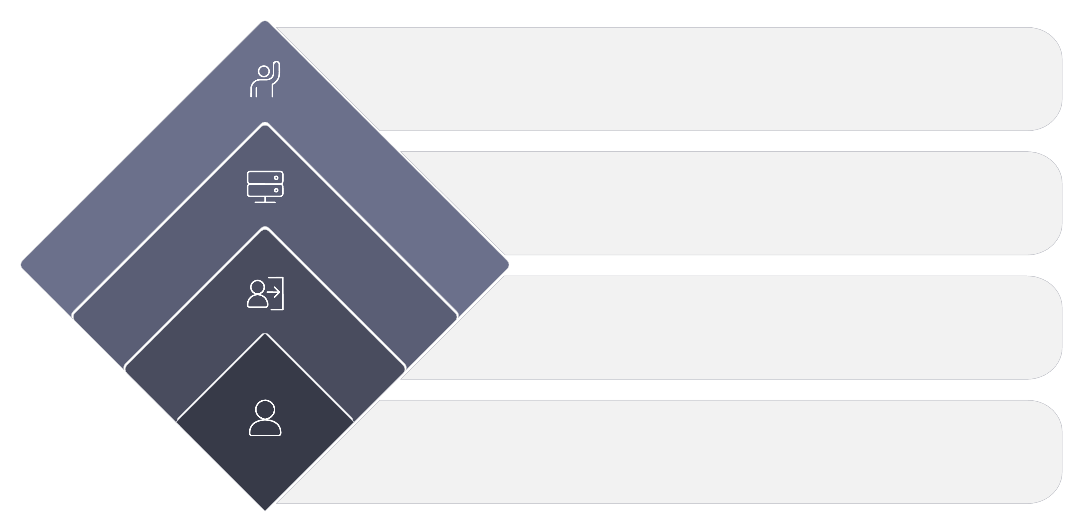
System Architecture
Valid credentials?
Decision: allow or reject
Express Server
Handle authentication
Login Page
Collect credentials
User Request
Initiate login flow

Slide 5
Authentication Process — Step-by-step
01
02
03
1. Credential Entry
2. Request to Server
3. Database Lookup
User provides email/username and password on login form.
Form posts to Express endpoint (POST /login).
Server queries MongoDB for the user document.
04
05
06
4. Password Verification
5. Create Session / Token
6. Redirect
Compare hashed password with bcrypt.compare() for validation.
On success, create server session or issue JWT for the client.
Authenticated users are redirected to the protected homepage.
07
7. Logout
Destroy session or invalidate token and return user to login.

Slide 6

Conclusion
Node.js offers efficient, event-driven backend capabilities for web labs.
Authentication secures user accounts and restricts protected pages.
MongoDB provides flexible storage for user data and session references.
This project demonstrates a practical, lab-ready Node.js authentication flow.

Slide 7
THANK YOU

