Slide 1
The Evolving Role of Software in Modern Society
Presented By:
A. Aishwarya
(257R1A66D0)
Here starts the lesson!

Slide 2
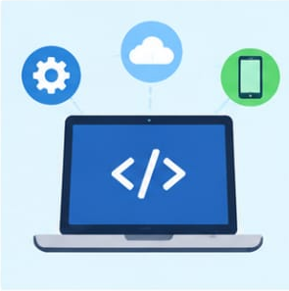
What Is Software?
Software is a set of instructions that tells a computer or device what to do.
Hardware is the physical part and the software makes it useful.
Used in phones, computers, ATMs, cars, hospitals and college systems.
Software processes information, automates tasks and connects people.
Example: Google Maps uses GPS data and software to guide us to a destination.

Slide 3
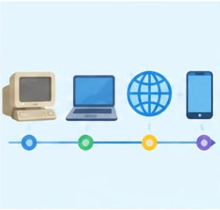
How the Role of
Software
Has Evolved
Software was mainly used for calculations and specific, fixed tasks.
Personal computers introduced word processors, spreadsheets, games, and desktop applications.
The Internet connected software through email, websites, online banking, and e-commerce.
Mobile and cloud technology made software available anywhere and anytime.
Today, AI-powered software can learn patterns, make predictions, and assist with decisions.

Slide 4

Software Around Us
Education : online classes, digital libraries and college portals.
Healthcare : patient records, appointments, telemedicine and medical systems.
Banking : ATMs, mobile banking, UPI and fraud detection.
Communication & entertainment : WhatsApp, social media, OTT and music streaming.
Transportation : maps, railway booking, ride-sharing and traffic management.
Agriculture & government : smart irrigation, weather tools and digital public services.

Slide 5
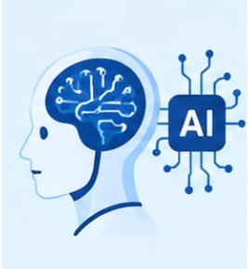
Software and
Artificial Intelligence
Traditional software mainly follows rules explicitly written by programmers.
AI gives software the ability to recognize patterns, predict and generate results.
Machine Learning (ML) learns patterns from examples and data.
Examples: ChatGPT, YouTube recommendations, facial recognition and fraud detection.
Autonomous vehicles use software, sensors and AI to understand surroundings and make decisions.

Slide 6

Benefits of Software in Modern Society
Automation : performs repetitive tasks automatically.
Faster communication : information can travel almost instantly.
Improved efficiency : completes tasks faster with fewer manual steps.
Better decision-making : analyzes large amounts of data.
Accessibility : services can be used remotely.
Innovation : enables new services such as UPI, AI assistants and smart devices.

Slide 7

Challenges and
Negative Impacts
Software can face cybersecurity threats such as hacking, malware, and data theft.
Apps and online services can raise privacy concerns by collecting personal information.
Automation can replace some repetitive jobs while creating new types of work.
Dependence on technology means failures can disrupt banking, transport, and communication.
Unequal access to technology creates a digital divide between different groups of people.
Software bugs and misinformation can lead to serious consequences.

Slide 8
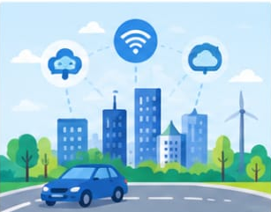
Future of Software &
Software Engineering
Future technologies include AI, IoT, cloud computing, robotics, and autonomous systems.
Smart cities can connect traffic, electricity, water, transport, and public services.
IoT connects physical devices so they can exchange information.
Software engineering provides a systematic way to build complex systems.
Software development involves requirements, design, development, testing, security, maintenance, and ethics.
Future engineers must focus on technology, reliability, security, and human needs.

Slide 9
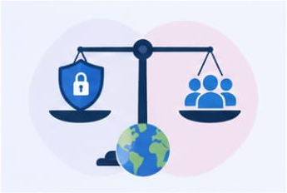




Conclusion
Software has evolved from simple programs into intelligent and connected systems.
It now influences education, healthcare, banking, communication, transport and many other areas.
AI is making software more capable of learning patterns, predicting and assisting decisions.
Greater power also brings cybersecurity, privacy, reliability and ethical challenges.
As future engineers, we must build software that is useful, secure, reliable and responsible.

