Slide 1
Data Science Foundation Project
Flight Data Set
By :: MVS Chaitanya

Slide 2
Personal Information:
Name : MVS Chaitanya
Email id : chaitanya2593@gmail.com
Contact No. : +91 9676233451
Total Experience : 4 years
Role : Software Developer Engineer in Test
Currently working @ Tech Mahindra Ltd
Location : Hyderabad, Telangana

Slide 3
Introduction to Flight dataset:
This dataset contains information about all flights that departed from NYC(e.g. EWR, JFKand LGA)in 2013: 336,776 flights in total.
Assumptions
The given dataset as original dataset provided by US Aviation department.
Values for the time columns are represented in minutes and distance column is represented in miles.
Pre-Conditions
Importing required packages - Numpy, Pandas, Matplotlib, Seaborn, PandasProfiling(if required)
Read all the contents of the file

Slide 4
Importing Packages : import numpy as np import pandas as pd
Importing Dataset file :
myPath="..." #Stored local path into this variable
#Code :
dataset = pd.read_csv(myPath+"flight_data.csv")
#A simple extract of data frame from the csv file.

Slide 5
Overview of Dataset : Size and shape of dataset: (336776,19) rows - 336776 columns – 19 Missing values – 46595 Variables : Numeric - 14 Categorical – 5
Highly Correlated Variables :
“hour" with “sched_dep_time“ & “dep_time”
“air_time" with “distance”"
*My Analysis : 1. Flight airtime will depends on the distance between the source and destination airports.
2. Field ““sched_dep_time“ & “dep_time” will be completey depends on the “hour” field

Slide 6
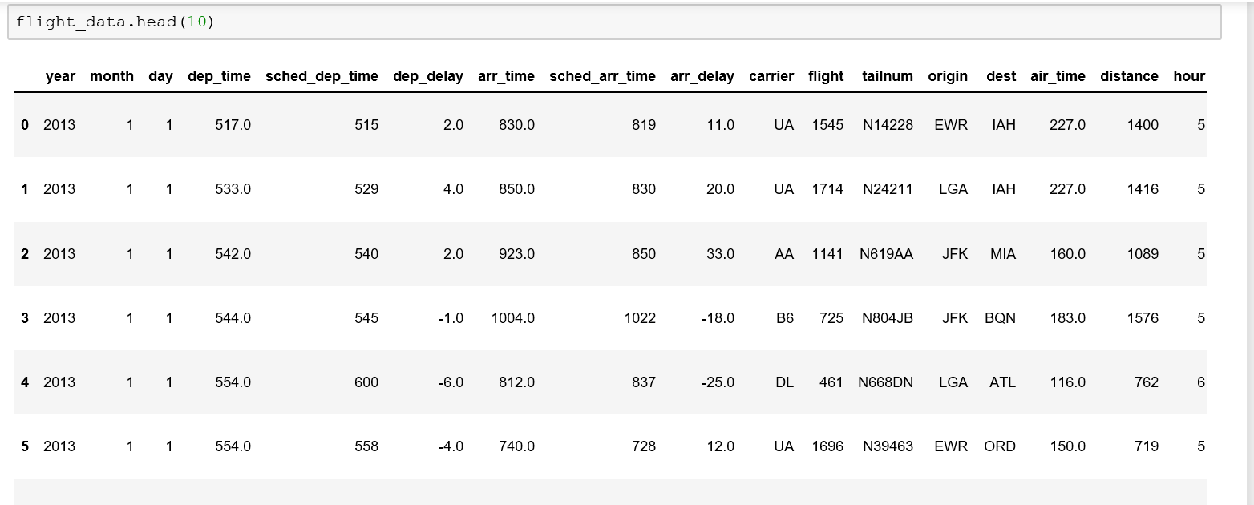
Flight Dataset Info and Sample

Slide 7
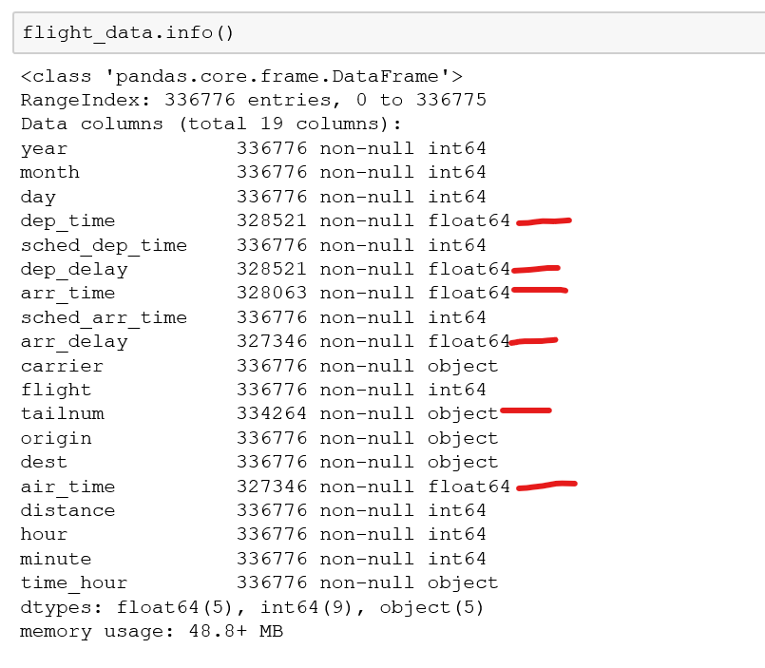
Flight Dataset Info and Sample
Below mentioned fields have missing values
dep_time
Dep_delay
Arr_time
Arr_delay
Tailnum
Air_time
The same values are highlighted in the screenshot in red

Slide 8
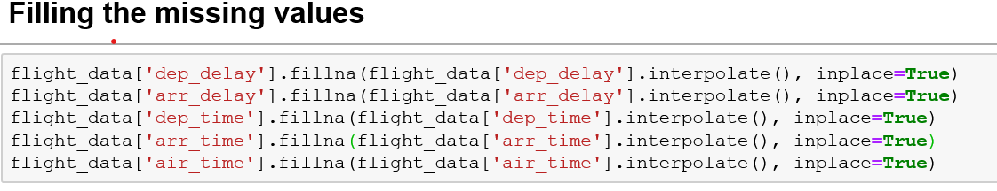
Filling the missing values
Filled the missing values for dep_time, Dep_delay, Arr_time, Arr_delay, Air_time fields using the interpolate function
Dropped tailnumber and year fields as there will be not used for the EDA.
If you observe the from the pandas profiling the points are highlighted

Slide 9
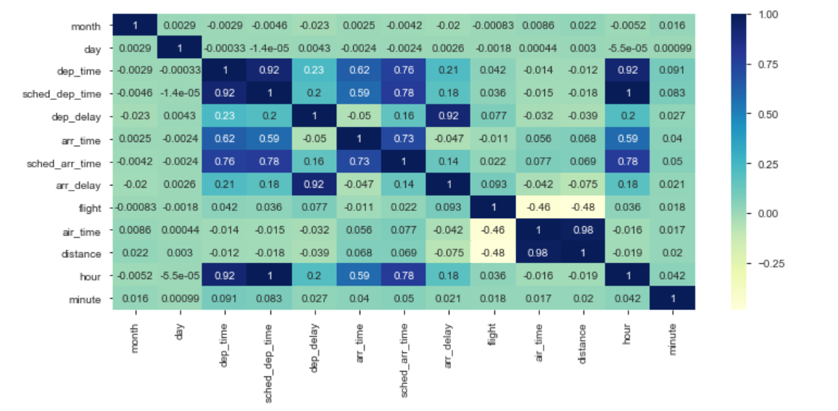
Heat map Analysis
We have created a heat map based to analyze the correlation between all the variables.
Hour and dep_time, scheduled_dep_time are highly correlated.
Distance and air_time are highly correlated
Arr_delay and dep_delay are also highly correlated

Slide 10
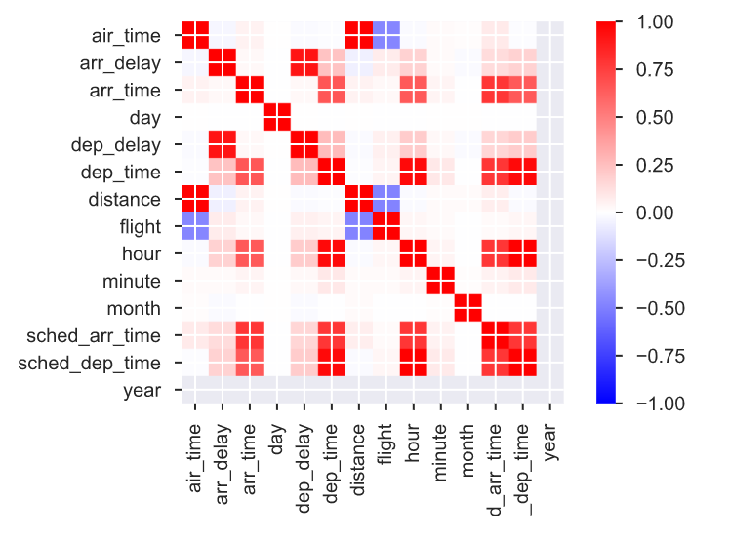
Pandas Profiling Analysis
Most Correlated columns
dep_delay is highly correlated with arr_delay (ρ = 0.9148)
distance is highly correlated with air_time (ρ = 0.99065)
hour is highly correlated with dep_time (ρ = 0.95331)
sched_dep_time is highly correlated with hour (ρ = 0.99915)

Slide 11
Business questions Identified :
1. Destination with maximum departure delays?
2. Destination with minimum departure delays
3. Delay calculations at the origin locations ?
4. Month during which Maximum Delays observed ?
5. Month during which Minimum Delays observed ?
6. Airline with highest and lowest mean speed ?
7. Airports most and least busy
8. Months During which airports are most and least busy

Slide 12
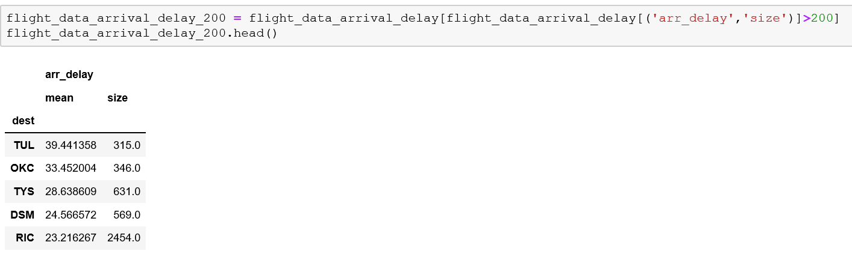
Delay calculations at the Destination locations
3 Origin and 105 unique destination airports listed in the Dataset.
We are keeping a threshold of minimum 200 arrivals for a given destination airport

Slide 13
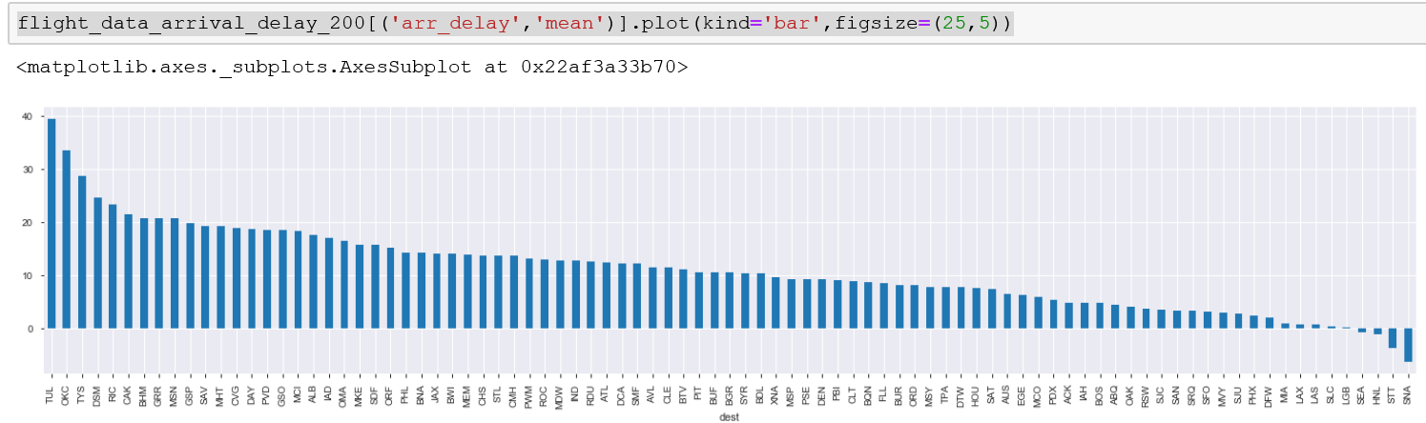
Figure Arrival_delay vs Destination code
From the figure we can infer that destination TUL has recordered the highest and destination SNA has recorded lowest arrival_delays

Slide 14
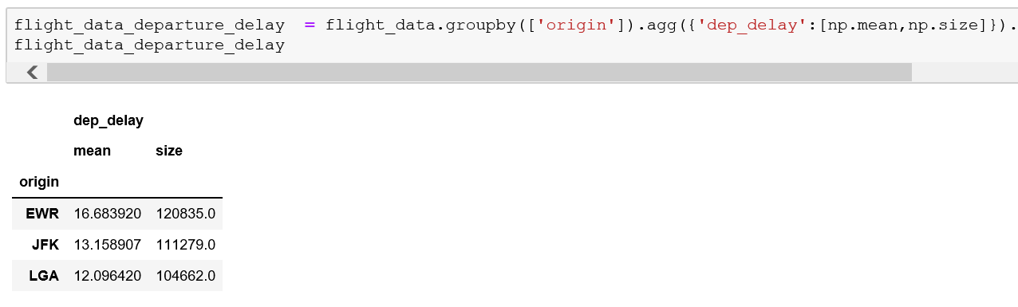
Delay calculations at the origin locations
From the above table it is clear that NYC EWR has most number of departures and NYC LGA has lowest recorded flight departures for year 2013

Slide 15
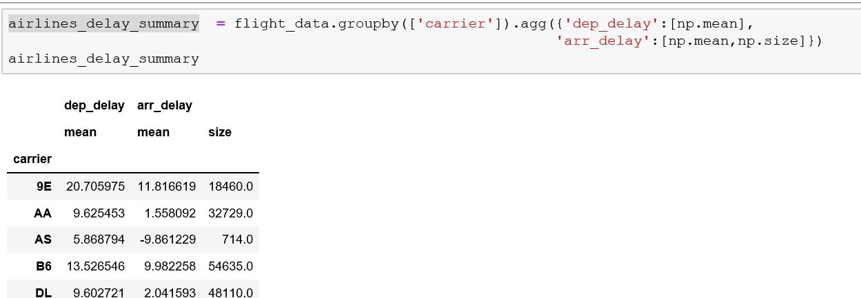
Airlines with Min & Max delays
To perform this analysis we are grouping the rows based on the Carrier and grouping is based on the mean arrival delays and departure delays.

Slide 16
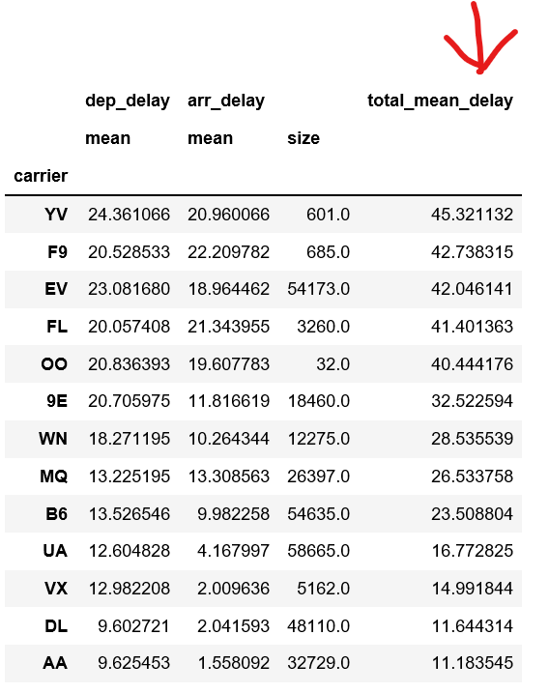
Airlines with Min & Max delays
Since the number of carriers are considerably less count we are not using any threshold criteria.
Adding a new column total_mean_delay which is the sum of the mean arrival and mean departure delay for respective carrier.
From the observation we can say total_mean_delay will be highly correlated with dep_delay

Slide 17
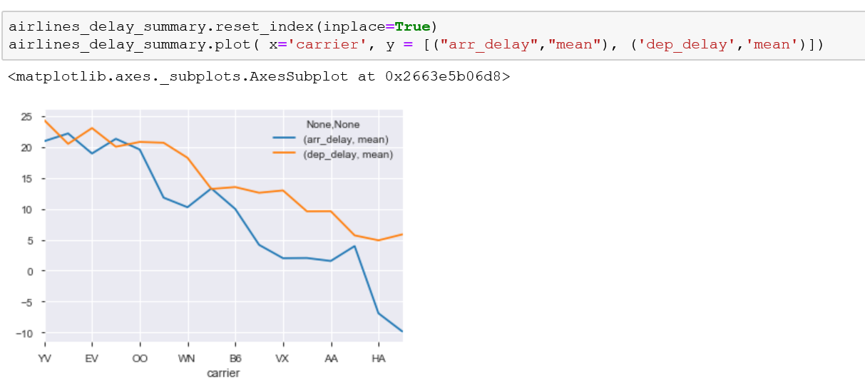
Figure delay_mean vs carrier
From the above plot we can infer that the dep_delays much higher than compared to arr_delay for most of the carriers .
Percentage of depature delay on overall delay :: 61.86%

Slide 18
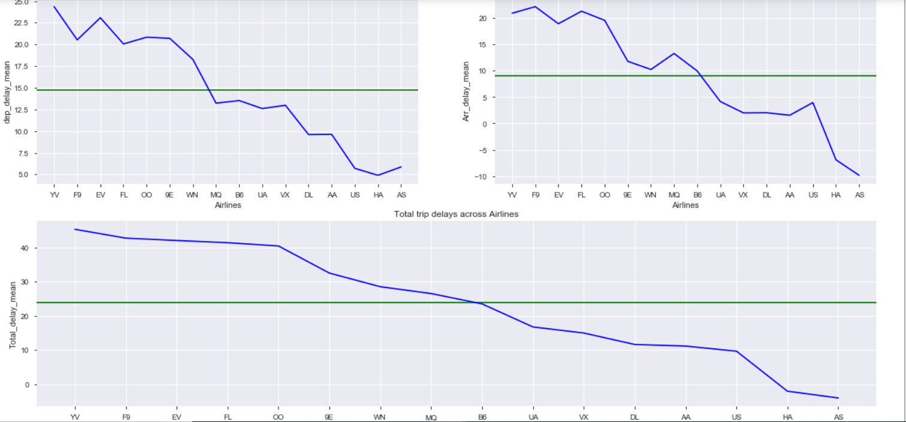
Figure dep_delay_mean, arr_delay_mean, total_delay_mean vs Airlines
From the above garphs we can interpret below points
Airline with Max mean Departure Delay :: YV with mean value 24.361065723071487

Slide 19
Airlines with Min & Max delays
Airline with Max mean arrival Delay :: F9 with mean value 22.20
Airline with Max mean Delay :: YV with mean value 45.32
Airline with Min mean Departure Delay :: HA with mean value 4.90
Airline with Min mean arrival Delay :: AS with mean value -9.86
Airline with Min mean Delay :: AS with mean value -3.99
Percentage of depature delay on overall delay :: 61.86%

Slide 20
Most & least busy Airports
Destination Airports
Destination airpot which is most busy :: ORD
Total no of fligts arrived ::17283.0
Destination airpot which is least busy :: LGA & LEX
Total no of fligts arrived ::1.0
NYC Airports
NYC airpot which is most busy :: EWR
Total no of flights arrived ::120835.0
NYC airpot which is least busy :: LGA
Total no of flights arrived ::104662.0

Slide 21
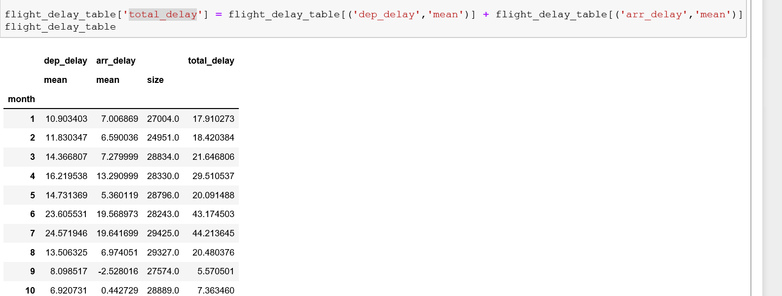
Month during which Max & Min Delays are observed
Creating new column named “total_delay” which is the sum of arrival and departure mean delays observed in respective months

Slide 22
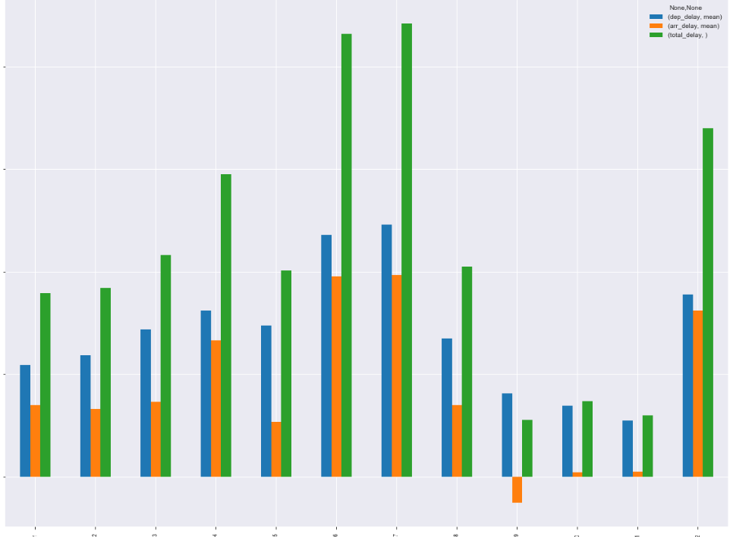
Month during which Max & Min Delays are observed
Figure :: arrival_mean_delay, depature_mean_delay & Total_mean_delay vs Month
Maximum delays observed on Month 7 of value:: 44.21
Minimum delays observed on Month 9 of value:: 5.57

Slide 23
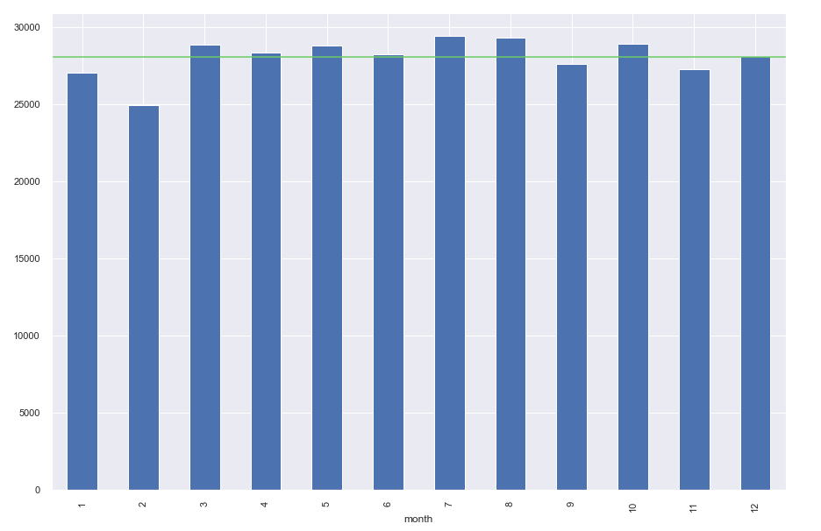
Month during which airports are most and least busy
Months vs Flight trips
From the graph we can infer that
Month during which destination airports are most busy 29425.0
Airports most busy on :: 7
Month during which destination airports are least busy 24951.0
Airpots most busy on :: 2

Slide 24
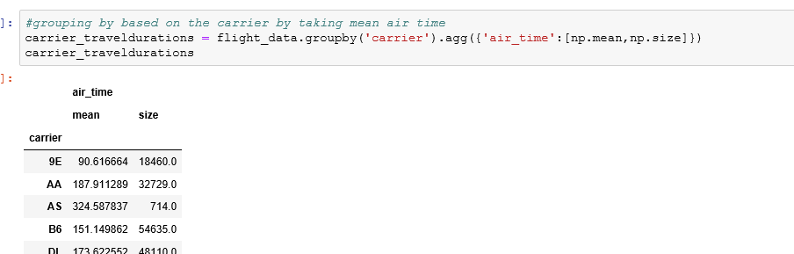
Fastest & Slowest airlines
Grouping the columns based on the carrier and aggregating based on the air_time
Created new column “Flight_speed” calculated based on the air_time and distance

Slide 25
Fastest & Slowest airlines
From the analysis we can infer that below points
Airline with highest speed recorded for year 2013 ::07-12-2013 13:00 by the carrier B6 With flight speed of 78.25 miles per minute
Airline with Lowest flight speed recorded for year 2013 ::27-07-2013 01:00 by the carrier US With flight speed of 0.08 miles per minute
Airline with Maximum mean speed recorded for year 2013 ::8.01 by the carrier HA
Airline with minimum mean speed recorded for year 2013 ::5.34 by the carrier YV

Slide 26
Speed vs Delay comparison
From the max delay analysis we came to know YV is most delayed carrier where as AS is the carrier with less delays
Ideally we AS should be fastest airlines but from the above speed analysis we confirm that HA is fastest airlines.
And as expected YV is slowest airlines as well.

Slide 27
Data Frames formed during analysis :
“flight_data” –
#Code : flight_data = pd.read_csv(your_path + "flight_data.csv")
Contents of given dataset is read into this variable from csv file
“flight_data_arrival_delay” –
#Code : flight_data_arrival_delay = Flight_data.groupby(['dest']).agg({'arr_delay':[np.mean,np.size]}).sort_values(by=[('arr_delay','mean')], ascending=False)
Formed by grouping the mean of “dest” column
“flight_data_arrival_delay_200” –
#Code : flight_data_arrival_delay_200 = flight_data_arrival_delay[flight_data_arrival_delay[('arr_delay','size')]>200]
Applying the threshold to the 200 to the flight_data_arrival_delay dataset

Slide 28
“flight_data_departure_delay” –
#Code : flight_data_departure_delay = flight_data.groupby(['origin']).agg({'dep_delay':[np.mean,np.size]}).sort_values(by=[('dep_delay','mean')], ascending=False)
Grouping based on the origin
“airlines_delay_summary” –
#Code : airlines_delay_summary = flight_data.groupby(['carrier']).agg({'dep_delay':[np.mean],
'arr_delay':[np.mean,np.size]})
Grouping based on the carrier and aggregating based on the dep_delay
“flight_delay_table” –
#Code : flight_delay_table = flight_data.groupby(['month']).agg({'dep_delay':[np.mean],'arr_delay':[np.mean,np.size]})
Grouping based on the month and aggregating based on the dep_delay
“carrier_traveldurations” –
#Code : carrier_traveldurations = flight_data.groupby('carrier').agg({'air_time':[np.mean,np.size]})
To calculate the flights speeds for every journey

Slide 29
Overview of Business questions identified and its analysis :
Destination with maximum departure delays?
Analysis : TUL has recorded the highest
2. Destination with minimum departure delays?
Analysis : SNA has recorded lowest arrival_delays
3. Delay calculations at the origin locations ?
Analysis : NYC EWR has most number of departures and NYC LGA has lowest recorded flight departures for year 2013
4. Month during which Maximum Delays observed ?
Analysis : Maximum delays observed on Month 7 of value:: 44.21
5. Month during which Minimum Delays observed ?
Analysis : Minimum delays observed on Month 9 of value:: 5.57

Slide 30
6. Airline with highest and lowest mean speed ?
Analysis :
Highest recorded :: 8.01 by the carrier HA
Lowest Recorded :: 5.34 by the carrier YV
7. Airports which are most busy ?
Analysis :
Month during which destination Airports are most busy 29425.0
Airports most busy on :: 7
8. Airports which are least traffic recorded ?
Month during which destination Airports are least busy 24951.0
Airpots most busy on :: 2
9. Months During which airports are most and least busy ?
Analysis :
Month during which destination airports are most busy 29425.0
Airports most busy on :: 7
Month during which destination airports are least busy 24951.0
Airpots most busy on :: 2

Slide 31
Thank You

