Slide 1


Home Credit Risk Analysis
by Chaitanya Madduri,
Diego Zucchino,
Kartik Vijay

Slide 2
Agenda
1. Business Case Introduction
3. Data Interpretation and Pattern Findings
4. Applied Machine Learning Model
5. Conclusion
6. Q&A Feedback
2. Data Transformation

Slide 3

1. Business Case Introduction
Home Credit B.v
Objective: Provide safe and positive borrowing experience
Dilemma: Clients have little to none previous credit history

Slide 4
Motivation
Status Quo
Process
Goal
Already existing statistical methods aiming to predict defaulters.
Exploratory Data Analysis into previous client's information.
Detecting the most important features from possible loan takers.

Slide 5

2. Data Transformation

Slide 6
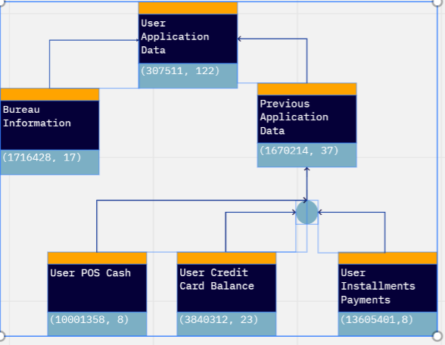
Raw Table Scheme

Slide 7
Analysis on Credit Card balance
Description:
Monthly balance snapshots of previous credit cards that the applicant has with Home Credit.
Data Transformations
Missing Values : Filled the numerical columns with zero
Columns like CNT_DRAWINGS_ATM_CURRENT, CNT_DRAWINGS_OTHER_CURRENT, CNT_DRAWINGS_POS_CURRENT which are count related are summed up to one column.
Dropped the highly correlated and less relevant columns.

Slide 8
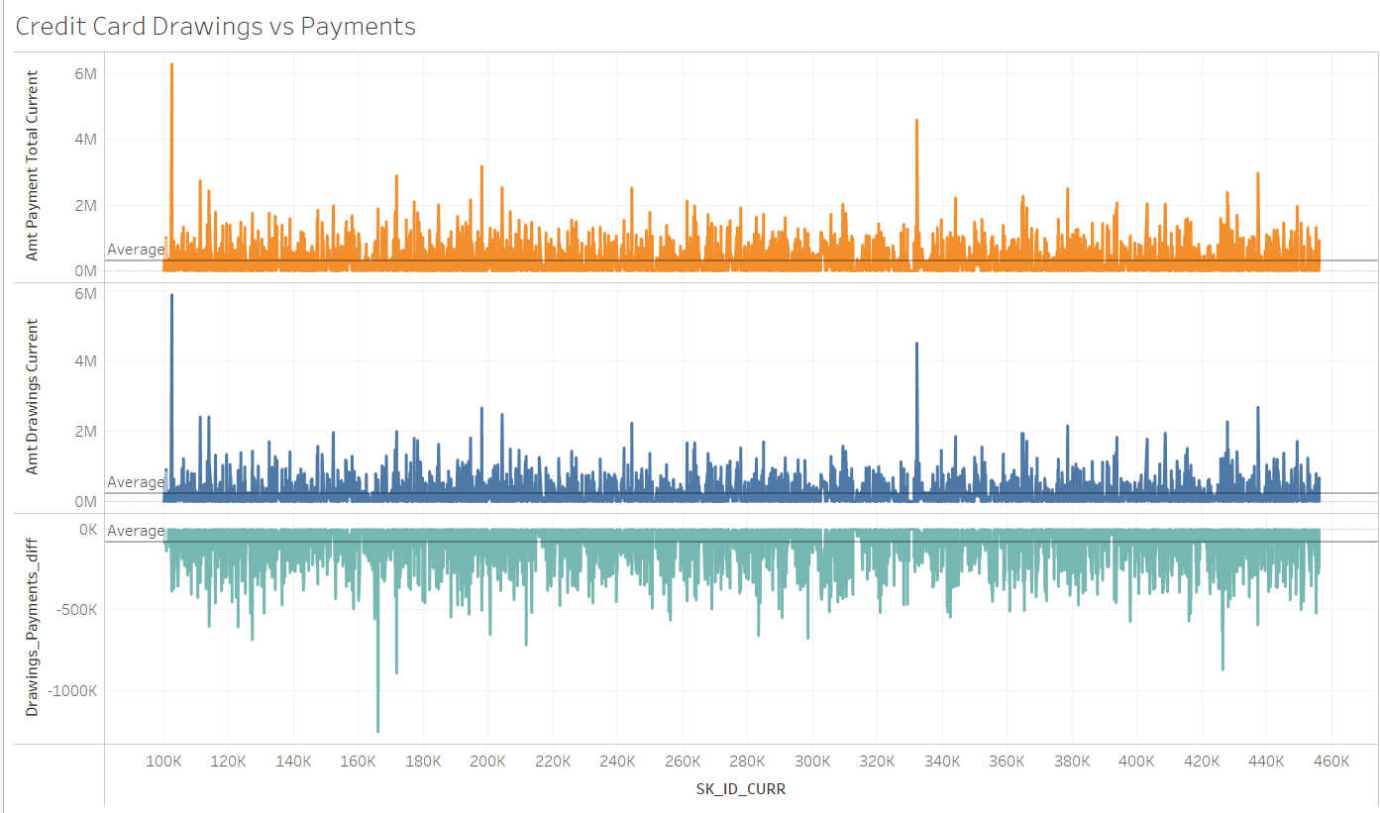
Analysis on Credit Card balance
Average Drawings – 3,00,055
Average Payments – 2,19,482
Average Difference -> - 80,573

Slide 9
Analysis on Previous Application
Description:
All previous applications for Home Credit loans of clients who have loans in our sample.
Data Transformations
Few Date Columns have max value as 356243 which is a default or garbage value. It is replacing these values with 0.
Columns with values Yes & No(or similar) are replaced by 1 & 0 respectively.
Applied the One hot encoding on the categorical Columns

Slide 10
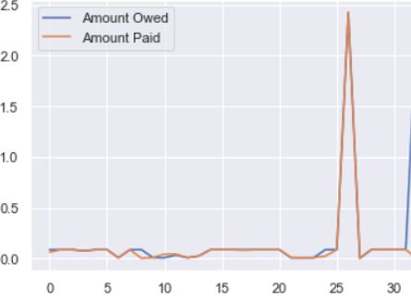
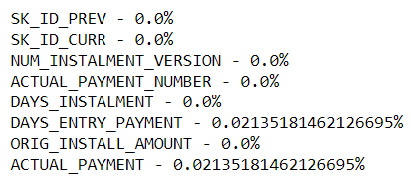
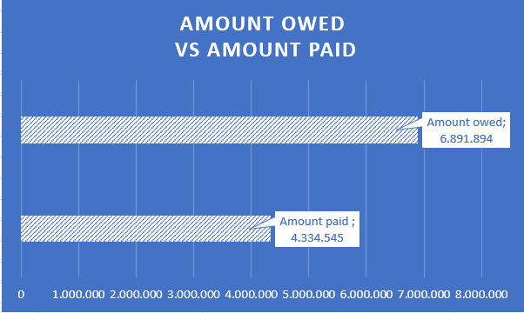
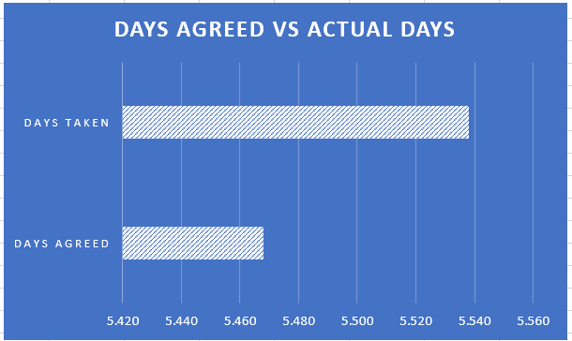
Installment Payments & Cash Balance
The devil is in the details
Credit History
Client’s ID: 111148
Client 111148 – Credit History
Installment Amount
Missing Data
Installment Number
15,17 Years
14.98 Years

Slide 11
Analysis on Bureau Data
Description:
All client's previous credits provided by other financial institutions that were reported to Credit Bureau (for clients who have a loan in our sample).
For every loan in our sample, there are as many rows as number of credits the client had in Credit Bureau before the application date

Slide 12
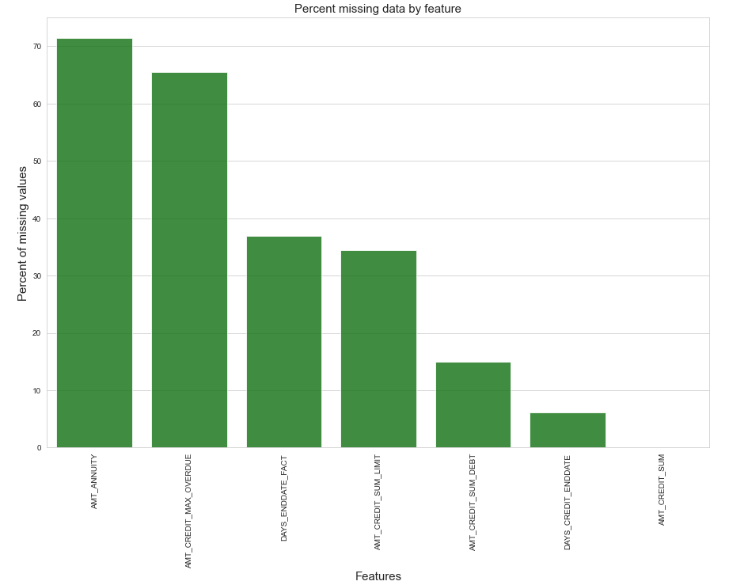
Bureau Data Transformation

Slide 13
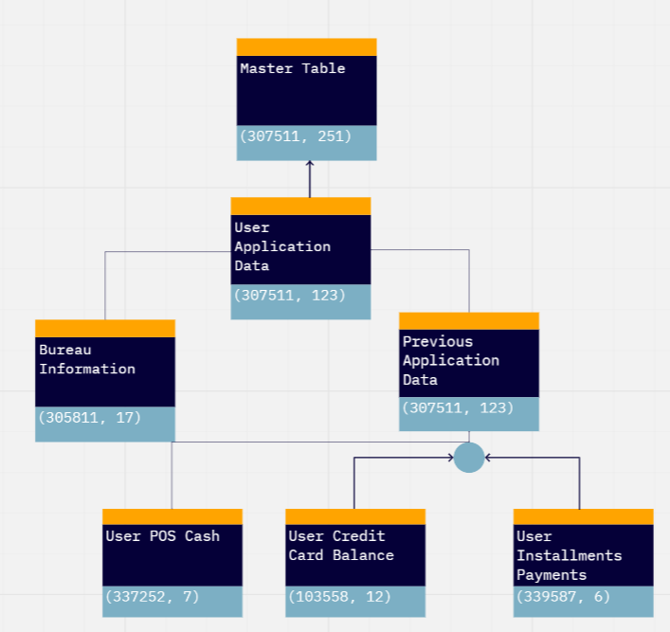
Processed Table Scheme
After data cleaning and extraction, the Volume of the raw data is reduced by almost 6 times.

Slide 14
3. Data Interpretation and Pattern Findings
Amongst all occupations, Laborers(17.95%) accounted for the most number of loans
The age group of 30-40 has seen more defaulters than the other age groups
In the entire cohort, female comprise of approximately 65% of the population. However, males seem to default more than females
59.82% of the population falls under the family status of married
71% of the cohort group have completed secondary education while 24% have completed higher education only

Slide 15
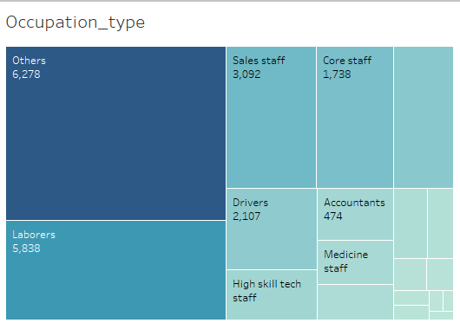
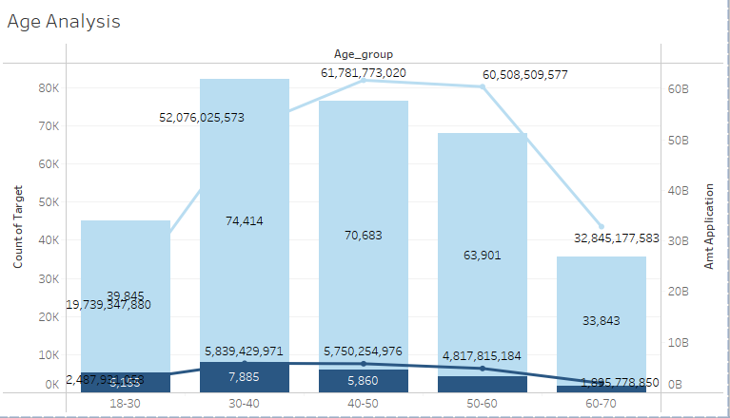
3. Data Interpretation and Pattern Findings
Amongst all occupations, Laborers(17.95%) accounted for the most number of loans
30-40 age group has the highest number of defaulters. 40-50 age group has applied for the highest amount of loans
Link:https://public.tableau.com/app/profile/mvs.chaitanya/viz/CreditRiskAnalysis_16362852398140/Analysis_2#1

Slide 16
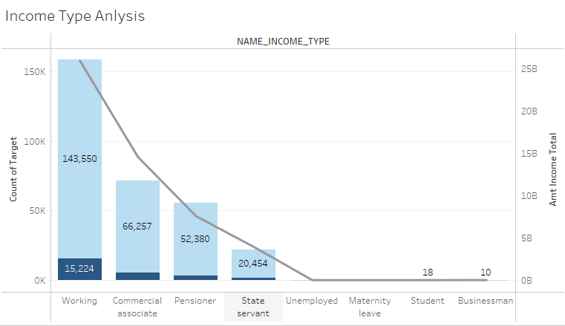
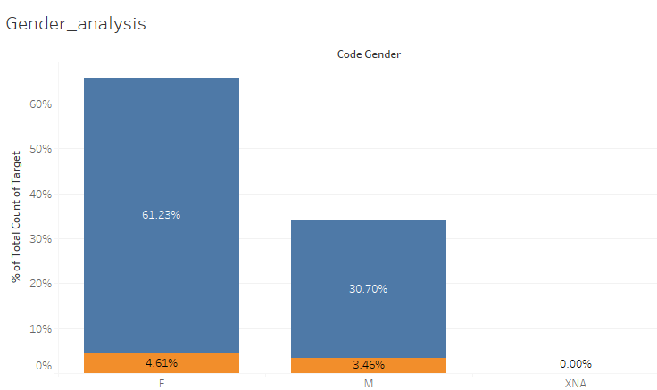
3. Data Interpretation and Pattern Findings
The working income type has the highest proportion of non-defaulters
In the entire cohort, female comprise of approximately 61% of the population and default more than the male population
Link:https://public.tableau.com/app/profile/mvs.chaitanya/viz/CreditRiskAnalysis_16362852398140/Analysis_2#1

Slide 17
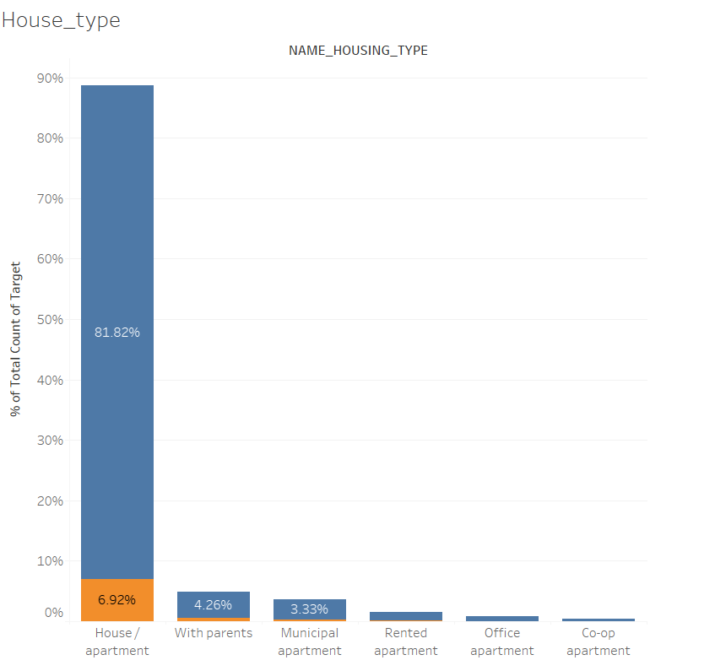
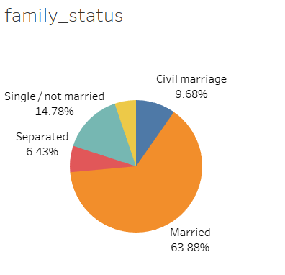
3. Data Interpretation and Pattern Findings
Majority of the Applicants are Married.
Most of the applications are living in House/Apartment.
Link:https://public.tableau.com/app/profile/mvs.chaitanya/viz/CreditRiskAnalysis_16362852398140/Analysis_2#1

Slide 18
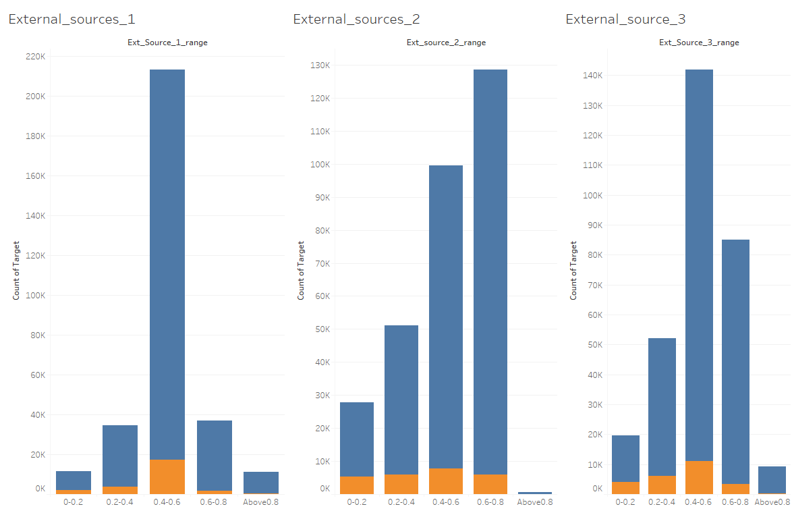
3. Data Interpretation and Pattern Findings
If the External Source normalized score greater than 0.8 then there are high chances that user won’t be default.
After the analysis External Source 1 is more reliable.
External sources scores cannot be used as sole criteria for defaulter estimation.
Link:https://public.tableau.com/app/profile/mvs.chaitanya/viz/CreditRiskAnalysis_16362852398140/Analysis_2#1

Slide 19
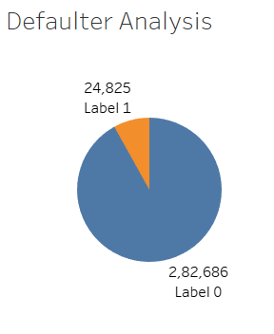
4. Applied Machine Learning Model
Selected all the User IDs who has all details in all
Created a Train and Test Data with 80-20 Split
Smote model is applied to handle the class imbalance. The minority class i.e the defaulter is increased by 300%.
Random Forest Algorithm is used for the model building.
NonDefaulter - 0
Defaulter -1

Slide 20
Metrics
Accuracy = 0.91920
Precision = 0.34000
Recall = 0.00013
F1 Score = 0.00026

Slide 21
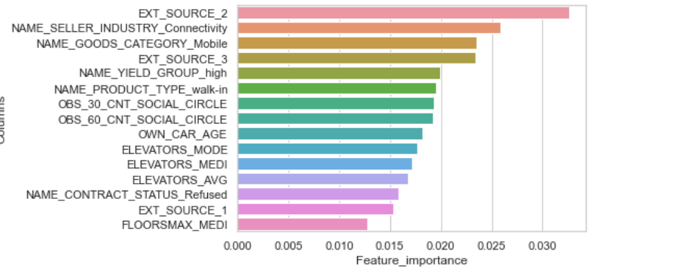
Features Importance based on ML Model

Slide 22
5. Conclusion

Slide 23

Next Steps
More analysis on user assets.
Advanced & better ML Models.

Slide 24

6. Q&A

Slide 25
Appendix
https://public.tableau.com/app/profile/mvs.chaitanya/viz/CreditRiskAnalysis_16362852398140/External_sources_1
https://www.kaggle.com/c/home-credit-default-risk
Github:: https://github.com/Chaitanya2593/home_credit_risk_analysis

Slide 26
Thank You

