Slide 1

वाक्प्रत्यभिज्ञा VAKPRATYABHIJNA
Team :- SIH_DCRUST
PS Code :- AD976
Institute Code :- U-0161

Slide 2
Team Details and Problem Statement
Statement Title – Sanskrit Voice to Text and interface in Google Engine
Institute Name – Deenbandhu Chhotu Ram University of Science and Technology, Murthal
Ministry Name – Indian Knowledge System (IKS), All India Council for Technological Education (AICTE)
Theme Name – Heritage & Culture
Team Details
Name | Member | Branch | Year
Paritosh Dahiya | Team Leader | B.Tech CSE | 4th Year
Chaitanya Gupta | Team Member | B.Tech CSE | 4th Year
Rishaab Kalra | Team Member | B.Tech CSE | 4th Year
Jatin | Team Member | B.Tech CSE | 4th Year
Romil | Team Member | B.Tech CSE | 4th Year
Priyanka | Team Member | B.Tech CSE | 4th Year

Slide 3
Why this Problem Statement?
Google supports 119 languages for voice to text but Sanskrit not yet one of them.
Sanskrit has many languages derive from it but due to lack of technical information, it is getting extinct.
The ancient texts can tackle many real-world challenges which can aid advancement in science and technology.
It is difficult to search for Sanskrit text online.
Accessibility of Sanskrit language is the main problem.
It connects us to our roots and promote Sanskrit as a language.

Slide 4
Features
We focused our attention on two major group of users :-
For General Public
Chrome Extension / Plugin
For making it universal and doing flexible integration with multiple websites.
Web Application
For providing user with a one click solution for transcribing Sanskrit text.
Mobile Application
For providing even more accessibility to the user on the palm of his hand.
For Developer Community
Providing API Support
We are providing our API endpoints along with docs for allowing developers to make their application in this domain hassle free.
We are providing advanced options for choosing models out of available ones according to needs.

Slide 5
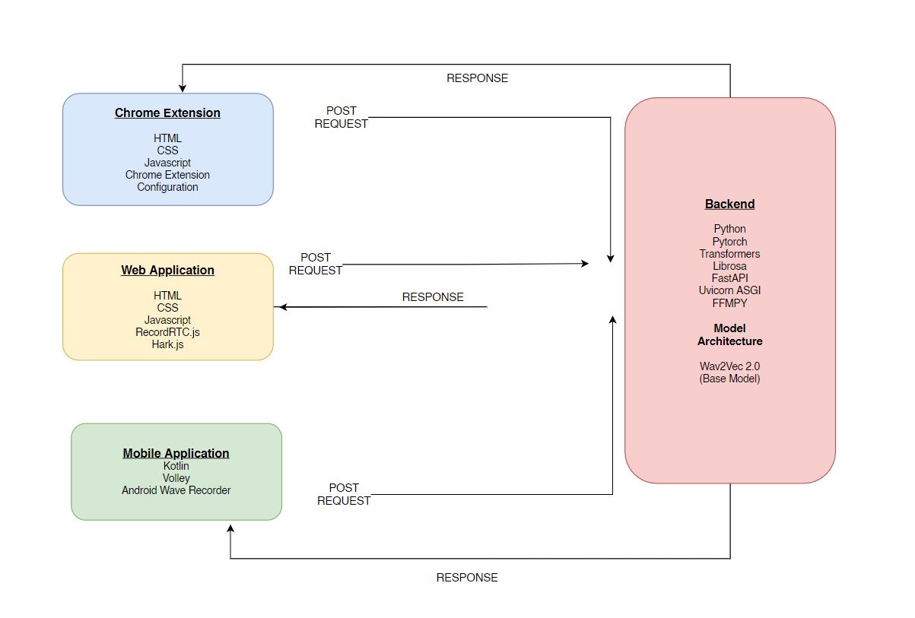
Technology Stack

Slide 6
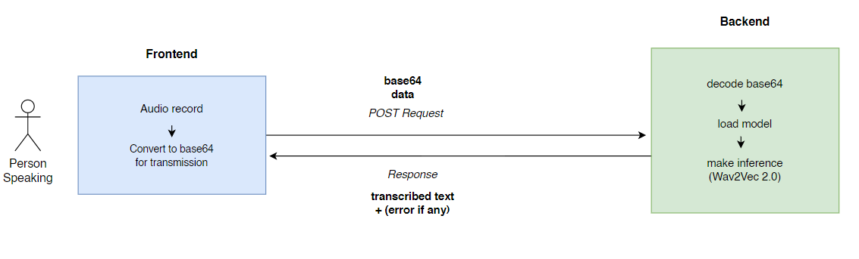
Black Box Overview

Slide 7
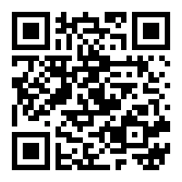
LIVE DEMO
https://sih-dcrust-backend.herokuapp.com/docs

Slide 8
Applications
Can be used to teach Sanskrit to students and improve their pronunciation.
Can be used to generate subtitles for Sanskrit language.
Can help to prevent data digitally making it more searchable and accessible.
It can be used to digitalise Vedas, Puranas, and other gharanth and sahetyas.

Slide 9
Future Scope
Increase accuracy of the machine learning model.
Make editor more robust and provide useful suggestions to the user.
Enhance scalability of our application both horizontal and vertical.
Contact with google officials for integration.

Slide 10
Thank You

