Slide 1
Kisan Mitra: Digital Assistant For Farmers
UiPath Hyperhack 20.10
Process Design Document
V2.0

Slide 2
Document History
Version | Date | Role | Name | Comments
1.0 | 29 Oct 2020 | RPA Developer | Chaitanya Kulkarni
1.1 | 2 Oct 2020 | RPA Developer | Chaitanya Kulkarni
1.2 | 15 Nov 2020 | RPA Developer | Chaitanya Kulkarni

Slide 3
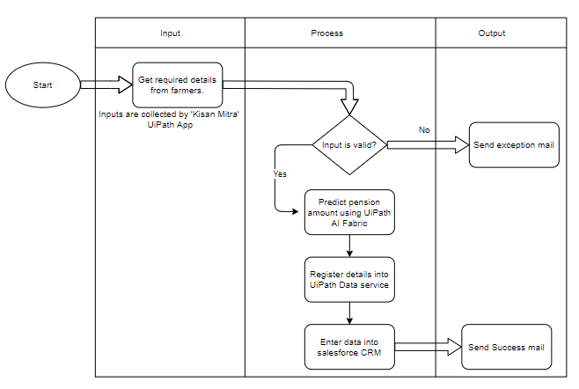
To-Be Process Flowchart

Slide 4
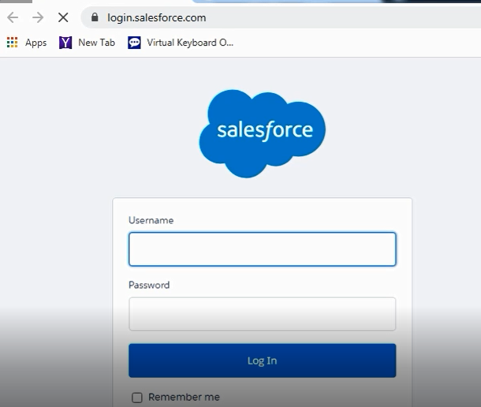
To-Be Process Detailed CRM Onscreen Operations. 1.1 Login to CRM
1.1.1
Operations to perform:
1.1.1 Open Salesforce CRM URL: login.salesforce.com
1.1.2 Enter Username to login.
1.1.3 Enter Password.
1.1.4 Click on login.
1.1.2
1.1.3
1.1.4

Slide 5
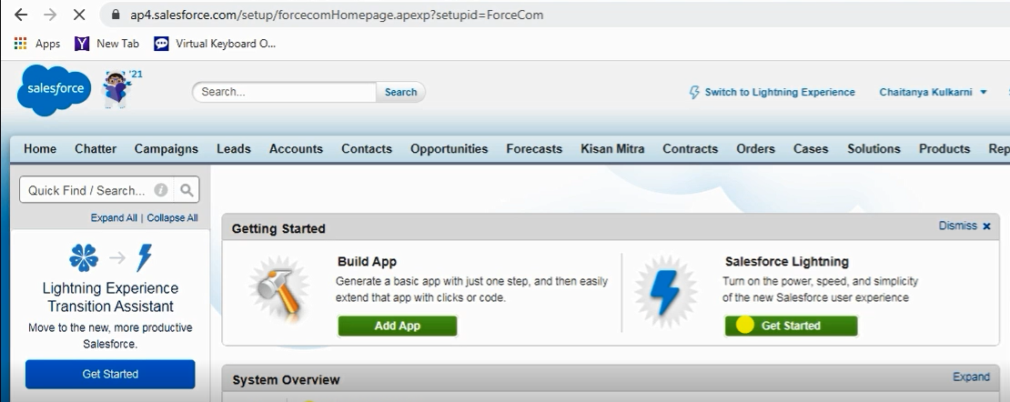
To-Be Process Detailed CRM Onscreen Operations. 1.2 Navigate to Kisan Mitra tab
Operations to perform:
1.2.1 Check if login to CRM is successful.
1.2.2 Click on ‘Kisan Mitra’ tab.
1.2.2

Slide 6
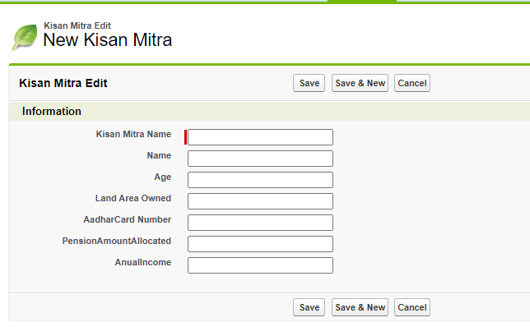
To-Be Process Detailed CRM Onscreen Operations. 1.3 Enter details in CRM
Operations to perform:
1.3.1 Enter Name of scheme
1.3.2 Enter Name of Farmer.
1.3.3 Enter Age
1.3.4 Enter land owned by farmer
1.3.5 Enter Aadhar card number
1.3.6 Enter predicted pension amount allocated
1.3.7 Enter Annual income
1.3.8 Click Save
1.3.1
1.3.2
1.3.3
1.3.4
1.3.5
1.3.6
1.3.7
1.3.8

Slide 7
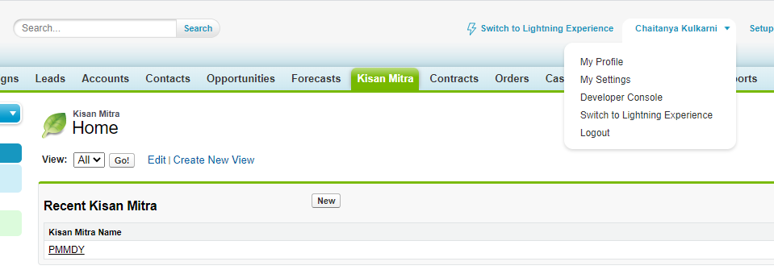
To-Be Process Detailed CRM Onscreen Operations. 1.4 Verify details are saved and logout
1.4.2
Operations to perform:
1.4.1 Check if details are entered correctly.
1.4.2 Click on user profile.
1.4.3 Click on logout and close tab.
1.4.3
1.4.1

Slide 8
Exception handling.
Below is are business exceptions:
Check if input age is greater than 60. If not mark case as invalid and send exception mail to business user on chaitanyakulkarni4000@gmail.com
Check Aadhar card number is 12 digits only and is not registered already in CRM.
Check if land owned by respective farmer is less than 30 acers.
In case of any application exceptions, bot is supposed to take a screenshot and report the issue to support team by sending mail to chaitanyakulkarni4000@gmail.com.
In case of other details refer to PDD version 0.1 (in word format.)

