Slide 1
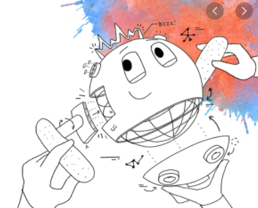
Kisan Mitra: A Digital Assistant For Farmers
Name: Chaitanya Kulkarni
Team Name: RPA Falcon
UiPath HyperHack 20.10

Slide 2
Agenda
Problem Statement
Solution Overview
UiPath Components Used

Slide 3


Problem Statement:
Central government of India has recently launched new scheme know as ‘Pradhan Mantri Maan-dhan Yojana’ under which small scale farmers whose age is more than 60, will be eligible to get free pension from Indian government.
To implement this scheme, government employees are working hard to collect data from farmers and maintain records on papers and excels of the respective farmers those who are eligible for government pension.
Can RPA UiPath help to bridge the gap between government and citizens and reduce the repetitive manual work done by government employees ?

Slide 4
Solution Overview:
UiPath has potential to provide RPA solution that can help out Indian government in collecting, managing and processing data of eligible farmers for allocating pensions.
Farmers can register and provide all the required details to government of India using UiPath Apps.
This cognitive solution is empowered with UiPath AI Fabric which also has capability to predict pension amount for respective farmers.
Solution is embedded with UiPath Data Service which will make it easy to manage and access data securely for Indian Government.

Slide 5

UiPath components used:
UiPath Apps
UiPath Data Service
UiPath AI Fabric
UiPath Orchestrator
UiPath Robot
UiPath Studio 20.10 Enterprise Trial Version

Slide 6
Thank you!

